Slide 1
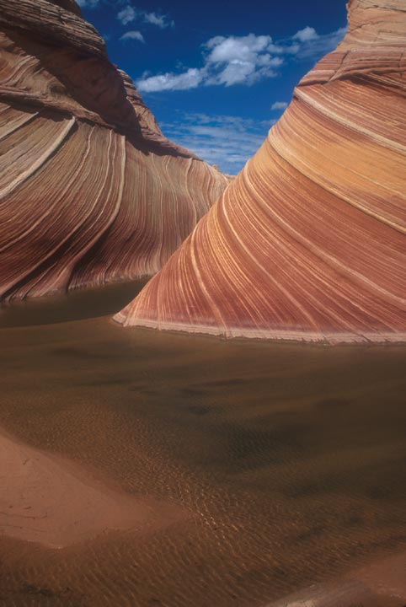
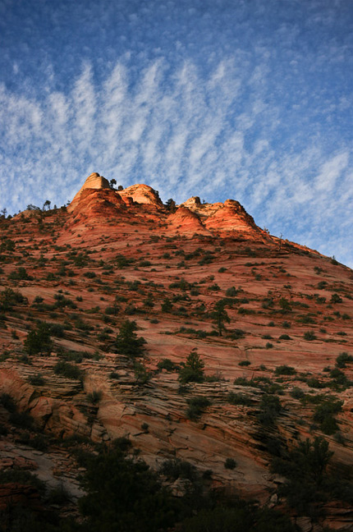
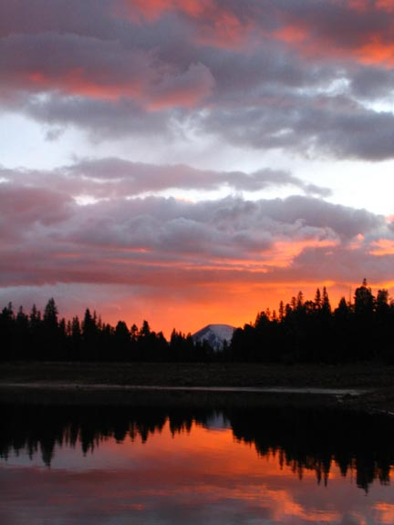
Celebrating 50 Years of Wilderness in Utah
Lone Peak Wilderness
Uinta-Wasatch-Cache National Forest
High Uintas Wilderness
Ashley National Forest
“If future generations are to remember us with gratitude rather than contempt, we must leave them something more than the miracles of technology. We must leave them a glimpse of the world as it was in the beginning, not just after we got through with it.”
-Lyndon B. Johnson
Paria Canyon – Vermillion Cliffs Wilderness
Vermillion Cliffs National Monument
Zion Wilderness
Zion National Park
[Four Logos Here]
BLM Logo
NPS Logo
FS Logo
FS Logo
Photo Credit: Mike Salamacha, Paria Ranger
Photo Credit: Ken Straley, Ashley NF

