Slide 1
Wilderness Fires
Law, Policy, Mgt Approach
Steve Kimball, R1 Prog. Mgr.
Wilderness, WSR’s, O/G’s

Slide 2
Wilderness Act of 1964
Statement of Purpose
“…it is hereby declared to be the policy of the Congress to secure for the American people of present and future generations the benefits of an enduring resource of wilderness.”
Sec 2(a)
Notes:
And… [READ SLIDE #] Thus was born the National Wilderness Preservation System…
Regional Wilderness Stewardship Training
November 2011

Slide 3
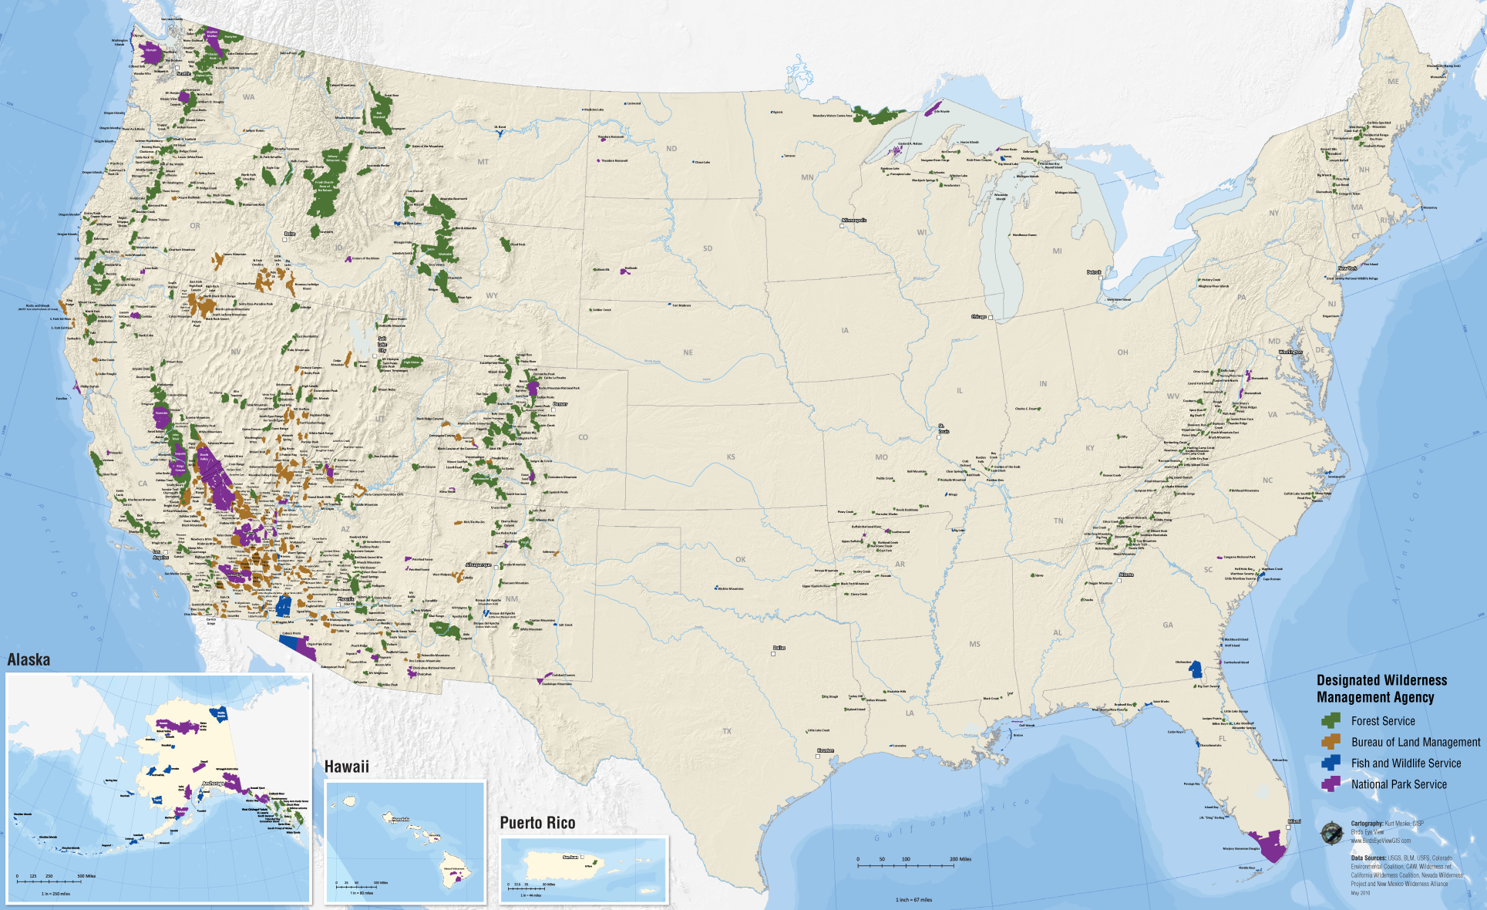
Extent of the System
NATIONAL WILDERNESS
PRESERVATION SYSTEM
1964
9.1 Mil Acres
54 Wilderness Areas
2014
109.5 Mil Acres
758 Wilderness Areas
Notes:
The Wilderness Act was not to be the end, but the beginning. In addition to establishing the NWPS, the Act prescribes a process for future designations. Congress intended the System to grow, and it has. [#] This looks like a lot of land, but it’s really only 5% of the US, and over half of it is in AK. The total area of currently designated is about the size of CA.
Do you know what the smallest wilderness is? [# Pelican Island @ 6 acres]. How about the largest wilderness? [# Wrangell-St. Alias @ over 9 mil acres].
Are there any states without wilderness? (There are six.) Which agency manages the most wilderness areas? (FS) Which manages the most acres? (NPS)

Slide 4
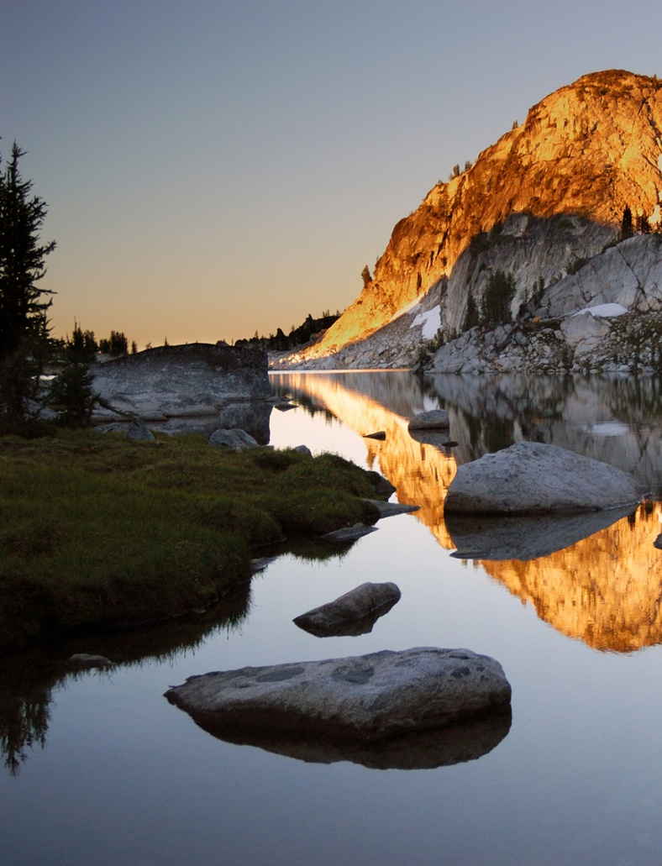
Definition of Wilderness
“…generally appears to have been affected primarily by the forces of nature, with the imprint of man’s work substantially unnoticeable…”
“…has outstanding opportunities for solitude or a primitive and unconfined type of recreation…”
Notes:
[## READ SLIDE]

Slide 5
Agency Responsibilities
“… these [areas] shall be administered for the use and enjoyment of the American people in such manner as will leave them unimpaired for future use and enjoyment as wilderness, and so as to provide for the protection of these areas, the preservation of their wilderness character.”
Sec 2(a)
Notes:
Now that we know what Congress intended wilderness to be, how do we honor that? Naturally, Congress told us how to do that too. Section 2(a) lays it out for us in general terms… [READ SLIDE]
Regional Wilderness Stewardship Training
November 2011

Slide 6
Agency Responsibilities
“… each agency administering any area designated as wilderness shall be responsible for preserving the wilderness character of the area and shall so administer such area for such other purposes for which it may have been established as also to preserve its wilderness character.” Sec 4(b)
Notes:
And, just in case you missed it the first time, the Act states twice more in Section 4(b) that we must preserve wilderness character. How important is this? There have been 287 suits involving wilderness character!
Regional Wilderness Stewardship Training
November 2011

Slide 7
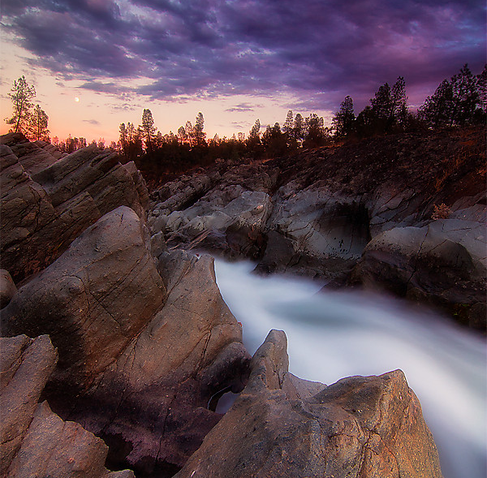
Qualities of Wilderness Character
Untrammeled
Wilderness is essentially unhindered and free from the actions of modern human control or manipulation.
Notes:
[READ SLIDE]
Regional Wilderness Stewardship Training
November 2011

Slide 8
Qualities of Wilderness Character
Undeveloped
Wilderness retains its primeval character and influence and is essentially without permanent improvement or modern human occupation.
Notes:
[READ SLIDE]
Regional Wilderness Stewardship Training
November 2011

Slide 9
Qualities of Wilderness Character
Natural
Wilderness ecological systems are substantially free from the effects of modern human civilization.
Notes:
[READ SLIDE]
Regional Wilderness Stewardship Training
November 2011

Slide 10
Qualities of Wilderness Character
Outstanding Opportunities
Wilderness provides outstanding opportunities for solitude or primitive and unconfined recreation.
Notes:
[READ SLIDE]
Regional Wilderness Stewardship Training
November 2011

Slide 11
Qualities of Wilderness Character
Unique/Other Features
Wilderness preserves unique attributes or other features that reflect the character
of a specific wilderness.
Notes:
[READ SLIDE]
Regional Wilderness Stewardship Training
November 2011

Slide 12
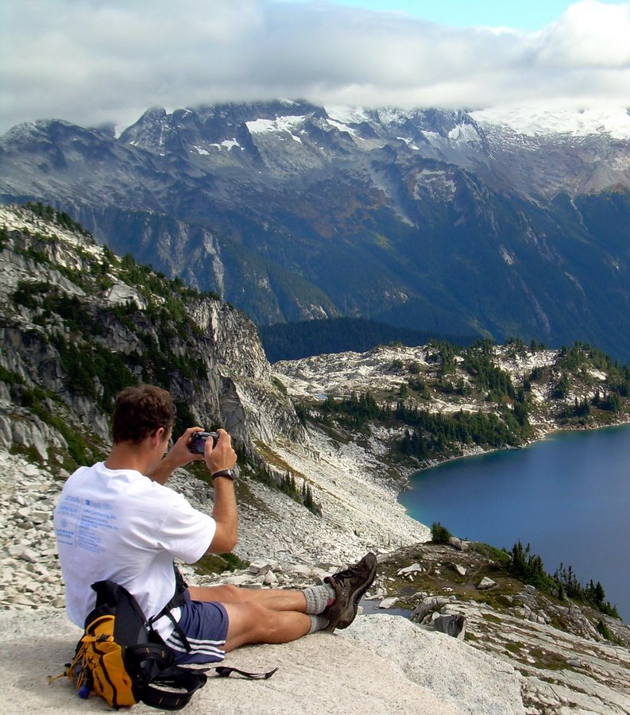
Use of Wilderness
“Except as otherwise provided in this Act, wilderness areas shall be devoted to the public purposes of recreational, scenic, scientific, educational, conservation,
and historical use.”
Sec 4(b)
Notes:
[READ SLIDE] These are known as the “public purposes” of wilderness. Does this look like a comprehensive list of wilderness values? [#] Are there others? (Economic, spiritual, etc) These are protected too… more about that later.
Regional Wilderness Stewardship Training
November 2011

Slide 13
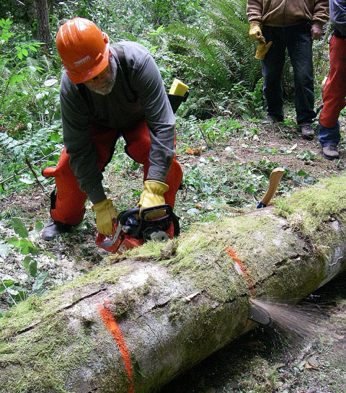
Prohibited Uses
Commercial Enterprise
Permanent Road
Temporary Road
Use of Motor Vehicles
Motorized Equipment
Motorboats
Landing of Aircraft
Mechanical Transport
Structure or Installation
Sec 4(c)
Notes:
To ensure wilderness character is preserved, some uses are explicitly prohibited… [READ SLIDE]
Regional Wilderness Stewardship Training
November 2011

Slide 14
Minimum Requirements
“…except as necessary to meet minimum requirements for the administration of the area for the purpose of this Act…”
Sec 4(c)
Notes:
But, all of the prohibited uses can be exempted by special provision of the Wilderness Act, an existing private right, or subsequent legislation. These are the only ways permanent roads and commercial services, may be exempted. [#] The other 8 prohibited uses, the ones we deal with most often, can also be exempted if we can demonstrate that it is both necessary to the administration of the area as wilderness and the minimum activity. This is where a “minimum requirements analysis” comes in, which we’ll talk much more about later.
Regional Wilderness Stewardship Training
November 2011

Slide 15
FSM 2320 Wilderness Management
Permit lightening fires to play, as nearly as possible, their natural ecological role in wilderness
Reduce to an acceptable level, risks & impacts within and outside of wilderness
(2324.21)

Slide 16
FSM 2320
Preference to methods & equipment causing least alteration & disturbance (2324.23)
Allow motorized equip. & mechanized transport only in emergencies with “unescapable urgency” and “temp need for speed” (2326.1)

Slide 17
FSM 2320
Protect Wilderness Character (2320.2)
Know special provisions in establishing legislation – some allow for non-conforming uses
Use interdisciplinary skills/expertise
Manage/inform visitors and public
(2320.3)

Slide 18
] Wilderness Fire Mgt Approach
Critical natural process, integral part of fire-adapted ecosystems
Restraint: fire mgt actions can degrade Wilderness Character
(Particularly Natural and Untrammeled)

Slide 19
] Wilderness Fire Mgt Approach
All natural fires in wilderness areas are managed
Response depends on:
Firefighter and Public Safety
Wilderness Character
Other Values- resource, social
Available Resources
Cost and Convenience Not a Driver

Slide 20
] Wilderness Fire Mgt Approach
Resource Benefits include:
Diverse Vegetation
Resilient Forest and Grassland Systems
Quality Habitats for wide-range of species
Wilderness Character Qualities Preserved
Each natural fire is an opportunity for Benefit!

Slide 21
Wilderness Fire Mgt Approach
Impacts include:
Smoke
Soil, Water, other Resource Effects
Visitors and Outfitters Displaced
Threat to Homes and Property
Public Support Reduced

Slide 22
Wilderness Fire Mgt Approach
Select methods causing least alteration & disturbance. Ask: Is this the Minimum Necessary to Manage this fire?
How Necessary is Necessary?
If Necessary, what is the Minimum Tool (method) to get this job done?

Slide 23
Wilderness Fire Mgt Approach
Dynamic and Flexible:
Resource objectives and management response can be varied on the same fire and change over time
Trigger Points/Contingencies
Prepare for Long Duration Fires

Slide 24
Wilderness Fire Mgt Approach
Resources/Tools Available Include:
Land Management Plan
Unit Fire Management Plan
Wilderness Plan
Local Wilderness Managers Letters of Delegation
Letters of Leaders Intent
Pre/Post-Season Reviews

Slide 25
Wilderness Fire Mgt Approach
Resources (continued)
Wilderness.net Fire Toolbox: including:
Fire Mgt Planning Checklist
READ Guides
(include MIST & Other Resource Protection Guidelines)

Slide 26
Wilderness Fire Mgt Approach
Beware of Risks Transferred or Deferred-
Deferral of Fire Can Mean Larger Impacts Later
Look Hard at “Exposure”

Slide 27
Wilderness Fire Mgt Approach
New Wilderness Performance Measures:
Accountable for:
Acres in Wilderness Burned (relative to established historic amounts)
Continue to report motorized- mechanized-aircraft landing/drops

Slide 28
Wilderness Fire Mgt Approach
50th Anniversary:
Debate about Wilderness Fire- Too Much or Too Little?
Impacts Acceptable?
Conditions are Important Focus
What About Trammeling?

Slide 29
Preserve Wilderness Character For Present & Future Generations

Slide 30
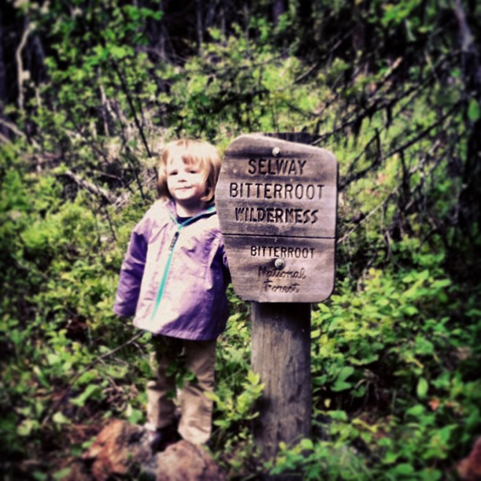
Wilderness: An Enduring Resource

