Slide 1
Wilderness Characteristics Guidance for the BLM
I. Introduction
II. Inventory Procedures
A. Background
B. Route Analysis & Boundary Identification
C. Size
D. Naturalness
E. Outstanding Opportunities & Supplemental Values
F. Boundary Adjustments & LWC Documentation
III. Planning
Inventory – Opp’s & Values
Notes:
ADVANCE SLIDE

Slide 2
Wilderness Characteristics Guidance for the BLM
Inventory Procedures:
Outstanding Opportunities
&
Supplemental Values
Inventory – Opp’s & Values
Notes:
ADVANCE SLIDE

Slide 3
Outstanding Opportunities
for
Solitude
or
Primitive Recreation
Inventory – Opp’s & Values
Notes:
Your inventory area has sufficient size and naturalness. The third required inventory screen deals with its recreational opportunities.
ADVANCE
These come directly from the Wilderness Act as the “outstanding opportunities for solitude or a primitive and unconfined type of recreation.”
As with “naturalness,” the “outstanding opportunities” are qualitative and subjective, but there are sideboards to help you through the analysis.
ADVANCE SLIDE

Slide 4
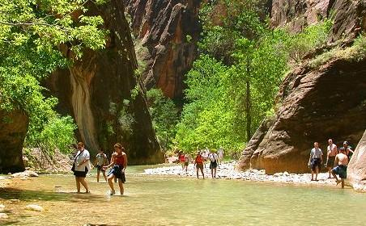
Outstanding Opportunities
for
Solitude
or
Primitive Recreation
Inventory – Opp’s & Values
Notes:
First, the “or” in “solitude or primitive recreation.” The word “or” in this sentence means that an area only has to possess one or the other. It may possess outstanding opportunities for both, but it doesn’t have to.
ADVANCE
Think of some of the most popular wilderness areas -- not much solitude, but fantastic primitive recreation!
ADVANCE SLIDE

Slide 5
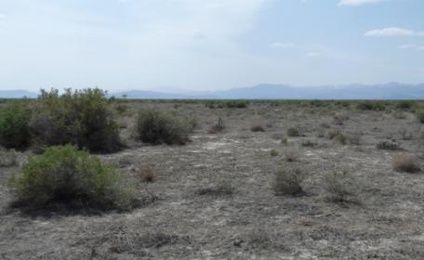
Outstanding Opportunities
for
Solitude
or
Primitive Recreation
Inventory – Opp’s & Values
Notes:
Or conversely, an area with good, if not outstanding recreational opportunities where your practically guaranteed of never seeing another human being.
ADVANCE SLIDE

Slide 6
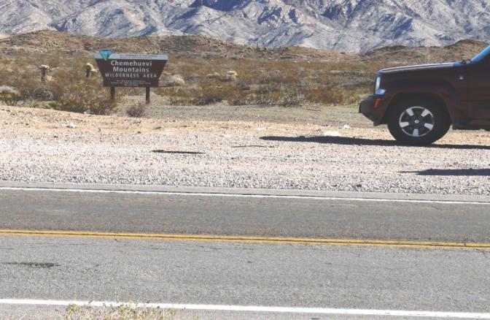
Outstanding Opportunities
not necessary on every acre
Inventory – Opp’s & Values
Notes:
Next, the area doesn’t have to have outstanding opportunities on every acre. This, too, should be obvious when you think about the designated wildernesses with which you may be familiar.
ADVANCE
Certainly the opportunities for solitude or primitive recreation may be limited at a trailhead that is next to a busy road, while being "outstanding" in the interior of a wilderness. So do not disqualify an area just because you find that outstanding opportunities exist in only a portion of the area.
ADVANCE SLIDE

Slide 7
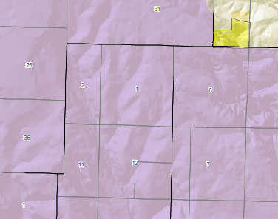
Outstanding Opportunities
not necessary on every acre
contiguous areas “inherit” opportunities
Inventory – Opp’s & Values
Notes:
Consequently, you should appreciate that if your inventory unit is contiguous with another area which has already been determined to have outstanding opportunities for solitude or primitive recreation,
ADVANCE
then those opportunities are “inherited” by your inventory unit, in the same way that the trailhead we just talked about “inherits” the outstanding opportunities of the interior of a wilderness.
ADVANCE SLIDE

Slide 8
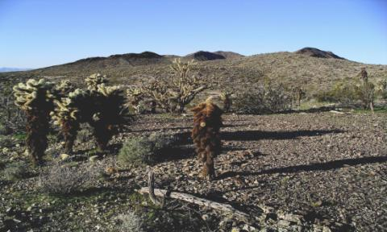
Outstanding Opportunities
Solitude
ability of visitor to avoid evidence of others inside the area
only consider outside impacts if pervasive
Inventory – Opp’s & Values
Notes:
So. Does your area have outstanding opportunities for solitude?
ADVANCE
Usually, the only factors you look at are the ability of a visitor to avoid the sights, sounds, and evidence of other people inside the area. This has been a long-standing Congressional direction, as far back as the Endangered American Wilderness Act of 1978.
ADVANCE
The only time we consider impacts of sights and sounds from outside the inventory area upon the opportunity for solitude, is if these impacts are pervasive and omnipresent. How “pervasive and omnipresent” is pervasive and omnipresent enough? Well, again, comparison with areas that have been designated wilderness by Congress can be instructive.
ADVANCE
This picture of the Bigelow Cholla Garden Wilderness was taken from the right-of-way of Interstate 40. So it has to be more pervasive and omnipresent than that.
ADVANCE SLIDE

Slide 9
Outstanding Opportunities
Solitude
influenced by
size
shape
Inventory – Opp’s & Values
Notes:
What are the factors limiting the ability of a visitor to avoid the sights, sounds, and evidence of other people in the area?
ADVANCE
They include the size of the area, of course, and it’s shape -- these both influence how easily people can access all parts of a wilderness.
ADVANCE
All other things being equal, the bigger the area the easier to find solitude
ADVANCE SLIDE

Slide 10
Outstanding Opportunities
Solitude
influenced by
size
shape
Inventory – Opp’s & Values
Notes:
and it may be harder to find solitude in a long, skinny area of the same acreage because any place in the area is closer to its edge.
ADVANCE SLIDE

Slide 11
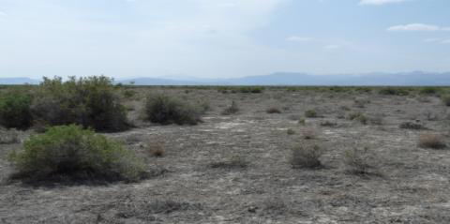
Outstanding Opportunities
Solitude
influenced by
size
shape
topography or vegetation
Inventory – Opp’s & Values
Notes:
Other factors influencing a visitor’s ability to find seclusion include topographic or vegetative screening.
ADVANCE
Solitude can be found in large areas lacking vegetation or topographic screening.
ADVANCE SLIDE

Slide 12
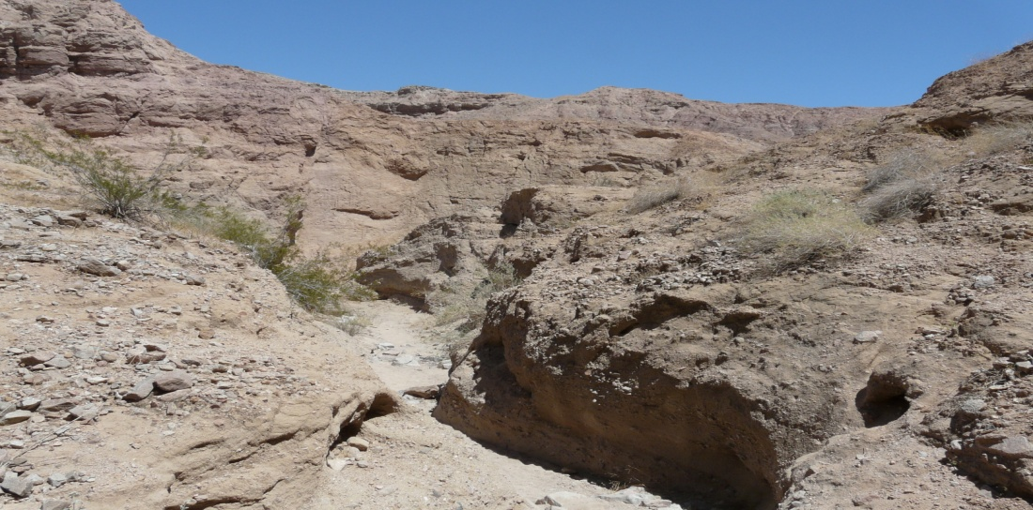
Outstanding Opportunities
Solitude
influenced by
size
shape
topography or vegetation
Inventory – Opp’s & Values
Notes:
A small area could also provide opportunities for solitude if, due to topography or vegetation, visitors can screen themselves from one another.
ADVANCE SLIDE

Slide 13
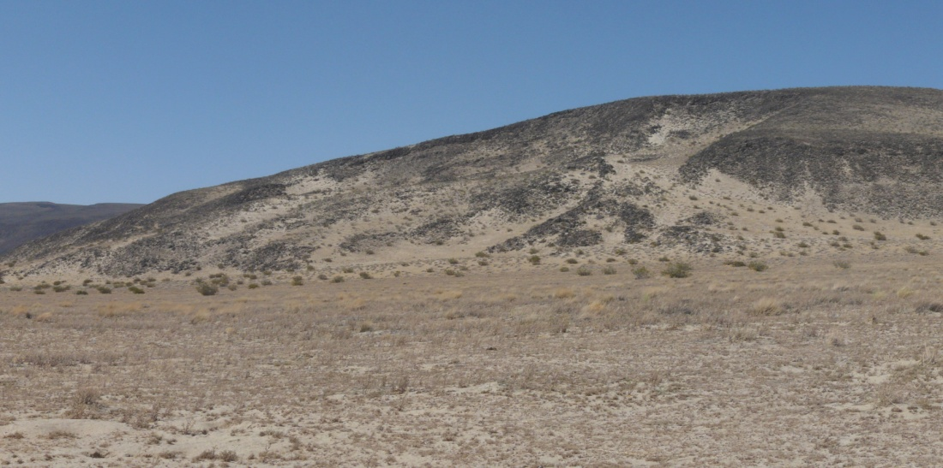
Outstanding Opportunities
Solitude
influenced by
size
shape
topography or vegetation
Inventory – Opp’s & Values
Notes:
But it’s possible that a relatively small area can have an outstanding opportunity for solitude even without screening if conditions are so harsh that few people go there!
You make your determination based on a combination of these and similar elements.
ADVANCE SLIDE

Slide 14
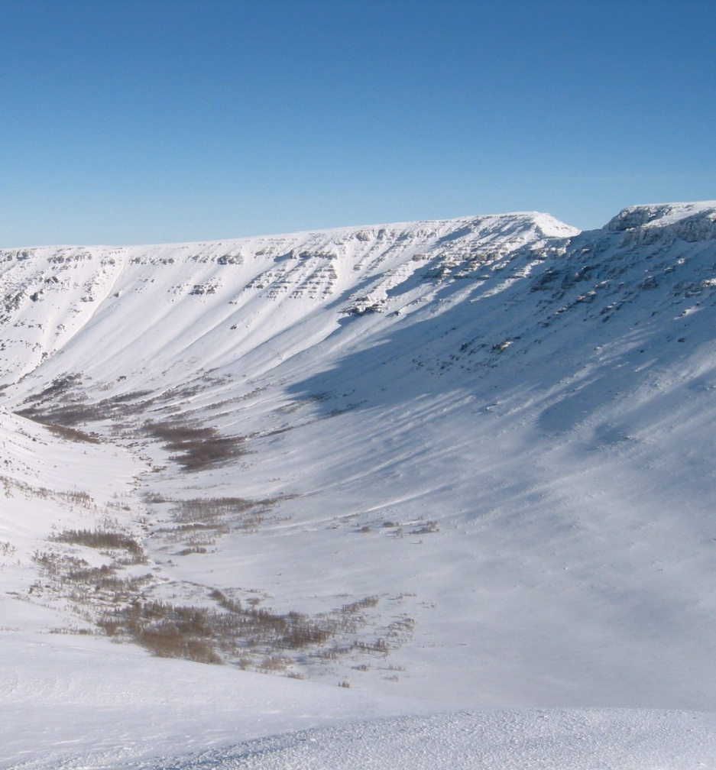
Outstanding Opportunities
Solitude
How much of the year does the opportunity for solitude have to be outstanding?
Inventory – Opp’s & Values
Notes:
And speaking of harsh conditions, during how much of the year does an area have to have an outstanding opportunity for solitude? This is a matter for your discretion. Certainly if the opportunity for solitude is less than outstanding only during a fall hunting season, the area would still qualify.
ADVANCE SLIDE

Slide 15
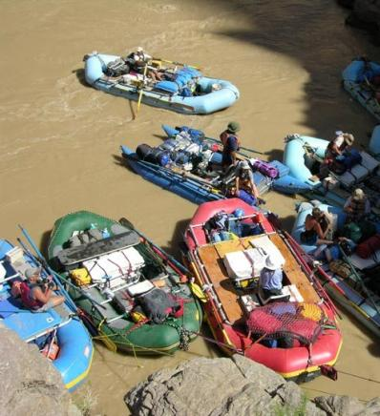
Outstanding Opportunities
Solitude
How much of the year does the opportunity for solitude have to be outstanding?
Inventory – Opp’s & Values
Notes:
But if the area was so popular there was no opportunity for solitude during the entire period that the area was physically accessible, then maybe that outstanding opportunity for solitude could be considered missing -- but maybe the primitive recreation opportunities that brought all those people to the area would be outstanding.
ADVANCE SLIDE

Slide 16
Outstanding Opportunities
Primitive Recreation
dispersed, undeveloped
hiking
horseback riding
fishing
hunting
climbing
canoeing
backpacking
snowshoeing
photography
birdwatching
Inventory – Opp’s & Values
Notes:
So, does your area have outstanding opportunities for primitive recreation --
ADVANCE
that is, dispersed, undeveloped recreation which does not require facilities, or use motor vehicles, motorized equipment, or mechanized transport?
ADVANCE
Things like hiking; horseback riding; fishing; hunting; climbing; canoeing; backpacking; snowshoeing; photography; bird watching.
ADVANCE SLIDE

Slide 17
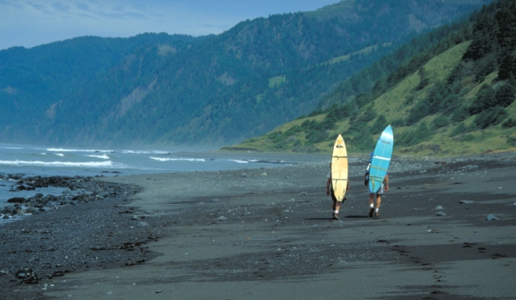
Outstanding Opportunities
Primitive Recreation
dispersed, undeveloped
hiking
horseback riding
fishing
hunting
climbing
canoeing
backpacking
snowshoeing
photography
birdwatching
Inventory – Opp’s & Values
Notes:
Surfing. The list is long. Just recreation without motors or mechanical transport.
ADVANCE SLIDE

Slide 18
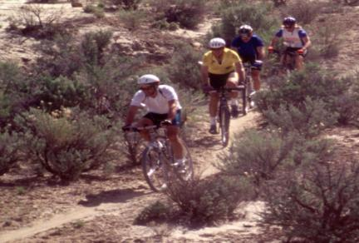
Outstanding Opportunities
Primitive Recreation
dispersed, undeveloped
non-primitive can be present, but
evaluate only how conflicts with primitive
Inventory – Opp’s & Values
Notes:
Non-primitive recreation, such as mountain biking, say, can be present, but those opportunities aren’t evaluated -- except in how they might conflict with outstanding primitive recreation.
ADVANCE SLIDE

Slide 19
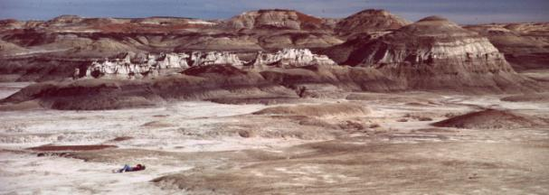
Outstanding Opportunities
Primitive Recreation
dispersed, undeveloped
non-primitive can be present, but
evaluate only how conflicts with primitive
trails or water not necessary
Inventory – Opp’s & Values
Notes:
You don’t need to have trails or a source of water to have outstanding opportunities. The absence of a trail may increase opportunities for primitive recreation, and there’s nothing like a lack of water to keep visitation down, increasing the opportunities for solitude!
ADVANCE SLIDE

Slide 20
Outstanding Opportunities
Primitive Recreation
dispersed, undeveloped
non-primitive can be present, but
evaluate only how conflicts with primitive
trails or water not necessary
diversity of activities -- or one activity
opportunity, regardless of amount of use
self-challenge important, not required
Inventory – Opp’s & Values
Notes:
Your area might possess outstanding opportunities for primitive recreation through either the diversity of primitive recreational activities possible in the area, or the outstanding quality of one particular activity. And it makes no difference whether the outstanding recreational potential is realized at the present time.
ADVANCE
Determine whether an outstanding opportunity exists, regardless of the amount of use.
ADVANCE
Opportunities for self-challenge and risk are important considerations, but they are not essential to these outstanding opportunities.
ADVANCE SLIDE

Slide 21
Outstanding Opportunities
“Outstanding”
“Standing out among others of its kind.”
“Superior to others of its kind.”
“Others of its kind”
other areas managed by BLM in the broad geographical area of the inventory
a subjective standard (not sliding scale)
do not rank areas against each other
Inventory – Opp’s & Values
Notes:
Well, we’ve talked a lot about outstanding opportunities.
ADVANCE
But you may wonder just what we mean by “outstanding.” How outstanding does “outstanding” have to be?
ADVANCE
The guidance has a glossary which defines outstanding as: “1. Standing out among others of its kind; conspicuous; prominent; 2. Superior to others of its kind; distinguished; excellent.”
ADVANCE
This definition begs the question, what is “others of its kind”?
ADVANCE
By that we mean “other areas managed by the BLM in the broad geographical area of your inventory unit.”
ADVANCE
“Outstanding” is a standard, albeit a subjective one -- but doesn’t occur on a sliding scale or a curve. One area is not more outstanding than another, it merely qualifies as “outstanding,” or it doesn’t. You shouldn’t compare your canyons with the Paria, or your badlands with the Bisti, or your -- anything! -- with the King Range.
ADVANCE
Don't start comparing your inventory units with each other by some sort of ranking scheme. Each area is evaluated on its own merits -- it either “makes the grade,” or it doesn’t. Upon designation, Congress doesn’t grade wilderness areas as the “A-list,” the “pretty good,” and the “mediocre” wildernesses. We shouldn’t be doing that either, when we inventory for wilderness characteristics. An inventory unit either has wilderness characteristics or it doesn’t.
ADVANCE SLIDE

Slide 22
Outstanding Opportunities
Document outstanding opportunities
Solitude?
Primitive Recreation?
If either or both, outstanding opportunities are present
If neither criteria are met
no wilderness characteristics
further inventory activity not necessary
Inventory – Opp’s & Values
Notes:
So, now you should know whether your inventory unit possesses outstanding opportunities for solitude, or primitive recreation, or both. Document -- in writing -- your rationale for this determination, either way.
ADVANCE
Note that if the inventory area has outstanding opportunities for neither solitude nor primitive recreation, it does not have wilderness characteristics. You don’t have to document any supplemental values.
ADVANCE SLIDE

Slide 23
Outstanding Opportunities
If outstanding opportunities are present
(assuming size and naturalness criteria met)
area has wilderness characteristics
proceed to “supplemental values” criterion
Inventory – Opp’s & Values
Notes:
If the inventory unit does meet the primitive recreation and/or solitude criteria (as well as the size and naturalness criteria), it does contain wilderness characteristics. What do you think you should do with that finding? Yes -- document it.
ADVANCE
And then proceed to determine if the area contains any supplemental values.
ADVANCE SLIDE

Slide 24
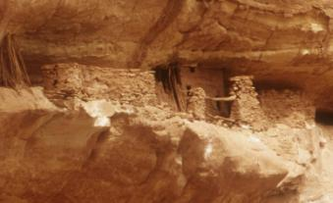
Supplemental Values
From the Wilderness Act:
“ecological, geological, or other features of scientific, educational, scenic, or historical value.”
Not required; document where present
Inventory – Opp’s & Values
Notes:
The supplemental values include those specifically mentioned in the Wilderness Act: ecological, geological, or other features of scientific, educational, scenic, or historical value. Things like endemic or T&E species, paleo resources, representative biomes, outstanding views, or culturally important properties.
ADVANCE
Such values are not required to be present in order for an inventoried area to be considered as having wilderness characteristics, but their presence should be documented where they exist.
ADVANCE SLIDE

Slide 25
Wilderness Characteristics Guidance for the BLM
Inventory Procedures:
Outstanding Opportunities
&
Supplemental Values
End of Module IIE
Inventory – Opp’s & Values
Notes:
It’s time to make our final determination on whether the area we've been looking at has wilderness characteristics. Before you go on to the final module in the group, print out Appendices B & C from Manual 6310 if you haven’t done so already. (You know, you don’t have to use the exact the forms in the Appendices if minor modifications would better meet the needs of your Field Office. But keep in mind that the primary criteria and definitions must remain unchanged.)
Ready to wrap up the inventory? Then let’s go to the final module in this group.
ADVANCE SLIDE

