Slide 1
Minimum Requirements Analysis
Note to presenters -
This file is part of the FS Resources section at: http://www.wilderness.net/fs/
This presentation should be reviewed and revised as needed to match the training objectives and target audience and to insert local images as needed.
The Minimum Requirements Analysis training presentations are posted in 6 parts which may be combined and used as needed:
Introduction
Basis in Law and Policy
Definitions
Minimum Requirements process
Step 1
Step 2
Use of the MRA process
Use of Traditional Skills and Tools

Slide 2
Minimum Requirements Analysis
Applying the
Minimum Requirements Analysis Process

Slide 3
Minimum Requirements Analysis
Is a Minimum Requirements Analysis required?
Law: Requires a determination of the minimum necessary
FS Regulations: No requirement for analysis or documentation
FS Policy – FSM 2326.1:
“Specify …the places and circumstances in which motorized equipment, mechanical transport, or aircraft are necessary… in the forest plan.”
“The Line Officer approving the use…shall specify what uses … are suitable and will have the least lasting impact to the wilderness resource.”
Chief’s Memo (2001): “The MRDG is a tool that can be used.”
Regional Forester approval - use of MRDG format recommended

Slide 4
Minimum Requirements Analysis
Minimum Requirements Process - Benefits
Meets the direction of both the law and agency policy.
Provides a process that is flexible enough to meet a range of proposed actions.
Creates a decision that is “visible” to the public and defensible.

Slide 5
Minimum Requirements Analysis
Minimum Requirements Process - Benefits
Helps prevent “decision creep” – the tendency over time for the cumulative effect of multiple decisions to permanently erode wilderness character
Avoids tendency to justify a pre-determined course of action
Helps make and support the best decision for your wilderness.

Slide 6
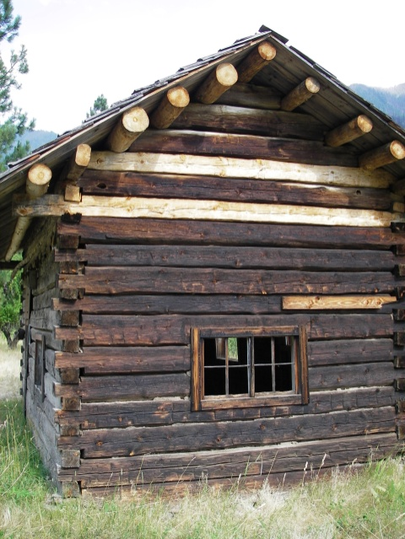
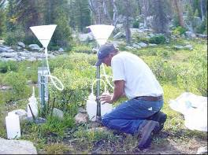
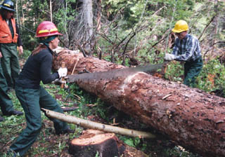
The Minimum Requirements Decision Guide (MRDG)
Appropriate Uses of the MRDG:
Project level analysis :
Maintenance and restoration
Scientific monitoring or research
Visitor use facilities or developments
Activities related to special provisions or subsequent legislation
Notes:
The MRDG process is applicable to actions which include, but are not limited to the following: Maintenance and rehabilitation; Scientific monitoring, or research; Recreational developments, such as trails, bridges and signs; and activities related to special provisions mandated by the 1964 Wilderness Act or subsequent legislation, such as grazing, exercising mineral rights, access to inholdings, maintenance of water developments, and commercial services.

Slide 7
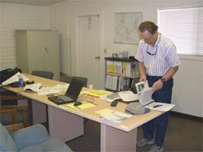
The Minimum Requirements Decision Guide (MRDG)
Inappropriate Uses of the MRDG
1) As a substitute for a NEPA analysis, documentation or public involvement.
Use the MRDG to support a NEPA analysis and decision
The MRDG determination can be the proposed action for a NEPA analysis if needed.
2) As a substitute for programmatic wilderness planning (LAC or other process)
Notes:
This process is NOT a substitute for NEPA analysis, which may be required by either agency policy or the scope of the proposed action.

Slide 8
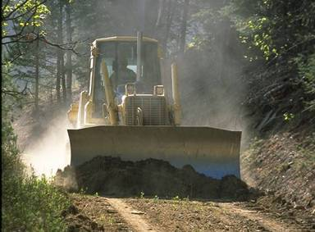
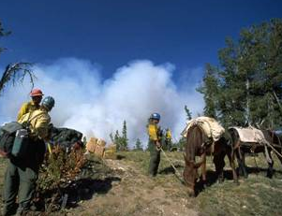
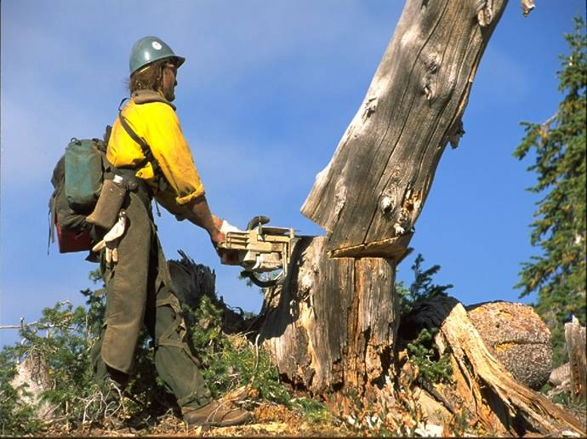
Minimum Requirements Analysis
Inappropriate Uses of the MRDG
3) As a decision process during Wildland Fire Emergencies
Integrate a minimum requirements decision process into wildfire management planning and operations:
Forest LMP (direction) or FMP (information/guidelines)
MIST guidelines for local operations
Wilderness Fire Resource Advisors or Technical Specialists
Need and approval process for motorized equipment
Notes:
This process should NOT be used for actions required during emergencies involving the health and safety of persons within the wilderness area. This process does NOT alter or diminish the need for taking actions in a manner that places priority on the safety of wilderness visitors, employees, volunteers, and contractors.

Slide 9
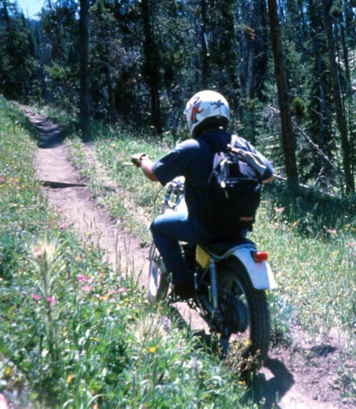
The Minimum Requirements Decision Guide (MRDG)
Minimum Requirements Analysis
Inappropriate Uses of the MRDG
4) Emergencies involving health and safety and law enforcement.
Use the minimum requirements direction from the law in programmatic SAR planning and agreements
Notes:
This process should NOT be used for actions required during emergencies involving the health and safety of persons within the wilderness area. This process does NOT alter or diminish the need for taking actions in a manner that places priority on the safety of wilderness visitors, employees, volunteers, and contractors.

Slide 10
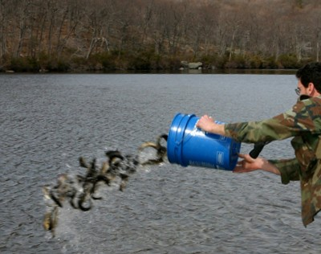
The Minimum Requirements Decision Guide (MRDG)
Minimum Requirements Analysis
Inappropriate Uses of the MRDG
5) Fish and wildlife management projects with prohibited uses
Use the Minimum Requirements Decision Process (MRDP) from the FS Policies and Guidelines (AFWA)
Follow the process described in the state MoU
Obey the law – preserve wilderness character
Notes:
The MRDP outline process in the AFWA Policies and Guidelines is somewhat different than the MRA process described in the MRDG.

Slide 11
Minimum Requirements Analysis
Minimum Requirements Decision Guide (MRDG)
Available at:
http://www.wilderness.net/mrdg/
-MS Word format
-Revised January 2009
Notes:
MRDG developed as a tool to help implement policy.
Available from wilderness.net – frequent updates based on feedback from users.

Slide 12
Minimum Requirements Analysis
Information Resources
for
Minimum Requirements Analysis

Slide 13
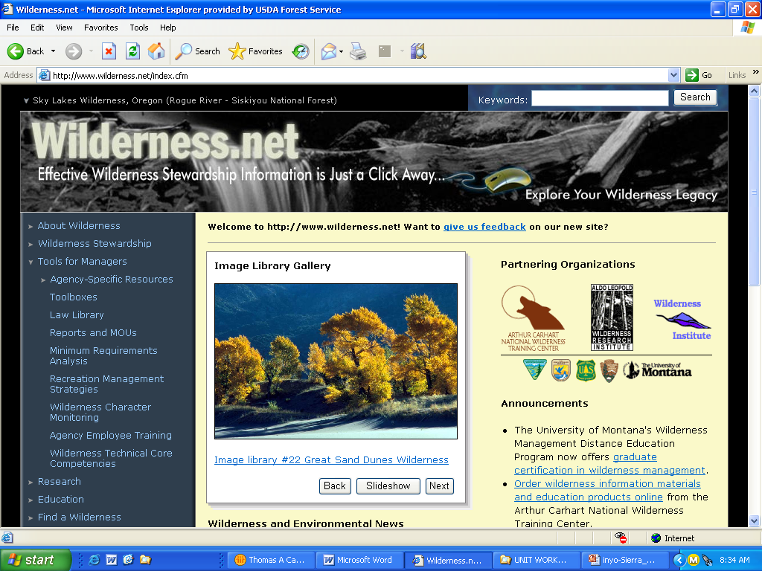
Wilderness.Net
Notes:
www.wilderness.net

Slide 14
Minimum Requirements Analysis

Slide 15
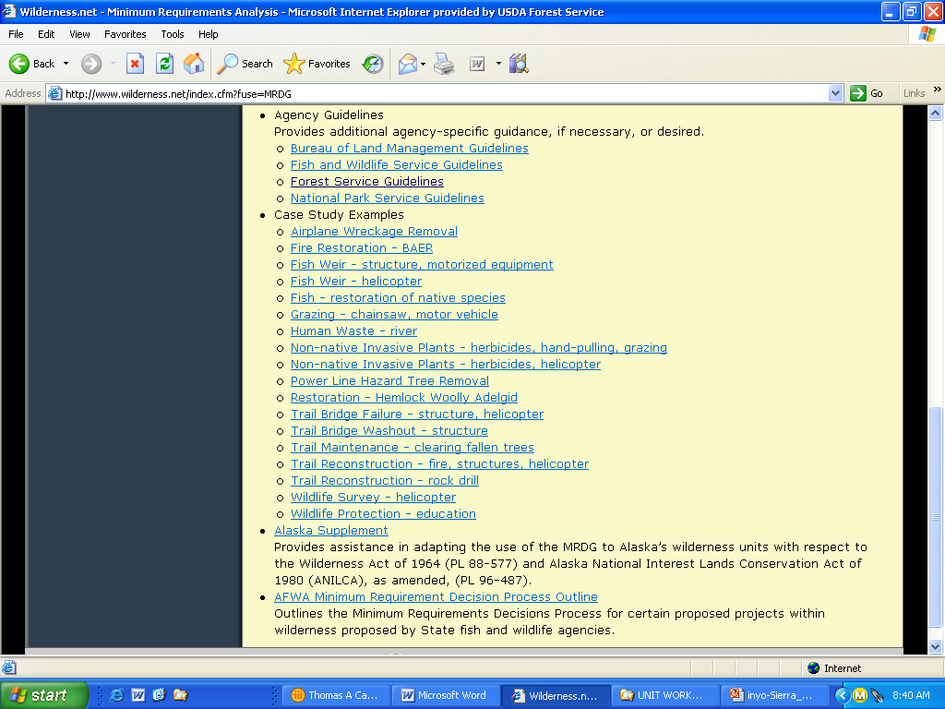
More examples
coming soon !

Slide 16
Minimum Requirements Analysis
Minimum Requirements Analysis
On-line Training Course
Available at:
http://www.carhart.wilderness.net/
-Free, no time limit, open to everyone
-Certificate of completion for AgLearn
Notes:
Minimum Requirements on-line training has been developed.
Available from wilderness.net

Slide 17
Minimum Requirements Analysis
How is a Minimum Requirements Decision Made?
Use a two step process
Step 1: Determine if any administrative action is necessary.
A. Options outside of wilderness
B. Valid existing rights/special provisions in wilderness laws
C. Requirements of other legislation
D. Other guidance (policy, plans, etc.)
E. Wilderness character
F. Public purposes of wilderness
Conclusion: Is the action necessary?
Step 2: Determine the minimum activity.
A. Describe alternatives
B. Compare alternatives
Decision: What is the minimum activity (method or tool)?
Use rationale for the decision based on law and agency policy.

Slide 18
Minimum Requirements Analysis
“A conservationist [wilderness steward] is one who is humbly aware that with each stroke he is writing his signature on the face of the land.”
- Aldo Leopold, A Sand County Almanac, 1949

