Slide 1
FS Resources
This file is part of the FS Resources section at: http://www.wilderness.net/fs/
This presentation should be reviewed and revised as needed to match the local training objectives and target audience and local images should be inserted where needed.
The Wilderness Act training presentations are posted in parts which may be combined or used separately as needed:
History and Purpose of the Wilderness Act
National Wilderness Preservation System
Values and Benefits
Definitions and Management
Other Laws
Stewardship Principles
Court Decisions
FS policy
More Information

Slide 2
Arthur Carhart National Wilderness Training Center
Notes:
This presentation is a product of the Carhart Wilderness Training Center
Suggestions for corrections and updates are welcome. Contact: tcarlson@fs.fed.us

Slide 3
Wilderness Stewardship
Definitions and Management
The Wilderness Act of 1964
Notes:
3

Slide 4
What is the definition of wilderness?
“Wilderness is a dark and dismal place where all manner of beasts roam around uncooked.”
- anonymous, 18th century
What is your definition of wilderness?
Notes:
This was a common definition of wilderness at one time but it doesn’t exactly match the definition from the 1964 Wilderness Act.

Slide 5
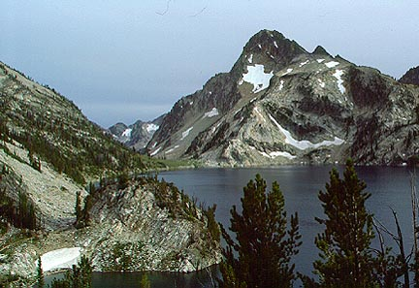
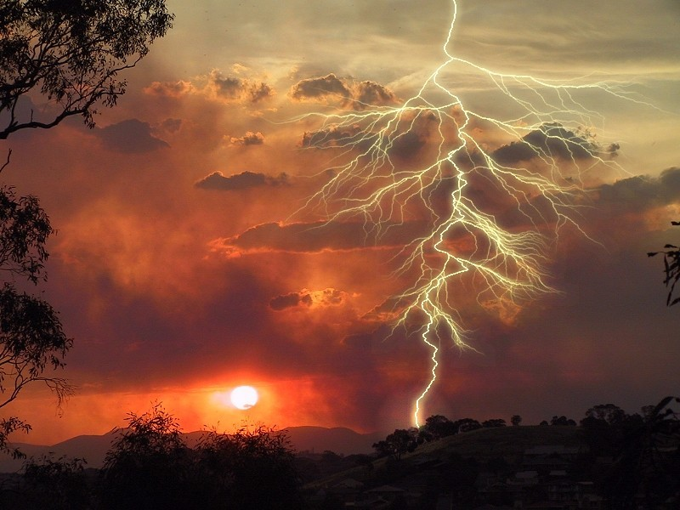
What is
Wilderness?
The earth and community of life is untrammeled by man
Man is a visitor who does not remain
Area that retains its primeval character and influence
Without permanent habitation
Managed to preserve natural conditions… wildness
Notes:
This is how the Wilderness Act of 1964 defines wilderness.

Slide 6
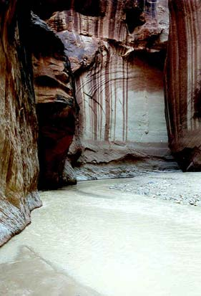
What is
Wilderness?
Affected primarily by the forces of nature
Man’s work is substantially unnoticeable
Outstanding opportunities for solitude or primitive and unconfined recreation
Ecological, historical, scenic, scientific, geological, educational, spiritual values
Notes:
More from the ‘64 Wilderness Act. These definitions provide the constraints and general constraints for a legal definition of wilderness but for management they require more examination and interpretation.

Slide 7
Why do we have to manage wilderness?
“Draw a line around it and leave it alone.”
- Early views of the need for management
Think of Wilderness Management as Wilderness Stewardship
It is both:
Biocentric (for nature)
Anthropocentric (for people)
Notes:
Early on in the wilderness movement the idea was just to protect lands from development or resource management in order to have wilderness. These days as the potential effects of civilization on lands designated as wilderness have become more apparent the federal agencies have embraced the need for management actions to insure that wilderness character is preserved.

Slide 8
Section 2 (c)
A wilderness, in contrast with those areas where man and his own works dominate the landscape,
…where man himself is a visitor who does not remain.
Definition of wilderness
Notes:
Let’s look at what the Act says about what wilderness is. To better understand the legal definition.
What does ‘in contrast mean?’ Wilderness is in contrast to other more developed lands and areas where an “expanding civilization and increasing mechanization” dominate.
Part of the meaning is that humans are visitors, not residents or developers of the landscape.
In addition it applies to how wilderness is managed, how we ‘work’ in wilderness and go about administrative activities, what tools we use and the ‘minimum requirements’ concept that we’ll talk about when we get to a discussion of Section 4(c).

Slide 9
Section 2 (a)
… these [lands] shall be administered for the use and enjoyment of the American people in such manner as will leave them unimpaired for future use and enjoyment as wilderness,...
Notes:
Wilderness is about and for people. We should never forget that the objective of our stewardship is to based on the use and enjoyment of wilderness.

Slide 10
Section 2 (a)
… these [lands] shall be administered for the use and enjoyment of the American people in such manner as will leave them unimpaired for future use and enjoyment as wilderness,...
Wilderness stewardship
Notes:
But, the rest of the story is that the objective of our stewardship is based on both the use and enjoyment of wilderness and insuring that wilderness exists to provide benefits to future generations. Wilderness stewardship provides opportunities for a wilderness experience but preserve wilderness character in an unimpaired condition.

Slide 11
Section 2 (a)
… and so as to provide for the protection of these areas, the preservation of their wilderness character,...
Wilderness character ???
Notes:
Sec 2 a tells us to be sure to ‘preserve the wilderness character’ of an area. It doesn’t tell us what the ‘wilderness character’ is because it is unique for every area.
But, this notion of preserving the wilderness character is so important that…… (next slide)

Slide 12
Section 4 (b)
… each agency administering any area designated as wilderness shall be responsible for preserving the wilderness character of the area
… and shall so administer such area for such other purposes for which it may have been established as also to preserve its wilderness character
Notes:
It appears in two additional parts of the Act and again directly linked to administration of the area.
First, it is our responsibility to insure the preservation of wilderness character. It is the over-riding criteria against which all actions and decisions must be measured.
Second, we need to preserve wilderness character while also meeting all other purpose for which wilderness was established and is managed. This includes minimizing effects on natural conditions caused by one of the legal but non-conforming uses that are part of the special provisions (grazing, mining, water developments, etc. )
So what is meant by ‘wilderness character and how can we define it? (next slide)

Slide 13
Wilderness character is more than the sum of its parts
“It is the combination of biophysical, experiential, and symbolic ideals that distinguish wilderness from other lands.*”
* Monitoring Selected Conditions Related to Wilderness Character: A National Framework, USDA-FS, 2005
Notes:
Just like a violin, wilderness character is more than the sum of its parts.
Our tendency is to talk about the air, the water, the animals, the plants, the scenery, the beauty, the quiet of a wilderness; these are the parts, the pieces, the social and biophysical components of the wilderness resource. But our task as stewards is more important, and that is to preserve the larger, harder to describe, richer and extraordinary idea and ideal of wilderness character.
Sometimes people equate the phrase “wilderness characteristics” with “wilderness character” but just like with the word “resources” the word “characteristics” implies individual parts or pieces and not the whole of “wilderness character.”

Slide 14
Is Wilderness Character defined in the Wilderness Act of 1964?
Section 2c: Definition of Wilderness
FOUR STATUTORY QUALITIES OF WILDERNESS CHARACTER
Notes:
Is wilderness character defined in the Act? Not specifically, but in Section 2c we get an idea of what is meant through the words and phrases used in the definition of wilderness.
A task force led by Peter Landres, Steve Boutcher, and others studied the definition of wilderness and determined that there are ‘four statutory qualities’ of wilderness character. This is by no means an all inclusive definition of wilderness character nor does it reflect all the necessary monitoring that must occur to properly steward wilderness but it serves as a useful discussion in helping to understand the Wilderness Act.
The report is published in the: Monitoring selected conditions related to wilderness character: a national framework. Gen. Tech. Rep. RMRS-GTR-151. Fort Collins, CO: U.S. Department of Agriculture, Forest Service, Rocky Mountain Research Station. 38 p. (http://www.wilderness.net/index.cfm?fuse=WC)
This definition of wilderness character is currently being adopted for use by all four agencies in monitoring wilderness character.

Slide 15
Defining Wilderness Character
The Qualities of Wilderness Character:
Applying to all areas:
Undeveloped
Untrammeled
Natural
Outstanding opportunities for solitude or primitive recreation
For each individual area:
5. Unique values of your wilderness area
Notes:
Wilderness character can be defined by these qualities. The following slides describe and examine each one in more detail.

Slide 16
Section 2 (c)
An area of wilderness is further defined to mean in this Act an area of undeveloped Federal land retaining its primeval character and influence, without permanent improvements or human habitation ...
Definition of wilderness - undeveloped
Notes:
To understand wilderness character let’s look at how each quality is defined in the Act.
The main elements of the first quality of Undeveloped are:
-Undeveloped as in contrast to other types of “developments’ on the public lands such as roads, timber management areas, campgrounds, ski areas, etc. It’s meant as a general definition to set wilderness aside from lands available for other uses. -

Slide 17
Section 2 (c)
An area of wilderness is further defined to mean in this Act an area of undeveloped Federal land retaining its primeval character and influence, without permanent improvements or human habitation ...
Definition of wilderness - undeveloped
Notes:
-Primeval character, meaning appearing largely as it would without modern influences such as control or manipulation by humans, civilization, mechanization., etc. ‘Influences’ refers to natural conditions and natural processes.

Slide 18
Section 2 (c)
An area of wilderness is further defined to mean in this Act an area of undeveloped Federal land retaining its primeval character and influence, without permanent improvements or human habitation ...
Generally without structures or the use of motors or mechanical transport devices that increase human ability to occupy or modify the environment
Definition of wilderness
Notes:
-Without permanent improvements or habitation. This doesn’t mean that it couldn’t have been developed or occupied at some point prior to designation. Prior use and development does not, by itself, exclude lands from becoming wilderness. It is meant to indicate the contrast between a permanent development such as a city vs. a historic cabin or farm site.

Slide 19
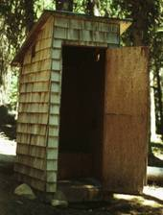
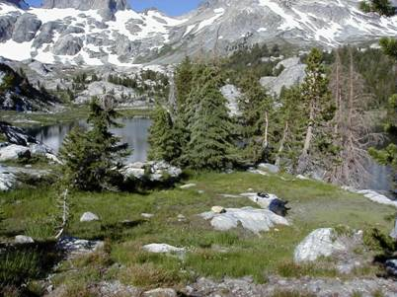
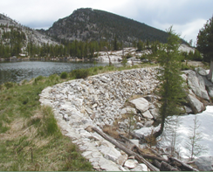
FOUR STATUTORY QUALITIES OF WILDERNESS CHARACTER
“Undeveloped” and “does not occupy and modify”
Wilderness has minimal evidence of modern human occupation or modification
Wilderness setting
Threats to this setting
Notes:
19
The Undeveloped Quality of wilderness character includes the concepts of ‘undeveloped and ‘does not occupy and modify’.
On the left, a wilderness setting with a campsite is not a threat to preservation of wilderness character.
However, if the sites multiply, or expand and begin to affect the natural conditions of wilderness than it could be a threat. Similarly our developments in wilderness, if continually increasing, could be a threat.
Other examples might include installation of toilets, bridges, or other structures, commercial grazing, mining, water developments, etc.
To maintain the undeveloped quality, effects to the undeveloped definition must be minimized.

Slide 20
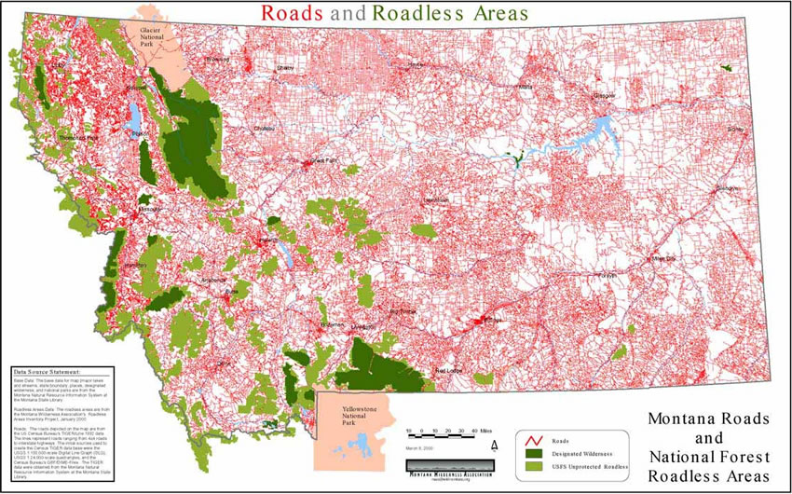
Undeveloped – “…in contrast with those areas where man and his works dominate the landscape...”
Notes:
One other way to view this is to recognize the contrast between undeveloped wilderness lands and all other lands shown here by this example of roads in Montana.

Slide 21
Section 2 (c)
A wilderness, … is hereby recognized as an area where the earth and its community of life are untrammeled by man, …
Definition of wilderness - Untrammeled
Notes:
The second quality is ‘untrammeled. And, it tells us that wilderness is a place where we are not to ‘trammel’ the earth and the naturally functioning ecosystems.

Slide 22
Section 2 (c)
A wilderness, … is hereby recognized as an area where the earth and its community of life are untrammeled by man, …
Definition of wilderness - Untrammeled
Notes:
So, what does ‘untrammeled’ mean?

Slide 23
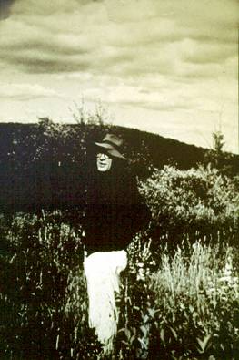
“The word ‘untrammeled’ is one that came into use in this definition after dissatisfaction with almost every other word that had been suggested.” -Howard Zahniser Author of The Wilderness Act
Notes:
Looking back through the hearings and congressional records it is clear that the author and many others wrestled with finding just the right word to help define what wilderness is. In fact members of Congress strongly suggested that a more commonly understood word be substituted but no other word could be found that held the same meaning as untrammeled.

Slide 24
Untrammeled?
Notes:
Any guesses as to what untrammeled means?

Slide 25
Untrampled ?
Notes:
It does not mean untrampled.
Most all lands in this country could be considered ‘trampled’ by some human at some time.

Slide 26
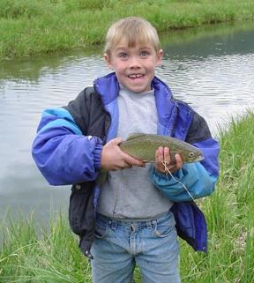
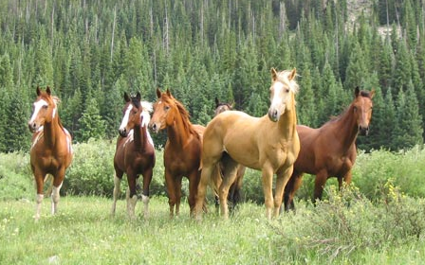
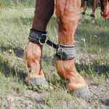
Trammel
Noun: A net for catching birds or fish; a shackle for making a horse amble
Verb: to catch or hold in or as if in a net; to prevent or impede the free play of
Notes:
26
The dictionary definition has to do with fishing nets and horses.

Slide 27
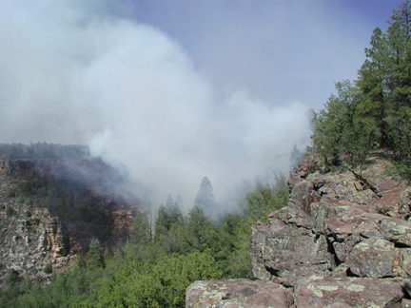
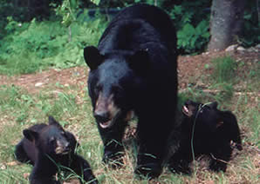
Untrammeled “Not being subject to human controls and manipulations that hinder the free play of natural forces.” - Howard Zahniser
Untrammeled = Unhindered, Uncontrolled, Un-manipulated
Wildness is what sets wilderness apart from other lands that are more developed or controlled.
Notes:
As we use ‘untrammeled in the wilderness definition and in wilderness stewardship it means that we do not control the forces of nature in wilderness and that we are to strive to avoid manipulation.
Untrammeled can be thought of as wildness or lands without human control of manipulation.

Slide 28
Section 2 (c)
“A Wilderness, in contrast with those areas where man and his works dominate the landscape, is hereby recognized as an area where the earth and its community of life are untrammeled by man, where man himself is a visitor who does not remain.”
Natural conditions and processes are essentially unhindered and free from modern human control or manipulation
Notes:
The untrammeled quality of wilderness character as defined in the Act.

Slide 29
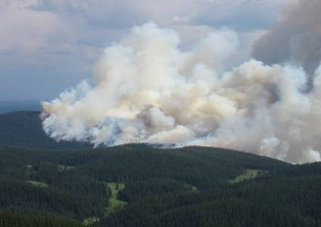
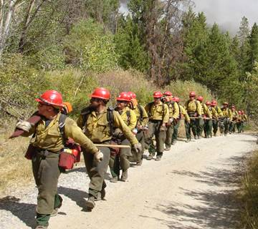
MANAGING for the QUALITIES OF WILDERNESS CHARACTER
“Untrammeled”
Wilderness is generally unhindered and free from intentional modern human control or manipulation
Wilderness setting
Threat to this setting
(suppression)
Notes:
29
Untrammeled as a quality of wilderness character describes whether the wilderness condition being intentionally manipulated or controlled by intentional actions of humans?
Ideally we would not suppress fires in fire dependent wilderness ecosystems. Every time we do suppress fires, even for good reason, we are manipulating the natural processes and conditions. If we attempt to correct this situation by lighting prescribed fires, even for restoration of natural conditions, we are again manipulating the ecosystem. These actions are sometimes necessary so our job is to minimize the actions and the effects of these actions.
Other examples might include pre-suppression activities such as thinning, wildlife water developments, putting lime in streams to reduce the effects of acid rain, etc.

Slide 30
Section 2 (c)
An area of wilderness …which is protected and managed so as to preserve its natural conditions…
Definition of wilderness - Natural
Notes:
30
The main elements of the definition of the Natural quality of wilderness character are:
-Protect and manage natural conditions to meet the goal of natural conditions.

Slide 31
Section 2 (c)
An area of wilderness …which is protected and managed so as to preserve its natural conditions…
Definition of wilderness
Notes:
31
-Once the wilderness is designated it is protected and managed to allow natural conditions to exist and natural processes to function. Wilderness ‘management’ is not an oxymoron. Some actions will be required to allow natural processes to take place, preserve wilderness character and provide for the use and enjoyment of the area as wilderness.

Slide 32
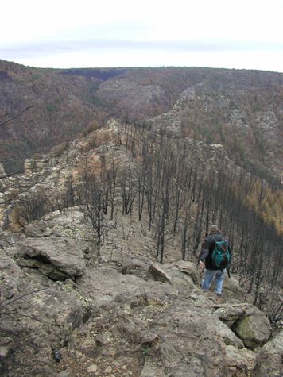
“…which is protected and managed so as to preserve its natural conditions…”
How should it look ? What is natural ?
Notes:
32
Natural conditions are not static but forever changing due to the forces of nature. They are neither good nor bad, they just are.
Sometimes the appearance of natural conditions may not be as ‘pretty’ as our desired vision of wilderness.
Our job is to is to allow for, and not prevent, natural change which will be the natural condition.

Slide 33
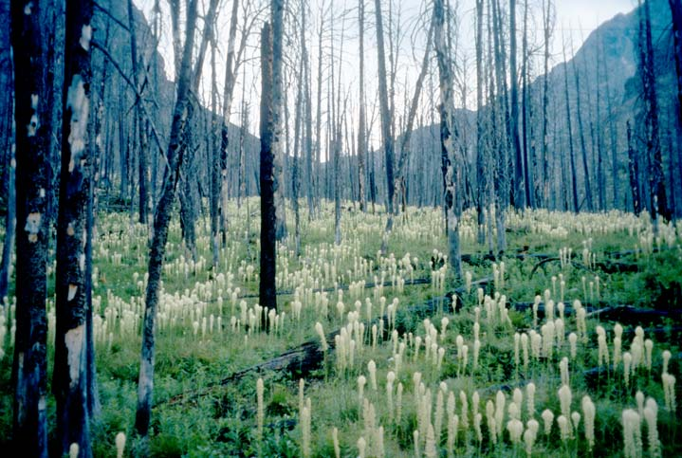
“Nature may not always be as beautiful as a garden but producing gardens is not the aim of the Wilderness Act.” - Federal Judge, 1975
Notes:
The courts have even reminded us of this when innappropriate actions have been proposed.

Slide 34
Section 2 (c)
“… preserve its natural conditions…”
Substantially free from the effects of modern civilization and manipulation by managers which result in unnatural conditions.
Management of wilderness - Natural
Notes:
For the Natural quality of wilderness character it is important to remember the goal for managing natural conditions

Slide 35
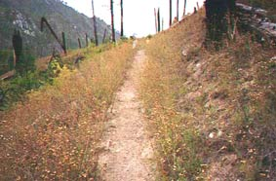
MANAGING for the QUALITIES OF WILDERNESS CHARACTER
“Natural”
Wilderness ecological systems are substantially free from the intentional and unintentional effects of modern civilization
Wilderness setting
Threat to this setting
(the weeds, not the trail)
Notes:
35
On the left is an example of a trail in wilderness which, by itself, is not a threat to the wilderness character.
But, if the trail serves as a vector for the introduction or spread of invasive species in wilderness than there is a threat to the preservation of character.
Other examples might include the loss of a native species such as predators, air quality related problems such as effects on lichen, or the effects of a downstream water diversion on upstream fisheries in wilderness.

Slide 36
Section 2 (c)
“…where the earth and its community of life are untrammeled by man,…”
“… preserve its natural conditions…”
Conflicting definition of wilderness ?
Notes:
How can we ‘manage’ wilderness to protect natural conditions if management can be a ‘trammeling’ of wilderness???

Slide 37
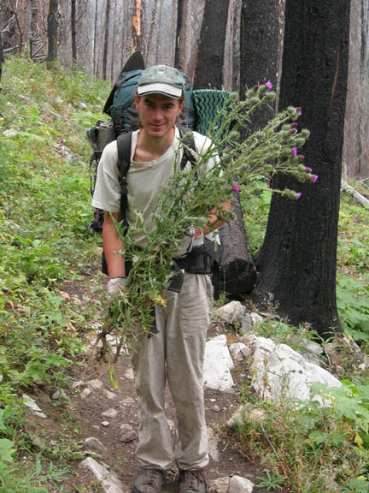
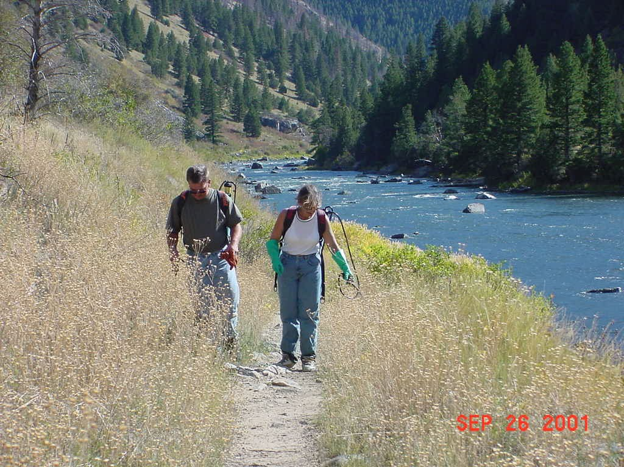
IMPLICATION:
A DECISION OR ACTION MAY IMPROVE ONE QUALITY WHILE DEGRADING ANOTHER QUALITY
Using herbicides to control exotic plants may improve the long term natural quality, but it degrades the short-term untrammeled quality
Notes:
This is simply the reality of wilderness stewardship, and we want to be intellectually honest about what we gain and what we lose in our decisions and actions. In this example, treating weeds improves the natural quality but it temporarily impacts the untrammeled quality because we are manipulating the natural conditions.
Photos, left to right: pulling weeds along a trail in the Selway Bitterroot Wilderness; spraying weeds in the Frank Church River of No Return Wilderness; bridge over Big Creek in Selway Bitterroot Wilderness.
For example, it’s common to hear the statement “By spraying herbicides we will have a more untrammeled wilderness.” Unfortunately, this statement is based on the misperception that getting rid of exotic invasive plants will allow the wilderness to be untrammeled, confusing the untrammeled quality with the natural quality. By using the four qualities, we acknowledge that spraying herbicides is an action that trammels the wilderness and may improve the natural quality.

Slide 38
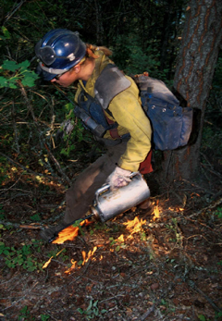
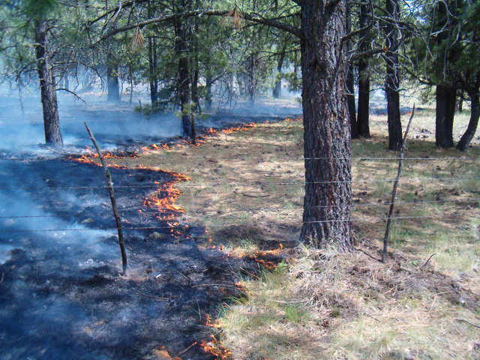
EXAMPLE:
A DECISION OR ACTION MAY IMPROVE ONE QUALITY WHILE DEGRADING ANOTHER QUALITY
Planned ignition (prescribed fire)
Natural - restores natural conditions
Untrammeled – manipulates conditions
Notes:
Another example – prescribed fire.

Slide 39
“…which is protected and managed so as to preserve its natural conditions…”
Goals for achieving naturalness?
Steward the natural conditions by not trammeling (hindering, manipulating, controlling) the natural processes
Relative naturalness will be the result
If necessary, to preserve wilderness character, restore natural conditions to reverse the adverse effects of human interference or to meet the intent of other laws.
Notes:
39
The most achievable goal for managing for natural conditions may be to achieve naturalness by removing human controls of natural processes and restoring natural conditions, if necessary, to mitigate modern era human influences.
For the purposes of wilderness management policy and guidelines, the federal agencies have not determined established policy that defines which changes are within the HRV and, if so, represent the natural conditions that the Wilderness Act requires them to protect. Lacking clear direction, managers are left to determine if action is necessary to introduce, maintain, or protect a component of the wilderness ecosystem that, up until now, was not considered natural or native. For example, there have been proposals to stock species of fish, that are not-native or indigenous to a particular wilderness, in high elevation lakes with abundant cool water in order to prevent an expected decline in their population due to climate change.
In order to meet the intent of the Wilderness Act and address the tension between the untrammeled and natural qualities ask yourself the following questions:
-Can the action be taken outside of designated wilderness?
-Is action necessary to meet the intent of another law (i.e. ESA)
-What are the consequences of no action?
-How likely is it that action will be successful?
-What are the potential adverse impacts, including unintended negative consequences?
-How frequently will action be necessary and over what period of time?
When policy and guidelines are developed by the federal agencies to address climate change and wilderness stewardship, they will be added to the Climate Change Toolbox (in development 2010) at: www.wilderness.net/toolboxes/

Slide 40
Section 2 (c)
… has outstanding opportunities for solitude or a primitive and unconfined type of recreation;
Definition of wilderness – Opportunities
Notes:
40
Criteria for management:
Opportunities for solitude OR primitive and unconfined recreation, but not necessarily both in the same place or at the same time or in all parts of every wilderness. Would this be possible in all areas? Probably not even in 1964..
The most common interpretation of this ‘OR’ statement would be as a ‘soft’ OR. The two terms are meant to be complimentary and not exclusive. It’s not meant to say ‘provide solitude OR provide something else’. Opportunities for both need to be identified and protected as appropriate for each wilderness.
But lands that provide either solitude or more popular opportunities for primitive recreation both qualify as wilderness.

Slide 41
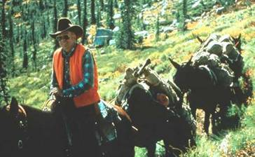
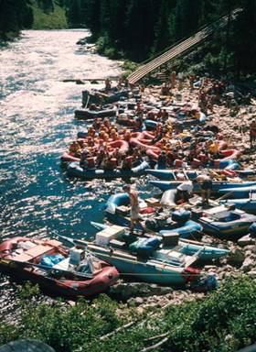
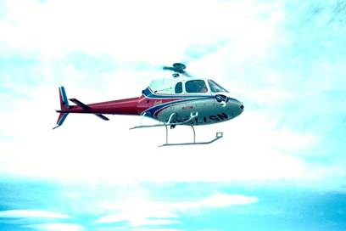
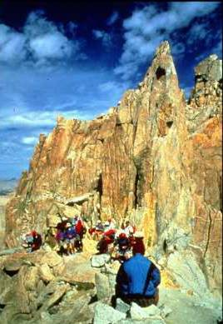
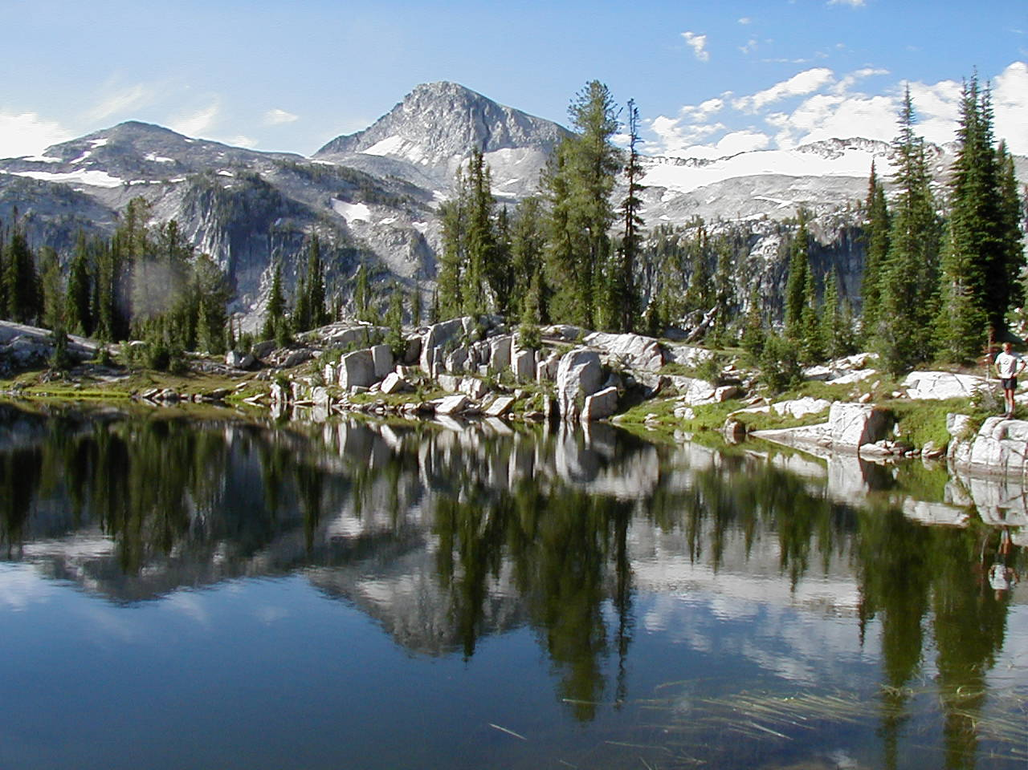
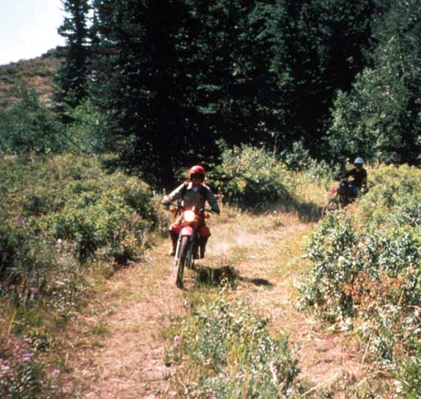
Photos
Notes:
41
Wilderness provides a variety of experiences in many different ways. The initial concept of Leopold was of wilderness so large it took two weeks to cross it with a pack train. The NWPS does offer outstanding opportunities for solitude but it also contains Mt. Whitney with lots of people, the Salmon River high use corridor, and even helicopter over-flights of wilderness, and areas where roads and trails formerly offered motorized recreation opportunities.
All of these use situations are part of the NWPS and fit within the definition of wilderness. However each wilderness has it’s own unique character and it doesn’t mean that every wilderness should have lots many more or far fewer number of visitors. The appropriate level of recreation opportunities or opportunities for solitude is correctly determined on a case by case basis for each wilderness.

Slide 42
Section 2 (c)
“… outstanding opportunities for solitude or a primitive and unconfined type of recreation .”
Biophysical and social settings not degraded by effects that reduce these opportunities (crowding, facilities, resource impacts, restrictions, etc.)
Definition of wilderness – Opportunities
Notes:
The quality of wilderness character is the ‘Outstanding Opportunities’ for wilderness visitor experiences that are not degraded by impacts of use or management.

Slide 43
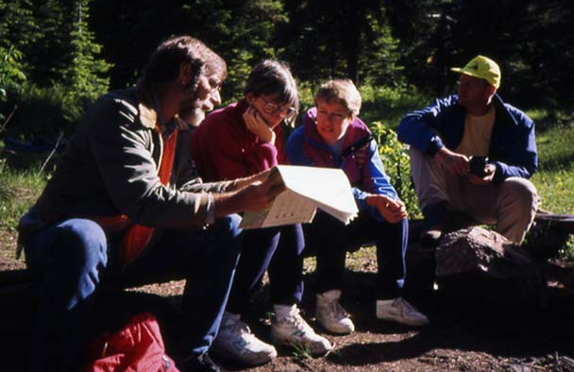
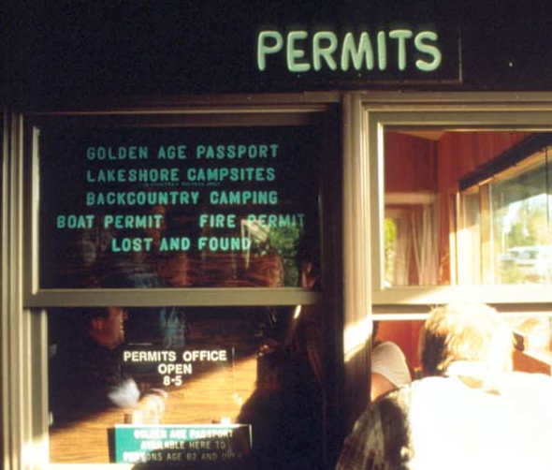
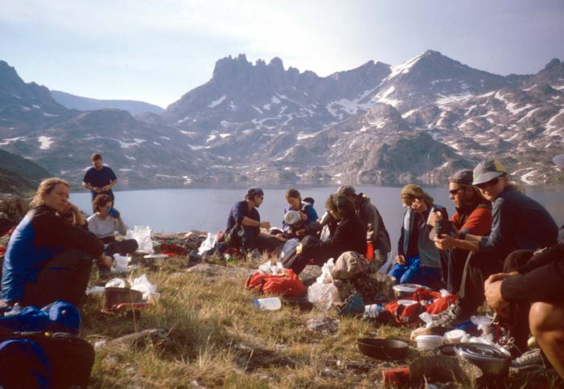
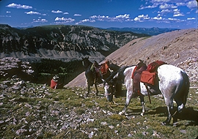
FOUR STATUTORY QUALITIES OF WILDERNESS CHARACTER
“Outstanding opportunities for solitude or a primitive and unconfined type of recreation”
Wilderness provides opportunities for wilderness experiences; remoteness, natural quiet, solitude, freedom, challenge, self-discovery and self-reliance.
Wilderness setting
Crowding Regulations
Potential threats to this setting
Notes:
43
Visitor use of wilderness, and the associated impacts on the biological and physical resources and the social experience of others can be a potential threat to wilderness character.
This quality of wilderness character can be demonstrated and measured in many ways. Examples might include the number of visits , the amount of area available to experience solitude such as trail-less areas more than ¼ mile from a trail, the recreation management system (permits, fees, fixed itineraries) and it’s effects on visitor freedom, and the effects of the sights and sounds of civilization.

Slide 44
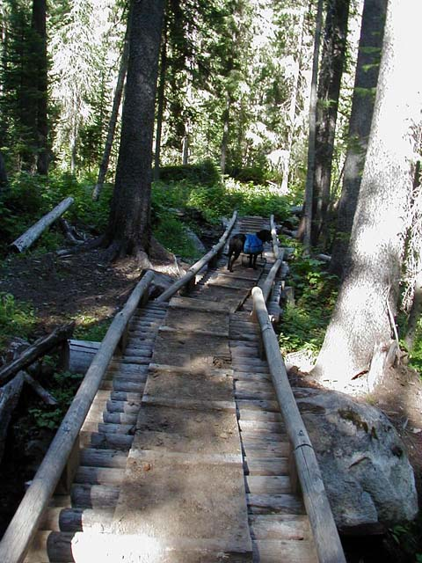
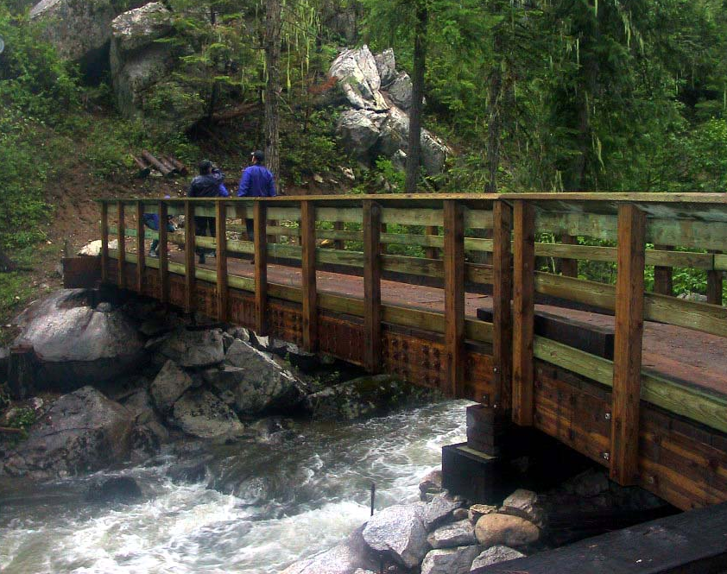
IMPLICATION:
A DECISION OR ACTION MAY IMPROVE ONE QUALITY WHILE DEGRADING ANOTHER QUALITY
Building a bridge to reduce site impacts at a stream crossing may improve the natural quality, and opportunities for primitive and unconfined type of recreation, …
...but the bridge degrades the undeveloped and solitude qualities
Notes:
Here again there may be conflicts in management for one quality of the other of wilderness character.
A rail bridge may be necessary and improve the ‘opportunities’ quality for primitive recreation , but the bridge is a development and degrades the ‘undeveloped’ quality while possibly allowing more people to visit the area and affecting the opportunities for solitude. All of these qualities should be considered in wilderness management decsisions.

Slide 45
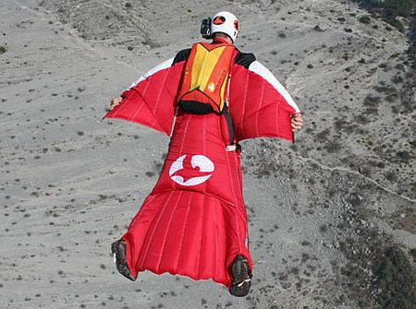
CHALLENGES:
Does a NEW type of recreation activity meet the definition of “a primitive and unconfined type of recreation” ???
Snow-Kiting
Winged Suits

Slide 46
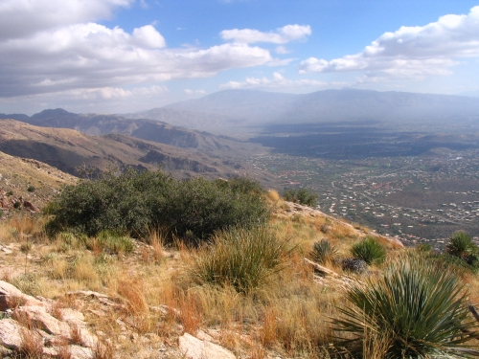
The FIFTH Quality: Unique qualities of wilderness character can be identified for each wilderness area?
Defining the specific qualities of wilderness character helps describe the desired condition and determine management objectives.
Helps define the ‘niche’ for each wilderness
Pusch Ridge Wilderness

Slide 47
Section 2 (c)
“…may also contain ecological, geological, or other features of scientific, educational, scenic, or historical value.”
The unique values of each area should be identified and must be protected, but always in a wilderness context
Definition and criteria for additions to the wilderness system
Notes:
The fifth or unique quality of wilderness character defined for each area is part of the values of wilderness that will be different for each area.
Identifying these values is part of management of designated wilderness areas and part of identifying areas for additional wilderness proposals.

Slide 48
What is the Primary Agency Responsibility for Stewardship of Wilderness ?
“…provide for…the preservation of their wilderness character…” Section 2(a)
“…each agency administering any…wilderness shall be responsible for preserving the wilderness character…” Section 4(b)
“…administer…to preserve its wilderness character…” Section 4(b)
Notes:
A review.

Slide 49
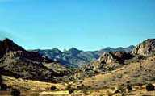
The importance of preserving wilderness character
Mandated by law:
“…each agency… shall be responsible for preserving the wilderness character of the area…”
Criteria for court decisions:
54 District Court
31 Circuit Court
Galiuro Wilderness
Notes:
The courts have had no difficulty in recognizing the mandate to preserve wilderness character.

Slide 50
Section 4 (d) – Special Provisions
AKA the non-conforming uses
Notes:
Lets’ move on to another key part of the definition and management of wilderness – Special Provisions.
These are also known as the ‘non-conforming uses’ in that hey don’t seem to fit with the definition of wilderness.

Slide 51
Section 4 (d) – Special Provisions
Use of aircraft or motorboats
…where these uses have already become established, may be permitted to continue subject to such restrictions as the Secretary … deems desirable
AKA the non-conforming uses
Notes:
Sec 4d allows for aircraft and motorboat use if previously established but it’s not an open door. Our role is to determine what is the minimum necessary and implement restrictions on this use where necessary.
The language of the law indicates room for analysis and determination. It’s ‘may’, not ‘shall’.

Slide 52
Section 4 (d) – Special Provisions
such measures may be taken as may be necessary in the control of fire, insects and diseases, subject to such conditions as the Secretary deems desirable.
Notes:
This part of the Act directs how we manage fire in wilderness and can apply techniques that don’t necessitate all out suppression. Actions may be taken as may be necessary. It does not say that action must or shall always be taken.

Slide 53
Section 4 (d) – Special Provisions
such measures may be taken as may be necessary in the control of fire, insects and diseases, subject to such conditions as the Secretary deems desirable.
Notes:
Sec 4d treats fire, insect and disease outbreaks (includes invasive plant species) the same way. It’s a ‘may’ not a ‘shall’ and therefore our job is to determine what is necessary and take management action if appropriate.
The insect and disease provision was originally inserted to guard against fire and insect and disease outbreaks coming out of the wilderness and affecting adjacent commercial timber lands. Today we are also concerned with treatment of Non-native Invasive Species (weeds) in wilderness but we reply on the ‘shall be managed and protected in their natural condition’ and the ‘so as to preserve their wilderness character’ provisions to take action against weeds.

Slide 54
Section 4 (d) – Special Provisions
Fish and wildlife management
Nothing in the Act shall be construed as affecting the jurisdiction or responsibilities of the several states with respect to wildlife and fish in the national forests.
Not changed – a shared responsibility
Notes:
The provision for fish and wildlife management in wilderness indicates that the authorities for management of populations in wilderness that the states had before passage of The Wilderness Act remained the same.
However, this does not give the states exclusive authority for management of populations or habitat in wilderness. The federal government is charged with preservation of wilderness character and all actions in wilderness, including management of fish and wildlife, must be decided using that over-riding criteria , while meeting the state fish and wildlife objectives whenever feasible.

Slide 55
Section 4 (d) – Special Provisions
Mining activity-valid claims
Mineral prospecting
Water resources and developments (dams and ditches)
State water rights
Commercial grazing
Access to state and private lands
Notes:
Sec 4d contains the ‘Special Provisions’ that, while seeming to conflict with the overall purpose of wilderness, were allowed to continue, in part to insure passage of the law. In all cases our role is to determine what type of access or activity is the minimum necessary and balance the right or privilege with the wilderness purposes.
Mining on valid claims OK, within reasonable restrictions
Mineral prospecting till 1984 (or later date established by subsequent Act)
Water impoundments and ditches can remain and be maintained
Grazing where previously established can continue
State water rights still apply

Slide 56
Section 4 (d) – Special Provisions
Commercial services
…may be performed within.. Wilderness… to the extent necessary for activities which are proper for realizing the recreational or other wilderness purposes of the area.
Notes:
The provision for outfitters and guides to operate in wilderness is recognized as legitimate but it is not automatic and is not a right. Wilderness managers need to assess the need and ‘extent necessary’ for wilderness dependent services and permit those that satisfy the intent of the law. Public demand or a potential business opportunity does not equal the ‘right’ to a permit.

Slide 57
Section 4 (d) – Special Provisions
Commercial services
…may be performed within.. Wilderness… to the extent necessary for activities which are proper for realizing the recreational or other wilderness purposes of the area.
Assess need and determine capacity
Notes:
The provision for outfitters and guides to operate in wilderness is specific to certain activities that depend on a wilderness setting and are ‘proper’ to utilize the ‘opportunities for solitude or a primitive and unconfined type of recreation’. Or other purposes.
Other purposes could include support of the scientific, educational or other public purposes of wilderness.

Slide 58
Section 4 (c) – Prohibited Uses
“Except as specifically provided for in this Act, and subject to existing private rights, there shall be no commercial enterprise and no permanent road within any wilderness area…”
Commercial Enterprise:
Lodges, resorts, restaurants, tourist shops, etc.
Notes:
The prohibition on commercial enterprise is different than the 4c prohibition on ‘commercial enterprises’. Hot dog stands or lodges are not necessary for wilderness dependent activities.

Slide 59
Section 4 (c) – Prohibited Uses
- no temporary road
- no use of motor vehicles, motorized equipment or motorboats
- no landing of aircraft
- no form of mechanical transport
- no structure or installation
Notes:
Section 4 (c) specifies certain things that wilderness managers cannot do. These are known as the ‘prohibited uses.
But of course it is not black and white and there are exceptions.

Slide 60
Section 4 (c) – Prohibited Uses
EXCEPT
as necessary to meet minimum requirements for the administration of the area for the purpose of this Act (including measures equired in emergencies involving the health and safety of persons within the area)…
Notes:
The exception is pretty clearly stated and includes specific mention of exceptions related to search and rescue measures.

Slide 61
Section 4 (c) – Prohibited Uses
EXCEPT
as necessary to meet minimum requirements for the administration of the area for the purpose of this Act
Notes:
The exception is only for administration of the area as wilderness. These are management actions, not public uses, and must be for the purposes of preserving wilderness character.

Slide 62
Section 2 (c)
… generally appears to have been affected primarily by the forces of nature, with the imprint of man’s work substantially unnoticeable;
Definition and criteria for additions to the wilderness system
Notes:
62
Another part of the definition of wilderness in the Act applies to both how we manage wilderness as well as how we select lands for possible additions to the wilderness system. The criteria are general.

Slide 63
Section 2 (c)
… generally appears to have been affected primarily by the forces of nature, with the imprint of man’s work substantially unnoticeable;
Definition and criteria for additions to the wilderness system
Notes:
63
The forest planning inventory and evaluation process determines whether lands meet this criteria.

Slide 64
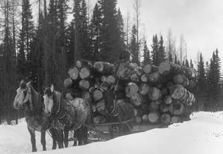
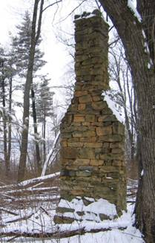
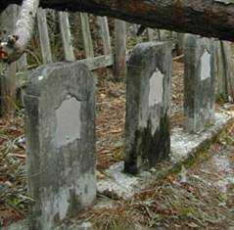
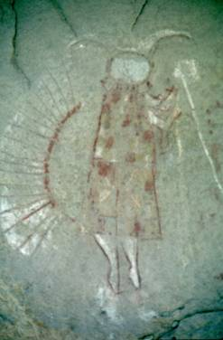
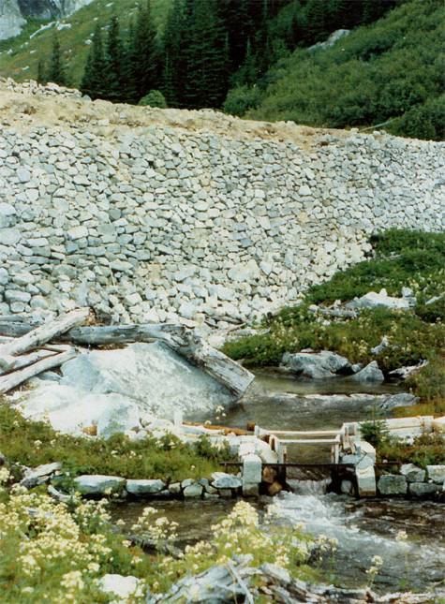
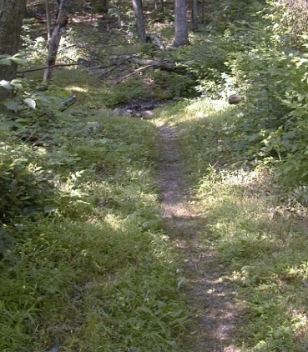
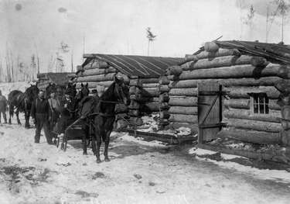
Examples of previous human development
included in wilderness:
Logging
Mining
Grazing
Roads
Farms and homesteads
Cemeteries
Dams and water diversion structures
Notes:
Often lands proposed for wilderness contain evidence of previous human use and occupation.

Slide 65
How can this be wilderness?
The law allows for:
Special provisions that may allow mining, water developments, commercial grazing, access to private lands?
Exceptions for use of motor vehicles, motorized equipment, structures, installations?

Slide 66
Section 4 (b)
“Except as otherwise provided in this Act, wilderness areas shall be devoted to the public purposes of recreational, scenic, scientific, educational, conservation, and historical use.
The public purposes
Notes:
One explanation is the ‘public purposes’ of wilderness which help define what wilderness is by law.
A key criteria used to manage wilderness is to keep in mind the need to screen possible management activities to determine if they conform to the public purposes of wilderness. Of course not all purposes are achievable in all areas of all wildernesses at all times but this where we get direction for stewardship of things like the wilderness dependent scientific opportunities and heritage resources.

Slide 67
Section 4 (b)
“Except as otherwise provided in this Act, wilderness areas shall be devoted to the public purposes of recreational, scenic, scientific, educational, conservation, and historical use.
The public purposes
Notes:
The ‘public purposes’ have to do with direct benefits of wilderness to all of us and are different from the purpose of the Act. Also, look at this entire sentence. The phrase ‘otherwise provided in this Act’ refers to the mandates to protect natural conditions and preserve wilderness character as will as outstanding opportunities for solitude or a primitive and unconfined type of recreation and to special provisions, even if they are not in conformance with the purpose of the Act. Example – motorized access to a water development, may be allowed by law, but would be managed to preserve wilderness character as much as possible.
Examples of how this is applied is that historical use is different from grand-fathered use. A historic cabin may have been used by those trappers before the area became wilderness but that doesn’t mean it must be restored and made available for use by current wilderness visitors. Historical use has more to do with the traditional methods of access that were in context in 1964: walking, riding horses, skiing and paddling.
Likewise, the scientific purpose of wilderness is important but it doesn’t mean that use of a helicopter to access inventory plots is always justified. The scenic purpose doesn’t mean suppress all fires and education doesn’t mean interpretive signs inside wilderness.

Slide 68
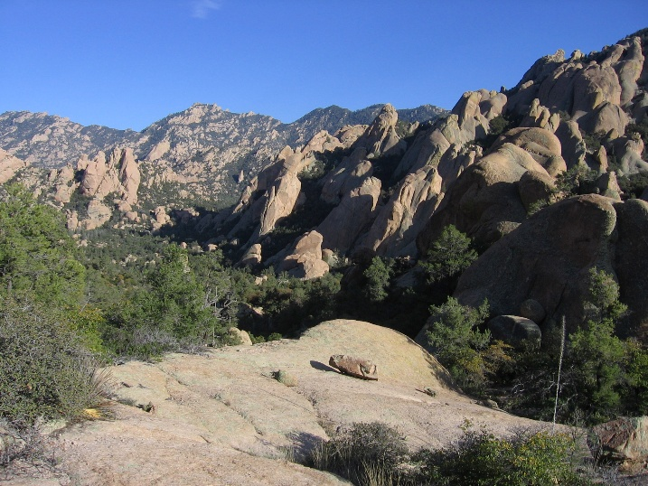
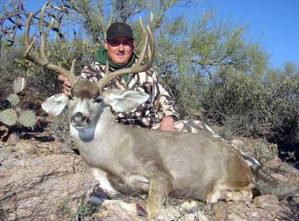
Public Purposes “recreational, scenic, scientific, educational, conservation, and historical use.”
Public lands and uses
Public rights and privileges
Public involvement and communication
Local custom, culture, and tradition
Notes:
These public purposes are critically important to keep in mind, especially during planning processes. How does the wilderness support or enhance the local custom, culture or traditions?
These are public lands, and designated for public use.
There sometimes are public rights (mining, private lands) and public privileges (grazing) involved
It is always important to insure public involvement and communication regarding wilderness management. ‘It’s a teachable moment’ for wilderness.
Consider how wilderness is a part of the local custom, culture, and tradition of the community. Is it’s a place to “hunt and fish and mess around” as Ed Abbey said? Is it one of the reasons the families have stayed in the area for multiple generations?

Slide 69
A Wilderness Stewarsdhip Model
Adapted from: FSM 2320.6
Pristine - Absolute wilderness
Definition of wilderness
Management effort
Wilderness ‘X’ at time of designation
Wilderness Character
Management effort
0
Human Use, Trammeling and Development
Notes:
69
Wilderness Management Principles tell us that in order to achieve ‘absolute wilderness’ (a pristine condition) we would likely not be able to allow any use or human influence because all uses cause some type of impact, even if it is imperceptible.
Our job, as defined by law and policy, is not to achieve absolute wilderness but rather to insure we manage it so that conditions do not degrade below what they were at time of designation.
If our wilderness is below the minimum legal standard, at time of designation or because of human influences, that it will take our management effort to move the condition of the wilderness up the scale.
Is this trammeling? Maybe but it may be necessary to restore natural conditions. There may be some management action that is justified in some areas to restore natural conditions or reduce the past influences or improvements caused by humans.

