Slide 1
FS Resources
This file is part of the FS Resources section at: http://www.wilderness.net/fs/
This presentation should be reviewed and revised as needed to match the local training objectives and target audience and local images should be inserted where needed.
The Wilderness Act training presentations are posted in parts which may be combined or used separately as needed:
  History and Purpose of the Wilderness Act
  National Wilderness Preservation System
  Values and Benefits
  Definitions and Management
  Other Laws
  Stewardship Principles
  Court Decisions
  FS Policy
  More Information

Slide 2
Arthur Carhart National Wilderness Training Center
Notes:
2
This presentation is a product of the Carhart Wilderness Training Center
Suggestions for corrections and updates are welcome. Contact: tcarlson@fs.fed.us

Slide 3
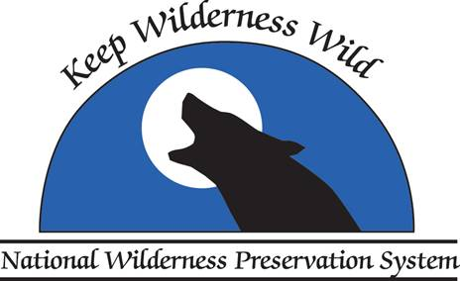
History and Purpose of the Wilderness Act
“for the permanent good of the whole people, and for other purposes.”
Location
Date
Notes:
3

Slide 4
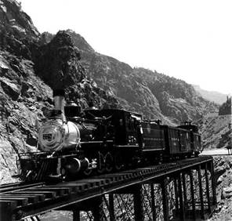
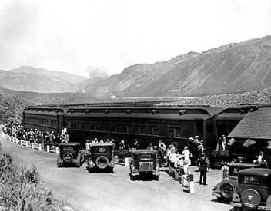
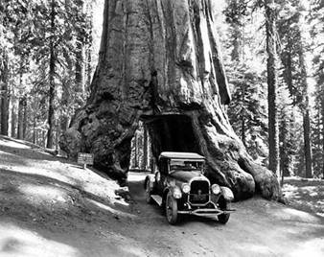
The Wilderness Movement
1920-1960: Era of Development
Notes:
4
America had become accustomed to exploring the ‘wilderness’ by train and car and lots of road development and tourist facilities were being constructed, especially in the national parks.
The huge threat of expanding civilization and mechanization that the auto made possible became a major motivation for the wilderness movement and eventually the main purpose of the Wilderness Act.
Good read on this subject: Driven Wild, Paul Sutter

Slide 5
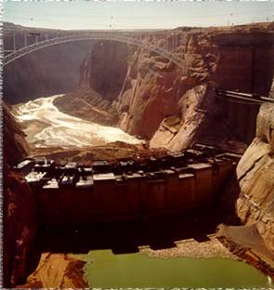
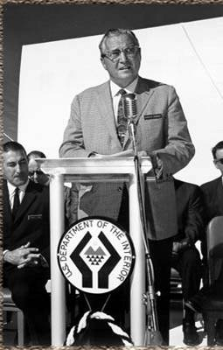
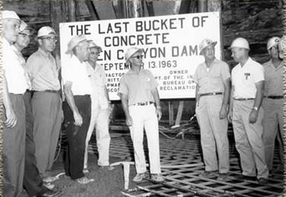
The Wilderness Movement
1920-1960: Era of Development
Glen Canyon Dam
under construction
1962
Floyd Dominy, Commissioner
Bureau of Reclamation
Notes:
Much of the concern for protecting wildlands came about because of dam building in the west.

Slide 6
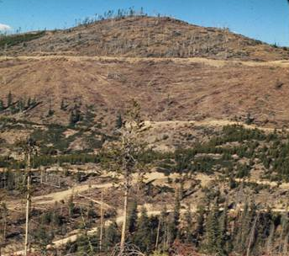
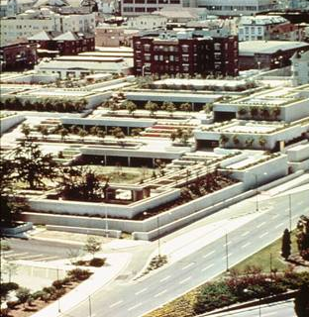
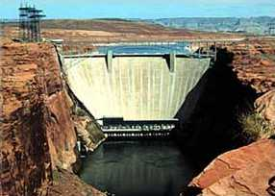
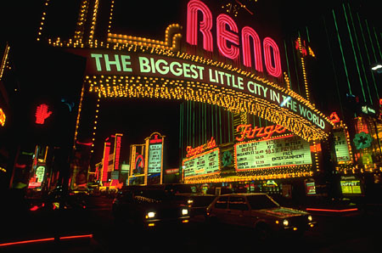
Photos
Notes:
6
The uses of the public lands in the 1950s and ‘60s were seen to focus primarily on the need for the natural resources of lumber for buildings, minerals for construction and manufacturing, and hydro. power for the expanding electricity demands of civilization.
The dominant view of Forest Service leadership at the time was that this was what multiple use management meant but many also supported the notion of managing some lands as wilderness.

Slide 7
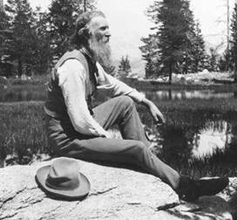
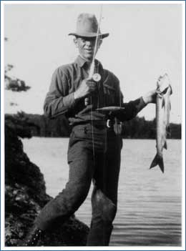
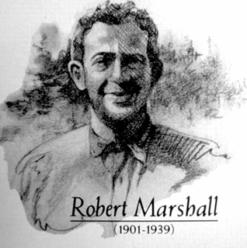
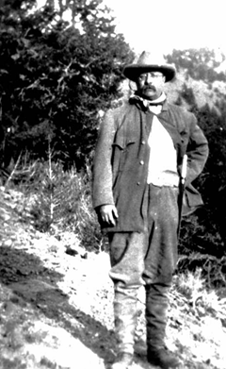
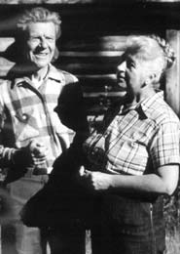
Muir, Leopold, Marshall, Murie, Roosevelt
John Muir
Aldo Leopold
Olaus and Mardy Murie
Teddy Roosevelt
Notes:
7
The Wilderness movement had many contributors and heroes and it did not begin overnight. In their own way all of these people contributed to getting the concept of preservation of wild lands off the ground.
John Muir’s writings inspired many to take a passionate stance for preservation of wilderness. Later he helped found the Sierra Club.
Olaus and Mardie Murie were pioneers in working for protection of wild lands in Alaska. Olaus later became a director of the Wilderness Society after moving to Moose, Wyoming. Mardie Murie remained active in the effort to protect wildlands, especially ANWR until here death in early 2004.
Bob Marshall worked for both the Bureau of Indian Affairs and the Forest Service. In both agencies he persuaded others, including leadership to move forward in the efforts to preserve more wildlands. He was the principle founder of the Wilderness Society.
Aldo Leopold was a FS employees who began thinking of land stewardship as an entire ecosystem concept and championed the necessity of setting aside some lands for purposes other than resource extraction. He saw wilderness as a fundamental human need as essen tial as more resource oriented activities such as the need for wood, coal, or fiber production.
Teddy Roosevelt was an enthusiastic outdoorsman who traveled to hunt, fish and camp in the backcountry. He also was instrumental in helping to expand the national forest system.

Slide 8
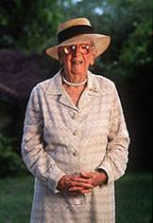
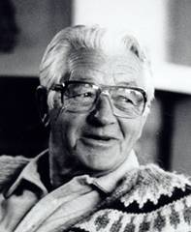

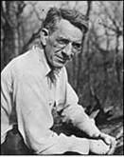
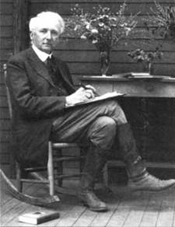
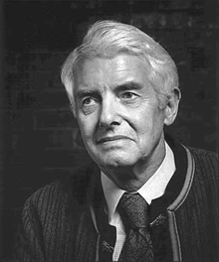
Douglas, Olson, Stegner, Mackaye,Yard, Brower
Marjory Stoneman Douglas
Wallace Stegner
Benton MacKaye
Sigurd Olson
David Brower
Robert Sterling Yard
Notes:
8
David Brower was the first Executive Director of the Sierra Club and helped lead the fight against the dam in Dinosaur National Monument and for passage of The Wilderness Act.
Sigurd Olson was instrumental in linking science to wilderness. He was an ecologist for the Izaak Walton League President of the National Parks Association and an advisor to the NPS and Secretary of the Interior. Helped establish a number of national parks, seashores, and wilderness areas.
Robert Sterling Yard was involved with the beginnings of the NPS and the National Parks Association and was one of the founders of the Wilderness Society and its first president.
Wallace Stegner, a writer, campaigned vigorously during the Kennedy administration for passage of the Wilderness Act
Marjory Stoneman Douglas, the Mother of the Everglades, wrote and campaigned for establishment of Everglades National Park. A wilderness was established in her name in 1978.
Benton MacKaye advocated against the uncontrolled urbanization and a network of wildlands, which became the NWPS. His vision of a wilderness pathway in the east became the Appalachian Trail.
Other wilderness pioneers include Ansel Adams, Stewart Brandborg, Frank Church, Ernie Dickerman, William O. Douglas, Celia Hunter, Robert . For more information go to: http://www.wilderness.nps.gov/toolbox21.cfm and find the Background Section of the Wilderness Education and interpretation Resource Notebook in Celebrate Wilderness.

Slide 9
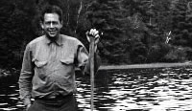
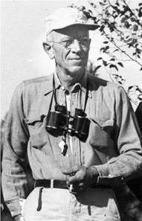
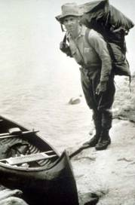
Wilderness Leaders in the Forest Service
Bob Marshall
Aldo Leopold
Arthur Carhart
Notes:
Three FS employees were major contributors to the wilderness movement.
Bob Marshall helped write and implement some of the first administrative protections for wilderness lands.
Aldo Leopold recognized the importance of naturally functioning ecosystems found in wild lands.
Arthur Carhart worked on both the Superior NF and the White River NFs in the early 1900s and appreciated the value of undeveloped lands.

Slide 10
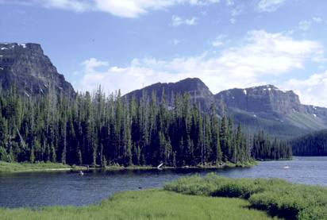
Arthur Carhart letter
“There is a limit to the number of lands of shoreline on the lakes;
there is a limit to the number of lakes in existence;
there is a limit to the mountainous areas of the world, and there are portions of natural scenic beauty which are God-made and which of a right should be the property of all people.”
- Arthur Carhart letter to Aldo Leopold, 1919
Notes:
10
Carhart’s role is in the origins of the concept of land management for purposes other than development.
Carhart had been sent to the Trappers Lake area in CO to lay our roads and summer home tracts. He resisted this assignment on the premise that not all lands need to be developed and talked with the Regional Forester, Aldo Leopold.
Leopold asked Carhart to reduce in writing some of the salient points of their conversation. The 4 page memo that Carhart wrote is the first federal document to capture the concept of wilderness. Carhart wrote this in a letter to Aldo Leopold who was then the Regional Forester for the southwest region of the FS.

Slide 11
FS ‘Wilderness’ Management
- Administrative Designations -
1929 L-20 Regulation:
55 million acres, 72 areas, identified for ‘protection’ as Primitive Areas
Logging, grazing, mining, road construction allowed in many areas
Temporary measure to control haphazard development
1939 U Regulations (formulated by Bob Marshall)
Wilderness, wild, and road-less areas
Logging, road construction, summer homes and mechanized access prohibited
Grazing, mining, and water developments allowed
Permanent designation intended
Notes:
Prior to the Wilderness Act the FS had attempted to administratively designate lands for some level of protection. Because these designations were not permanent they could be changed by the next adminsistration.

Slide 12
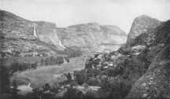
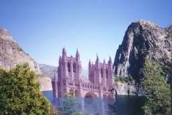
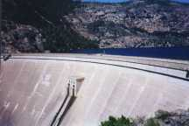
Hetch Hetchy Valley
Yosemite National Park
"Dam Hetch Hetchy! As well dam for water-tanks the people's cathedrals and churches, for no holier temple has ever been consecrated by the heart of man."
-- John Muir
1926
Notes:
About this same time their were other concerns about development sin national parks, such as the Hetch Hetchy area in Yosemite. The conservationists lost this battle and the dam was built but the movement became much stronger because of it.

Slide 13
Western Issues - Dam Construction Projects
The Wilderness Movement – 1900-1964
Upper Colorado River Storage Project
– national political issue
5 major dams planned or approved
Eastern Land Conservation Issues
  Appalachian Trail
  Everglades
  Shenandoah National Park developments
Notes:
The wilderness movement gained momentum due to a variety of issues both east and west. In one way or another wild lands or national parks were threatened by development.

Slide 14
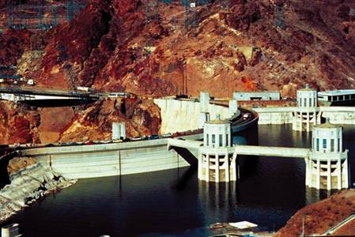
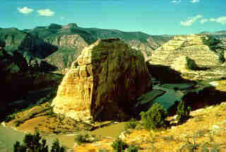
Steamboat Rock at Echo Park
1956 Dam Proposal
Dinosaur National Monument
National Park Service
Utah and Colorado
Notes:
14
This is Steamboat Rock in Dinosaur National Monument. – When the Bureau of Rec. proposed damming the Green River to build a hydro. Power dam on this site, inside a unit of the National Park system, the wilderness movement, then led by people like Howard Zahniser and the Wilderness Society, got organized and got the attention of Congress and mainstream America. The very fact that the federal agencies would consider building another dam inside what was supposed to be lands protected in their natural condition inside a national monument supported the need for a law to permanently protect wildlands.
Slides 2 and 3 – It took five years of debate, much public information, and many lobbying efforts but eventually a bipartisan group in Congress gathered enough votes to defeat the dam proposal. The stage was set for an even greater effort to protect wildlands across the country. The movement felt empowered and became better organized.

Slide 15
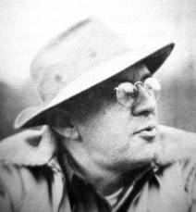
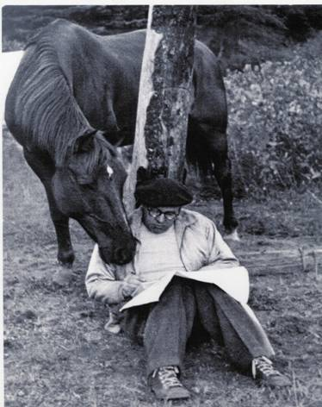
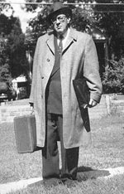
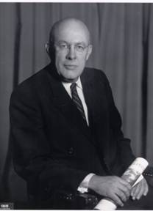
Howard Zahniser 1906-1964
The Principal Author of The Wilderness Act
Notes:
Howard Zahniser was the principal author of The Wilderness Act and labored tirelessly to lobby congress and others for it’s passage.

Slide 16
Making Wilderness by Law
These key issues led to compromises and the Special Provisions contained in The Wilderness Act of 1964:
Need for resources (timber, grazing, minerals, water)
Water developments and water rights
Access to state and private lands
States rights (fish and wildlife management)
Fire and insect and disease ‘control’
Temporary vs. permanent designation
Administrative vs. legislative authority for designation of lands as wilderness

Slide 17
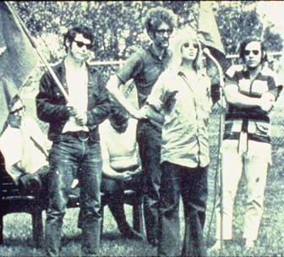
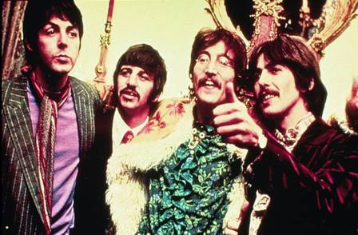
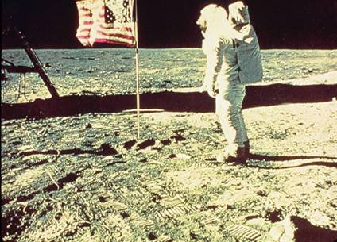
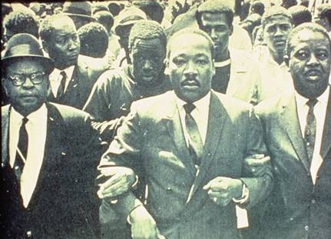
Photos
Notes:
17
When the idea of wilderness was first being developed in the late 1950s and early 1960s America was in a different time and the majority of Americans were more concerned with other issues, needs, and interests.
Designating lands as wilderness was not at the top of most peoples issues list, including Congress.

Slide 18
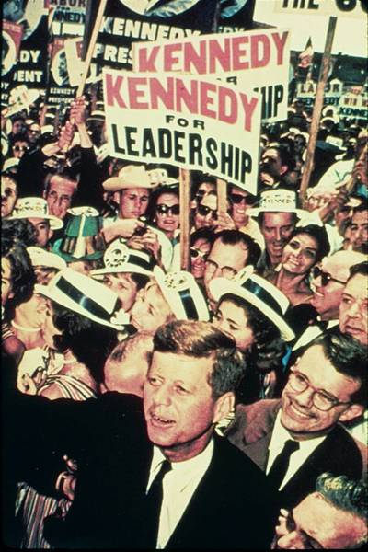
President Kennedy
“It is our task in our time and in our generation, to hand down undiminished to those who come after us, as was handed down to us by those who came before, the natural wealth and beauty which is ours.”
Senator John F. Kennedy
Notes:
18
President Kennedy was the first president to include the idea of a law to protect lands as wilderness in his campaign platform and later advocate for and support wilderness legislation.

Slide 19
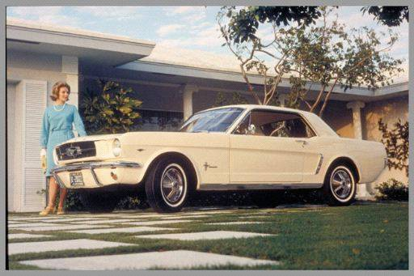
What was the most significant event of 1964?
1964 Ford Mustang
Notes:
Just a little humor.

Slide 20
The Wilderness Act of 1964
PL 88-577
COMPLETE TEXT OF THE WILDERNESS ACT
Public Law 88-577 (16 U.S. C. 1131-1136)
88th Congress, Second Session
September 3, 1964
A N A C T
To establish a National Wilderness Preservation System for the permanent good of the whole people, and for other purposes.
Be it enacted by the Senate and House of Representatives of the United States of America in Congress assembled.
SHORT TITLE
SECTION 1. This Act may be cited as the "Wilderness Act."
WILDERNESS SYSTEM ESTABLISHED STATEMENT OF POLICY
SECTION 2.(a) In order to assure that an increasing population, accompanied by expanding settlement and growing mechanization, does not occupy and modify all areas within the United States and its possessions, leaving no lands designated for preservation in their natural condition…
After 8 years of debate in Congress
66 different rewrites of the bill
18 public hearings that generated over 6,000 pages of testimony…
Notes:
20
Finally, after a tireless effort by the author, Howard Zahniser, and others the Wilderness Act became law.
This is no small thing. But the debate was never really about the overall goal – legal designation and protection for wilderness. The debates were about the need to recognize and allow for certain existing uses and also whether wilderness should be designated by an Act of Congress or by some administrative decision.
Lots of compromises were made, out of political necessity, to insure passage. These special provisions represent the most challenging issues for wilderness stewards today.

Slide 21
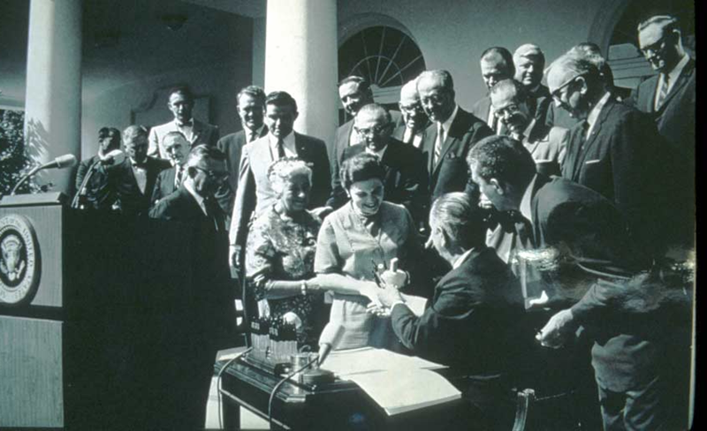
President Johnson signing The Wilderness Act on September 3, 1964
“If future generations are to remember us with gratitude rather than contempt, we must leave them more than the miracles of technology. We must leave them a glimpse of the world as it was in the beginning, not just after we got through with it.”
Notes:
21
The two women in the picture are Alice Zahniser (on right) widow of Howard who died 6 months before the final Act was signed, and Mardi Murie, widow of Olaus who was instrumental in protecting wildlands in Alaska.
Sadly, Mardi Murie recently passed away at the age of 103. She was still active in protecting ANWR and lived in Moose, WY.

Slide 22
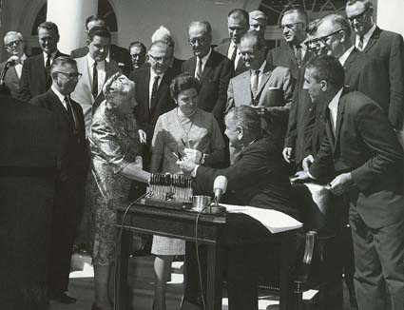
Final votes:
Senate 73 – 12
House 373 -1
Frank Church
Clinton P.
Anderson
John
Saylor
Wayne
Aspinall
Mardy
Murie
Alice
Zahniser
Stewart
Udall
President
Lyndon
Johnson
Notes:
The Wilderness Act was a bipartisan effort. The members of congress identified were some of the major supporters of the legislation.
Stewart Udall was President Johnson’s Secretary of Interior.
John Saylor was a Republican member of Congress from PA who supported including solitude as one of the many values of wilderness and introduced the first bill in the House.
Clinton Anderson was a republican Senator from New Mexico who was a major supporter of the wilderness bill but agreed with Congressional authority for designating lands as wilderness the special provisions to respect existing rights and uses of the lands.
Wayne Aspinall, Democrat member of the House from CO insisted that adding lands to the wilderness system be a legislative and not an administrative process.
Senator Frank Church, Democrat from Idaho, floor manager of the wilderness bill in the Senate, recognized the challenges of wilderness management without modern methods and tools and succeeded in including the minimum requirements language that allows exceptions for some use of motorized equipment and other non-conforming practices.

Slide 23
Title
An Act to establish a National Wilderness Preservation System for the permanent good of the whole people, and other purposes.
Notes:
As stated right up front in the Title, the challenge in creating the NWPS was in how to establish and manage a system of incredible diversity that already had a variety of uses in a country that is governed by the rule of law with existing individual and property rights and privileges being one of the key values.

Slide 24
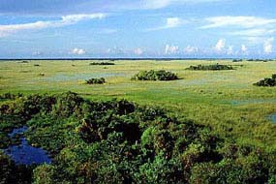
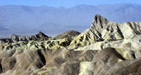
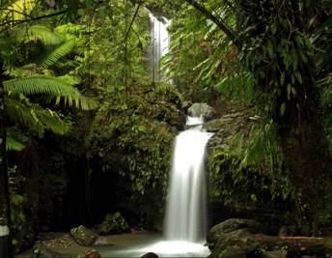
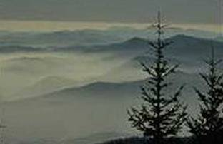
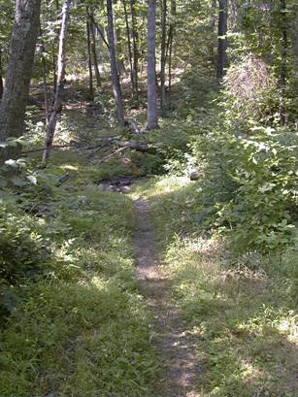
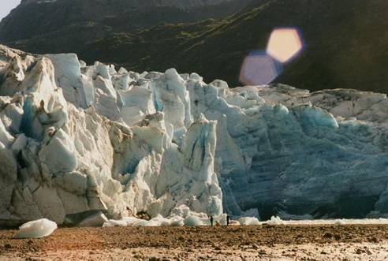
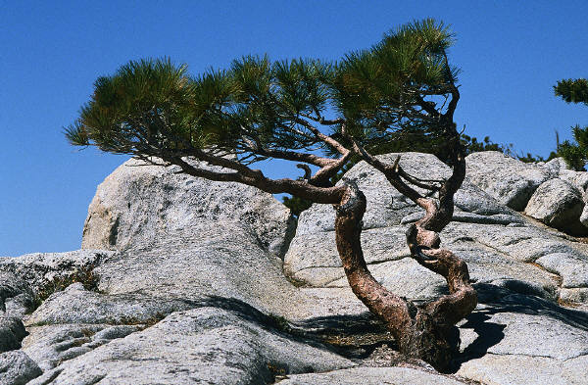
Photos
Notes:
24
Results of the ‘Act’ are protection of a diverse system of wilderness in virtually all ecosystems across the country.

Slide 25
The Wilderness Act:
Describes the purpose of wilderness
Creates the National Wilderness Preservation System
3. Defines “wilderness”
4. Establishes the process for designating wilderness areas
5. Sets provisions for the management and use of wilderness areas

Slide 26
Section 1
Short Title:
This Act may be cited as ‘The Wilderness Act.’
Notes:
The joke is that this is the only part of the Wilderness Act that everyone can agree on.

Slide 27
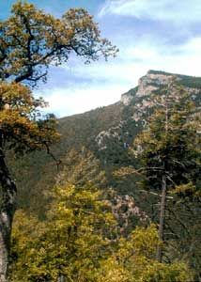
What is the purpose of wilderness, as described in the Wilderness Act of 1964?
Miller Peak Wilderness

Slide 28
Section 2 (a)
In order to assure that an increasing population, accompanied by expanding settlement and growing mechanization, does not occupy and modify all areas within the United States and its possessions,
The Purpose of the Wilderness Act
Notes:
Sec 2a states the ‘purpose of wilderness. The reason the NWPS was created was to counter the advancing civilization before all wildlands were gone. This is the main purpose for which wilderness was designated.

Slide 29
Section 2 (a)
In order to assure that an increasing population, accompanied by expanding settlement and growing mechanization, does not occupy and modify all areas within the United States and its possessions,
The Purpose of the Wilderness Act

Slide 30
Section 2 (a)
… leaving no lands designated for preservation and protection in their natural condition…
The Purpose of the Wilderness Act
Notes:
Included in the purpose is this key concept of preservation and protection of lands in their natural condition.
The effects of development and a mechanized modern society were slowed down and partially mitigated by designating a portion of the public lands to be permanently managed for their natural attributes.

Slide 31
Section 2 (a)
… it is hereby declared to be the policy of the Congress to secure for the American people of present and future generations the benefits of an enduring resource of wilderness.
The Purpose of the Wilderness Act
Notes:
In addition to countering development, another purpose was to look at wilderness in terms of the benefits that the wilderness resource provides over the long term. Lets look at this in a little more detail.

Slide 32
Section 2 (a)
… it is hereby declared to be the policy of the Congress to secure for the American people of present and future generations the benefits of an enduring resource of wilderness.
The Purpose of the Wilderness Act
Notes:
The Act uses the term “resource of wilderness” not “resources” of wilderness.

Slide 33







Resource of wilderness ???
physical/biological
emotional/social
Notes:
What is meant by the term ‘resource of wilderness’?
Though wilderness provides a number of values and components that make up the ‘resource’ it is important that we manage it as a whole and not favor any one value in our stewardship.
The wilderness concept is similar to the ecosystem concept or a piece of complex machinery like a car.
If one part or piece is removed it doesn’t function correctly.
If one component of wilderness is favored, others may be degraded.
Example – Favoring human use of biophysical protection to an extreme would impair the opposite component.
The resource of wilderness contains the biological, physical and social elements.

Slide 34
Section 2 (a)
… it is hereby declared to be the policy of the Congress to secure for the American people of present and future generations the benefits of an enduring resource of wilderness.
The Purpose of wilderness
Notes:
The rest of this statement concerns the ‘benefits’ of the resource of wilderness.

Slide 35






Benefits ???
Notes:
What are the benefits of wilderness?
There are a variety of benefits that the biological, physical, social components of the wilderness resource wilderness provides.
These benefits accrue to the American people whether they visit wilderness or not.

Slide 36
Section 2 (a)
… it is hereby declared to be the policy of the Congress to secure for the American people of present and future generations the benefits of an enduring resource of wilderness.
The Purpose of the Wilderness Act
Notes:
Finally we are reminded that wilderness is both for the present and the future.

Slide 37





Enduring for future generations
Notes:
Our stewardship needs to fully consider the long term cumulative effects and preservation of the resource of wilderness so that it is around for future generations to experience and benefit from, as wilderness.
There is a real tendency to make wilderness stewardship decisions based on short term needs (cost, efficiency, favor of one resource, politics, local pressures, etc.) and compromise long term benefits.

Slide 38
Section 4 (a)
Nothing in this Act shall … be in interference with the purpose for which the national forests are established as set forth in the Act of June 4, 1897 (The Organic Act) and the Multiple Use Sustained Yield Act of 1960.
Notes:
The Act specifies that wilderness is part of the national forest and not separate from it or in conflict with the purposes for which national forests are created as described in the Organic Act and the MUSY of 1960
(The MUSY of 1960 actually provides that the establishment and management of wilderness is consistent with management of the NF for multiple uses.)
For multiple use agencies like the BLM and FS, wilderness does not conflict with multiple use. The 1960 Multiple Use, Sustained Yield Act is referenced in the 1964 Wilderness Act and there is a statement of ‘no interference’. In 1976 the multiple use mission of the BLM was identified in Section 103c of FLPMA.

Slide 39
Section 4 (a)
The purposes of this Act are hereby declared to be within and supplemental to the purposes for which national forests and units of the national park and wildlife refuge systems are established and administered…
Notes:
The ‘purposes of the Act’, that is the wilderness purposes are to be ‘within and supplemental’ to the other purposes of the public lands. This means that wilderness objectives need to be met along with other objectives. Wilderness is not subordinate to other resource management objectives and we need to strive to carefully consider the need for administrative actions in wilderness in an interdisciplinary manner. Management of the areas as wilderness is an ADDITIONAL purpose of the forests, refuges, and parks (and later by FLPMA) the BLM areas. Wilderness should have a seat at the multiple use management table that is equal to the representation of other resource values found on public lands. This part of the Act is often critical to management decisions regarding wilderness projects.
Why designate part or all of a park or refuge as wilderness? For the parks it was to re-think recreation developments. For the refuges it was a change to emphasize natural conditions and the untrammeled nature of wilderness in contrast to controlling, manipulating, or modifying an area for the purpose of the refuge.

Slide 40

National Forest System
Ecosystem Management
Multiple Use Management
Timber, Mining, Grazing, Water, Wildlife,
Recreation, [and Wilderness] Resources
Designated wilderness is nearly 19% of all national forest lands.
Notes:
40
Within the National Forest System, wilderness represents one part of the spectrum of multiple use management.

Slide 41

National Forest System
Recreation Management
Wilderness
Developed
Recreation
Roaded
Natural
Semi-Primitive
motorized and
non-motorized
recreation
Notes:
41
Unfortunately due to the budgeting process and a misunderstanding of the primary purpose for wilderness it is often seen and managed only as part of the Recreation Program and the Recreation Opportunity Spectrum within the National Forest System.

Slide 42
National Forests
Ecosystem Management
Wilderness
Notes:
42
Wilderness, as its own RESOURCE, is actually by law, equal to all other multiple use resources for national forest management purposes.

Slide 43
National Forests
Ecosystem Management
Wilderness
Fire
Weeds
Air, soil, water,
fish and wildlife
Cultural Resources
Notes:
43
Wilderness is really on of many resources to be managed on the national forest.

