Slide 1
FS Resources
This file is part of the FS Resources section at: http://www.wilderness.net/fs/
This presentation should be reviewed and revised as needed to match the local training objectives and target audience and local images should be inserted where needed.
The Wilderness Act training presentations are posted in parts which may be combined or used separately as needed:
History and Purpose of the Wilderness Act
National Wilderness Preservation System
Values and Benefits
Definitions and Management
Other Laws
Stewardship Principles
Court Decisions
FS Policy
More Information

Slide 2
The National Wilderness Preservation System
Facts and Trends

Slide 3
Title
An Act to establish a National Wilderness Preservation System for the permanent good of the whole people, and other purposes.
Notes:
The Wilderness Act established the National Wilderness Preservation System (NWPS) to include federal lands designated as wilderness areas.

Slide 4
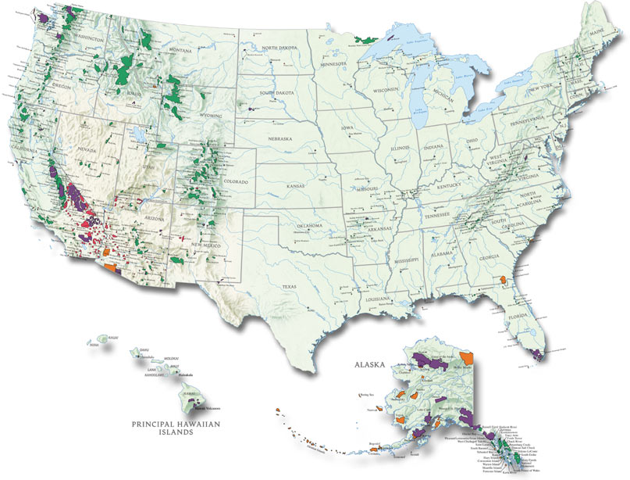
How much wilderness now?
Over 109 million acres, nation-wide managed by four federal agencies (BLM, FWS, FS, NPS)
Notes:
4
So, a few fun facts. How much wilderness exists in the entire NWPS now? (Started with 9.1 million acres in 1964)
Every president since Lyndon Johnson has signed legislation creating new wilderness. President Reagan signed more wilderness bills than any other president so far. Expansion of the system has continued despite changes in politics, values, and other priorities.

Slide 5
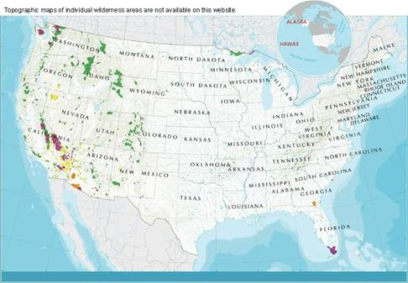
Wilderness Facts *
4.7% of all U.S. lands are designated as wilderness (2.2% outside Alaska)
6.1% of all lands (except Alaska) are ‘developed’ (roads, commercial and urban areas)
Acres of developed lands are increasing at 2 million acres per year
* Source: USDA National
Resources Inventory
Notes:
5
From a recent survey by The USDA National Resources Inventory

Slide 6
Where is largest wilderness area? Smallest?
Notes:
6
Details on next slide

Slide 7
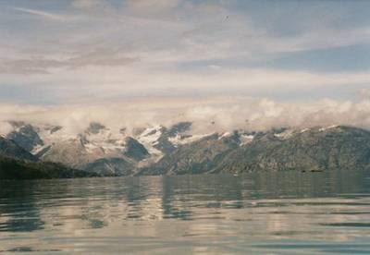
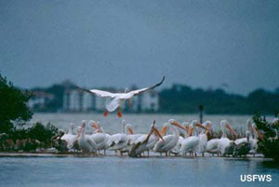
Smallest Wilderness Area
Largest Wilderness Area
Wrangell-St. Elias National Park
Alaska 1980
9.1 million acres
Pelican Island
National Wildlife Refuge
Florida 1970 - 6 acres

Slide 8
Any states with no federal wilderness?
Notes:
8
RI, CT, MD, DE, IA, KS

Slide 9
Where was new wilderness added in 2009?
Notes:
9
Omnibus Public Lands Act of 2009 – 51 new areas or additions
FS - CA, CO, OR, UT, VA, WV
BLM – CA, ID, NM, OR, UT
FWS – AK
NPS – CA,CO,MI

Slide 10
Are there any National Forest wilderness
areas outside the 50 states ?
Notes:
10
The El Toro Wilderness on the Carribean NF in Puerto Rico was designated December 1, 2005.

Slide 11
Section 2 (b)
… the area shall continue to be managed by the Department and agency having jurisdiction thereover immediately before its inclusion in the National Wilderness Preservation System ...
Notes:
The Act specifies that, once established, a wilderness area remains part of the national forest, park, refuge or BLM area that it was in before designation.
However, subsequent legislation has occasionally adjusted agency jurisdiction to make management more efficient. For example the California Desert Wilderness Act swapped some lands between the BLM and NPS.

Slide 12
Percent of Acres by Agency
Notes:
Currently each of the four federal land management agencies is responsible for the amount of wilderness acres displayed.

