Slide 1
FS Resources
This file is part of the FS Resources section at: http://www.wilderness.net/fs/
This presentation should be reviewed and revised as needed to match the local training objectives and target audience and local images should be inserted where needed.
The Wilderness Act training presentations are posted in parts which may be combined or used separately as needed:
  History and Purpose of the Wilderness Act
  National Wilderness Preservation System
  Values and Benefits
  Definitions and Management
  Other Laws
  Stewardship Principles
  Court Decisions
  FS Policy
  More Information

Slide 2
Arthur Carhart National Wilderness Training Center
Notes:
2
This presentation is a product of the Carhart Wilderness Training Center
Suggestions for corrections and updates are welcome. Contact: tcarlson@fs.fed.us

Slide 3

Wilderness Values and Benefits
“for the permanent good of the whole people, and for other purposes.”
Location: ________
Date: _______
Notes:
3

Slide 4
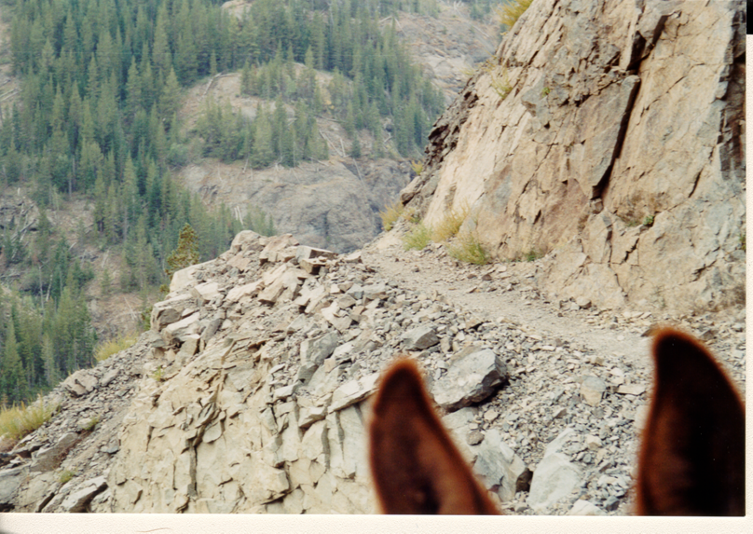
What’s your view of wilderness ?
Image by Skip Shoutis

Slide 5
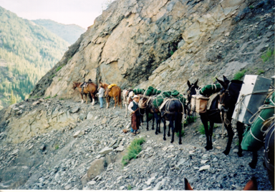
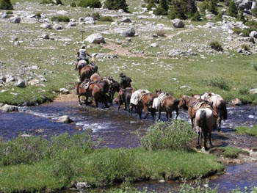
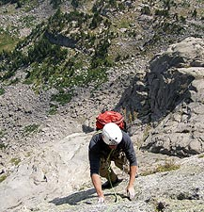
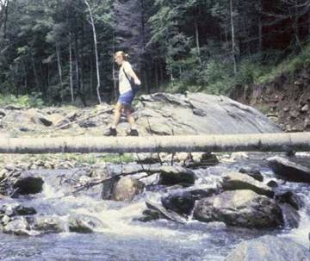
Different Views of Wilderness
Challenging, Requires Skill
Notes:
Some view wilderness as a place that provides for physical and mental challenge. FS regulations support this.

Slide 6
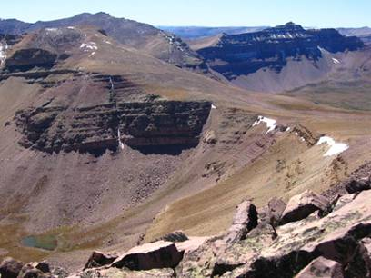
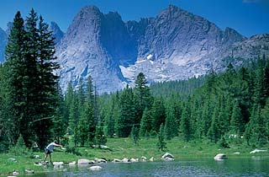
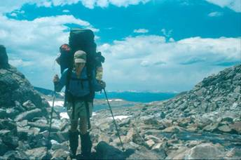
Different Views of Wilderness
Discovery, Solitude or Primitive Recreation
Images by Skip Shoutis and Josh Whitmore, Ken Straley
Notes:
Others appreciate the values of self-discovery or opportunities for solitude or primitive and unconfined recreation.

Slide 7
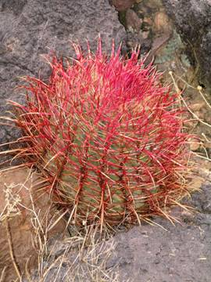
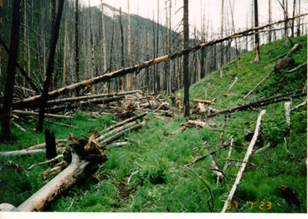
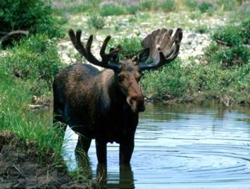
Different Views of Wilderness
Biocentric – Fire, Wildlife, Vegetation
Images by Skip Shoutis, Josh Whitmore, Chris Barns
Notes:
Others take a biocentric view and value wilderness for it’s habitat or natural processes and the community of life.

Slide 8
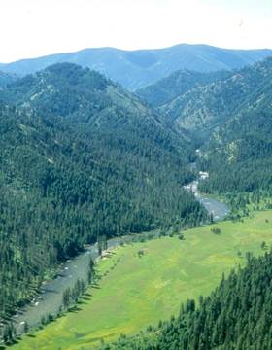
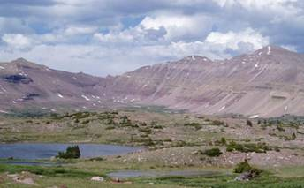
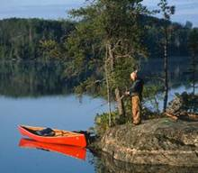
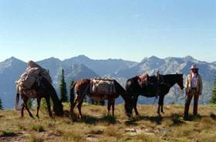
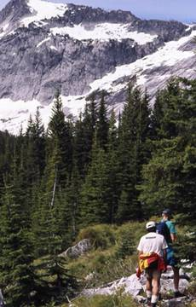
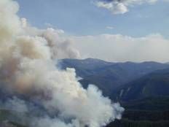
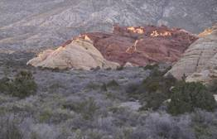
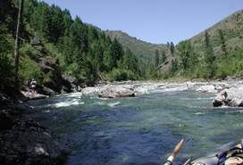
What is the ideal wilderness ?
Images by Karen Wattenmaker, George Weurthner, Tom Kaffine, Chris Barns,Ken Straley
Notes:
8
This is just a question for discussion as everyone’s opinions will likely differ.

Slide 9
Public Benefits of Wilderness
Recreation – 12 million annual visitors
Ecological – air, water, biological interrelationships and the natural processes (fire, flood, etc.) that effect people inside and outside wilderness
Geological – caves, volcanoes, canyons, geysers, mountains, fossils, glaciers, beaches, etc.
Scientific – a natural laboratory
Educational – a living classroom
Scenic – in person, through a window, via photographs
Historical/cultural – connections with the past

Slide 10
Wilderness and the Economic Health of Neighboring Communities *
* The Sonoran Institute, 2004
New economic drivers in the west
  - lifestyle, retirement income, protected public lands
Rural western economies are diversifying
  - less resource based, global economy
Western counties with wilderness (and other attributes) grow economically
  - access to metro areas and education opportunities contribute also

Slide 11
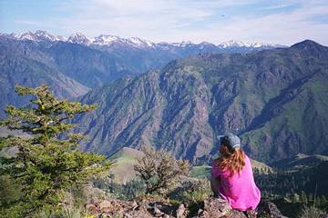
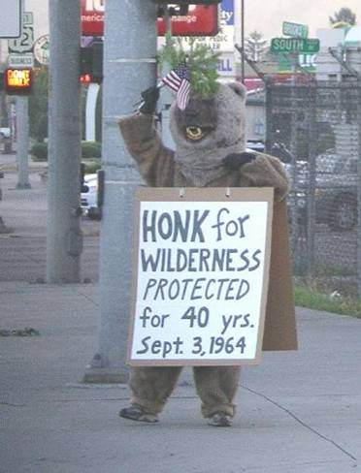
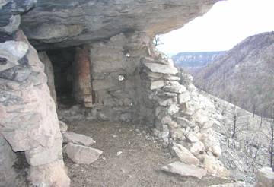
How do you value wilderness?
What are the major benefits that the wilderness resource provides for you and the nation ?

Slide 12
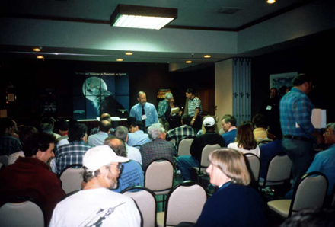
Societal Values
Norms, majorities, averages
Ethical, political, spiritual
Economic
Utilization vs. preservation, conservation
Notes:
12
Societal Values influence natural resource management decision making and wilderness is no different. People value wilderness for many different reasons and some believe wilderness designation has no value.
Often in wilderness planning and decision making there are no easy choices among polarizing views of challenging issues..

Slide 13
Public Views of Wilderness
Wilderness Opinions
71% want at least 10% of all U.S. lands protected as wilderness
  currently 4.7% is protected
  2.7% is in Alaska
Source: The Campaign for America’s Wilderness, 2003
Notes:
13
From a recent survey by The Campaign for America’s Wilderness

Slide 14
Wilderness Opinions
The National Survey on Recreation and the Environment (NSRE) 2002
Queries about lands managed by all four federal wilderness management agencies
Random survey of the general public
Defined what wilderness is and what uses are allowed
Notes:
14
From a recent survey by Forest Service research.

Slide 15
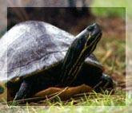
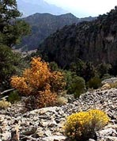
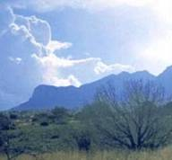
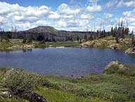
Should we designate more Wilderness within existing Federal lands?
Important/
Very Important
North 66%
South 55%
Great Plains 50%
Rockies 59%
Pacific Coast 59%

Slide 16
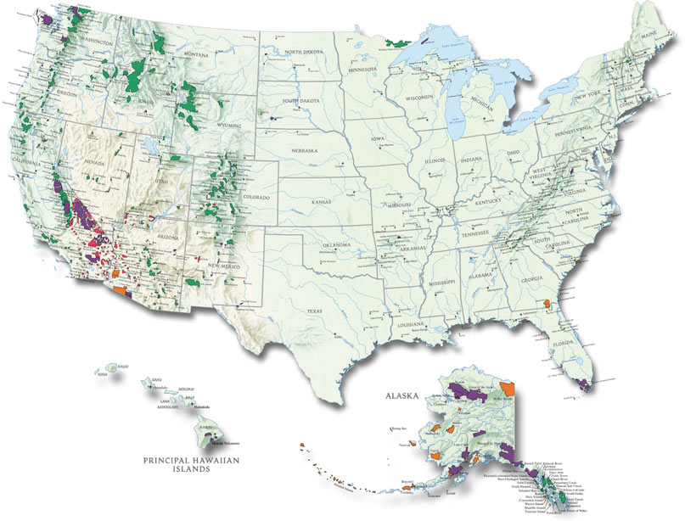
How much wilderness is there now?
Notes:
As of April, 2010 over 109 million acres

Slide 17
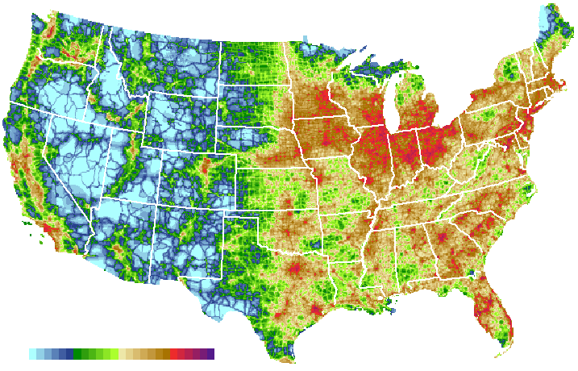
So, Do We Have Enough?
Road Density in the United States
Notes:
Much of the land not containing roads is designated wilderness.

Slide 18
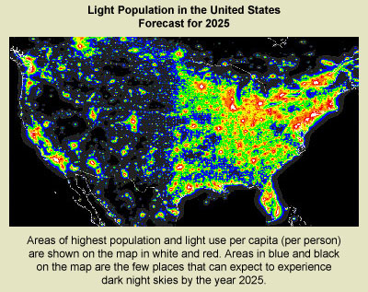
So, Do We Have Enough?
Light Pollution in the United States

Slide 19
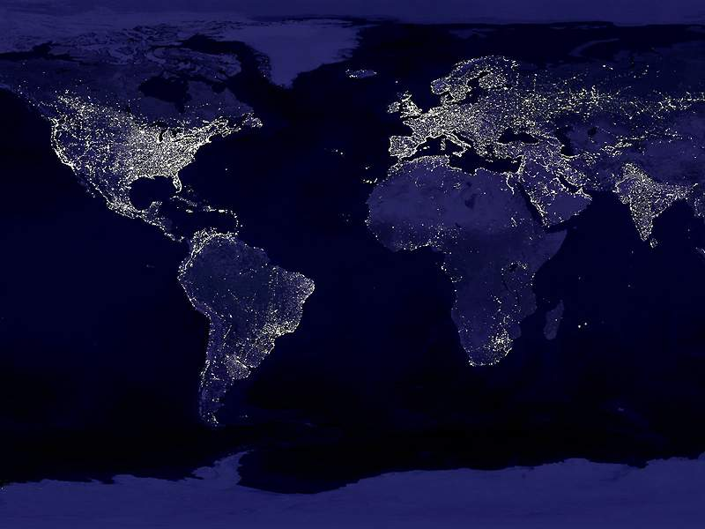
So, Do We Have Enough?
The Earth at Night

Slide 20
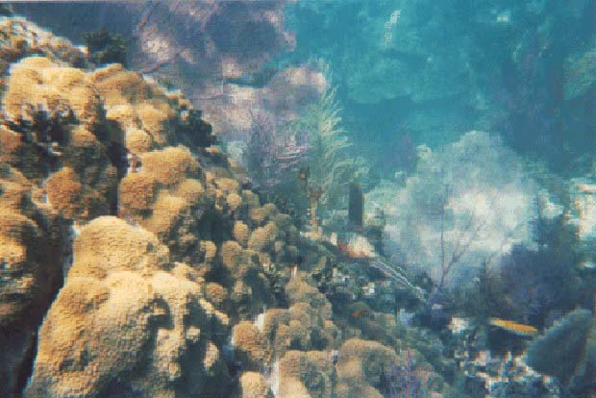
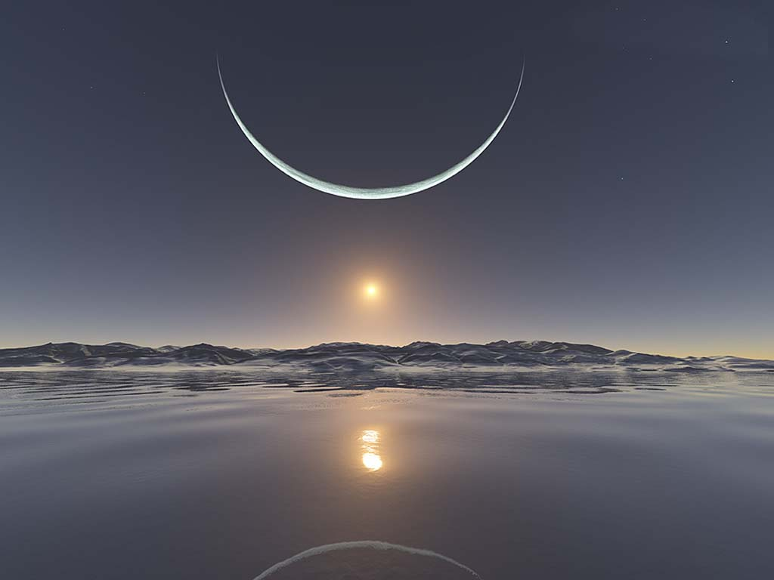
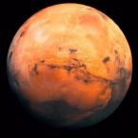
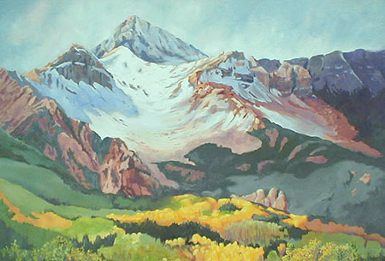
Is There Any Wilderness Left?

Slide 21
What is Wilderness?

Slide 22
Public Wilderness Values
According to the 2000 NSRE survey:
94% value wilderness because it contributes to air and water quality
94% value wilderness because it helps to preserve plant and animal species
89% support protecting wilderness in its natural condition, even if no one were to ever visit or otherwise benefit
93% believe that the natural features protected in wilderness have values themselves, whether or not humans benefit from them

Slide 23
Public Wilderness Values
According to the 2000 NSRE, people responded “very” or “extremely” important wilderness values:
Protecting water quality | 92%
Knowing that future generations will have wilderness | 85%
Providing recreation opportunities | 67%
Protecting wildlife habitat | 87%
Providing spiritual inspiration | 58%
Preserving natural areas for scientific study | 57%
Preserving unique wild plants and animals | 80%
Having the option of visiting wilderness | 73%
Protecting air quality | 92%
Providing income for the tourist industry | 33%
Protecting rare and endangered species | 83%
Providing scenic beauty | 74%
Just knowing that wilderness exists | 74%

Slide 24
What does the general public know about wilderness?
Attitude:
  “more public land should be set aside as wilderness”: 69% agree
Knowledge:
  “timber harvest is permitted in federally designated wilderness”: 18% correct
  “motor vehicles are permitted in federally designated wilderness”: 17% correct
  both questions: 7% correct
Source: Fly et al. 2000
Notes:
24

Slide 25
Wilderness Myths
Wilderness is ‘closed’ to all but the young, healthy, and wealthy | A broad range of recreation opportunities are available 76% of visitors report their experience is not diminished by wilderness Over 12 million people visit wilderness areas each year: > 25% of visitors over 50 < 14% of visitors high income
Wilderness is bad for rural economies | Long-term economic benefits and increased property values

Slide 26
Wilderness Myths
Most public lands are protected as designated wilderness | Only 4.85% of the US is wilderness; 53% of this is in Alaska
Wilderness is found only in remote areas of the West | The NWPS includes diverse ecosystems in 44 states; over half of the wilderness areas are within a day’s drive of the largest cities
Wilderness ‘locks up’ commercial forest lands | Less than 5% of the nation’s timber comes from National Forest lands; more expensive access, less commercial value

Slide 27
Wilderness Myths
Wilderness conflicts with multiple-use management | Wilderness provides for all uses except timber (recreation, wildlife, water, forage)
Wilderness erodes private property rights | Use and access to private lands preserved, no buffer zones established, acts as a scenic backdrop, increases property values
Wilderness is supported by only one political party | Wilderness has historically had broad bipartisan support which continues today

