Slide 1
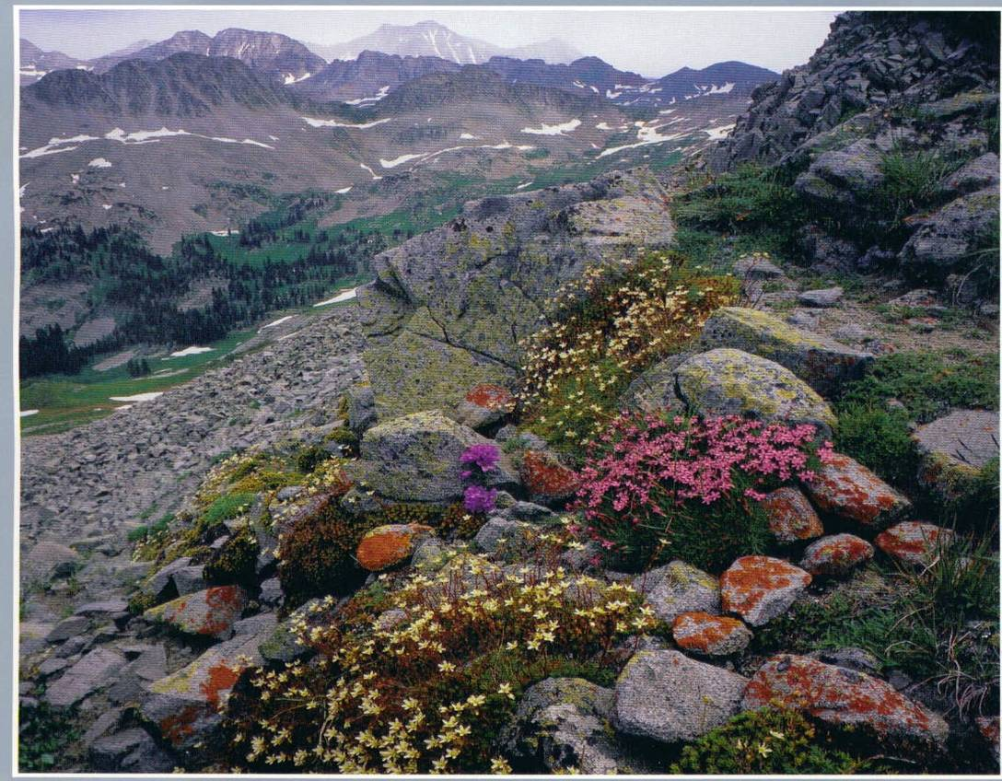
Wilderness Perspectives
Notes:
Introduction – Objectives of Session
Introduction to US Public Lands history – foundation for understanding origin of the NWPS.
Provide a historical perspective to the establishment of the NWPS.
Touch briefly on perspectives in wilderness management.

Slide 2
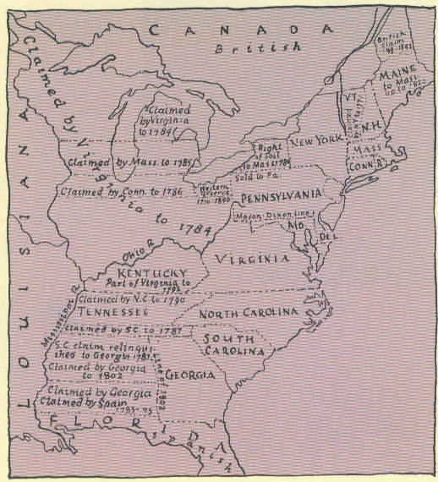
Birth Of A Nation
Notes:
Birth of a Nation
The first explorers and settlers arriving from Europe saw and experienced “true” wilderness – land affected primarily by the forces of nature. The settlers cleared that land, farmed some of it, began building towns and establishing a new nation. The wilderness was endless, a challenge to be conquered.
After the Revolutionary War, our forefathers had the job of managing a new nation, and several basic principles relating to the land of this new nation emerged.

Slide 3
Birth Of A Nation
The “Haves” vs. the “Have Nots”
Notes:
Seven of the original thirteen colonies claimed land outside of their colonial boundaries, such as lands east of the Appalachian Mountains towards the Mississippi River. This loose union of states was having difficulty in coming together, and a major sticking point was that the six "have not" states did not have the fortunes of outside land holdings.

Slide 4
Birth Of A Nation
The “Haves” vs. the “Have Nots”
Early Land Policy
Pubic Domain -All citizens equal owners.
Notes:
To resolve the dispute, states with land holdings outside of the colonial boundaries agreed to give these lands to the new Federal Government. These lands were referred to as "Public Domain" because the land belonged to all citizens equally, regardless of their state.
A second principle also emerged in these early years.

Slide 5
Birth Of A Nation
The “Haves” vs. the “Have Nots”
Early Land Policy
Pubic Domain -All citizens equal owners.
Dispose of public domain.
Notes:
This principle was that public domain lands were to be disposed of into private ownership. Our new nation was land rich and money poor and the public domain lands were seen as a source of revenue to prime this pump of the new democracy. Besides, part of the reason we revolted against the King was our objection to the Crown Lands, lands that were owned by the King and worked by the peasants. The thought of the new "Federal" govenment OWNING land was close to treasonous.
.

Slide 6
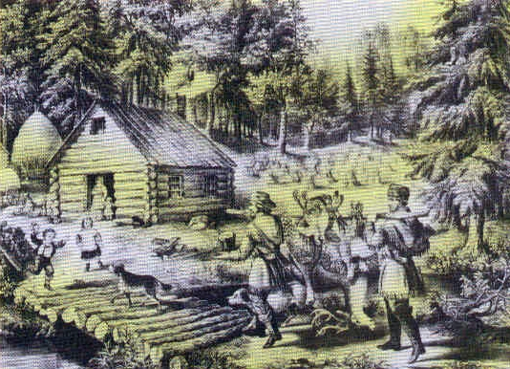
Natural Resources – Unlimited and Untamed.
Notes:
During the time of growth following the Revolution, the land and water resources of the nation were seen as unlimited and untamed. The vast, untamed wilderness was feared as a place where wild animals and savages resided and was therefore seen as an obstacle to progress.

Slide 7
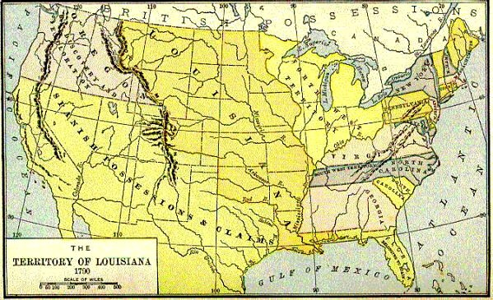
Louisiana Purchase - $15 Million, 600 Million Acres
America doubles in size with one stroke of a pen.
Notes:
Early in the 1800s, there was tremendous expansion to the west. In 1802, Lewis and Clark were commissioned to explore the Missouri River drainage to the Pacific Ocean. In 1803, the US negotiated the Louisiana Purchase, doubling the size of the new county. Lands ceded to the US after the Mexican-American War continued the westward growth. All lands coming into the ownership of the US were classified as Public Domain. The natural resources held in the wilderness of the new nation had to be “conquered” and exploited to make way for farms and settlements. To overcome the obstacle to progress presented by the wilderness, government policy was developed to encourage settlement in the untamed lands.

Slide 8
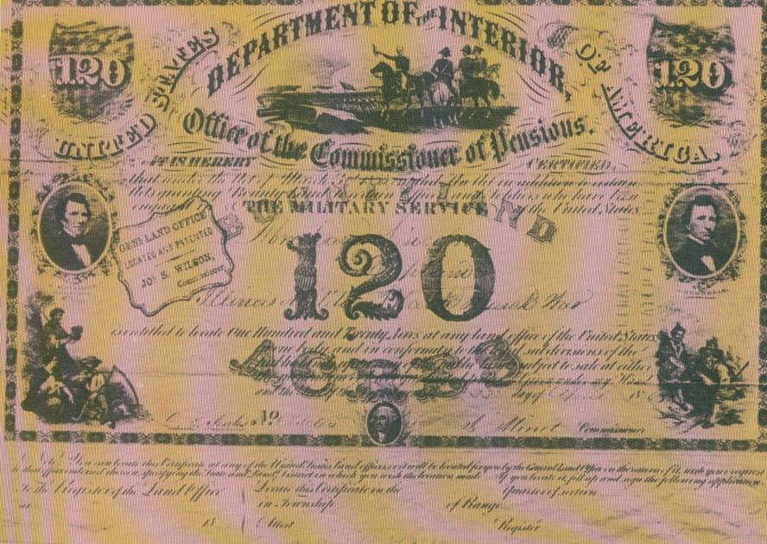
Land Grant Certificate
Notes:
Soldiers of wars were given land in payment of their service.
Note: Rectangular survey “invented” to facilitate/standardize legal descriptions of public domain as it went into public ownership. Jefferson.

Slide 9
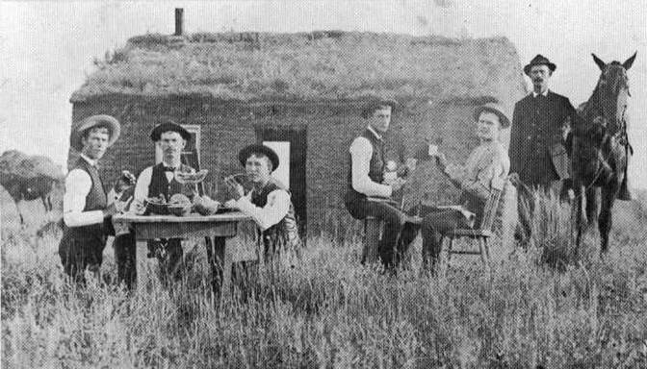
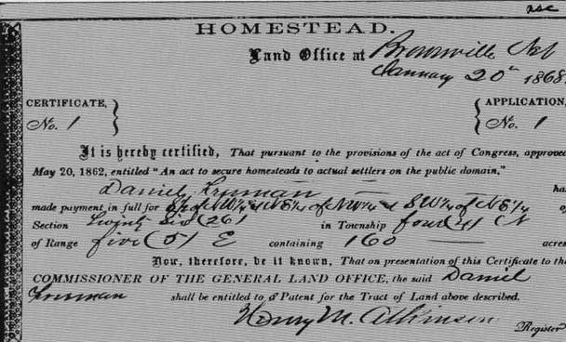
General
Land
Office
Notes:
The General Land Office was established in 1812 within the Department of the Treasury to implement much of this policy. The Homestead Act (1862) and other acts were passed that allowed giving public domain land to individuals at rock bottom prices, provided that they clear the land and live on it.

Slide 10
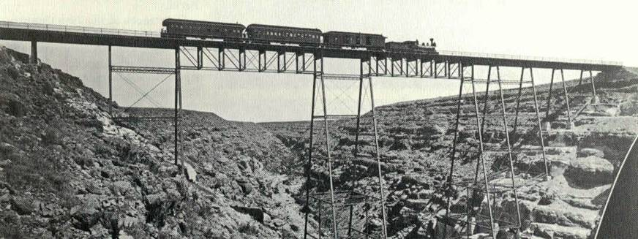
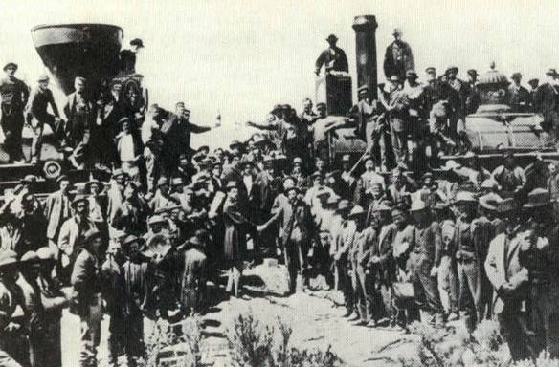
Railroad photos
Notes:
Railroads were given enormous tracts of land throughout the west, provided that they build the railroads to move our nation westward. The western land rush was on…

Slide 11
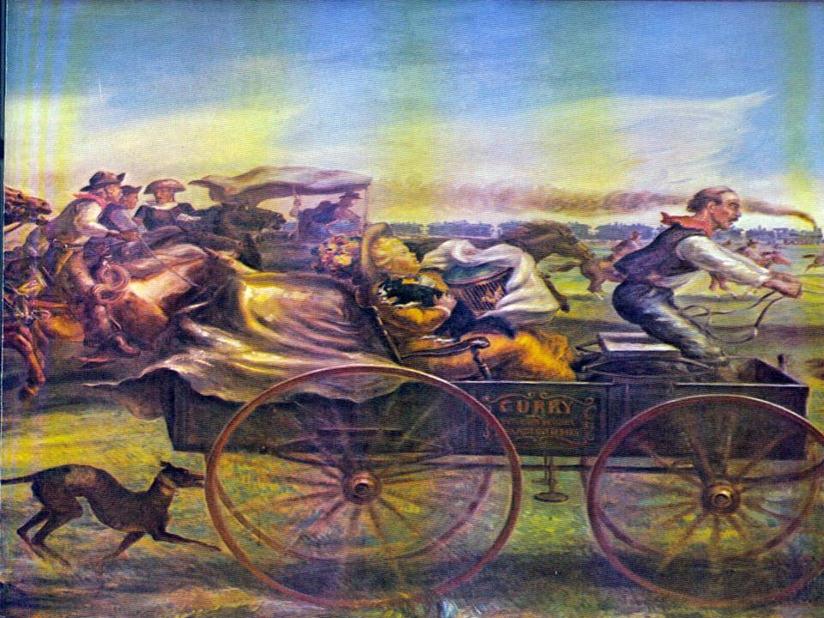
Painting
Notes:
Land was an asset to be converted to cash, and the government was doing a lot of converting. The term "doing a land office business“ came from this period when the General Land Office was aggressively disposing of the public domain from the Mississippi to the Pacific Coast.

Slide 12
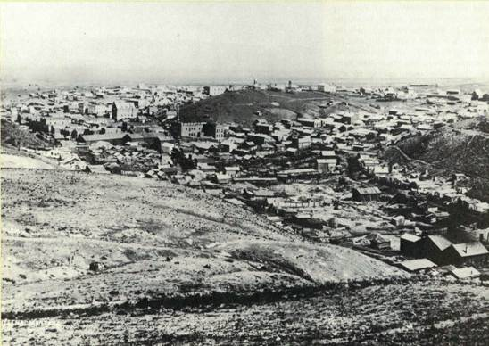
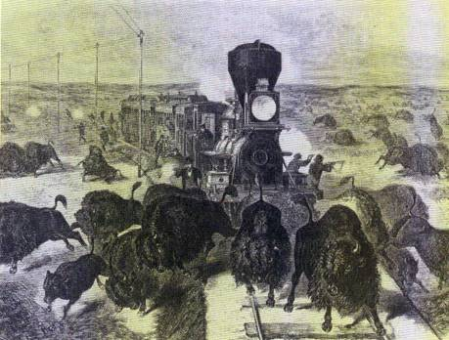
Realization:
Resources are not unlimited.
Notes:
Toward the end of the 1800's, the attitude toward the public domain began to shift. The country began to realize there was a cost to the westward movement of civilization. With the settlement of the west coast, the nation realized the continental limits of our country and saw that it's natural resources were not "unlimited".

Slide 13
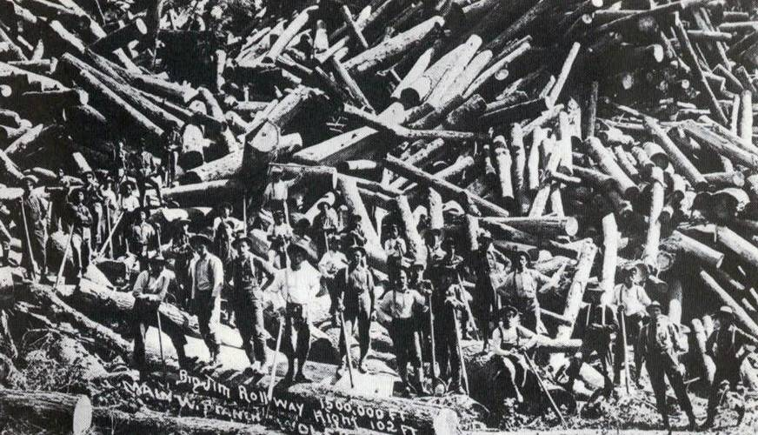
Attitudes begin to change
Notes:
The public domain lands that had not been converted into private holding were being abused by uncaring or unknowing people. In 1872, the first major shift in the public land policy in the country occurred.

Slide 14
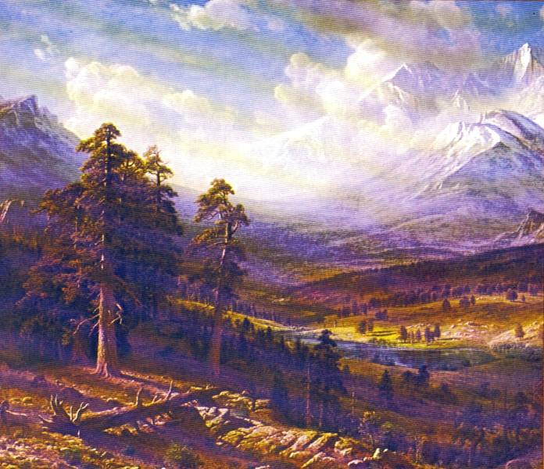
Yellowstone National Park established 1872
Notes:
The untamed beauty of the west had captured the imagination of explorers and then painters (Thomas Moran and George Catlin) and naturalists (George Perkins Marsh, John James Audobon); they brought their stories and convictions to the population and political centers in the east. The threat of losing the “untamed beauty” or the western wilderness to exploitation moved Congress to set aside the public domain lands of Yellowstone area as a National Park in 1872.
This was an unprecedented move; not only in this country, but in the world. There had never been a National Park....land to be held by a central government to protect and preserve "for the pleasure and recreation of the people". The federal government, for the first time, was in the land management business.

Slide 15
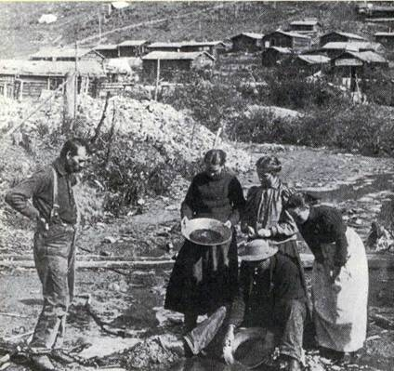
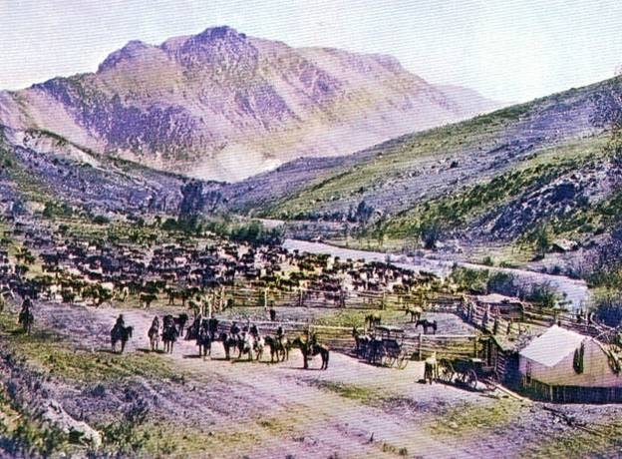
Old photos
Notes:
The situation on public domain out west continued to deteriorate – unregulated grazing, mining, forest fires, misuse, trespass were common. An increasing public demand for watershed and resource protection brought tremendous political pressure on Washington, DC to protect what was left of the public domain before it was ruined.

Slide 16
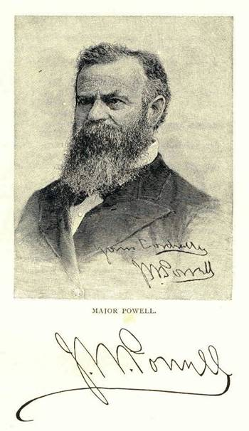
John Wesley Powell publishes “1878 Report on the Lands of the Arid Region of the United States”
Notes:
John Wesley Powell’s “1878 Report on the Lands of the Arid Region of the United States” is published. He calls for more realistic systematic planning for the west and it’s resources, including the need for public water storage and resource conservation.

Slide 17
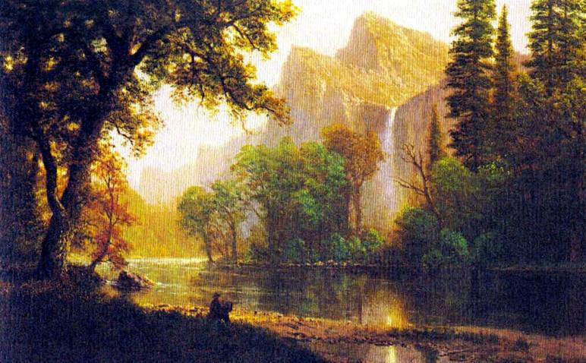
“From the forest and the wilderness comes the tonics and barks which brace mankind.” Henry David Thoreau
Notes:
Early conservationists Henry David Thoreau and John Muir pursue wilderness as essential for individual thought, freedom and identity. Muir was largely responsible for the establishment of Yosemite National Park in 1890. Yosemite NP differed from Yellowstone in that it was established to preserve the area from development as opposed "for the pleasure and recreation of the people". (Mention John Muir’s visit to the southern Appalachians in the late 1860s - “A Thousand Mile Walk to the Gulf “. Wagon factory accident in Indiana lead to hike.)

Slide 18
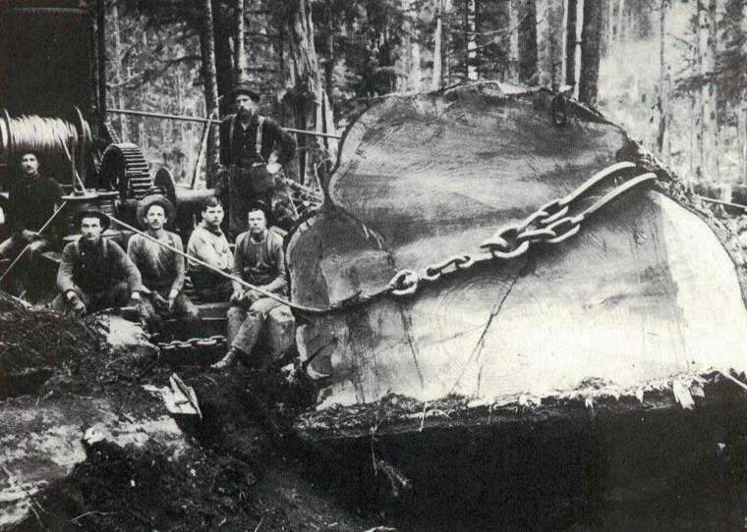
Forest Reserves established in 1891
Notes:
In 1887, Congress passed the Forest Management Act in an attempt to gain control of public domain misuse. Then, in response to continued public pressure, in 1891, Congress authorized the President to set aside "Forest Reserves". These forest reserves were to be managed by the General Land Office and made available to the public for free firewood, fencing, building material; and, the timber from these reserves could be sold. This is very different from the National Parks, established to preserve and protect for recreation. The forest reserves were to provide resources for citizens and industry, but managed to protect basic resource values. Congress had taken another big step....…public domain lands were now being reserved (held by the government) for something other than National Parks!

Slide 19
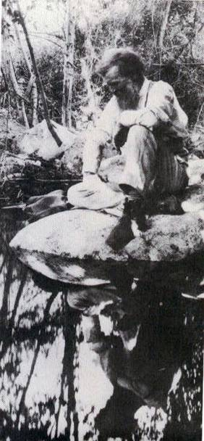
1892 – John Muir
1892 –John Muir and 26 San Francisco residents form the Sierra Club “to explore, enjoy and render accessible the mountain regions of the Pacific NW… and enlist the support and cooperation of the people and the government in preserving the forests and other natural features of the Sierra Nevada.”
Notes:
I mentioned John Muir earlier. He was not satisfied with the establishment of Yosemite and continued to be instrumental in organizing public support for preservation ideals, founding the Sierra Club in 1892. The lessons learned during this time would play a significant role at the turn of the century when he found a receptive ear in a conservation minded president.
Deeply held values, able to inspire others.
In 1897, Congress passed the Forest Management Act, opening the forests in the reserves and other public domain to timber cutting, mining and grazing. This “clarified” the difference between preservation and conservation, a polarized view of public resources that still plagues land-use debates.

Slide 20
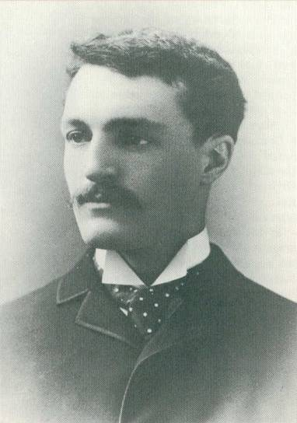
Gifford Pinchot
Notes:
Some of you may have heard of Gifford Pinchot because he lived for a while no too far from here. Mr. George Vanderbilt used his Biltmore estate to demonstrate many of the most progressive land management concepts and ideals of that era (Fredrick Law Olmstead). He hired Gifford Pinchot, one of the few American professional foresters of that era, to try out some modern forest management concepts at Biltmore. In 1898, Pinchot moved to Washington DC and became the second person to head the U.S. Department of Agriculture's Division of Forestry. As the advisor to the President on scientifically based forest management, he heavily criticized the General Office's mismanagement of the new forest reserves.
Link Pinchot to Muir.

Slide 21
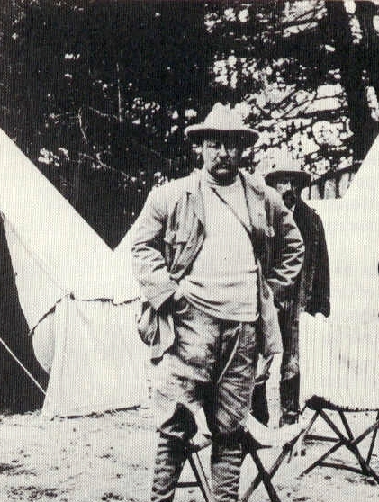
Teddy Roosevelt “That damn cowboy…”
Notes:
Vice President Theodore Roosevelt became unexpected president in September of 1901 when McKinley was assassinated. Bitter politicians of the day complained “that damn cowboy” got into the White House.
In 1903 President Theadore Roosevelt began setting aside vast acreage of public domain creating forest reserves, national parks and wildlife refuges that are a conservation legacy today. But, misuse and fires continued, and valuable resources were being lost. The General Land Office was involved in major land fraud scandals and was in disfavor with Congress; so at the turn of the century, Pinchot began politicing to transfer responsibility for managing the Forest Reserves away from the Land Office to the U.S. Department of Agriculture's Division of Forestry. Western special interests and politicians hated the idea. First, they opposed the basic idea of expanding federal holdings. Second, the Land Office was so corrupt, they could get by with just about anything they wanted.

Slide 22
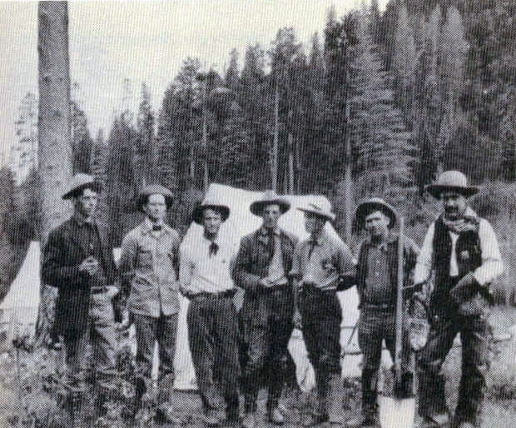
1907 – Forestry crew, Santa Fe National Forest, NM
Notes:
In 1905, after years of heated debate, Congress transferred the responsibility for forest reserves, now over 148 millions acres, to the Department of Agriculture to what was to become National Forests administerd by the US Forest Service. As Pinchot put it in his direction to forest manager's of the time, "The timber, water, pasture, mineral and other resources of the forest reserves are for the use of the people. They are to be obtained under reasonable conditions without delay. Legitimate improvements and business enterprises will be encouraged".

Slide 23
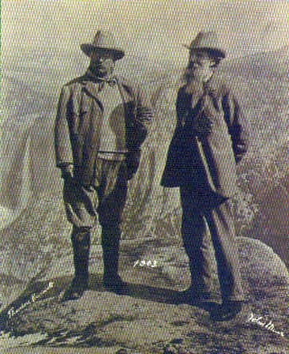
Hetch Hetchy Controversy
“These temple destroyers, devotees of ravaging commercialism, seem to have a perfect contempt for nature, and instead of lifting their eyes to the God of the mountains, lift them to the almighty dollar.” Muir, 1912
Notes:
San Francisco politicians were undaunted by the 1890 Yosemite National Park designation of the Tuolumme River valley as preserved “wilderness”. In 1908, the Secretary of Interior approved an application from San Francisco to build a dam in the valley. This became the first national debate and “cause celebre” over the competing demand for a specific area - preserving wilderness verses developing resources for “civilization”. It was a bitter fight. Pitted Muir against Pinchot. Roosevelt was torn, but reluctantly approved of the issuance. The big fight that ensued in congress over funding the project raised the public consciousness about the values of protected wilderness. Battle was lost in 1913, but the wilderness political movement was born. (lost the battle, won the war?)
Key point, not that dam was built, but that there was even a debate, much more, that it lasted for more than 8 years!

Slide 24
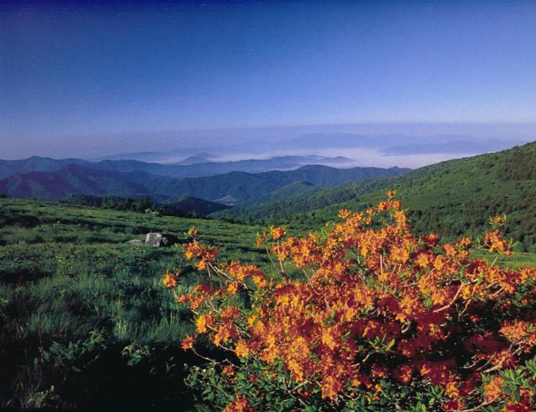
Round Bald – Pisgah National Forest, North Carolina
Notes:
Up to this point in my story, the east has been pretty much left out. The eastern states of the
original colonies had no national parks or forests because parks and reserves were originally
carved out of the public domain of the west. If the founiding fathers considered the Federal
Government's retention of public domain lands as bad, the thought of the Government
purchasing private lands within the original colonies was even worse. (Thomas Jefferson would
have flipped his whig over the idea of the federal government purchasing private land).
But the forests of the east had also been abused, in some cases even more than those in the west. Without trees to shade the mountain streams, their temperatures increased and many trout died. Without trees, erosion ruined the water supplies of nearby communities. Large timber land-holding companies simply left the stripped lands behind. The demand to repair the damaged eastern forest grew and in 1911, the US Congress responded by passing the Weeks Act.
The Weeks Act authorized the President to purchase "forested, cutover or denuded lands
within watersheds of navigatable streams". The state legislature where the lands were to be acquired had to approve the purchase. The basic purpose of the Act was to buy and restore
timberlands severely damaged by excessive cutting, fire, disease, or farming. Most owners
were happy to unload lands which they now viewed as a liability (paying taxes on unproductive
land). The first tract of land purchased by the Federal Government under the Weeks Act was none
other than the Pisgah National Forest in North Carolina. In 1916, President Wilson signed the
proclamation creating the Pisgah National Forest, the first National Forest East of the Mississippi
and in one of the original colonies. Part of North Carolina's first National Forest was sold to the
Federal Government by Mrs. George Vanderbilt.....over 86,000 acres from the Biltmore Estate.

Slide 25
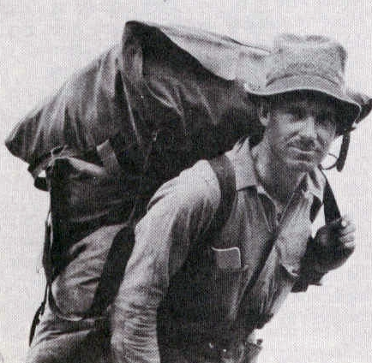
Arthur Carhart
“Perhaps the rebuilding of the body and spirit is the greatest service derivable from our forests, for of what worth are material things if we lose the character and the quality of people that are the soul of America.”
Notes:
Early on, in an effort to gain public support for retention of public domain as forest reserves and parks, congress allowed private individuals to lease tracts and build recreational residences on them. (no longer allowed, but recreation residences from this period still exist on national forest in the west.) USFS Landscape architect Arthur Carhart was evaluating lands at Trapper’s Lake* in Colorado for subdividing into recreation resident tracts. Carhart was enthralled with the beauty of Trappers Lake and could not stand the thought of seeing it developed with summer cabins. In 1920 he proposed the first designation of an undeveloped and roadless area to protect Trappers Lake.
*In 1891 when forest reserves were first established, there were two designated. Public domain surrounding Yellowstone was one, and the White River Forest Reserve in Colorado was the other. Trappers Lake was part of the original White River River Reserve.

Slide 26
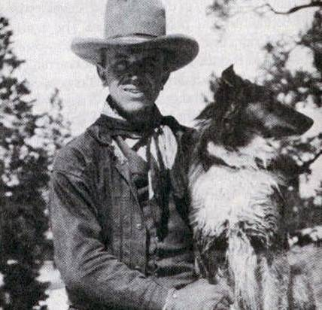
Aldo Leopold
“Ability to see the cultural value of wilderness boils down, in the last analysis, to a question of intellectual humility….It is only the scholar who understands why the raw wilderness gives definition and meaning to the human enterprise.” Aldo Leopold
Notes:
1924 – Ecologist Aldo Leopold achieves designation of the first official wilderness, the Gila Wilderness in New Mexico. “Our tendency is not to call things resources until the supply runs short” wrote Leopold to his Forest Service superiors in 1925 about the dwindling treasure of wilderness.

Slide 27
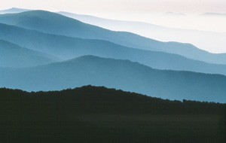
Robert Marshall, 1930
“There is just one hope of repulsing the tyrannical ambition of civilization to conquer every niche on the whole earth. That hope is the organization of spirited people who will fight for the freedom of the wilderness.”
Notes:
1935 – Wilderness Society founded. Bob Marshall is a principle force behind the establishment.

Slide 28
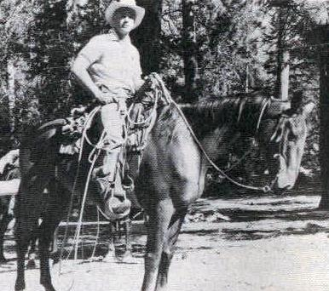
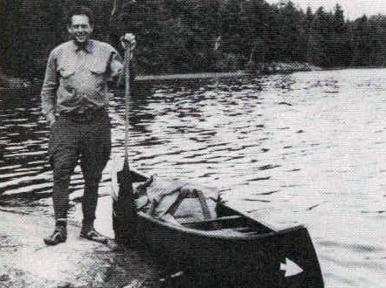
People
Robert Marshall US Forest Service
Lowell Sumner National Park Service
Notes:
Many people contributed to the wilderness movement in the United States. Lowell Sumner of the National Park Service helped inventory wilderness conditions in the Sierra Nevada in the 1930s and, at this early, date recognized that these fragile lands had a “saturation point” beyond which use could lead to irreversible damage. Bob Marshall, the Chief of the Div. of Recreation and Lands for the US Forest Service led the establishment of the U-Regulations in 1939 creating wilderness, wild and roadless areas, the immediate forerunner of today’s NWPS.
From: Wilderness Management by Hendee, Stankey and Lucas; 1978 USDA Forest Service Misc. Publication 1365

Slide 29
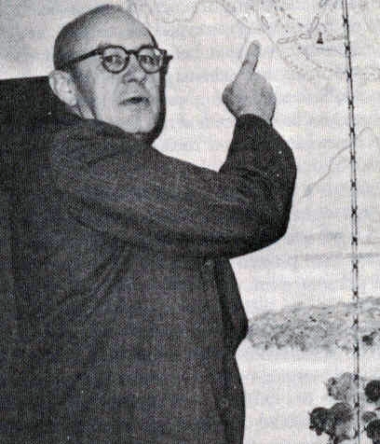
Howard Zahniser
“An area where the earth and its community of life are untrammeled by man, where man himself is visitor who does not remain.”
Notes:
For decades, wilderness designations were for the most part at the “whim” of a government administrators pen, subject to change by future administrators. In the 1950s and 60s, the Wilderness Society spearheaded efforts for a congressionally designated National Wilderness Preservation System. In 1955, Howard Zahniser, Executive Director of the Wilderness Society wrote the first draft of the act which was first introduced in the US Senate by Senator Hubert Humphrey in 1956. Also in 1956, Congress passed a bill prohibiting dam construction in National Parks – John Muir would have been proud.
(Untrammeled - not subject to human controls and manipulations that hamper the free play of natural forces.)

Slide 30
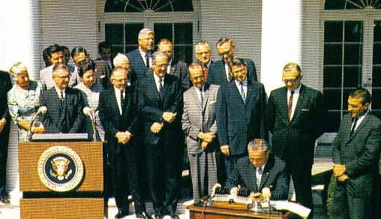
Lyndon B. Johnson signs the Wilderness Act in 1964
“The benefits of an enduring resource of wilderness”
Notes:
After seven uears of debate and numerous revisions, the Senate passed the Wilderness Bill in 1963, and the House passed the Wilderness Bill in 1964. President Johnson signed the Wilderness Act on September 3, 1964.

Slide 31
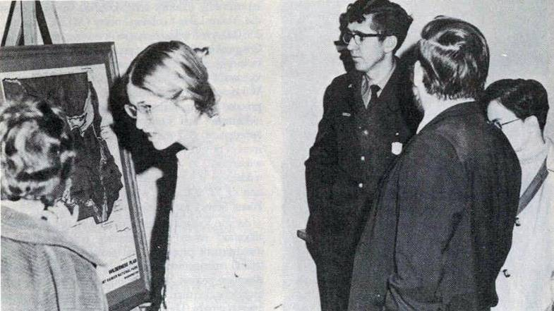
Inventory and allocation decision were controversial.
Notes:
Following passage of the Wilderness Act, NPS, USFS and BSF&W (now the Fish and Wildlife Service) were required to inventory lands that had potential for addition to the National Wilderness Preservation System. In 1976, with the passage of the Federal Land Policy and Management Act, policy of disposal of public domain was essentially terminated and the Bureau of Land Management was given a “multiple use” management mandate, including review of all BLM administered lands for potential wilderness designation.

Slide 32

NWPS
AGENCY
UNITS
FEDERAL ACRES
PERCENT OF NWPS ACRES
Entire NWPS
Bureau of Land Management
133
5,237,800
5%
Forest Service
400
34,766,995
33.2%
Fish and Wildlife Service
71
20,686,134
19.8%
National Park Service
44
44,048,239
42.1%
TOTAL
628
104,739,168
NWPS excluding Alaska
Bureau of Land Management
133
5,237,800
11.3%
Forest Service
381
29,014,774
62.3%
Fish and Wildlife Service
50
2,009,222
4.3%
National Park Service
36
10,295,156
22.1%
TOTAL
600
46,556,952
NWPS in Alaska
Forest Service
19
5,752,221
9.9%
Fish and Wildlife Service
21
18,676,912
32.1%
National Park Service
8
33,753,083
58%
TOTAL
48
58,182,216
Notes:
Eastern Wilderness Act passed in 1975, “Congress finds that.. in the more populous eastern half of the United States there is an urgent need to identify, study, designate, and preserve areas for addition to the National Wilderness Preservation System”. Attempted to clarifying congressional intention regarding size and evidences of humans.

Slide 33
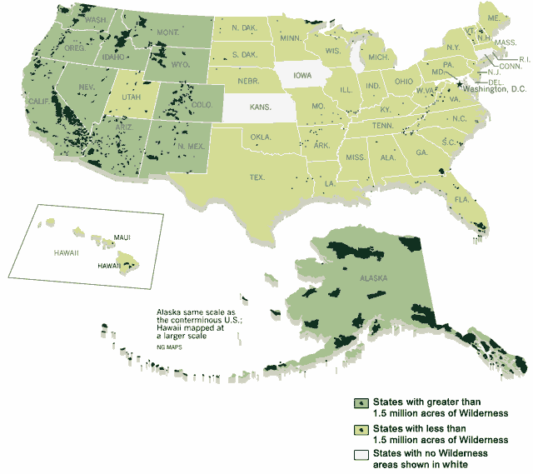
Map

Slide 34
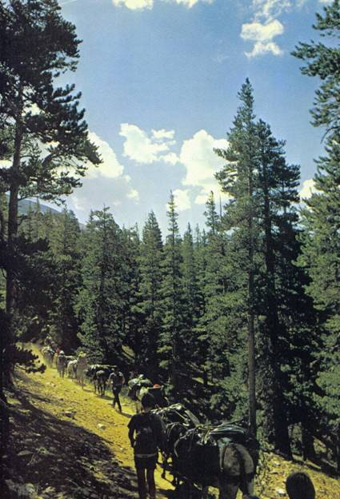
Managing to protect the Wilderness is the challenge for the new century.
Notes:
The debate over to designate or not designate has overshadowed very serious issues related to protecting the wilderness resource. What tools are appropriate for use varies among management agencies and is often left to local managers. Allocation of use issues are unpopular with increasing recreational demands, but unrestricted use threatens the very resource the public wished to experience.

Slide 35
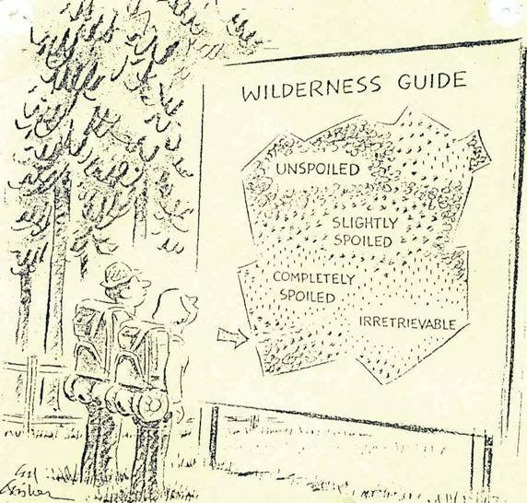
Wilderness Guide illustration
Notes:
Increased regulation detracts for the wilderness experience, but must play a role in future management if we are to be successful in our objective of protecting basic Wilderness resource values.

Slide 36
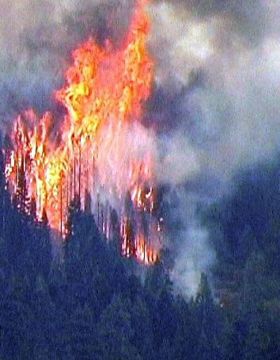
Fire photo
Notes:
Management issues in Wilderness are not restricted to the designated boundaries. Pollution from outside is affecting wilderness values, and management decisions within the wilderness cause concern from neighbors who fear their property and safety may be affected.

Slide 37
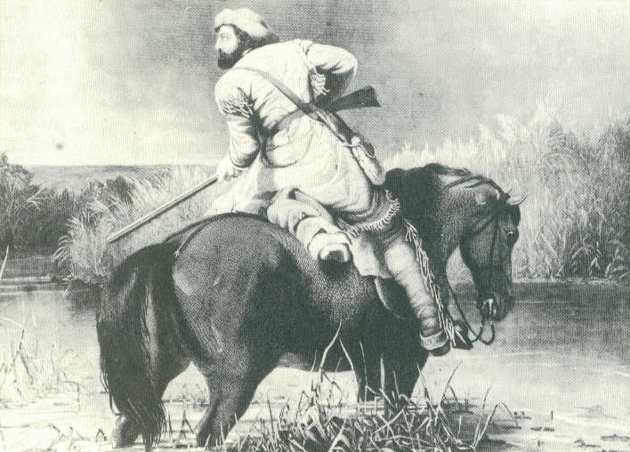
Aldo Leopold quote
The richest values of wilderness lie not in the days of Daniel Boone, nor even in the present, but rather in the future.” “The good life on any river may…depend on the perception of its music, and the preservation of some music to perceive.” Aldo Leopold
Notes:
Wilderness mangers must step up to the plate and make the difficult management decision. Our mandate is not to provide a play ground, but to “protect and enduring resource of wilderness.” Mention “Think Like A Mountain.” Effort by USFS to instill a strong, ground level wilderness presence and ethic by wilderness managers.
Leave No Trace.

Slide 38
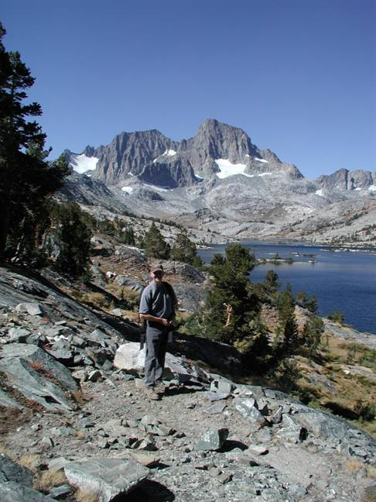

“There is no more frontier, we have got to make it here.” The Eagles
Notes:
1700’s – Creation of public domain belonging to all citizens.
1800’s – Retaining public domain for the benefit of future generations.
1900’s – Defining management of public lands in response to public demands (commodity v. non-commodity values). Establishment of the National Wilderness Preservation System!
2000’s – How do meet the management objectives in designated Wildernesses to ensure the innate values of the Wilderness that is the very spirit of our nation are protected into the future.

