Slide 1
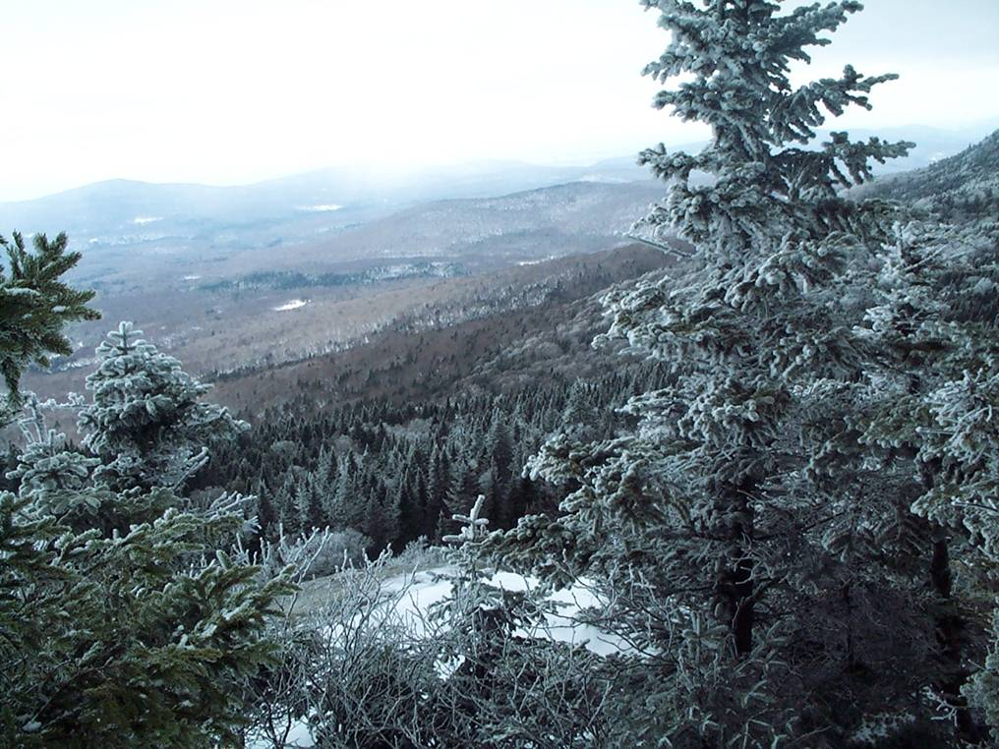


Green Mountain National Forest
Wilderness : An Enduring Resource
Notes:
Introduction: Ken Norden, Field Implementer/Lead Wilderness Ranger on GMNF since 1996. (View from Breadloaf Wilderness)
In this country, Congress designates capital “W” Wilderness. There are three other federal agencies that manage Wilderness in our National Wilderness Preservation System. Do you know what they are? The National Park Service, Bureau of Land Management and the US Fish and Wildlife Service.

Slide 2
What We Will Do :
Lay out the locations and some of the highlights of the eight Green Mountain National Forest Wilderness areas.
See how the Wilderness Acts including the latest New England Wilderness Act of 2006 added acres to the Green Mountain National Forest.
Discover the public purposes of wilderness.
Explore the role of Wilderness Rangers on the Greens and how they work to monitor and protect wilderness from threats to an enduring resource.

Slide 3
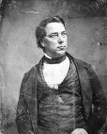
Why preserve wilderness?
Pioneers had cleared the land in Vermont:
75% cleared to 25% forested.
In the late 1800’s, people in America began to realize wilderness as a limited resource that needed protection.
George Perkins Marsh
Notes:
Europe had no designated wilderness set aside. In fact, many Europeans came over to see wild areas in America.
Back in the 1800’s…George Perkins Marsh caused a stir with his thesis published in 1864 called “Man and Nature”. He argued that protecting wilderness is compatible with progress and economic welfare.
Erosion was significant.
Fire was significant.

Slide 4
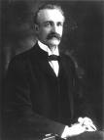
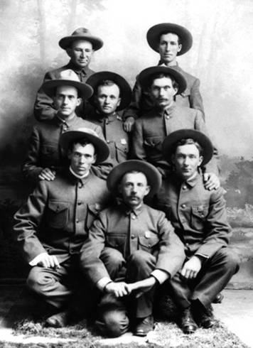
An Evolution of Conservation and Preservation Ideas
Gifford Pinchot:
The first Chief of the Forest Service in 1905.
Notes:
The Forest Service was established in 1905 and became an agency of the U.S. Department of Agriculture with a sustainable multiple use mission.
The Green Mountain National Forest was established in 1932 after uncontrolled logging, fire, and flooding ravaged the state of Vermont.
Today, Vermont is 75% forested and 25% cleared.

Slide 5
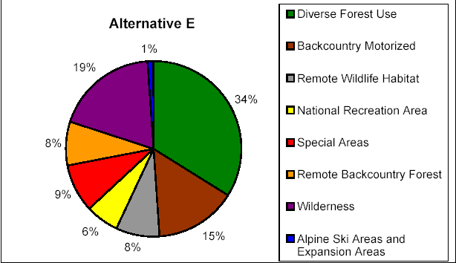
The Multiple Use Management Area Concept in the US Forest Service
Notes:
A multiple use concept was created to balance a variety of resources and uses including wilderness.
Shown is Management Alternative E from the recent Forest Plan Revision Process.

Slide 6
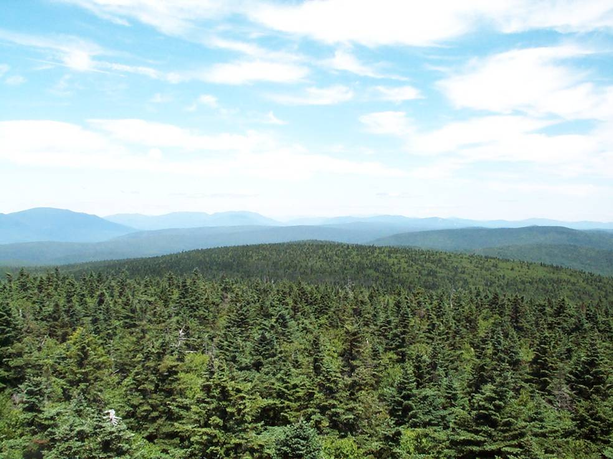
Doing the Math:
400,000 plus acres exist on the Green Mountain National Forest.
101,000 acres has been designated as Wilderness.
25% of the Green Mountain National Forest is Wilderness.
Notes:
Wilderness currently represents 18.3% of all NF system lands. As additional land is bought for this Forest, the wilderness percentage will go down some.

Slide 7
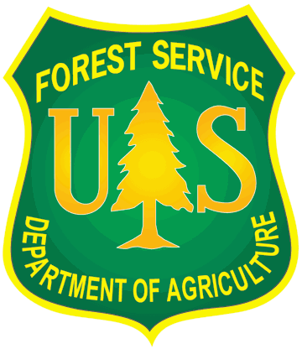
Wilderness Legislation
Wilderness Act of 1964
  Established the National Wilderness Preservation System.
“Eastern Areas” Wilderness Act of 1975
  Created Lye Brook and Bristol Cliffs Wilderness.
PL 94-268 (1976)
  Adjustment of Bristol Cliffs Wilderness boundary to accommodate private lands.
Vermont Wilderness Act of 1984
  Created George D. Aiken, Big Branch, Peru Peak, and Breadloaf. It made additions to Lye Brook.
Notes:
The Wilderness Act of 1964 established permanent, legal protection for wilderness. All subsequent Wilderness Acts fall under or refer to this original Wilderness Act for continuity.
Other laws were needed to reflect the qualities of wilderness in the Eastern United States. Although Wilderness areas in the east have scars from human activity in the past, these areas recover quickly. People still had a need for wilderness in the east with the increase of population pressures. Sixteen wilderness areas in the east were created by this law.
Bristol Cliffs was established at 5,000 acres in 1975 but in 1976 had to be adjusted to give back private lands designated as wilderness.

Slide 8
Wilderness Legislation (cont.)
New England Wilderness Act signed by President Bush December 1 of 2006.
  Established the Glastenbury and Joseph Battell Wilderness areas. It made additions to Lye Brook, Big Branch, Peru Peak, and Breadloaf Wilderness areas.
  Established the Moosalamoo National Recreation Area.
Notes:
The Forest Service worked with the public during Forest Planning meetings to identify issues and concerns and come up with a recommendation proposal for Congress of lands suitable to become Wilderness.
Congress makes the decision of what becomes wilderness and designated the New England Wilderness Act which added 41,650 acres of Wilderness to the National Wilderness Preservation System.

Slide 9
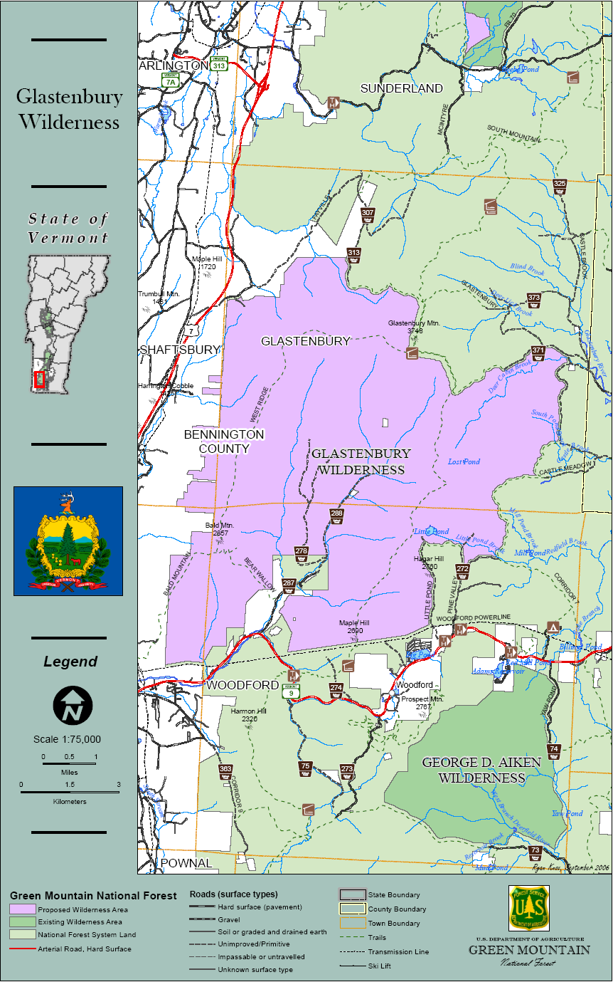
The Glastenbury Wilderness has the Appalachian and Long Trail traverse its slopes for eight miles or so.
There are no shelters inside this wilderness but a lookout tower and shelter are nearby.
The Glastenbury/West Ridge Loop Trail offers a 21.8 mile hike through a good part of the Wilderness.
Snowmobile trail systems sometimes border this new wilderness.
The New England Wilderness Act of 2006 adds Glastenbury as an entirely new wilderness at 22,425 acres.
Notes:
Boundary marking will need to be done with a priority on private lands next to Forest Service lands.
Only a surveyor with the right knowledge and surveying equipment can do this type of boundary work.
Some internal Forest Service land wilderness boundary lines can boundary signed by Wilderness Rangers with GPS units. Sometimes previously painted lines can be found to confirm locations.

Slide 10
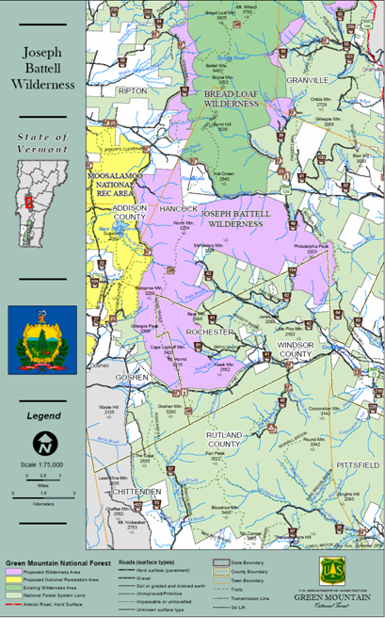
The Joseph Battell Wilderness area traverses about 9.9 miles of the Long Tail.
Monastery Mountain is an untrailed peak at 3,224 feet.
The spur trail from the Mount Horrid Cliff is closed from March 15 to August 1 so that Peregrine Falcons can nest undisturbed.
The New England Wilderness Act of 2006 adds Joseph Battell Wilderness as an entirely new wilderness at 12,333 acres.
Notes:
Middlebury College owns 700 acres at the Snowbowl Ski area including 1.8 miles of the Long Trail and Lake Pleaid to the north.
The wilderness below is all in the Green mountain National Forest.
New issues like rock climbing, caves and the disturbance of fragile plants in a Resource Natural Area on the MT Horrid Cliffs in Battell Wilderness will likely need upper management recognition to protect the resources.

Slide 11
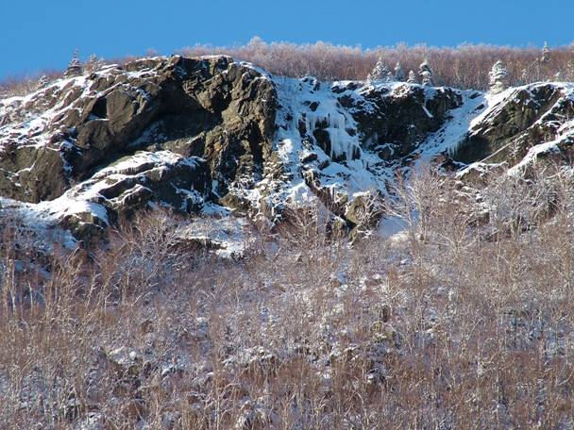
New issues in the new Wilderness: Rock climbing, ice climbing, caving, bat protection and the disturbance of fragile plants in a Resource Natural Area on the MT Horrid Cliffs in the Joseph Battell Wilderness will likely need upper management recognition to sort how to best legally protect the resources.

Slide 12
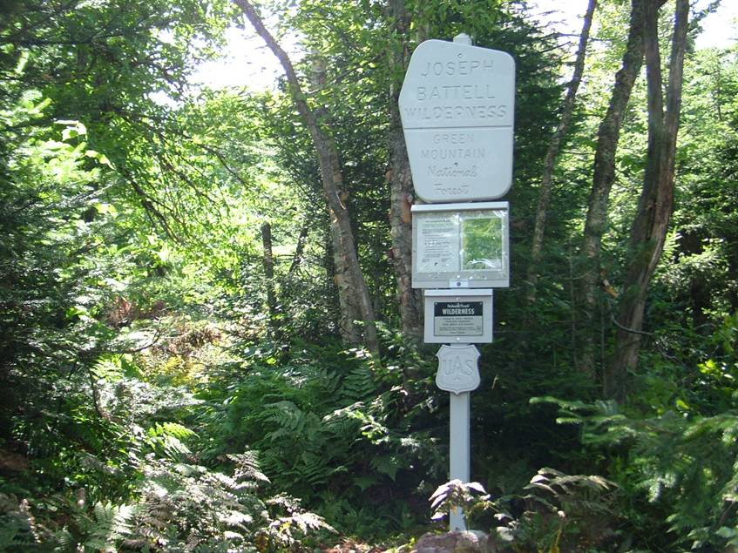
Notes:
Example of a new wilderness boundary sign portal on the Long Trail at the Battell Wilderness border and Middlebury College land a few miles in. Some wilderness information, Leave No Trace information and a map is given to visitors at the wilderness portal boundaries.

Slide 13
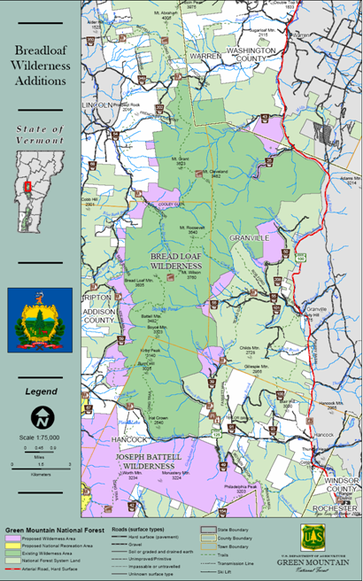
The Breadloaf Wilderness is named after Bread Loaf Mountain at 3,835 feet.
Climb Vermont's Presidential Range: Mounts Wilson, Roosevelt, Cleveland, and Grant.
Moose and black bears live here in considerable numbers.
Contains 17.4 miles of the Long Trail, four shelters and five major side trails.
The New England Wilderness Act of 2006 adds 3,757 acres.
Notes:
Breadloaf never reaches heights above tree line but there are many views along the way.
Sunset Ledge and Silent Cliff are popular day hike destinations near the east-west roads above and below.
Breadloaf contains Boyce Shelter, Skyline Lodge, Emily Proctor Shelter and Cooley Glen Shelter.
The Norske Trail and the Hancock Branch Trail are popular cross country ski trails.
Austin Brook road has 18 culverts in the wilderness now and needs to be decommissioned if possible.
Six boundary signs have been moved down trail and reinstalled with a GPS unit for new wilderness boundary location points.

Slide 14
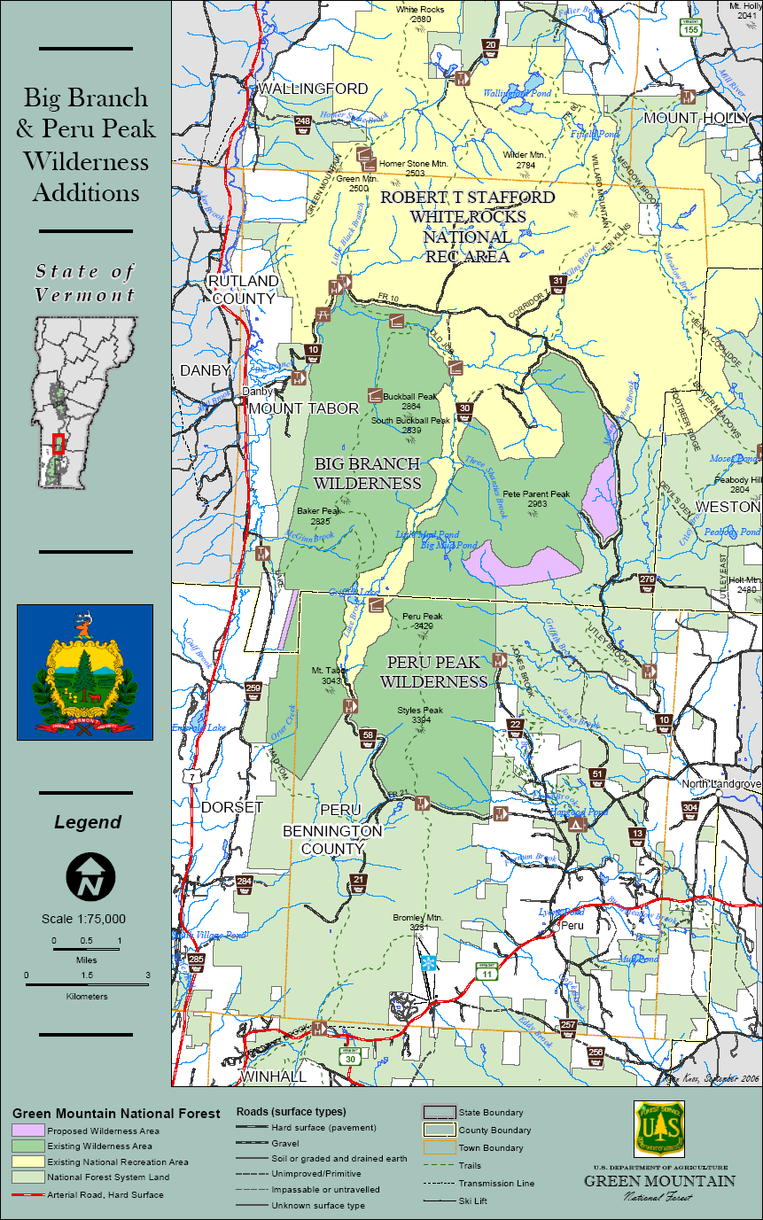
The Big Branch Wilderness is named after Big Branch Stream.
Located just west of the Peru Peak Wilderness.
Separated by snowmobile Corridor 7.
Contains about 6 miles of the AT/LT.
Big Branch shelter is on AT/LT.
The New England Wilderness Act of 2006 adds 47 acres.
Notes:
The Robert T. Stafford White Rocks National Recreation area was established to preserve many of the qualities of wilderness while allowing an extensive network of snowmobile trails to be located outside of the Big Branch and Peru Peak boundaries.
A 100 foot suspension bridge over a stream that is part of the AT/LT needs replacement and this project is in the works.
Lost Pond Shelter on the AT/LT has been burned down twice recently. After a Minimum Requirement Tool Decision Requirement process, it was determined that it will be rebuilt with mostly native materials.

Slide 15
The Peru Peak Wilderness is named after the highest mountain in the area.
Contains 4 miles of the Appalachian/ Long Trail.
Styles Peak has a view and Peru Peak is wooded.
Pete Parent Peak, a 3,000-footer that, unlike most in Vermont, has no marked path to the top.
There are no shelters or platforms in this Wilderness but there are some near Griffith Lake.
The New England Wilderness Act of 2006 adds 752 acres.
Notes:
Porky Point is a southern access point that used to have so many porcupines that brake lines would get chewed through. People had to put wire caging around their vehicle for protection. Otherwise, it was a fast ride down the hill!
Big Mud Pond and Little Mud Pond are compass treks in this wilderness.
Moose can be seen in the wet areas if you are lucky.

Slide 16
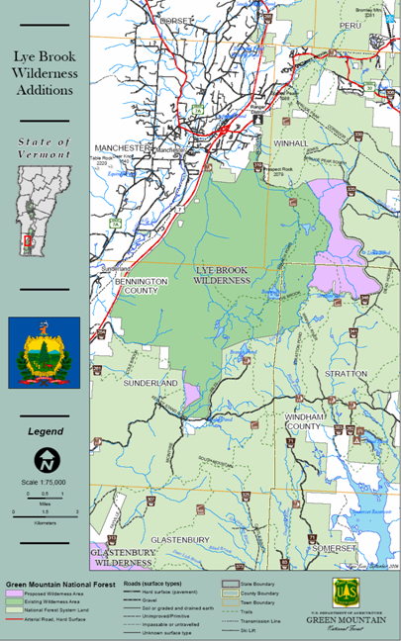
Lye Brook Wilderness ranges from 900 feet to 2900 feet above sea level.
The western section is extremely steep, facing west-northwest towards U.S. Route 7 and Manchester.
The Appalachian/Long Trail skirts the northeast corner for about 3 miles.
South Bourn Pond shelter was removed in 2005.
Remnants of railroad grades and old logging roads remain.
The New England Wilderness Act of 2006 adds 2,338 acres.
Notes:
Prospect Rock and Lye Brook Falls are popular day hiking destinations near the town of Manchester.
Bourn Pond, in the center of this wilderness, is used by day hikers, campers and fisherman.
Expect wet trails and an intense black fly season in the spring and early summer.
Pine Martin were reintroduced and inhabit these woods.
Brook Trout fry are “historically” stocked by helicopter in Bourn Pond one day in the spring.

Slide 17
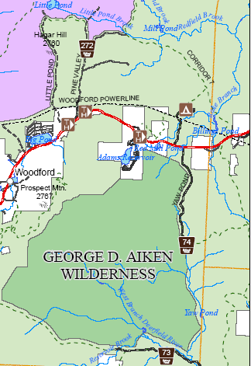
The George D. Aiken Wilderness was named after the late senator who helped secure the Eastern Wilderness Act of 1975.
Sits on a plateau rising as high as 2,300 feet.
Land of ponds, meadows, hills and brushy forest.
Popular for cross country skiing and snow shoeing in the winter.
Like Bristol Cliffs, is managed without designated trails.
Notes:
There are many ridges that allow dry travel.
In spring and summer, be prepared for swarming mosquitoes and black flies.
Wildlife abounds: Bears, moose, deer, otters, and many similar mammals and birds share the area.
Beavers are very active here flooding streams by creating dams that hold brook trout.

Slide 18
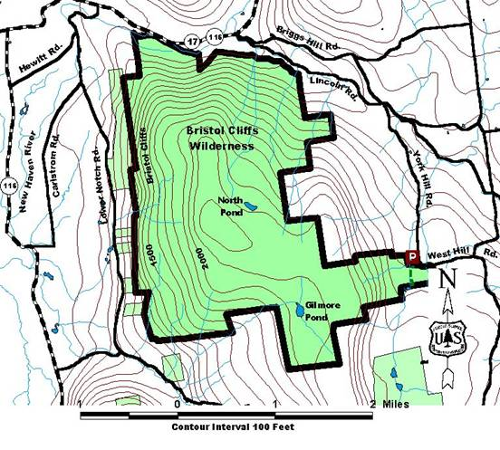
The Bristol Cliffs Wilderness was named for unique cliffs on west side.
Like the Aiken, is managed without designated trails.
North Pond and Gilmore Ponds.
Home to bears, moose, grouse, peregrine falcons and the tallest hobblebush in the state!
Notes:
You can end up doing a lot of slope walking.
Talus slopes are difficult to walk on.
Used for ice climbing on the west side. Not recommended for rock climbing.
West Hill Parking lot is a good parking access point.

Slide 19
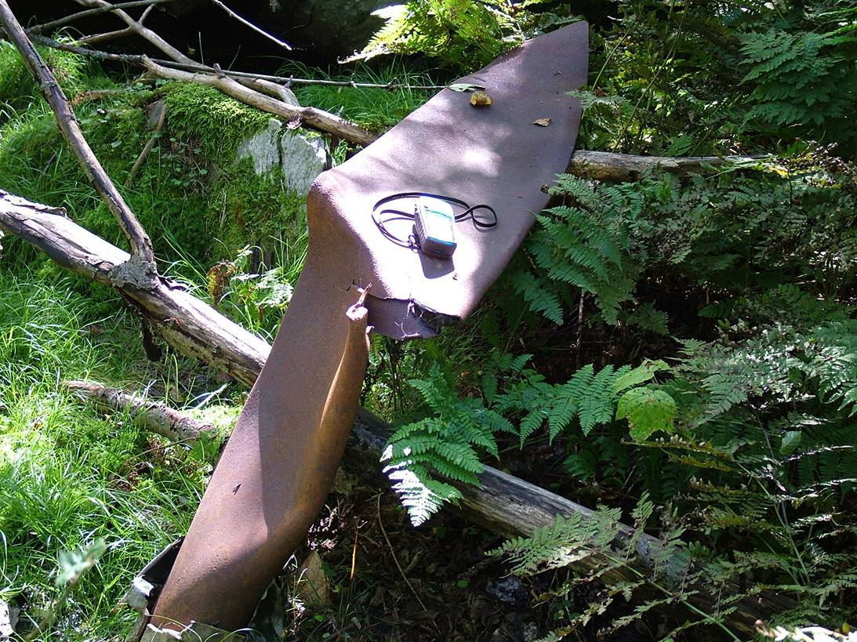
Notes:
Propeller from plane wreck in the 1940’s in Bristol Cliffs Wilderness near South Mountain.

Slide 20
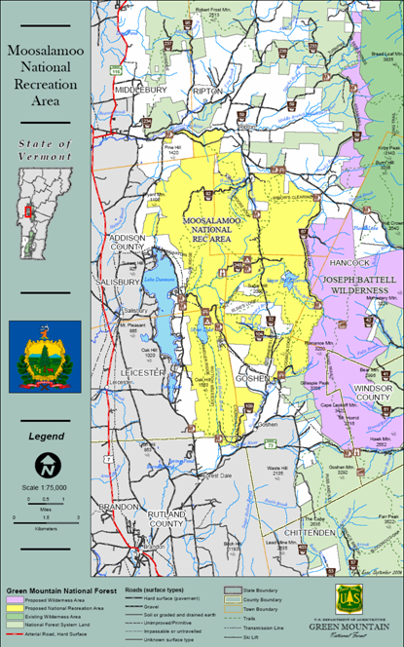
The Moosalamoo National Recreation Area (NRA) was established under the New England Wilderness Act of 2006.
A main objective is to showcase National Forest multiple use management.
The Joseph Battell Wilderness is outside this NRA.
The New England Wilderness Act of 2006 created an entirely new NRA at 15,800 acres.

Slide 21
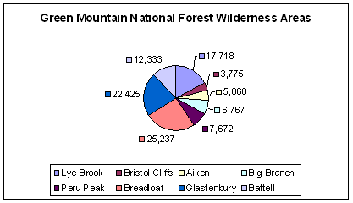
Wilderness Acre Distribution
Notes:
Quick Quiz:
Which is the largest?
Which is the smallest?
What percent of the GMNF is wilderness?
Summary. Number of Wilderness Areas
703 wilderness areas
Trivia Question
How many designated Wildernesses does the Appalachian National Scenic Trail traverse? Answer: 21
Total Wilderness Acreage
107,405,094 acres

Slide 22
Some Initial Administrative Steps Involving the Implementation of the New England Wilderness Act of 2006
Establish a communication link between five property owners who have inholdings.
Identify roads for closure that maybe obliterated after an appropriate environmental analysis is complete.
Request funding for 30 miles of boundary to be completed by surveyors to Forest Service standard.
Continue to fund Wilderness Rangers and a wilderness work force dedicated to completion of national goals .

Slide 23
Some Initial Field Steps Involving the Implementation of the New England Wilderness Act of 2006
Move nine, existing wilderness boundary portal signs and associated new wilderness maps and information.
Paint, carry and install eight, new wilderness boundary portal signs, wilderness maps and information.
Inventory all new boundaries and remote sections for nonconforming uses.
Post wilderness boundary license plates at locations where motorized and mechanized use is occurring or could occur with a GPS device.
Travelways Management: Move rocks and debris onto illegal trails that lead into wilderness to keep motorized and mechanized equipment out.
Hire a hand crew to remove some road culverts in the new wilderness.
Notes:
It most likely will take at least several years to catch up with the field work associated with the New England Wilderness Act of 2006.

Slide 24
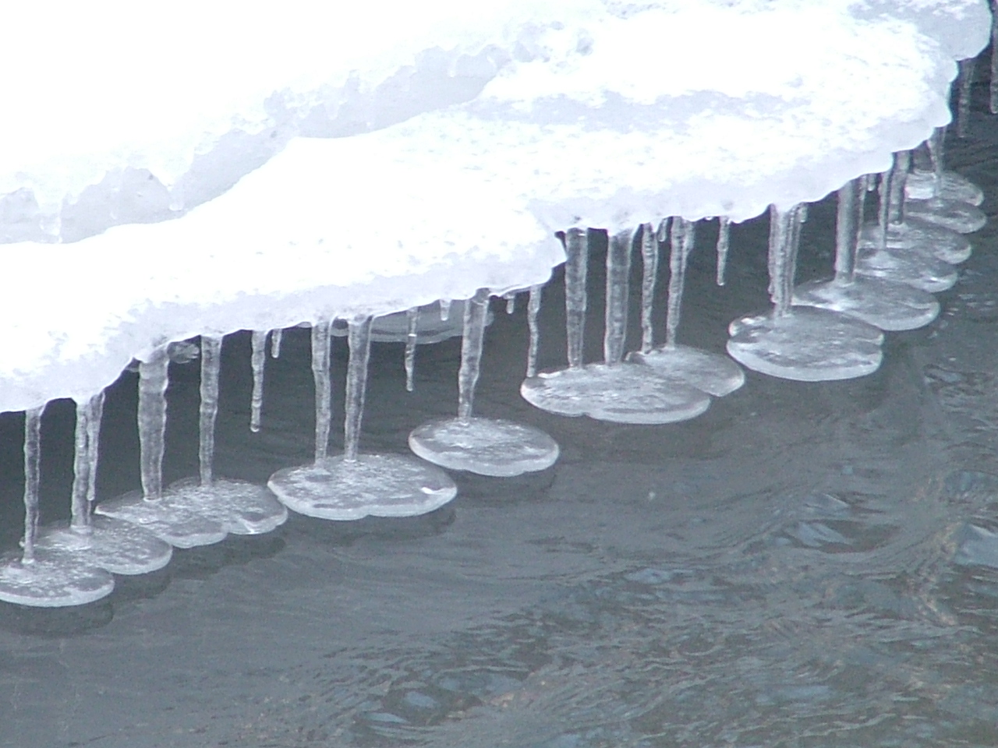
The 1964 Wilderness Act – Sec. 4(b)
… wilderness areas shall be devoted to the public purposes of recreational, scenic, scientific, educational, conservation, and historical use.
Notes:
There are six public uses of the 1964 Wilderness Act listed.

Slide 25
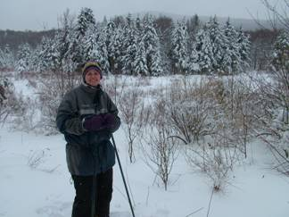
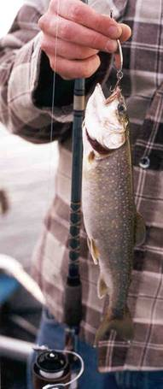
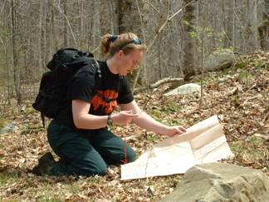
…”devoted to the public purposes of recreational, scenic, scientific, educational, conservation, and historical use”
Notes:
Recreation is just one of the public purposes of Wilderness but it is a big one.
Wilderness provides opportunities for people to experience a “primitive and unconfined recreation” including the specific values of inspiration and the physical and mental challenges of self-discovery and self-reliance.
Examples of primitive, non motorized, non-mechanized types of recreation are hiking, backpacking, camping, skiing, fishing and swimming.

Slide 26
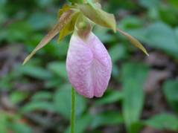
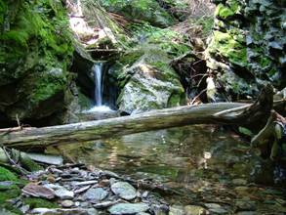
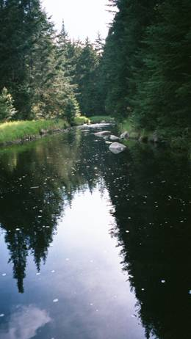
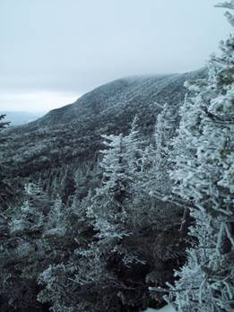
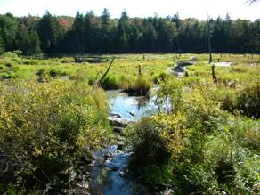
…”devoted to the public purposes of recreational, scenic, scientific, educational, conservation, and historical use”
Notes:
Wilderness is a place where natural processes remain. Many times this includes scenic purposes.
(Top Left) Clark Brook in the Breadloaf Wilderness.
(Bottom Left) Aiken Wilderness.
(Middle) Winhall River in the Lye Brook Wilderness.
(Top Right) Lady Slipper in Peru Peak Wilderness.
(Lower Right) View in Breadloaf off ridge.

Slide 27
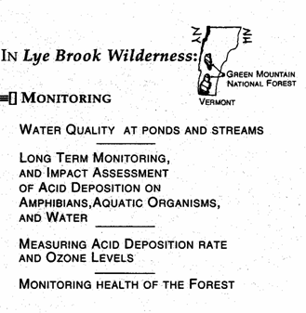
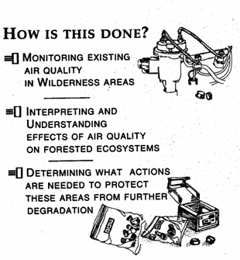
…”devoted to the public purposes of recreational, scenic, scientific, educational, conservation, and historical use”
Notes:
Wilderness has a public purpose of scientific use.
The Clean Air act of 1977 (P.L. 95-95) has amendments in its legislation that requires the Forest Service to monitor 88 class 1 wilderness areas for visibility and mandated action if air quality is deteriorated.
Lye Brook Wilderness has been designated a Class 1 Air Quality wilderness in Vermont. Great Gulf Wilderness is one in NH.
Weekly air quality checks are done from equipment installed on Mount Equinox located near the Lye Brook Wilderness.
Collected filters are sent to labs for spectral analysis.
Air pollutants identified are ozone, sulphur, nitrogen, mercury.
Acid rain deposition has been found to be evident. The composition of particulate matter is predominately sulphate.
University students and environmental groups conduct amphibian checks which are done on rainy nights. They count amphibians that fall into coffee cans placed in the ground next to barrier walls.
Amphibian checks are also done by flipping rocks to count salamander eggs in the area streams.
Water tests are conducted by the state of Vermont.

Slide 28

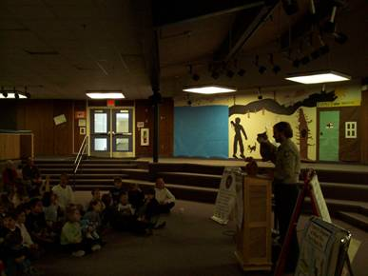
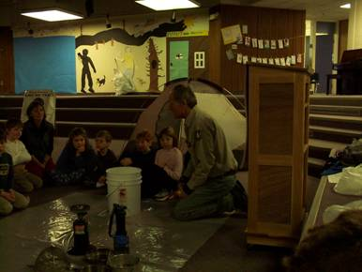
…”devoted to the public purposes of recreational, scenic, scientific, educational, conservation, and historical use”
Leave No Trace Puppet Show and Hands-on Activity Station
Notes:
These photos are from the Hanover School. We were teaching 96 second graders about Leave No Trace with a puppet show with an emphasis on Respect Wildlife.
We also had a smaller hands-on activity stations set up for a water filter use and…… the four letter word…………”poop” and dug “cat holes” in a bucket.
Leave No Trace Masters have been using some of the GMNF wilderness for educational uses such as for Leave No Trace Trainer courses.
Outfitter/Guide permits now ask leaders to explain how they will use Leave No Trace practices in wilderness.
Leave No Trace is an important, initial, informational/educational tool used by Wilderness Rangers to help avoid using heavy-handed, visitor management controls or regulations that are not in line with the freedoms of the wilderness acts.

Slide 29
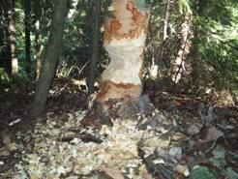
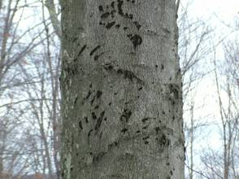
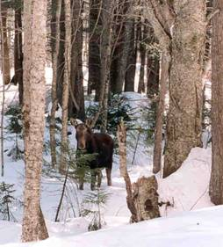
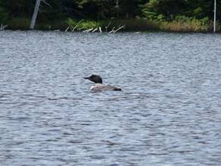
…”devoted to the public purposes of recreational, scenic, scientific, educational, conservation, and historical use”
Notes:
State hunting and fishing laws apply in Vermont Wildernesses.
Bear hunters can use telemetry year round with dogs to track bears.
Telemetry with dogs causes bears to fear humans and dogs more. May contribute to the reason we have less bear encounters.
A pair of loons have successfully had their young hatch and survive at Bourn Pond most recent years.
(Clockwise) Bear claws on a beech tree, a beaver chewed tree, Lye Brook Wilderness, a moose and a loon.

Slide 30
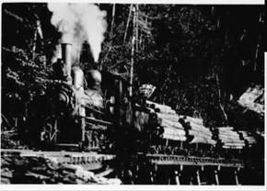
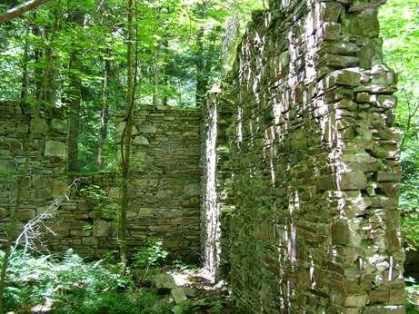
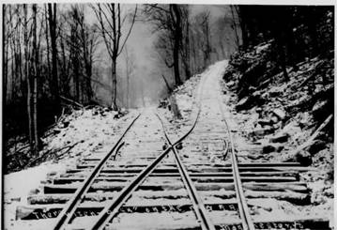
…”devoted to the public purposes of recreational, scenic, scientific, educational, conservation, and historical use”
Notes:
The Wilderness Act recognizes historical use as a purpose of wilderness.
In fact, the Wilderness Act of 1964 and the National Historic Preservation Act of 1966 represent Congress’s recognition of two Acts that work together in preserving the past. Both have a similar focus, to preserve and manage significant resources for the enjoyment and use of present and future generations.
Evidence of past uses are visible in parts of our Vermont Wildernesses. The photo on the left is of huge foundation walls discovered off trail in the Lye Brook Wilderness near a stream. Photos on right are in Lye Brook too.
Decisions on whether to remove artifacts, move them, preserve them, or let them “melt” into the landscape are based on their significance historically in relation to what effects the decision has on wilderness values.
Interpretation of historical sites is normally done outside of Wilderness.

Slide 31
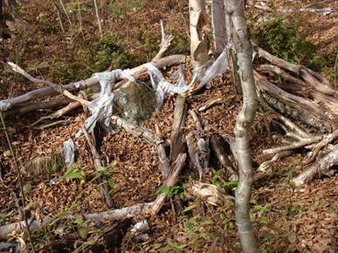
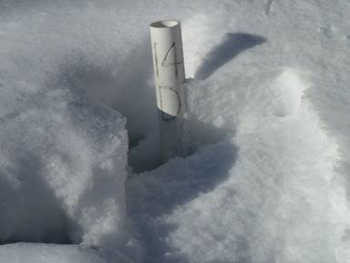
Why Monitor Threats to Wilderness?
A loss of naturalness and wildness is incremental.
Ultimately, in the long run, if monitoring is not consciously done, “degradation creep” builds up to dramatic levels and it is often difficult to reverse.
Joseph Battell Wilderness: An old, abandoned human shelter remaining as trash and an unidentifiable, research study plot marker (one of many here).

Slide 32
Some Wilderness Ranger Activities to Protect Wilderness as an Enduring Resource
Abandoned Property , Human-made Structures and Trash Removal.
Campsite Condition Inventory and Monitoring.
Wilderness Boundary Monitoring and Signing.
Monitoring Motorized and Mechanical Equipment Trespass.
Advanced Technology : Following Geocaching.
Monitoring Pre-existing Special Use Authorizations, Recreation and Non-recreation Special Use Permits.
Finding and Documenting Illegal Trail Cutting.
Invasive Species Inventory and Removal.
Reports, Records and Data Entry.
Notes:
At the same time, the days of the Wilderness Ranger daily operations of making visitor contacts, cleaning campsites, providing a Forest Service presence and performing trail maintenance has become more complex to incorporate in a schedule.
We will explore each one of these threats to Wilderness so I won’t repeat them as there are many!

Slide 33
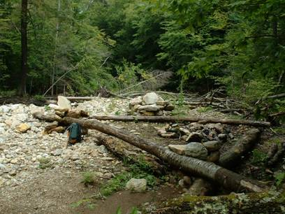
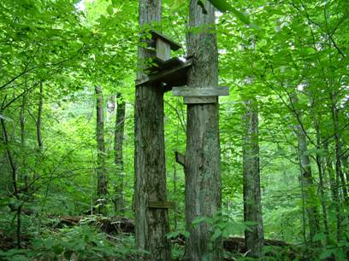
Human-made Structure Removal: From Native Materials to Processed Wood Construction
Notes:
Structures such as human-made seating, multiple campfire rings or natural shelters are dispersed back into the wilderness when found. These unnecessary items contribute to a “wilderness degradation creep” that do not fit the law or spirit of wilderness.
A permanent deer stand left up in the Lye Brook Wilderness that is old and falling apart. It will need to be dismantled and carried out.

Slide 34
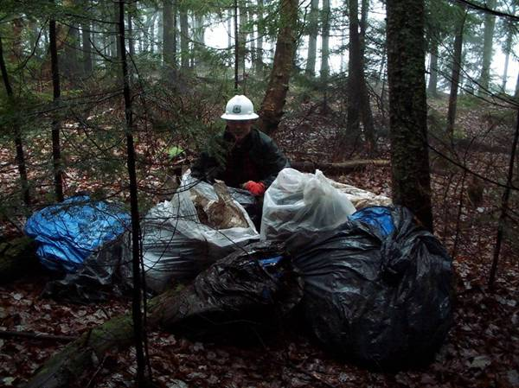
Trash Removal
Notes:
Much time is spent taking things out of the Wilderness that does not belong there.
Careful searching can reveal trash sites stashed by campers such as this one even in remote locations.
Incident reports are written to reflect these findings.

Slide 35
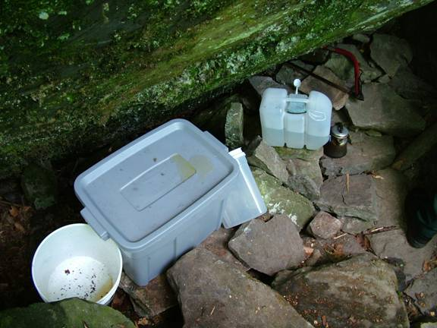
Abandoned Property
Notes:
Someone was found occupying a cave in the Bristol Cliffs Wilderness. A notice is put in the local papers and at the cave for removal of the items. After a certain number of days and under the supervision of a law enforcement officer, items are inventoried and cached if not removed. Items may be discarded or put up for auction depending on their value after a period of time. There is a Green Mountain Supervisor’s Order that allows someone to only stay on the Forest 14 days out of thirty a month to discourage vagrancy.

Slide 36
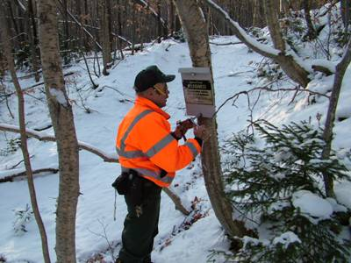
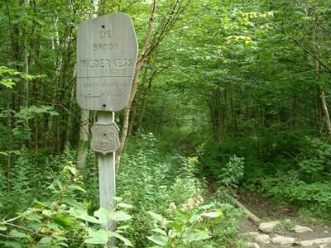
Wilderness Boundary Signing
Notes:
(Left) shows where license plate signing in Breadloaf is used to indicate wilderness boundary locations in a remote access area.
(Right) Appalachian and Long Trail hikers will see more pleasant wilderness boundary portals such as this Lye brook example.

Slide 37
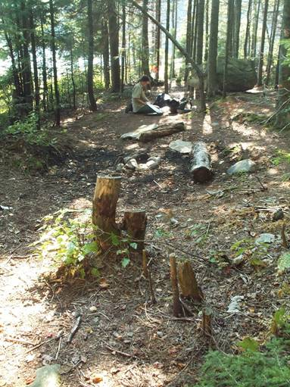
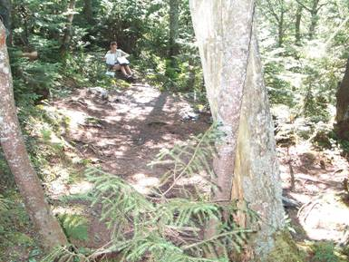
Campsite Condition Inventory and Monitoring
Digital Pictures
GPS Locations
Site Mapping, Measuring and Reference Points
Inventory of Area Damages
Notes:
Campsite Monitoring : Done in a rotation of five years to reflect changes for the better or worse to a baseline.
This is a very detailed process that gives us accurate data for long term monitoring efforts and provides a baseline for future management decisions.
Data items are recorded on a sheet and rated 1 – 5 to determine a site condition impact index number. Some of the data items recorded are the camp area, core area, social trails, tree damage, litter and duff, etc.

Slide 38
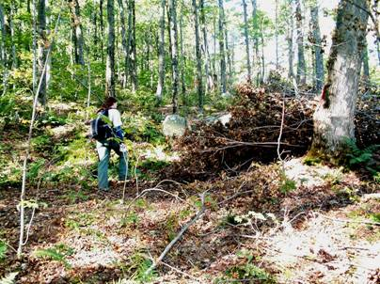

Wilderness Boundary Monitoring
Notes:
Red paint is often used to mark wilderness boundaries where there is private land up against it.
(Left) shows where a private timber sale had mistakenly taken National Forest timber over the line in Wilderness. The timber company was fined for the motorized use as well as for the wood value taken from the National Forest.
(Right) wilderness boundaries are set by legal descriptions and are not always clearly marked. This require interpretation in the field i.e. – road sides and trails may have various offsets (300 feet; 2 rods, or even “the edge” of a trail) out from the center of a town road. Here we are challenged by the expanded Rootville Road construction and roadside logging activity.

Slide 39

Notes:
GPS units such as this Trimble unit are a highly valuable tool for following boundaries and recording locations. Also determining which trails and old logging roads entering the wilderness needing to be signed or blocked are found with an accuracy of 3 meters. The knowledge for pre-loading maps and themes into these units or recognizing the time for processing and organizing any field data into maps later can be huge and requires quite a bit of specialized computer training.

Slide 40

Human Vandalism to Signs = Maintenance
Notes:
Austin Brook access is on the end of a cherry stem road. Here a visitor broke off the Plexiglas to get at a map indicating the Breadloaf wilderness.

Slide 41

Animal Damage to Signs = Maintenance
Notes:
Animal damage to signs occurs too, requiring maintenance needs.

Slide 42


Monitoring Motorized and Mechanical Equipment Trespass: Motorcycles and ATV’S
Notes:
(Left) Motorcycle tracks up Lye Brook Trail into the Wilderness. I personally observed this while cleaning water bars. Snowmobile tracks have been documented going up this trail too.
(Right) ATV bridge over river into the Lye Brook Wilderness. We dismantled the bridge and signed the area.
Sometimes, such as in this case, a letter to a camp owner whose tracks lead from their camp to the wilderness is an effective strategy.

Slide 43

Notes:
Jon and Carol, Wilderness Rangers in 2007.
Travelways management sometimes means placing rocks across snowmobile trails that go into wilderness such as this one. An alternate route along a power line was available. A power winch on a fire truck with a cable was used to block this one off naturally. Signs went up later.

Slide 44

Monitoring Motorized and Mechanical Equipment Trespass: Snowmobiles
Notes:
Success story? A snowmobile went around a Forest road gate and up Ausitn Brook. It turned around at the boundary sign.

Slide 45



Advanced Technology : Following Geocaching
Notes:
Picture of a geocache taken at Lye brook Falls. People sign in or take and leave toy items in a box. I found one by accident next to the Lake Trail bridge in the Big Branch Wilderness that said on a sandwich box that it was not trash. Inside was a rubber stamp kit and a notebook.
The use of GPS equipment, cell phones, radios, beepers, pagers, and other electronic equipment has become increasingly common. Some consider these intrusions of advanced technology in a place established for self reliance and wilderness discovery.
Wilderness Rangers have been documenting geocache impacts in Wilderness for now. (sometimes putting a Leave No Trace card inside them!) It is easy to go to websites and find their locations.
It may be more appropriate for geocache boxes to be located outside of wilderness in the other 75% of the Forest to avoid degradation creep. Alternately, virtual sites could be used, but all this is relatively new.

Slide 46


Monitoring Pre-existing Special Use Authorizations
Non- Recreation Special Use Permits
Recreation Special Use Permits
Notes:
Pre-existing Special Use Authorizations and private land inholdings within wilderness areas can create impacts.
Property owners have a right to reasonable access and use of their lands.
This sometimes allows motorized access to be granted in wilderness. Camp owners may need to be reminded to stay on agreed access routes with their ATV’s and Snowmobiles. Changes in the facilities need to be checked too.
Non-Recreational Special Use permits are also important to monitor to see that they are abiding to the guidelines of the permit. An example is this picture of a water tank and water line that exists in the Bristol Cliffs Wilderness that is checked on by Wilderness Rangers occasionally.
Recreation Special Use permits are a big issue as groups have significant social and biological impacts in wilderness. Wilderness Rangers check groups that charge a fee for valid permits and see that they are following their restrictions.

Slide 47


Finding and Documenting Illegal Trail Cutting
Notes:
Picture on left is of a four foot wide trail cut to Little Mud Pond linked to a major snowmobile route.
Picture on right is of trail cutting in the Aiken Wilderness. The height of the cutting gives a clue that it was done in the winter for winter use.
Code of Federal Regulation 261.10 (a) Signing is put up to let people know that cutting new, unauthorized trails carries a fine of $150.

Slide 48


< A sign has been placed stating no cutting or maintaining of new trails is allowed without permission on an illegally cut trail.
Repeated glade skiing by groups does undocumented damage on vegetation too. >
Photo by Jeff Harvey 1/27/2008
Notes:
Trails illegally cut open for skiing, sledding and snowboarding are becoming more common. Above, is a trail I found and signed for no cutting that is obviously known by someone and used often in the Breadloaf Wilderness in the Lincoln Gap area. A lot of times the cutting starts away from main trails or roads to remain hidden but tracks show use to them just the same. Even without cutting new trails, groups skiing or snowboarding through glades off trail or cutting switchbacks has shown damage to small understory trees by stripping whole branch sides or the tops off.

Slide 49


The Chief’s Ten Year Wilderness Stewardship Challenge
Goal :
To have all the Forest Service wilderness areas managed
to a “minimum stewardship level” by 2014 coinciding
with the 50th anniversary of Wilderness Act.
Notes:
The Chief’s Ten Year Wilderness Stewardship Challenge is an additional, accountable but worthy challenge to Wilderness Staff and other specialists beyond normal operations and maintenance.
Each and every wilderness must score a minimum of 60 points to be considered meeting this challenge to standard.
The average wilderness score has risen from 34.7 in FY 2005 to 42.3 in FY 2007.
(Breadloaf MT and falls in Big Branch Wilderness)

Slide 50




Invasive Species Identification and Removal
Japanese
Barberry
Garlic Mustard
Bush
Honey Suckle
Japanese Knotweed
Notes:
Invasive Species identification and removal has become an important element to meet to standard in the Chief’s Ten Year Wilderness Stewardship Challenge.
For example, at the Lye Brook Trailhead in Manchester, we have discovered Morrow Honey Suckle. First, we turn in data sheets with specific information, gps location, a sample and a rough drawing of a map of the invasive species locations, and then work with a Forest Ecologist to correctly complete the removal.

Slide 51

Honey Suckle Popper
Notes:
A Honey Suckle Popper was purchased to remove Honey Suckle at trailheads. It is like a huge adjustable pry bar using a piece of wood as leverage. Here, Wilderness Ranger Morgan is getting some by the roots. It is very important to consult with the Forest Ecologists because they can tell you about the dangers of spreading invasive species. Fortunately, we removed these plants after their berries had gone by. Otherwise, they needed to be bagged and destroyed properly.
Training is important. Cutting Japanese Knotweed incorrectly, can lead to the individual pieces cut to re-root and spread the plant more rather than contain it.

Slide 52

Where does most of this information go???
Notes:
Pause and look confused…

Slide 53



Where does most of this information go???
A.
B.
C.
OR
Click to the next slide please…and quick ->
Notes:
Joke? ☺

Slide 54

Where does most of this information go???
INFRA WILD : National Reporting
  Wilderness Regulations Report Wilderness Management Records
  Special Uses Summary Report
  Wilderness.net Web Links Summary
  Wilderness.net Public Contact Summary
  Accomplishment Report Summary
Notes:
INFRA WILD is a national database that is fairly new and evolving that keeps track of accomplishments, wilderness regulations, special use permits, and a variety of comparable data that can be processed across the country.
Some of these reports and records tie in with the wilderness.net website for wilderness regulations, national forest web site links and public contact information.

Slide 55
What We Have Done :
Laid out the locations and some of the highlights of the eight Green Mountain National Forest Wilderness areas.
Seen how the Wilderness Acts including the latest New England Wilderness Act of 2006 added acres to the Green Mountain National Forest.
Discovered the public purposes of wilderness.
Explored the role of Wilderness Rangers on the Greens and how they work to monitor and protect wilderness from threats to an enduring resource.

Slide 56

Time for Reflection
Notes:
The public purposes of the Wilderness Act help define the wilderness experiences, challenges and opportunities available to us for pursuing if we are indeed up for it.
Wilderness may not be “absolute Wilderness” free of human activity but it is still worth protecting.
Right now, the Green Mountain National Forest is within a days’ drive of 70 million people.
The best we can do is recognize and appreciate this slice of land we have, as something special… something to not disturb unnecessarily …. and try to work together to preserve its’ wilderness character against threats the best we can over time.

Slide 57
Where to Get More Information
Middlebury Ranger District, 1007 Route 7, Middlebury, Vermont 05753-8999. (802) 388-4362.
Rochester Ranger District, 99 Ranger Road, Rochester, Vermont 05767-9431. (802) 767-4261.
Green Mountain and Finger Lakes National Forests Supervisors Office, 231 North Main Street, Rutland, Vermont 05701-2417. (802) 747-6700.
Manchester Ranger District, 2538 Depot Street, Manchester Center, Vermont 05255-9419. (802) 362-2307.
www.wilderness.net
* All color photographs by Ken Norden except the one taken by Jeff Harvey
Notes:
The End! Thank you! (Click show off)

