Slide 1
Roads and Fires
Anatomy of Roads
Surface Drainages structures

Slide 2
Cut and Fill Road
Road Surface, Insloped
Cut slope
Gravel?
Fill Slope
Hillside
Ditch
Ditch Relief Culvert

Slide 3
Fill Roads
Fill Through
Turn Pike

Slide 4
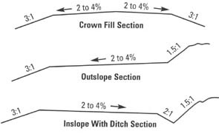
Road Surface Shape

Slide 5
Road Drainage – Belt Top

Slide 7
Rolling Dip
Spring and Fall use

Slide 8
Slash Filter Windrows

Slide 9
Ditch Relief Inlet

Slide 10
Common Impacts to Roads
Over use – powdering
Poor blading – side casting of surface material
Over watering – rutting
Damage to drainage structures – surface and ditch
Undercutting of toe slope – long term erosion
Damage to signs and gates

Slide 11
Discussion

