Slide 1
Resource Advisor Training
May 2014
Suppression Rehabilitation
Shane
Hendrickson
Julie Shea

Slide 2
Objectives
Non-Wilderness Minimum Impact Strategies & Techniques (MIST)
Concerns / capabilities of heavy equipment (aka Big Iron)
Example of Rehabilitation Actions and Objectives.

Slide 3
Roles & Responsibilities
Primary Objective: Identify Resource Issues of Concern
Prevent
Minimize
Repair
Communicate & Document
(WFDSS,IAP, Rehab. Plan, Strategy & Planning meeting)

Slide 4
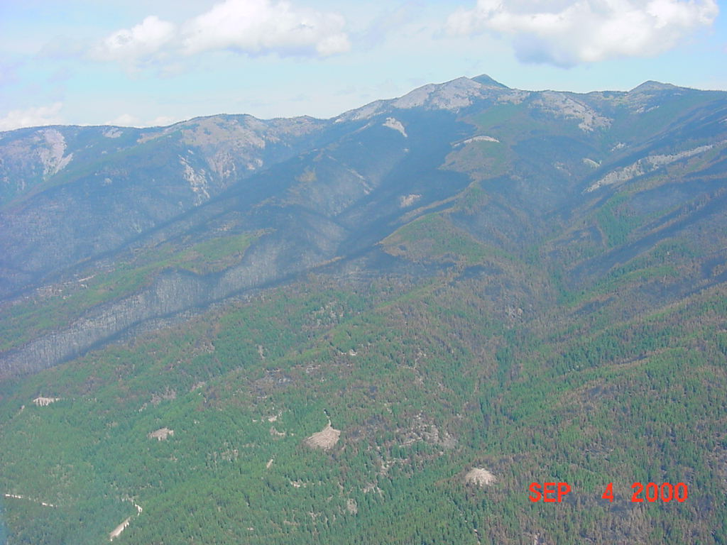
Suppression Rehabilitation
Repair or minimize damage to soil, water, and other resources directly attributable to the fire suppression activity on National Forest System Lands. This is based on premise that Forest Service programs must include precautions necessary to prevent their operations from causing damage to forest resources. Do this work in conjunction with or promptly following fire suppression action. (FSH 6509-11G, 52.15)

Slide 5
Suppression Impacts & Rehabilitation
General READ Concerns:
Overall suppression strategy (Confine, Contain, Control)
Letter of Delegation/WFDSS/IAP Direction.
Values at Risk
Equipment Inspection
Weed transport (Forest EMS requirements)
Aquatic Nuisance Species transport
Equipment Use (Impacts to various resources& Rehab.)
Stream crossings
Line Construction
Safety Zones
Road Impacts & Rehab.
Summary

Slide 6
Suppression Rehabilitation
IC is delegated responsibility for completion of fire suppression activity damage repair
Funded through emergency suppression account (same as fire suppression)
Usually performed immediately after fire containment
Guided by specifications provided by home unit in Delegation of Authority and Rehabilitation Plan

Slide 7
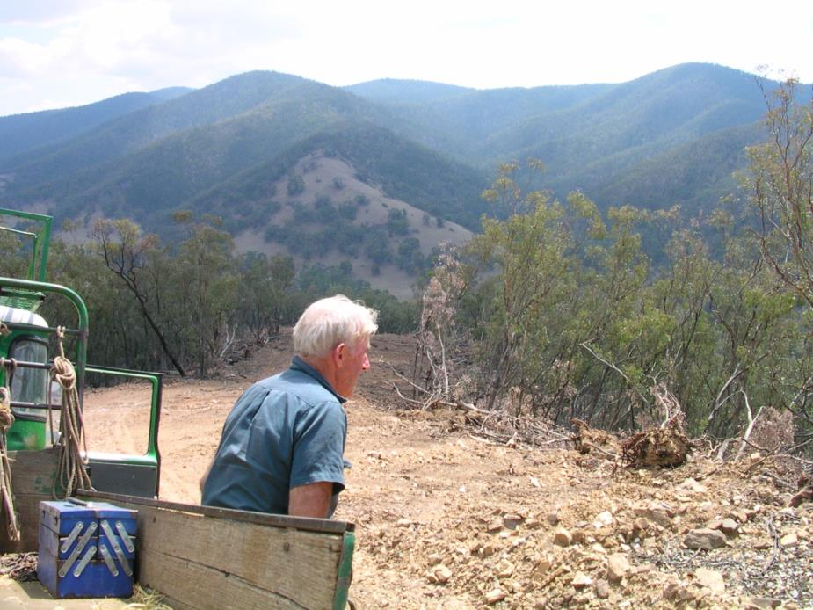
Fire Suppression Rehab: Federal Fire Protection Jurisdiction on private or other agency lands
* Provide contact/rehab coordinator assisting rehab on private land

Slide 8
Suppression Rehabilitation Plans
Goals
Objectives
General Rehabilitation Guidelines
Standard Specifications (i.e. water bar spacing, seeding rates, fertilization rates)
Site Specific Rehabilitation Needs
Implementation Monitoring

Slide 9
UPPER NINEMILE COMPLEX SUPPRESSION REHABILITATION PLAN
Rehabilitation Objectives:
1) Firefighter Safety – Ensure all suppression rehabilitation work is done in a safe and efficient manner.
2) Vegetation and Soils – Avoid accelerated soil erosion, restore natural landscape surface water flows, and reestablish vegetation to prevent accelerated soil erosion.
3) Water Quality - Minimize sediment delivery into streams and/or drainages to maintain water quality. Restore drainage patterns along cat lines.
4) Noxious Weeds – Minimize noxious weed spread along all constructed dozer lines, safety zones, and drop points to protect native vegetation.
5) Fish Habitat- Mitigate effects to shade and large woody debris loss along riparian corridors.
.
.

Slide 10
UPPER NINEMILE COMPLEX SUPPRESSION REHABILITATION PLAN [cont]
6) Heritage Resources - Protect cultural resource sites that were impacted; rehabilitate areas where fire suppression activities destabilized slopes above sites.
7) Facilities (ICP) - Restore to original pre-fire condition as agreed to by Lolo NF and Ninemile and Plains Districts management.
8) Travel/Access Management - Restrict unintended/undesired access to motorized vehicle travel that may have been created by the construction of dozer lines. Provide for re-establishment of pre-incident road closures and re-establish administratively desired roadway widths to pre-disturbance widths.
9) Visuals - Maintain visual quality near major Forest system roads.
10) Cleanup – Remove suppression related material (debris, trash, signing, flagging) at facilities used by suppression personnel. Also, remove fire suppression related products including flagging and discarded fire hoses.

Slide 11
UPPER NINEMILE COMPLEX SUPPRESSION REHABILITATION PLAN[1]
General Action Items to Meet Rehabilitation Objectives
Hand lines
Pull berms into hand line and restore line to blend with undisturbed soil contours.
Berms, topsoil, and organic matter should be pulled back onto the hand line. Scatter limbs and tops to obliterate evidence of the line as much as practical.
Water bar spacing should follow standard specifications stated below.
Hand lines should be seeded at rates specified below. Seeding should occur prior to pulling berms and organic matter back over the line.
Block off motorized access.
Remove all trash, equipment, and flagging.
Where a designated Forest system recreation trail was used for fire line, reconstruct the trail tread to 24”. Trails created during fire suppression will be rehabilitated.

Slide 12
UPPER NINEMILE COMPLEX SUPPRESSION REHABILITATION PLAN
Dozer Lines
Pull berms back into line. Provide drainage with water bars. Water bars should follow standard specifications stated below.
Whole tree yard with root wad and other organic material back into line perpendicular to slope. Lop and scatter limbs and tops onto line, placing in contact with the ground. Block off motorized access.
Seed and fertilize all disturbed sites according to specifications.
Construct dozer line closures, using boulders or natural large woody material, to eliminate motorized access.
Remove trash, equipment, and flagging from the area.
Dozer lines that were constructed across slopes will need to be fully obliterated with slash pulled across the top.
On steeper dozer line (>50%) whole trees may be used as water bars. Spacing will follow standard specifications stated below. Water bar outlets should also be alternated to the opposite sides of line.

Slide 13
UPPER NINEMILE COMPLEX SUPPRESSION REHABILITATION PLAN
Site Specific Rehabilitation NEEDS:
Blue/Pine Flank:
Fire suppression efforts created a combination of dozer and excavators lines. Also, existing roads (#5500) were widened to create a better fuel break. Other roads were previously grown in with trees and shrubs and then reopened as fire lines or access routes. A total of 10 miles of road were used to access the fire. Approximately 3 miles were grown in and were not accessible (#18010 & portions of #5500). Several relatively short sections of dozer line were constructed above road #5500 to provide a more direct line and cut off points in the road around ridgelines. There are at least eight safety zones in this area that removed trees and shrubs and exposed bare mineral soils.
Dozer lines between Camp Creek and Blue Creek will need ripping in order to alleviate soil compaction, deeper ripping will be required on access route #18009. Dozer and excavator lines on the Pine Creek side will need berms and slash pulled over the disturbed area and then seeded and fertilized. The dozer lines above road #5500 will need ripped, seeded and fertilized. Berms will need pulled and slash scattered. One of these lines is constructed on an old road bed that had grown in and will need deeper ripping to reduce compaction.

Slide 14
UPPER NINEMILE COMPLEX SUPPRESSION REHABILITATION PLAN
Site Specific Rehabilitation Needs
Blue/Pine Flank, cont:
Access roads, approximately 7 miles will need bladed, surface drainage repaired, rock raked, and seed/fertilized.
Access roads, approximately 3 miles will need to be treated for weeds, deep ripped, slash pulled over disturbed areas, and seed/fertilized.
An excavator line also crosses Big Blue Creek and an intermittent drainage, thus requiring the stabilization of streambanks with native materials.
Safety zones will need to have berms and slash pulled over the top of disturbed areas and then seeded and fertilized. Tree planting may also be part of the rehabilitation effort in order to reestablish stocking rates and alleviate long-term visual concerns.

Slide 15
Equipment Inspection - Weed Wash

Slide 16
Equipment Inspection - Aquatic Nuisance Species

Slide 17
Equipment Inspection - Aquatic Nuisance Species
Where problems
may occur
Drafting from contaminated source
Sucking up organics and sediment
Transport to new sites
Cynthia Tait, USFS

Slide 18
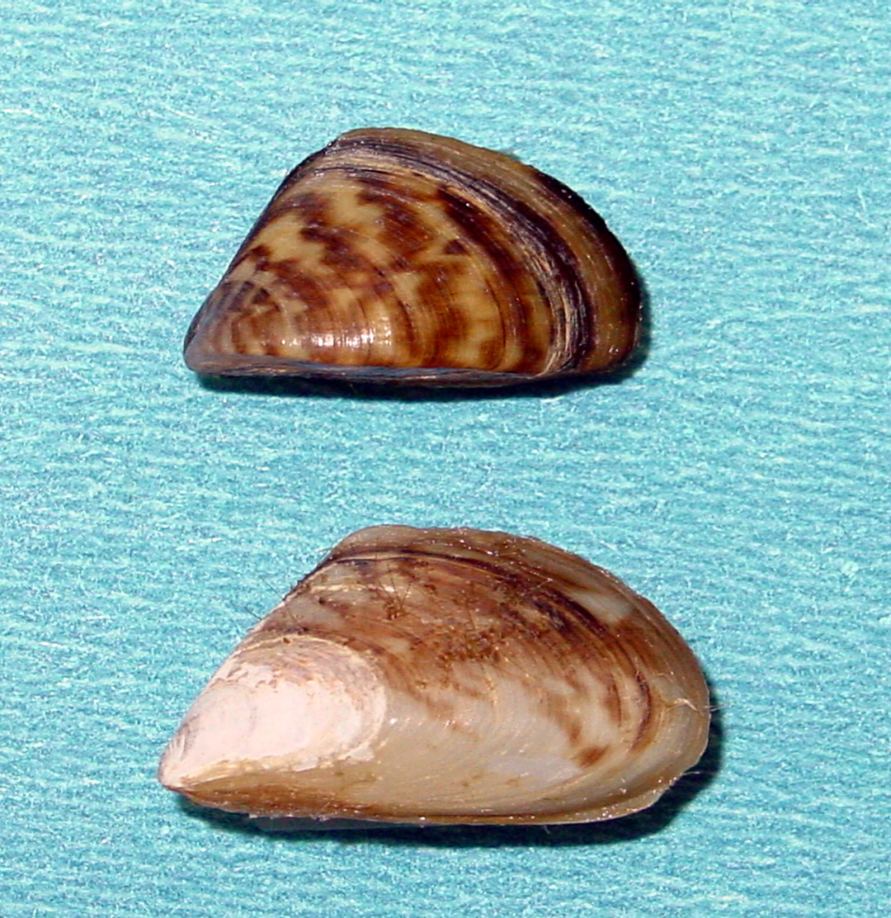
zebra
quagga
Cynthia Tait, USFS

Slide 19
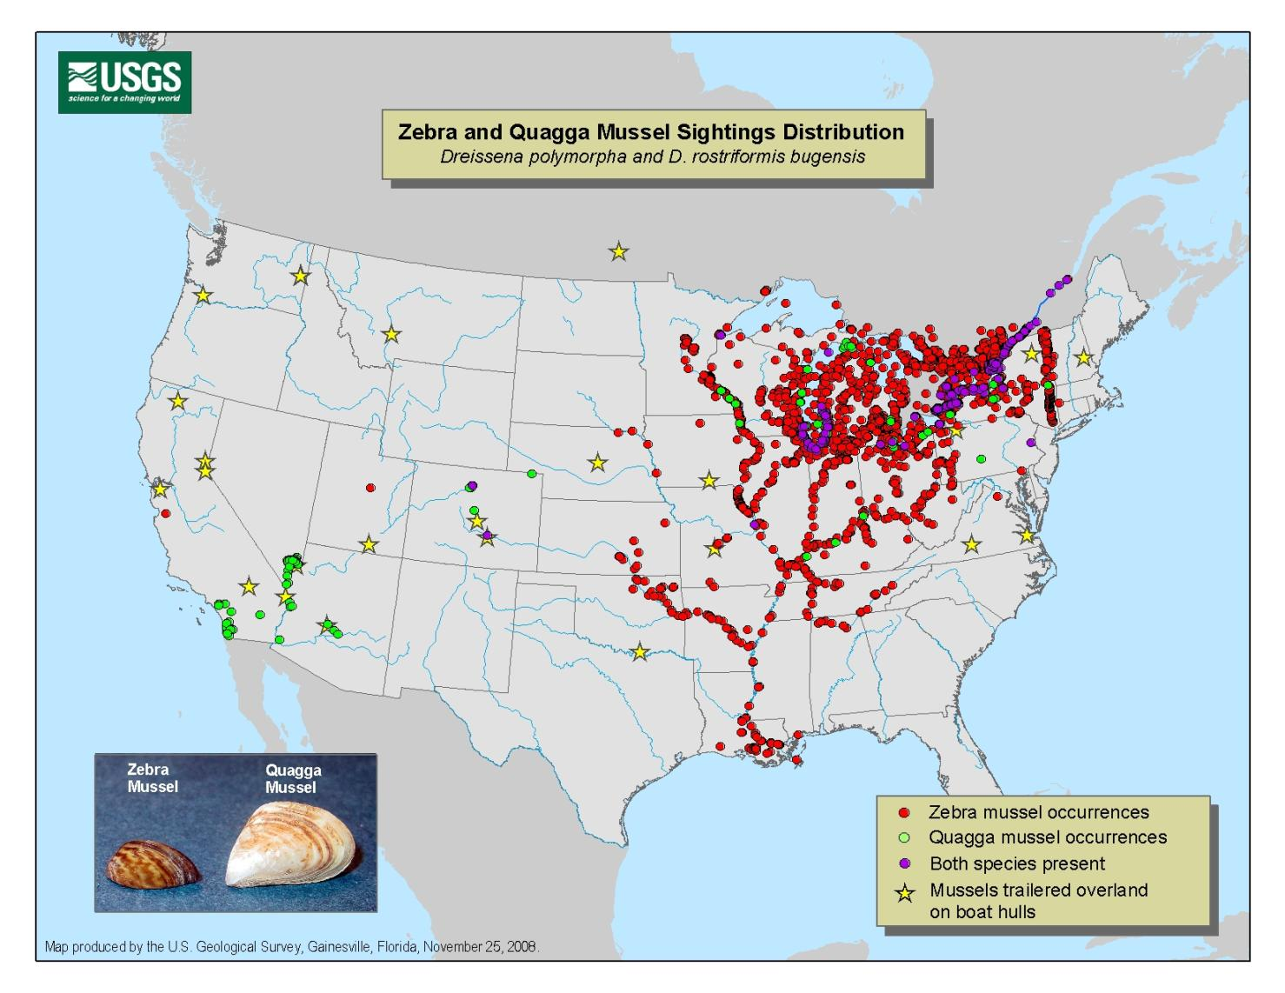
NOV 2009

Slide 20
Zebra and Quagga Mussels
Cynthia Tait, USFS

Slide 21
Lake Michigan

Slide 22
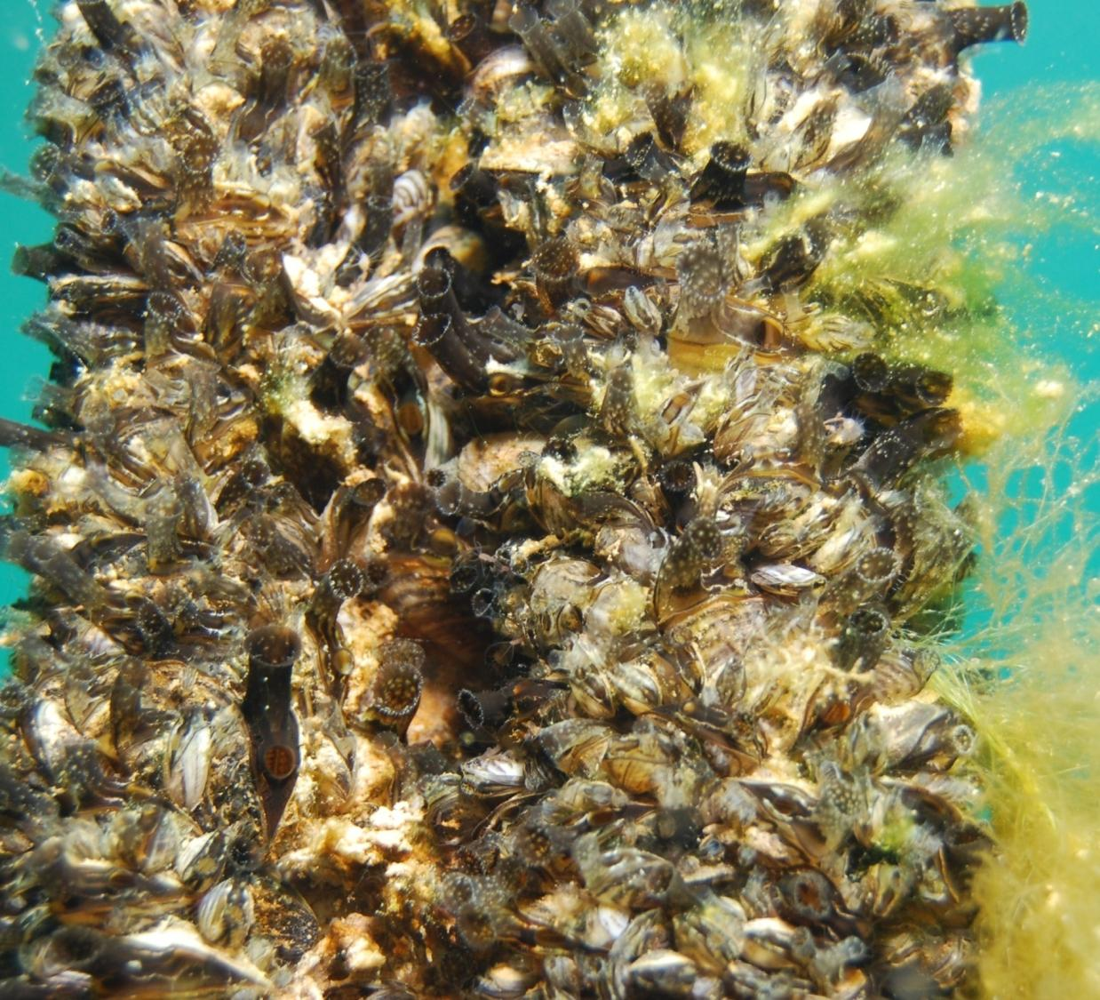
Quaggas on
Lake Mead dock rope
Cynthia Tait, USFS

Slide 23
Bottom Line:
Quagga mussels overwhelmingly spread by boaters; risk of spread by FS ops (relatively) low
FS ops unlikely to come into contact with adult mussels
BUT pumped water or gear surfaces may be contaminated with veligers
Cynthia Tait, USFS

Slide 24
Recommendations:
Wash the outside and inside of equipment that will come in contact with waterbodies :
Wash debris, mud, sediments, organisms, plant material and fragments from all equipment that will enter water feature. Allow equipment to thoroughly air dry (inside and out) for a minimum of 48 hrs.
Wash equipments with heated water (>140° F) for a minimum of ten minutes and until all mud, sediments, organisms, plant material and fragments are removed from equipment. Allow equipment to thoroughly air dry for a minimum of two hours, or until no visible moisture exits.
Wash equipment with a minimum of 5% Quaternary ammonium solution (Quat128 Sparquat256) for a minimum of ten minutes and until all mud, sediments, organisms, plant material and fragments are removed from equipment. Allow equipment to thoroughly air dry for a minimum of two hours, or until no visible moisture exits.
Cynthia Tait, USFS

Slide 25
Sumps

Slide 26
Equipment Usage
Stream Crossings

Slide 27
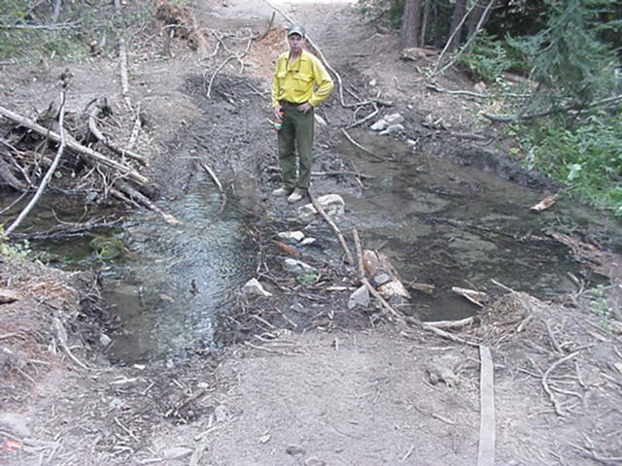
Stream Crossings Cont.

Slide 28
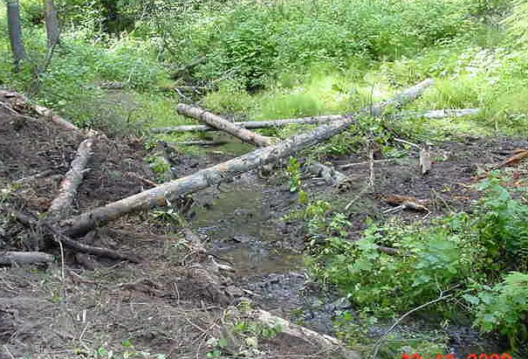
Stream Crossings Cont.

Slide 29
Stream Crossings
Avoid if you can.
Minimize it when you can’t avoid it
Lift blade when crossing stream (15’-25’ both sides of stream). Plan and using hand crew to tie line together.
Cross stream at right angles.
Don’t parallel stream within the riparian area

Slide 30
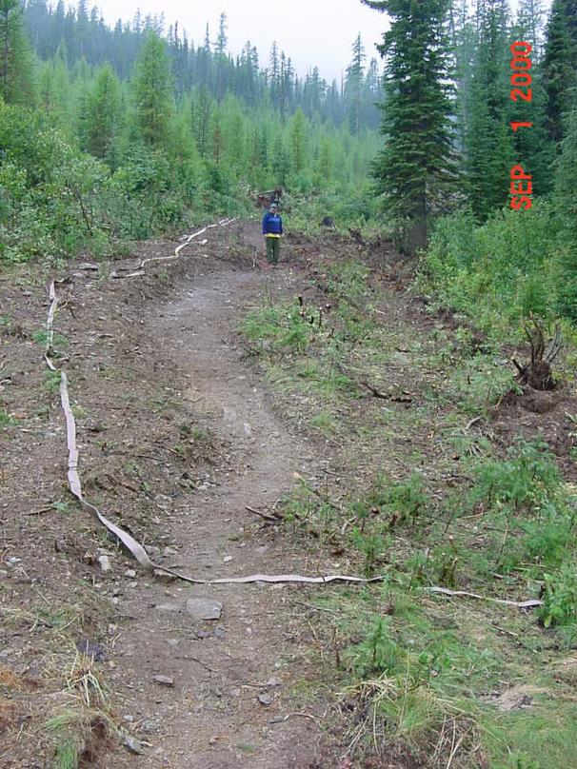
Hand/FLE Lines
Spread berms, topsoil, and organic matter onto the hand line. Scatter limbs and tops (even burned material) to obliterate evidence of the line as much as possible. Leave site in a roughened conditioned to allow for better water infiltration and seed take.
Provide drainage with water bars (where appropriate) ¹. Water bar spacing should follow standard specifications stated below. (Water bars are needed in rehabilitation situations where surface runoff is expected.)
Where a designated Forest system recreation trail was used for fire line, reconstruct the trail tread back to pre-suppression condition. Trails created during fire suppression will be obliterated.
Seed hand lines at rates specified below. Seeding should occur after pulling berms and organic matter back over the line². (Seeding may not be needed if there is an adequate duff layer that can be pulled back over the line.)
Block off motorized access.
Remove all trash, equipment, and flagging
Figure 1. Hand line prior to rehab. Pull berm and slash back onto line. Ensure that motorized access is blocked.

Slide 31
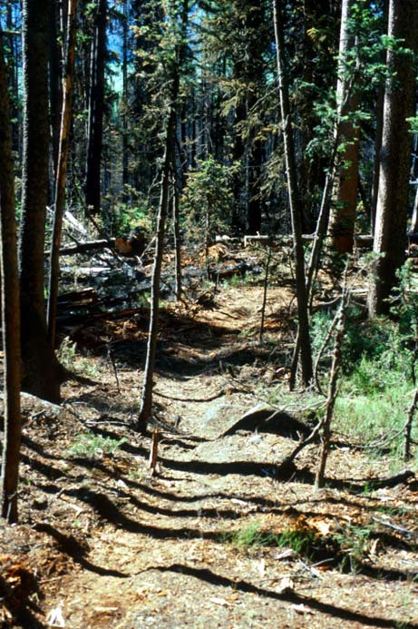
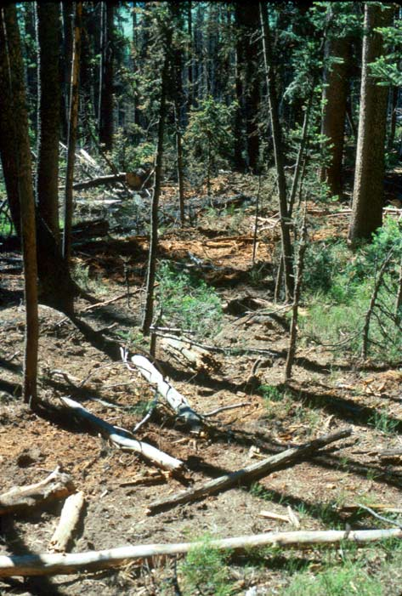
Handline Rehab

Slide 32
Lines and Fuel Breaks
Indirect lines
Direct lines
Fuel breaks
Single blade width
Double blade width
Excavator bucket width
Above combinations with fuel breaks

Slide 33
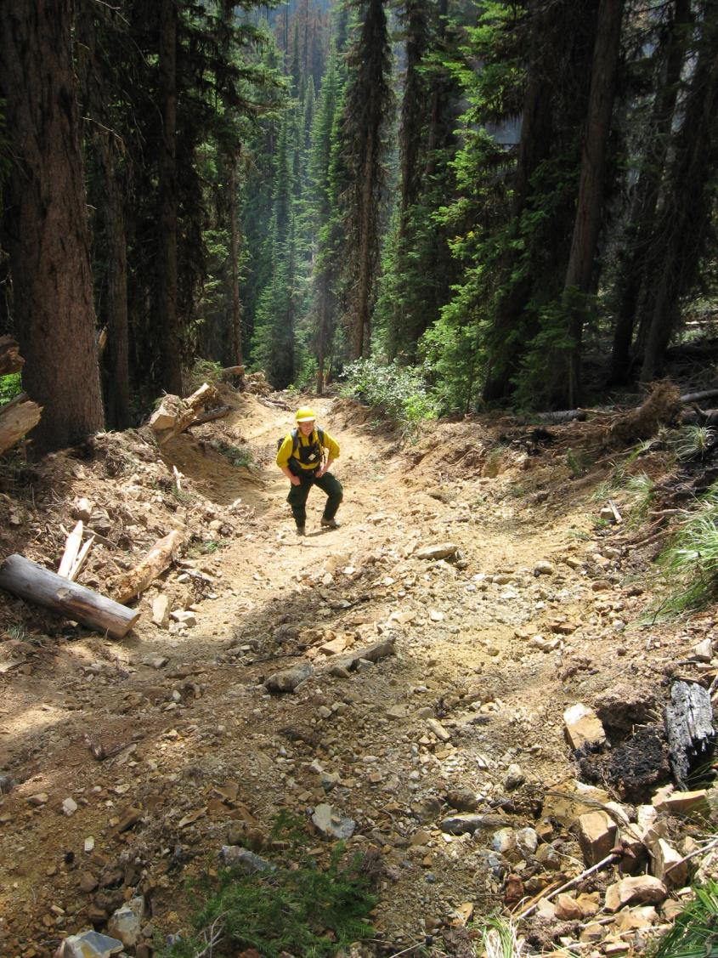
How deep does a line need to be?
4 – 5 Ft

Slide 34
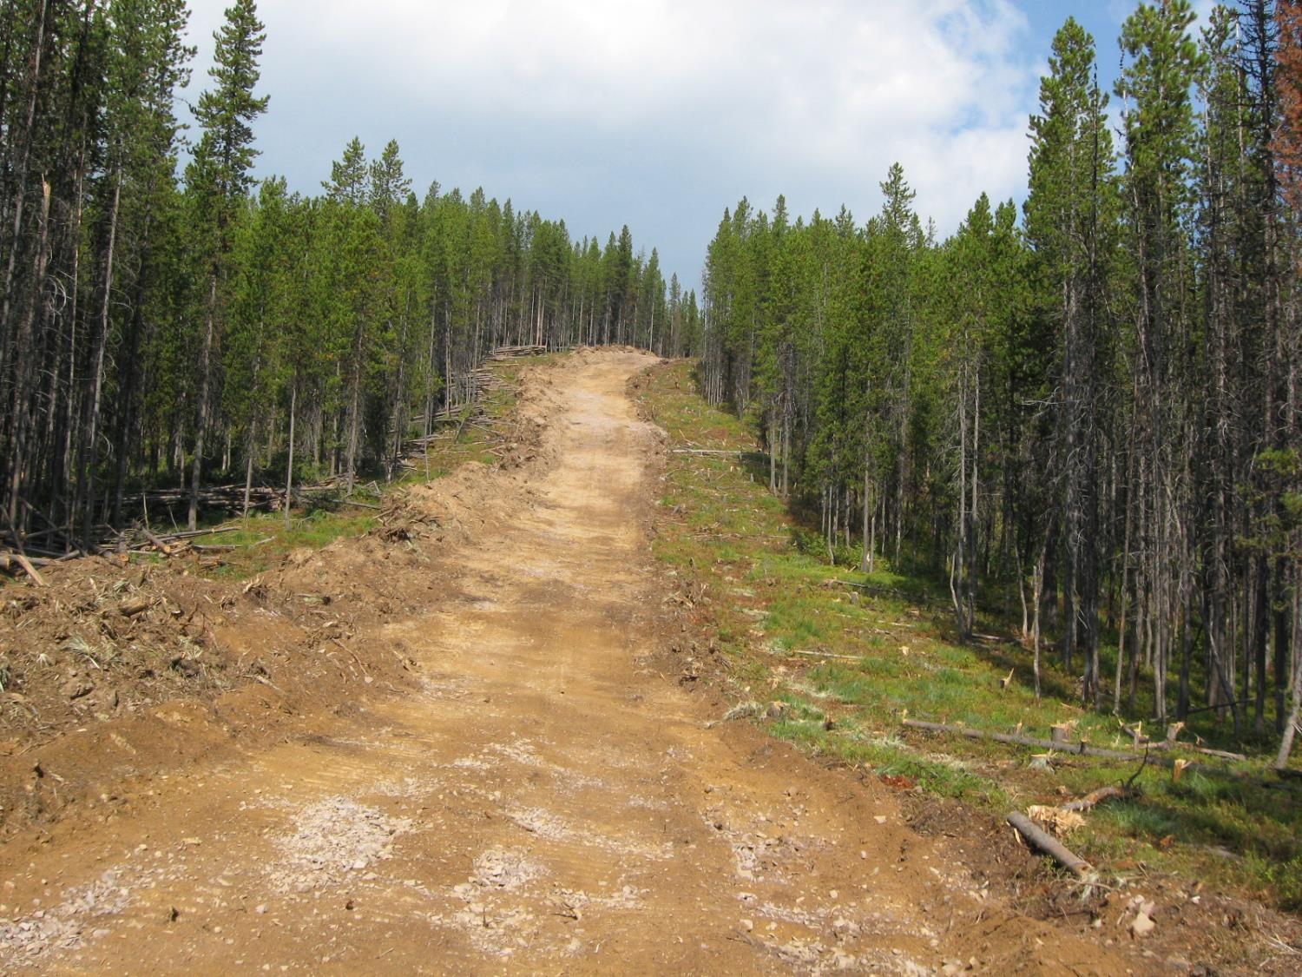
Indirect Line

Slide 35
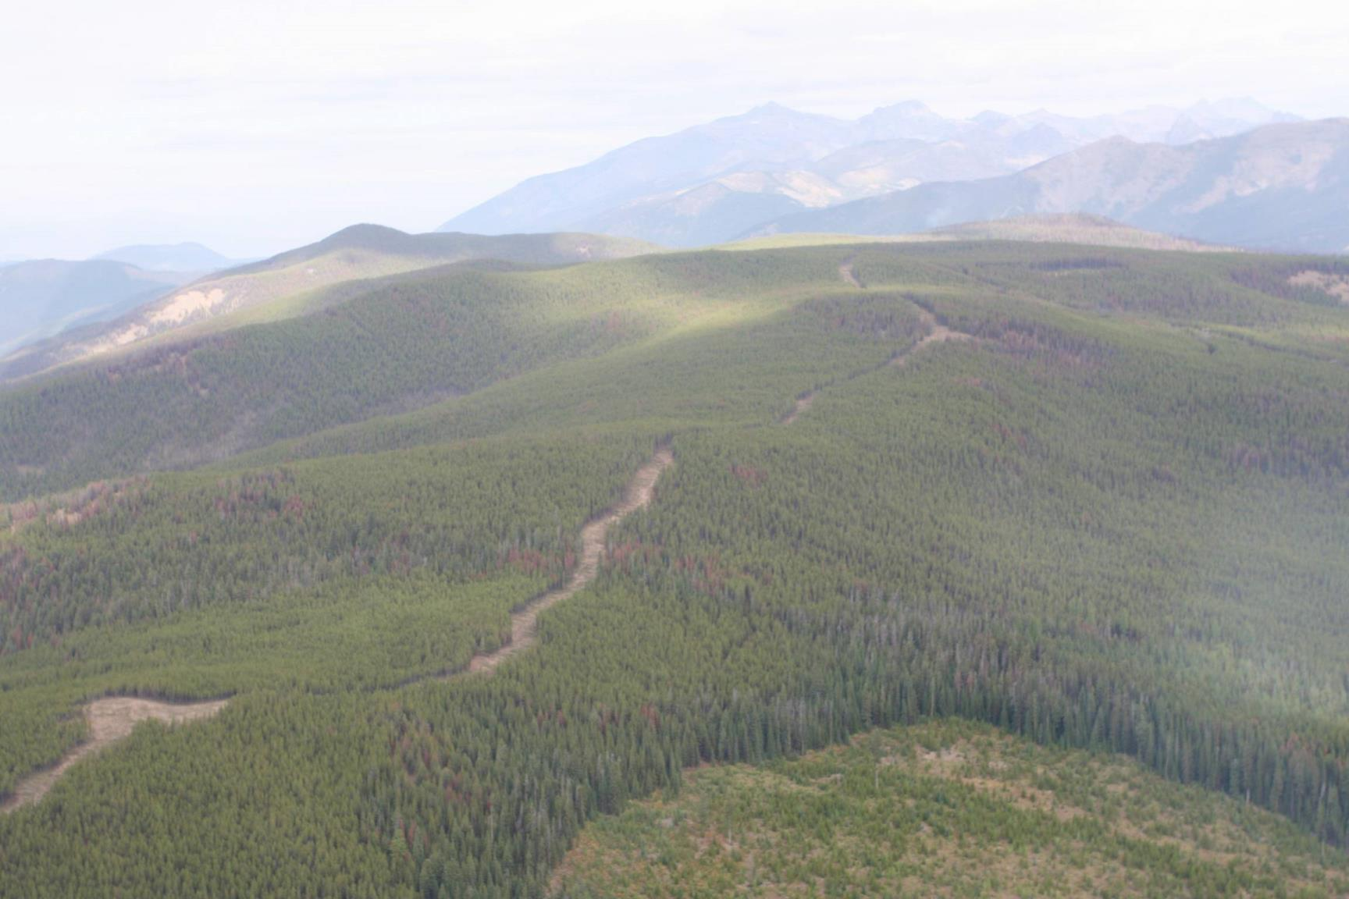
5 miles long
2 – blade line
30’ – 100’ fuel break

Slide 37
Direct Line

Slide 39
Ended up with 70%+ dozer line
Required special equipment and operator to complete rehab.

Slide 40
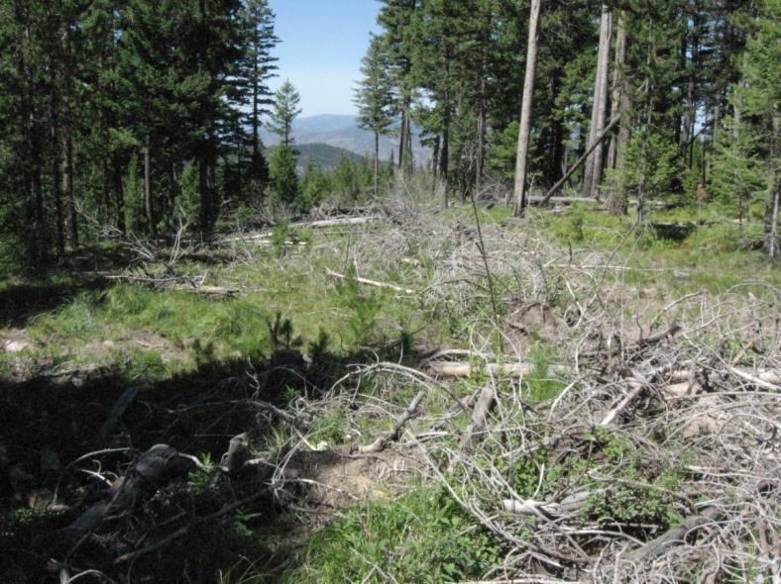
2000 Dozer Line on 70% slope
2000 excavator Rehab.
2009 after photo
Decompact soils
Pull berm and duff layers
Pull slash over top
Seed

Slide 41
Excavator Line

Slide 42
Excavator Line

Slide 43
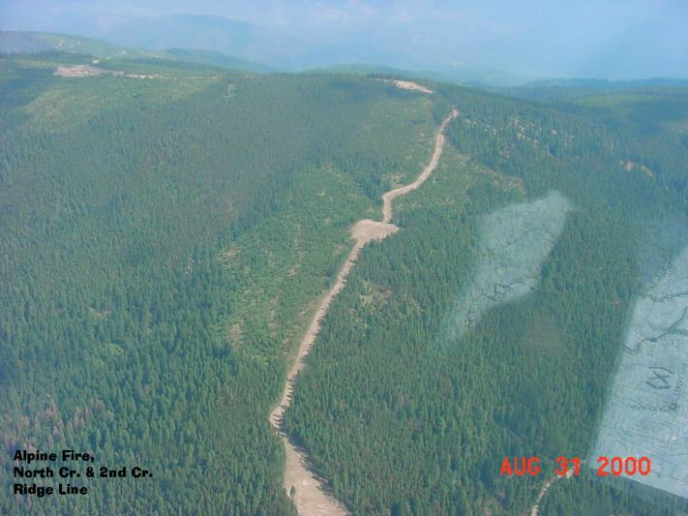
Dozer Lines
Use an excavator (with articulated thumb) or hand crews to spread berms back over line. (dozers are not recommend for dozer line rehab)
Fully obliterate (fill pulled up to top of cutslope) dozer lines that were constructed across slopes (cut and fill) and spread slash across the surface.
Provide drainage with water bars (where appropriate) ¹. On steeper dozer line (>50%) whole trees may be used as water bars (remove limbs & ensure continuous ground contact). Spacing will follow standard specifications stated on Page 11. Water bar outlets should also be alternated to the opposite sides of line where the line is perpendicular to the slope. Otherwise waterbars should discharge to the downslope side.
Whole tree yard with root wad and other organic material (even burned material) back into line perpendicular to slope. Lop and scatter limbs and tops onto line, placing in contact with the ground. Block off motorized access.
Seed and fertilize all disturbed sites according to landowner specifications.²
Eliminate motorized access using boulders or natural large woody material.
Remove trash, equipment, and flagging from the area.

Slide 44
Safety Zones

Slide 47
Safety Zones
Where heavy vehicle traffic has compacted soils, scarify or deep rip the area as appropriate to reduce compaction and establish a sufficient seedbed. (digging a hole in the ground with a pulaski or shovel will help determine the depth of compaction and subsequent ripping depth)
Where topsoil has been removed, spread berm onto area and leave in a roughened condition to aid in water infiltration.
Disperse accumulation of downed trees and brush evenly across opening. Where appropriate transplant trees and shrubs.
Where safety zones occur adjacent to open roads, block off motorized access.
Seed and fertilize all disturbed sites according to landowner specifications².
Replanting of trees will need to be discussed on a site by site basis.
Remove trash, equipment, and flagging from the area.
Where appropriate, treat weeds at disturbed sites.

Slide 48
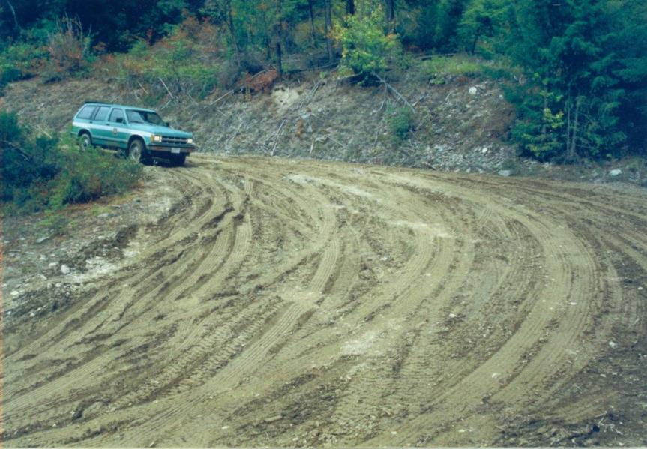
Improved Roads
Ditch Relief Culvert Crushed Ditch Function Compromised
Over Watering

Slide 49
Line Scouting

Slide 50
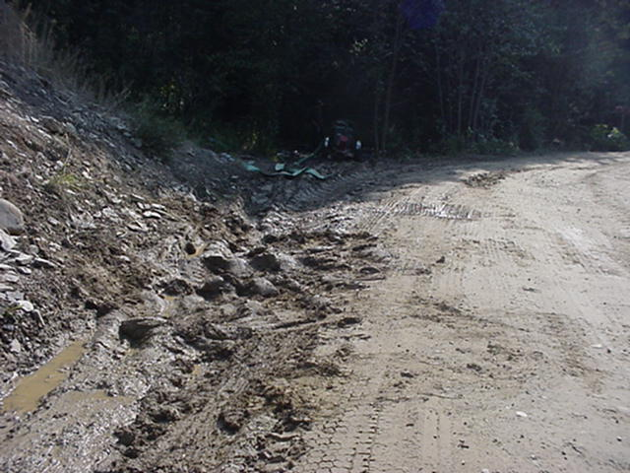
Improved Roads
Ditch Function Compromised

Slide 51
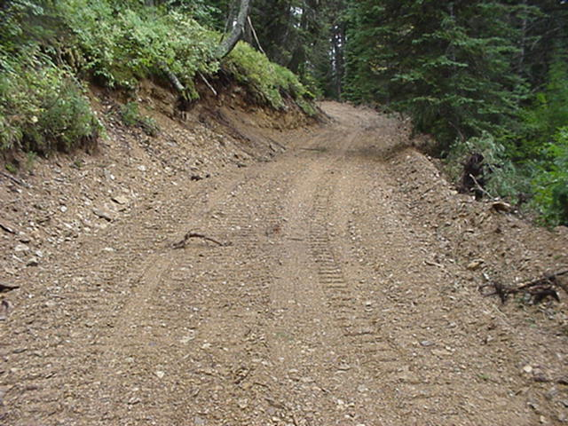
Improved Roads
Undercut Toeslope Berm on outside of road

Slide 52
Improved Roads
Road Powdering

Slide 53
“opening” closed or grown in roads

Slide 54
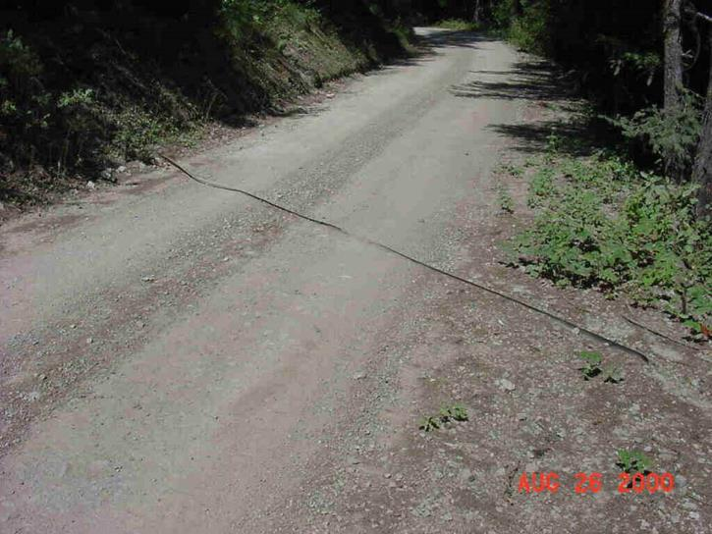
Roads³
Up to ten years of use can be put on certain roads during a large incident.
Rehab of road may require the need for an engineer from the appropriate agency.
Apply dust abatement early or water frequently, don’t over water.
Repair or replace damage culverts.
Repair shape of road to pre-fire conditions.
Where road widths have been altered, reestablish original road widths.
Remove berms and incorporate back into road prism. Reconstruct appropriate road surface drainage.
Restore/replace any damaged drainage features, i.e. culverts, rolling dips, cross-drains, belt tops, ditches, etc.
Where appropriate blade the road, while blading make sure there is adequate moisture in the road surface and use a roller to recompact the travelway.

Slide 55
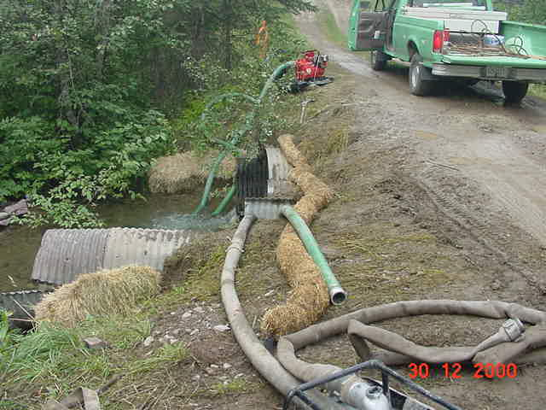
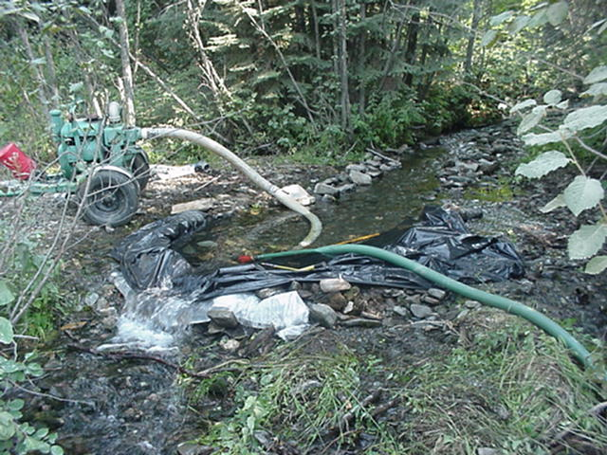
Drafting Sites

Slide 56
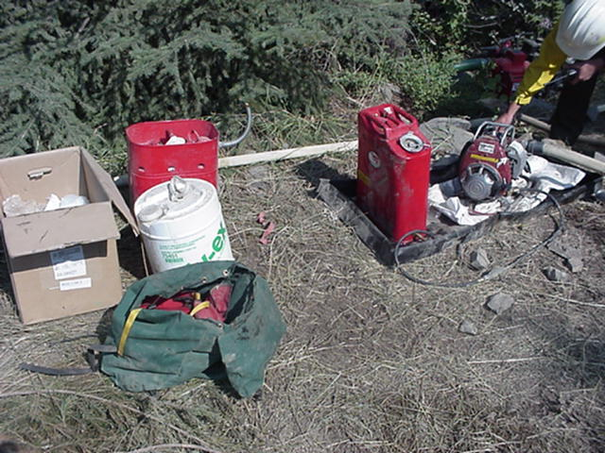
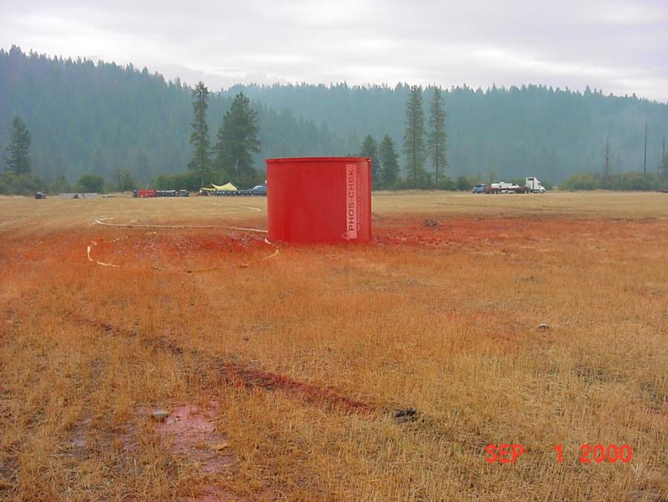
Hazardous Materials

Slide 57
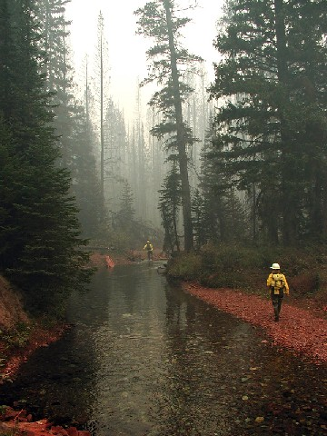
Hazardous Materials
Contact Fish Biologist, Agency Administrator, and Incident Commander Immediately!

Slide 58
Hazardous Materials

Slide 59
Base Camps/Spike Camps/Helibases
Wood chips should be raked to remove the majority of litter and the remainder spread evenly across the area.
Seed and fertilize all disturbed areas specified² by landowner.
Where appropriate treat weeds at disturbed sites.
Remove all litter, trash, equipment, and signs
Restore natural topography where power and telephone lines were trenched.
Work with the appropriate landowner on developing agreements and rehab plans.
Rip surface to alleviate compaction of parking area or other areas of concentrated use. (digging a hole in the ground with a pulaski or shovel will help determine the depth of compaction and subsequent ripping depth)

Slide 60
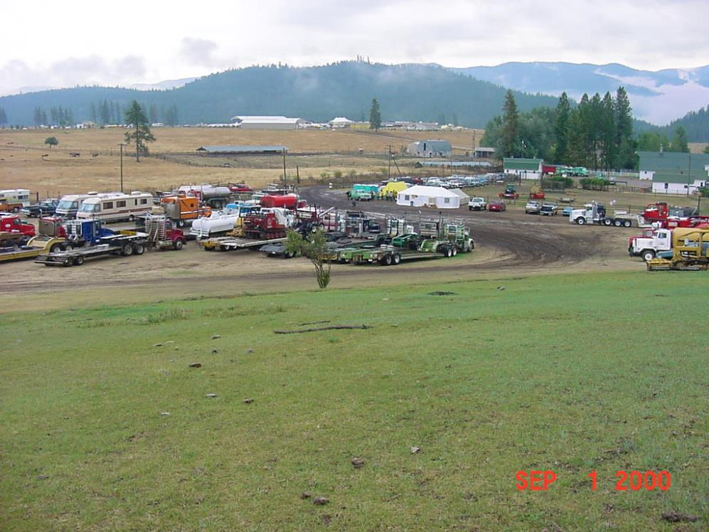
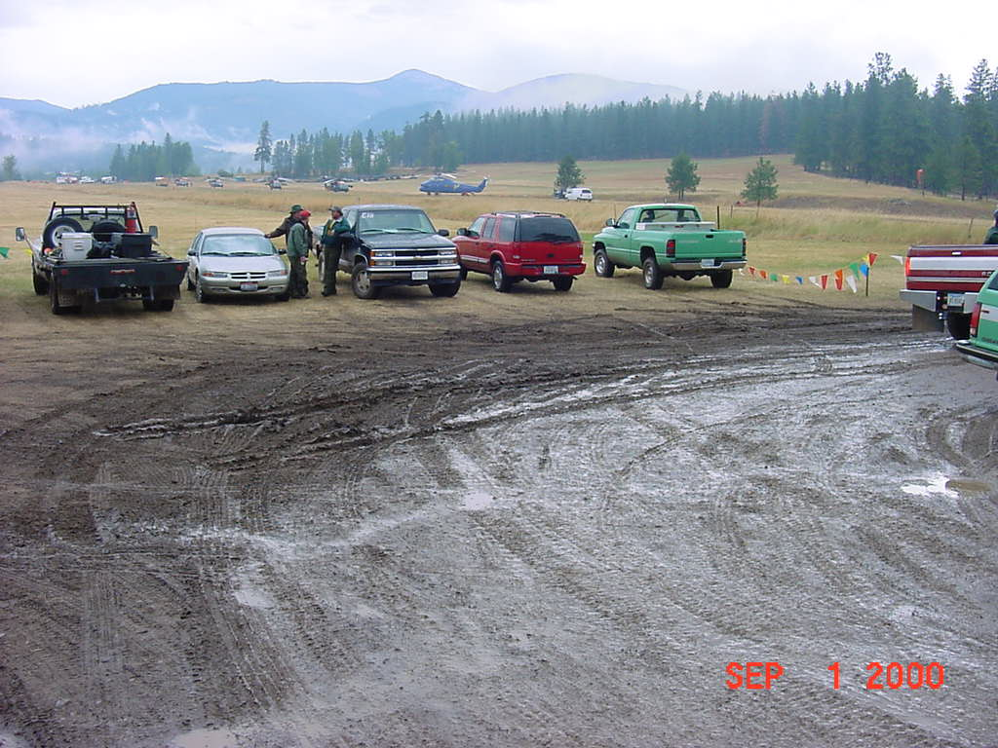
Helibase & Camps

Slide 61
Rehab Implementation Map

Slide 62
Summary
Train yourself to recognize resource impacts outside your ordinary field of work. Take advantage of various opportunities to do this.
This can be done through After-Action reviews.
Helping other resources specialist during rehab.
Become familiar with equipment capabilities.
Start the Rehab Plan immediately upon fire assignment.
Cover as much ground as possible as to qualify/quantify impacts.
Know who, how, and when to contact the appropriate resource specialist.
Make sure that rehab is complete while the equipment and personnel is still available. Rehab will likely need to be done within the same Fiscal year.

