Slide 1
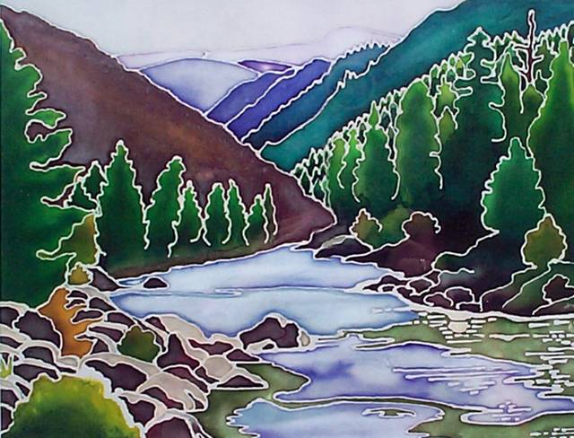
Wilderness Invasive Species Plans
Art work by
Keri Evans,
2001
Tommy Gionet SCNF
Notes:
This document is part of the Non-Native Invasive Plants Toolbox on http://www.wilderness.net/toolboxes/
So they know they are in the right room
Easiest Slide to Make

Slide 2
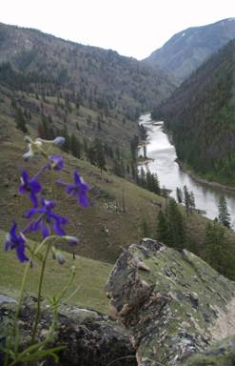
Goals
Manage Wilderness Areas to Standard
Satisfy NFRW–WD Primary Output # 2
Number of wildernesses which successfully treated for noxious/ invasive plants.
Invasive Species Management
“Reduce, minimize, or eliminate the potential for introduction, establishment, spread, and impact of invasive species across all landscapes and ownerships.”
Main Salmon River near Sheep Creek
Notes:
This output is in the process of being updated to include all invasive species management not just weeds.
NATIONAL STRATEGY AND IMPLEMENTATION PLAN FOR INVASIVE SPECIES MANAGEMENT The TEMPLATE
My experience is with noxious weeds but I will attempt to shed light of the greater issue of all invasives

Slide 3
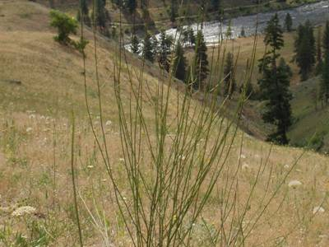
Session Goals
Provide you with a template and instruction with respect to establishing a successful Invasive Species Plan for your Wilderness Area
Notes:
Straight from the session description on your agenda,
Talk a little about FC-RONRW efforts with respect to noxious weed management, more about the national strategy (your template)

Slide 4
Why are we worried about Invasive Species in the Wilderness ?
The Wilderness Act
wilderness
Impacts
Invasive Species Executive Order 13112 (1999)
USFS Strategic Plan (2004)
Notes:
Wilderness Act mandates that wilderness areas be maintained in their natural condition. Wilderness areas provide valuable ecological benchmarks by which we can measure environmental change.
Wilderness societal benefits of protecting biodiversity, unique natural features, and watersheds, as well as opportunities for recreation and personal fulfillment.
Introduction of non-native species into wilderness, intentionally or unintentionally, has the potential for irreversible impacts on natural systems (loss of native biodiversity, alteration of ecosystem processes and reduction in the quality of wilderness recreation experiences).
Presidential Executive Order on Invasive Species directs all federal agencies to prevent and control introductions of invasive species in a cost-effective and environmentally sound manner.
Invasive Species Executive Order 13112 (1999) directs federal agencies to use relevant programs and authorities to: (1) prevent the introduction of invasive species; (2) detect and respond rapidly to and control invasive populations efficiently and safely; (3) accurately monitor invasive populations; (4) provide for restoration of native species and habitat conditions in ecosystems that have been invaded; and (5) promote public education on invasive species.
USFS Strategic Plan (2004) was designed to emphasize the Chief’s Four Threats. Key invasives items in the 2004-2008 Strategic Plan are: (1) Implement and support actions to prevent and detect introduction of invasive species. (2) Manage populations of established invasive species using prevention, suppression, and restoration tactics to reduce impacts and restore ecosystems. (3) Implement risk-based detection surveys to identify forest vulnerability to invasive species, suitable environmental conditions for invasion, and vectors of spread. (4) Cooperate with other federal, state, tribal, and non-governmental partners in education about invasive species and encourage support and participation in management actions.

Slide 5
Invasive Species
Invasive species have been characterized as a catastrophic wildfire in slow motion. "Thousands of invasive plants, insects, fish, mollusks, crustaceans, pathogens, mammals, birds, reptiles, and amphibians have infested hundreds of millions of acres of land and water across the Nation, causing massive disruptions in ecosystem function, reducing biodiversity, and degrading ecosystem health in our Nation’s forests, prairies, mountains, wetlands, rivers, and oceans. Invasive organisms affect the health of not only the Nation’s forests and rangelands but also of wildlife, livestock, fish, and humans.
Notes:
How these “unwanted pests” arrive on our shores varies. Kudzu, for example, was introduced in the southeast in the 1930s to control erosion. The Asian longhorned beetles arrived in the 1990s as stowaways in packing crates from China.
With the globalization of commerce and foreign travel to and from the US, the number of new invasive species from abroad is growing.
In the US, there are 2,000 non-native plants, about 400 of which are invasives. Invasive plants now cover about 133 million acres in all ownerships nationwide and advancing at the rate of about 1.7 million acres per year.
Unwanted plants infest millions of acres of National Forest System lands. Leafy spurge, knapweeds and starthistles, saltcedar, non-native thistles, purple loosestrife, and cheatgrass are the biggest problems. Livestock carrying capacity and wildlife habitat value is negatively impacted on sites infested by invasive weeds.
Seventy million acres of forest in all ownerships are at serious risk of mortality from 26 different insects and diseases, including non-natives such as gypsy moth, hemlock woolly adelgid, dogwood anthracnose, beech bark disease, Asian longhorned beetle, white pine blister rust, Sudden Oak Death, and Port Orford cedar root disease.
Non-native diseases have led to the significant decline of the American elm, once a feature of the urban landscape, the American chestnut, and the western white pine.
Each year, weeds cost the U.S. about $13 billion. All invasive species, including invasive plants, insects and diseases, cost Americans $137 billion per year in damages and control costs.
Non-native plants, insects, and diseases threaten the survival of native species. Scientists estimate that non-natives contribute to the decline of as much as half of all endangered species. They are the single greatest cause of loss of biodiversity in the US, second only to habitat loss.

Slide 6
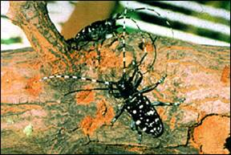
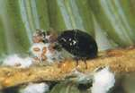
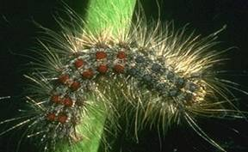
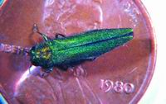
Invasive Species
Major
Invasive
Insects
Asian longhorned beetle
Hemlock woolly adelgid
Gypsy moth
Emerald ash borer
Notes:
The next four slides show pictures of the major invasive insect pests, diseases and pathogens afflicting forest trees, land and aquatic plants weeds,
Asian longhorned beetle is a problem in Chicago, Illinois, and New York City. The beetle prefers maple species.
Hemlock woolly adelgid, believed to be a native of Asia, is a serious pest of eastern hemlock and Carolina hemlock. In the eastern United States, it is present from the Smoky Mountains, north to the mid-Hudson River Valley and southern New England. Its presence in Pennsylvania has recently been reported.
Gypsy moth is generally prevalent in the East and spreading westward and southward.
Emerald ash borer is an emerging problem in Michigan and surrounding areas.

Slide 7
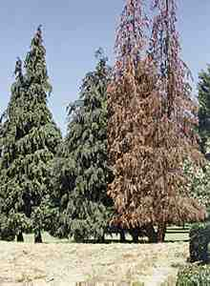
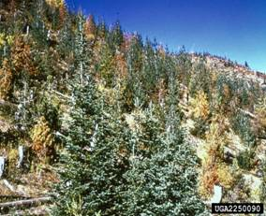
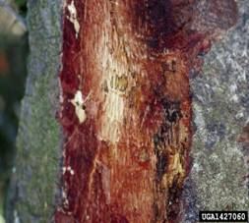
Invasive Species
Diseases and pathogens
Sudden Oak Death (SOD) canker
White pine blister rust
Port–Orford cedar root disease
Notes:
Sudden Oak Death, Phytophtera ramorum, is confined to oak trees in California and southern Oregon, for now.
White pine blister rust and Port-Orford Cedar root disease occur also in the West.

Slide 8
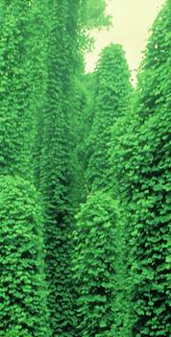
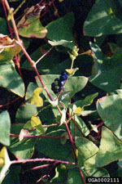
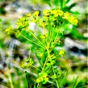
Invasive Species
Plants (including aquatics and wetland)
Leafy spurge
Kudzu
Saltcedar
Mile-a-Minute
Notes:
Leafy spurge displaces native vegetation in prairie habitats and fields through shading and by usurping available water and nutrients and through plant toxins that prevent the growth of other plants underneath it. Leafy spurge is an aggressive invader and, once present, can completely overtake large areas of open land.
Kudzu was originally imported from Japan in 1876 to landscape a garden at the Japanese Pavilion of the Philadelphia Centennial Exposition. It was later planted as forage for cows, pigs, and goats in the South. It was also promoted as cover for erosion control in gullies. The distribution of kudzu in the United States today extends from Connecticut to Missouri and Oklahoma, south to Texas and Florida.
Saltcedar, also known as tamarisk, is a fire-adapted species with long tap roots that allow them to intercept deep water tables and interfere with natural aquatic systems. Saltcedar occurs in the intermountain region of the western United States, throughout the Great Basin, and California and Texas.
Mile-a-minute weed is currently found in Pennsylvania, Maryland, Delaware, West Virginia, New York, Virginia, Ohio and Washington, D.C.

Slide 9
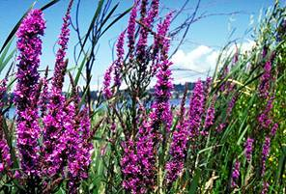
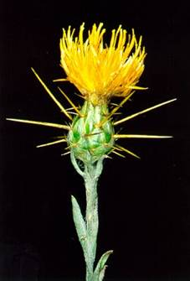
Invasive Species
Plants (including aquatics and wetland)
Purple loosestrife
Yellow starthistle
Spotted knapweed
Notes:
Purple loosestrife chokes up rivers, lakes and streams.
Thistles and knapweeds turn grazing lands into “NO-EAT” zones. Cattle just don’t like these weeds.
Over the years, the Forest Service has been taking an aggressive stance against invasive species through a combination of natural or biological control (e.g., by pitting beetles against the hemlock woolly adelgid) and chemical agents (e.g., application of GypChek, developed and patented by the Forest Service Research & Development, against the gypsy moth).

Slide 10
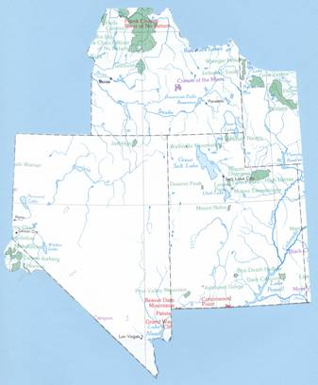
FRANK CHURCH – RIVER OF NO RETURN WILDERNESS NOXIOUS WEED MANAGEMENT PROGRAM
FC-RONRW
Notes:
First effort with respect to invasive species management that I was involved in
Northern Most extent of the region
Better Map

Slide 11
1984: FC – RONRW Management Plan
Stated: Small Patches of noxious weeds and other non-native species are present in scattered locations and, although not noticeably expanding, must be considered a serious threat to natural succession.
…Integrated pest management strategies and techniques will be utilized to suppress or eradicate introduced undesirable plants, animals including insects, and diseases to protect the Wilderness and/ or resources outside the Wilderness commensurate with ecological, environmental and economic values.
Notes:
1980 CIWA created the RONRW
1984 1st Mgmt. Plan
ID’ed weeds as serious threat
IPM and bigger than weeds

Slide 12
FC-RONRW INVASIVE SPECIES PLANNING
1984 to the early 90’s Invasive Species Management was basically limited to the mechanical treatment (hand pulling and grubbing) of noxious weeds (spotted knapweed) along travel corridors and river systems.
During this time Invasive Species Management (particularly noxious weed management) was becoming a national priority for land managers.
1991 USDA, FS began the FC-RONRW Management Plan Revision process.
1994 FS initiated official scoping under NEPA and held several public meetings.
Notes:
Scoping – majority of comments supported an aggressive weed management program which included Herbicides, in fact it was the internal publics that where most concerned about chemicals and biologicals
Pulling together, Stemming the Tide, Idaho Weed Law…..

Slide 13
FC-RONRW INVASIVE SPECIES PLANNING
1994 Rush Skeletonweed (Chondrilla juncea) was first found in the FC-RONRW in the Mackay Bar Area and along the Middle Fork of the Salmon River in 1995
By late 1998 the noxious weed management portion of the FC-RONRW Mgmt. Plan was separated from the plan as a whole and an EIS was prepared addressing just noxious weed management issues.
Notes:
1996 Management options were limited to mechanical treatment techniques (hand – pulling and grubbing) Not very effective particularly with Rush
Based on what folks knew about what was happen to the SW (Boise/ Payette river)
The inventory of all noxious weed species, not just Rush Skeletonweed became a higher priority

Slide 14
1999 EIS, FC-RONRW NOXIOUS WEED TREATMENTS
1999 EIS authorized integrated weed management in the wilderness, including herbicides.
Herbicide treatments began in spring of 2000.
Adaptive management allows for the inventory, analysis and treatment of new sites.
1999 ROD is an interim weed treatment decision until finalization of “Inclusive” FC-RONR Wilderness Plan.
Notes:
By 1999 when the ROD was signed the FC-RONRW was tracking approximately 300 infestations occupying about 1775 acres

Slide 15
FC-RONRW INVASIVE SPECIES PLANNING (continued)
1999 ROD & EIS only provided interim direction until the FC-RONRW Mgmt. Plan was implemented.
November 2003 the FC-RONRW Mgmt Plan was signed.
Work began on a Draft Supplemental EIS for FC-RONRW Noxious Weed Treatment
Notes:
Quick word on the fact that in 1999 the intent was that the FC Plan would address noxious weeds. BY 2003 planners decided to leave separate. NEPA
DSEIS Timeline
Draft Supplemental EIS April, 2004
Final SEIS - Pending
Implement Project - Pending
Consultation
BA received by USFWS, April 29, 2003
Letter of Concurrence, USFWS, June 23, 2003
Presently working with NOAA on The draft Reasonable and Prudent Measures and the Terms and Conditions of their BO
Extension only if asked
2002 data: 4222 acres, 471 sites

Slide 16
Frank Church – River of No Return
That’s what the Frank Church – River of No Return Wilderness managers have done, and are doing with respect to noxious weed management.
NOW
What can you do with respect to Invasive Species Management for your Wilderness Area.
Notes:
Transition back to National

Slide 17
What does my plan need to do ?
Improve our understanding of and ability to MINIMIZE the impacts of invasive plant, animal (vertebrate and invertebrate ) and pathogen species to the Wilderness, in both the terrestrial and aquatic habitats.
Notes:
Examples: More than just weeds and bigger then outside campgrounds.
Reduce, minimize, or eliminate the potential for introduction, establishment, spread, and impact of invasive species across all landscapes and ownerships.”
FLPMA, etc.

Slide 18
A Plan
Understand the introduction, spread and distribution of invasive species within the Wilderness.
Understand the effects of these species on Wilderness values.
Identify and evaluate management options and their consequences.
Notes:
Wilderness Act does not provide clear direction - mandates that wilderness must be maintained in both a natural condition and an “untrammeled” condition; a conflict between these two occurs when control or eradication of non-native species (i.e., restoring natural conditions) requires human manipulation of the wilderness ecosystem.
Establishing management goals or desired future conditions and deciding which management approaches to implement can be value-laden processes.
Maybe explain the “duh” that invasive species management in wilderness is complicated. Wilderness areas are typically remote and difficult to access, making invasive species management a logistical problem.
Discussion about:
Integrated Pest Management (IPM)
Natural and Un-trammeled conditions
Restoring natural conditions
Human manipulation of wilderness ecosystem
Goals and/or DFC development is value-laden process
Its just hard in a wilderness setting

Slide 19
Balance
We balance both mandates by choosing the least obtrusive action (i.e., the minimum tool) to accomplish management objectives.
Maintaining natural conditions while preserving its untrammeled character.
Weigh the various risks and benefits, both ecological and social, when choosing an appropriate management strategy.
Notes:
Not easy…. Determining the minimum tool for non-native species control in wilderness isn't easy. Chemical and biological control methods can have unintended, potentially irreversible ecological impacts. However, they also may be the only effective way to combat some non-native species. Tie in social issues (public acceptance of different control methods, public attitudes toward specific non-native species, and, ultimately, the role of humans in wilderness).
Remember IMPACTS of doing nothing

Slide 20
National Strategy and Implementation Plan
Program Elements
Prevention – Keep out invasive species.
Early Detection and Rapid Response – Detect and eradicate invasive species to stop them from spreading.
Control and Management – Apply integrated control techniques to manage the problem.
Rehabilitation and Restoration – Heal, minimize, or reverse the harmful effects from invasive species
Notes:
07 budget package specifies invasive species management activities will be conducted under these program elements.
And are components of any IPM system

Slide 21
Guiding Principles - Foundation for the National Strategy
All aspects of the national strategy will include direction to implement an invasive species management program through these guiding principles:
Science-based prioritization of invasive species problems,
Enhanced collaboration on the solutions to those problems, and
An improved system of accountability that ensures the most efficient use of limited resources at all levels of the organization.
Notes:
Prioritize. New invaders, effective management
Collaborate: Stakeholders, others w/ problem, outside wilderness before it gets to you. PARTNERS (all landscapers and ownerships)
Accountability:

Slide 22
QUESTIONS ?
http://www.fs.fed.us/foresthealth/publications/Invasive_Species.pdf
Notes:
Invasive Species Management
“Reduce, minimize, or eliminate the potential for introduction, establishment, spread, and impact of invasive species across all landscapes and ownerships.”
Prevention – Keep out invasive species.
Early Detection and Rapid Response – Detect and eradicate invasive species to stop them from spreading.
Control and Management – Apply integrated control techniques to manage the problem.
Rehabilitation and Restoration – Heal, minimize, or reverse the harmful effects from invasive species
COPIES IN THE BACK OF ON THE FOREST HEALTH WEB SITE. A LOT OF INFORMATION, I BARELY TOUCH THE SURFACE

