Slide 1

Paleontological Resource Management: An Overview
Barbara A. Beasley
North Zone Paleontologist
308-432-0351
babeasley@fs.fed.us

Slide 2
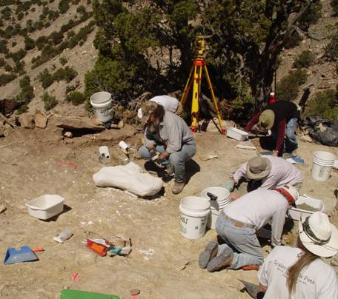
Objectives
Describe fossils & collection policy
Describe FS paleo program
Identify and locate paleo authorities
Identify tools for management
Know paleo contacts
Picketwire Sauropod P.I.T Project, Comanche NG

Slide 3
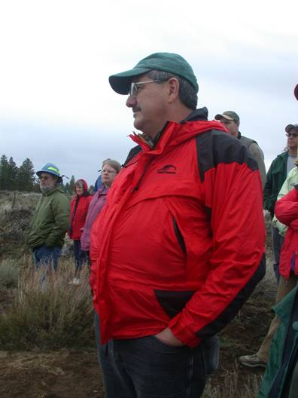
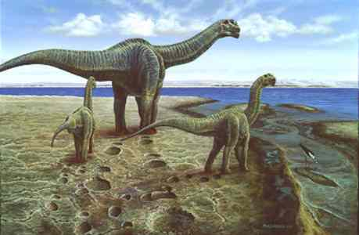
What is Paleontology?
Paleontology is the study of plants and animals that have lived throughout geologic history.

Slide 4
FS Paleontological Resource Definition
Any evidence of fossilized remains of multicellular invertebrate and vertebrate animals and multicellular plants, including imprints thereof.
Organic fuel resources are excluded
  FS is one of the few agencies that has a regulatory definition!

Slide 5
36 CFR 261.9(i)
“Excavating, damaging, or removing any vertebrate fossil or removing any paleontological resource for commercial purposes without a special use authorization.”
Therefore need to know fossil types.

Slide 6
4 Major Types of Fossils*
Plants and any plant parts (petrified wood).
Invertebrates- animals with external “skeleton”.
Vertebrates- animals with internal skeleton.
Ichnofossils (trace fossils) – behavior: tracks, trails, burrows, etc.
* Includes imprints, impressions, and natural molds and casts

Slide 7
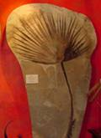
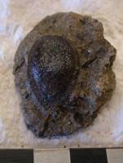
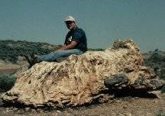
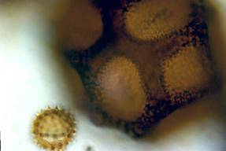

Plant Fossils
Every part of a plant has fossilized.
  Seeds, leaves, bark, roots, flowers, fruit, & pollen!
Palm Frond
Fig
Seed from DPG
Pollen: Sunflower (sm) and Cactus (lg)
Flower
Cypress Stump,
Dakota Prairie Grasslands

Slide 8
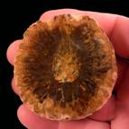
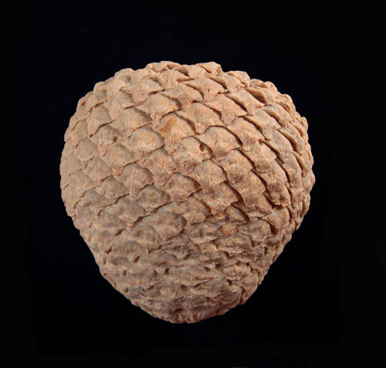
Collection Policy:
Plants
Petrified wood:
  Federal Property
  Personal noncommercial collection allowed.
    Free use permit may be issued.
      Minerals Materials Permit issued for commercial uses.
Research requires a permit.
25 lbs/day and up to 250 lbs/yr.
Pine Cones
R1 only

Slide 9
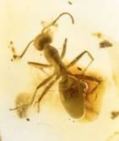
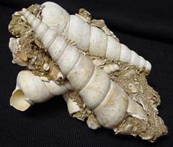
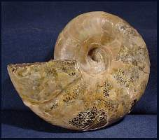
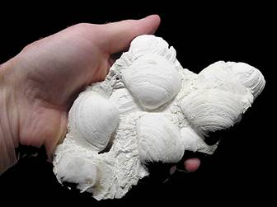
Invertebrates
Ant in Amber
Hard shell (skeleton) on outside
Often well preserved
Wide variety (extinct & extant)
Snails
Ammonite, Extinct Mollusc
Clams

Slide 10
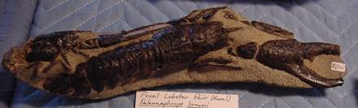
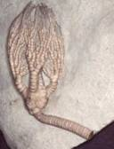

Collection Policy: Invertebrates
Lobster- Montana
Permit not required for personal, hobby, and noncommercial collecting:
Permit required for research.
Permits not issued for commercial purposes (includes bartering).
Federal Property
Crinoid (Sea Lily)

Slide 11
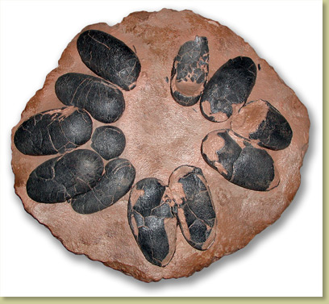

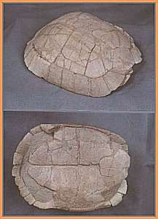
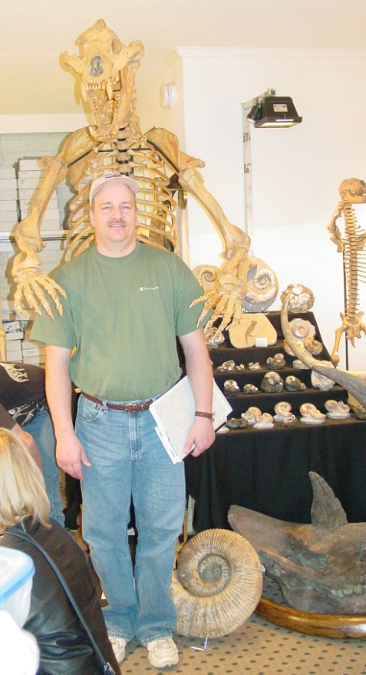
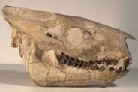
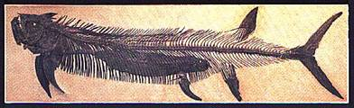
Vertebrates
Animals with an internal skeleton. Includes:
  trace fossils
  imprints, impressions, molds & casts
  nests, skin, poop, etc.
Rarest in fossil record
Most sought after by all types of collectors.
Dinosaur Nest
Tortoise
USFS SA Tucson Fossil Show
Oreodont, Extinct “sheep”
Xiphactinus 15 foot carp

Slide 12



Collection Policy:
Vertebrates
Permit required:
  to collect, duplicate, disturb, or excavate (36 CFR 261.9 a, b, i, & j).
Permits not issued for hobby &/or commercial uses
  casting, molding, etc
Permits issued to institutions w/ repository:
  w/qualified paleontologists
  accepted research projects
Personal collection prohibited, includes FS employees
Federal Property
Shark tooth

Slide 13
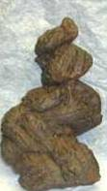
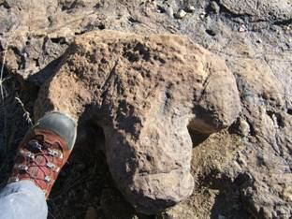
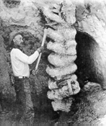
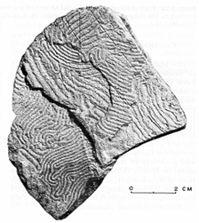
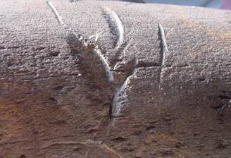
Ichnofossils
Dinosaur Track
Record of behavior
  Trails,
  Tracks,
  Burrows,
  Resting Places,
  Feeding,
  Predation (tooth marks)
Feces
Tooth Marks
Worm Trails
Beaver Burrow

Slide 14
Collection Policy: Ichnofossils
Records Behavior
Can be fossil plant, invertebrate or vertebrate
Permit not required for hobby collection of invertebrates (minimal ground disturbance)
Permit required for vertebrate collection
Permit required for research on any paleontological resource

Slide 15

Paleontology?
Another program to fund!?!
Non renewable
Only record of life on Earth
Accountable Federal Property
Multiple values:
  Scientific
  Educational
  Recreational
  Commercial
  Aesthetic
  Black Market
Natural resource enjoyed by many.
3rd Grade Class Chadron, NE

Slide 16
Why manage paleontological resources?
In accordance with Sec. 101(b)(4) of NEPA (42 USC § 4331)……
“… it is the continuing responsibility of the Federal Government …to improve and coordinate Federal plans, functions, programs, and resources to…preserve important historic, cultural, and natural aspects of our national heritage…”
Federal Property
Finite Extinct Resource
Sought After by Public

Slide 17
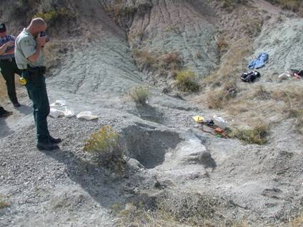
Too Bureaucratic?
Google Search: Type: “Fossils for Sale”
  1,350,000 web sites (3x since 2003)
Nebraska NF
  Oglala NG since 1992, 500 sites- 20% shows unauthorized collecting
  8 fossil theft cases since 1996
  Avg 10 reports of unauthorized collecting/year
LEO documenting a fossil theft, Oglala NG

Slide 18
Authorities for Management of Fossil Resources
Laws
  Organic Act of 1897
  Forest Planning Act
  Federal Cave Resources Protection Act
  Archeological Resources Protection Act
  18 U.S.C. 641 Property18 U.S.C. 1361
  Depredation
Regulations
  36 CFR 261.9(a,b,i, j)
  36 CFR 251

Slide 19
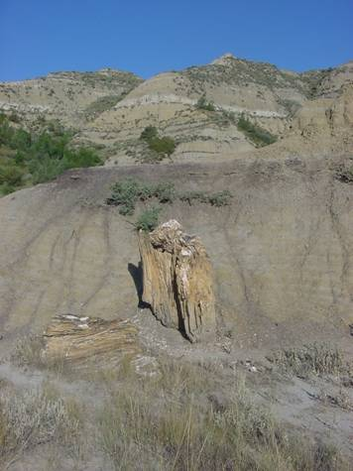
Forest Service Administrative Policies
FS Manual 2860: Policy - Hobby Mineral and Fossil Collecting allowed (on hold)
FS Manual 2700: Special Use Permit required for:
  Collecting fossil vertebrates,
  Collecting significant fossil nonvertebrate resources, &
  Creating ground disturbance.
Fossil Tree- DPG

Slide 20
Management Tools
Administrative
  Forest Plans
  Paleontological Resource Appendices
  FSM 2860 (draft)
  Repository Agreements
On-the-ground
  Special Use Permit
  Fossil Yield Potential Classification (FYPC)
  Significance Criteria
  Paleo Database
  GIS

Slide 21
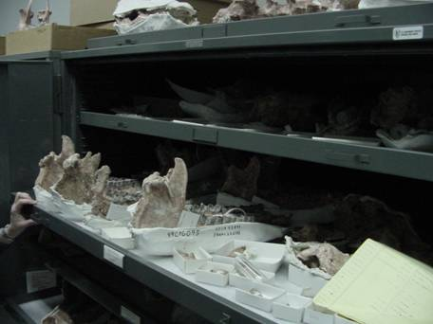
Curation Agreements
Collection is just tip of iceberg
Federal Property
For long term care in fossil repository.
Part of authorizing instrument:
  SUP “Umbrella”,
    CCS,
    PA, and/or
    MOU
Fossil curation at the Museum of Geology Collections, South Dakota School of Mines & Technology

Slide 22
Fossil Yield Potential Classification (FYPC)
A geologic unit is assigned a FYPC # between 1-5 (5 is fossil rich).
Classification dependent upon “fossil richness”.
Model is designed to be fine-tuned.

Slide 23
Fossil-bearing Rock Layers on National Forest System Lands
(exclusive of Alaska and Hawaii)
Bedrock Legend
Quaternary Deposits
Triassic/Jurassic
Neogene
Paleozoic/Mesozoic
Thunder Basin NG
Paleogene
Pennsylvanian/Permian
Cretaceous and Tertiary
Paleozoic
Cretaceous
Silurian/Devonian/Mississippian
Mesozoic
Cambrian/Ordovician
- geology taken from J. C. Reed, Jr. and C. A. Bush, 2001.
generalized Geologic Map of the Conterminous United
States edition: 1.0, United States Geological Survey.

Slide 24
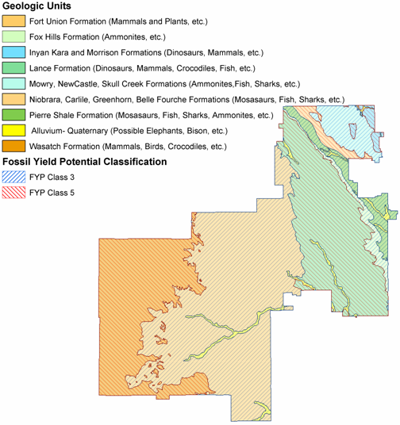
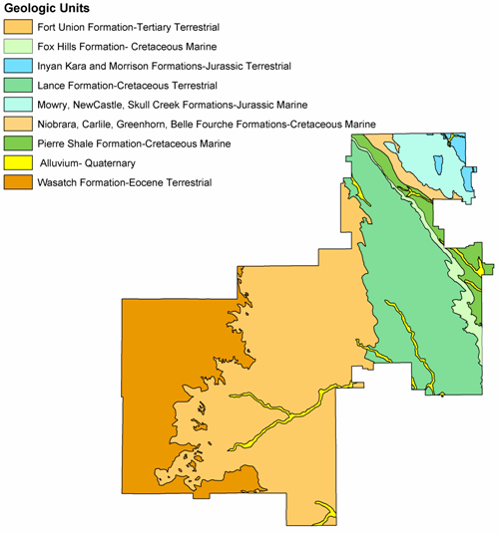
Thunder Basin National Grassland
Geology
Fossil Yield Potential Classification

Slide 25
Who do you Call?
P.A.G.!
Paleontological Advisory Group (PAG)
  Each regional geologist is the PAG coordinator for that region
  FS Zone Paleontologists located
    Bruce Schumacher-Comanche NG
    Barb Beasley-Nebraska National Forest
  WO Paleontology Program Leader
    Vacant

Slide 26
SUMMARY
What is a fossil?
What are the 4 fossil types?
What are the collection policies?
  Plants?
  Invertebrates?
  Vertebrates?
  Ichnofossils?
What is paleo policy?
Who do you call?

Slide 27
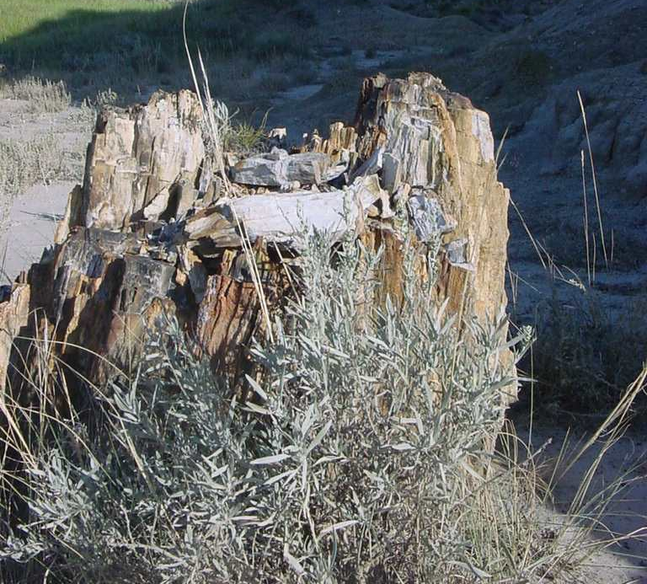
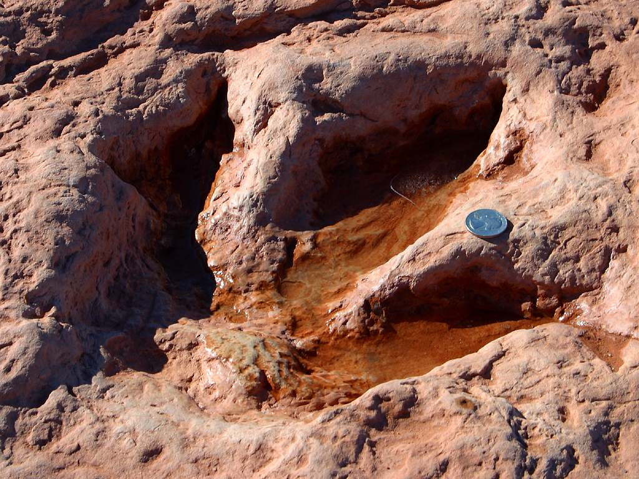
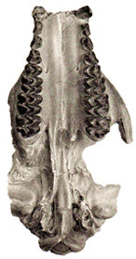
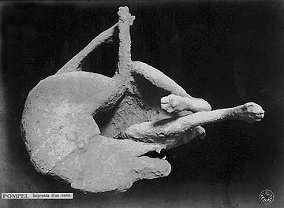
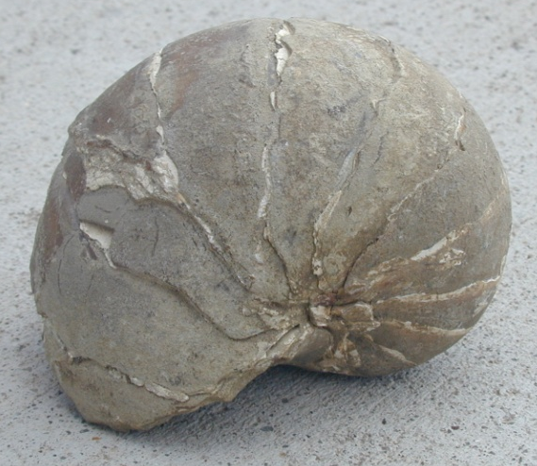
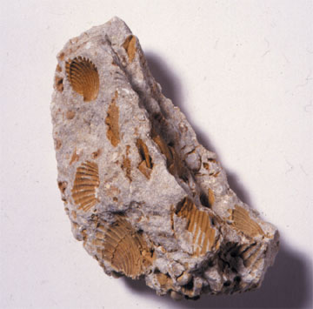
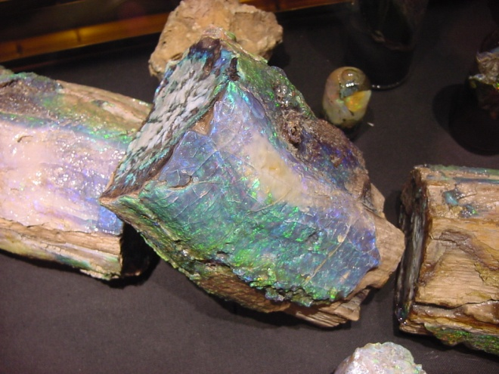
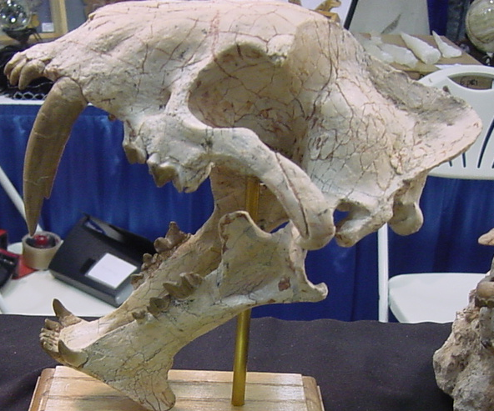
ASSESSMENT
P
V,T
V
Vertebrate Cast
INV
P
V
INV

Slide 28

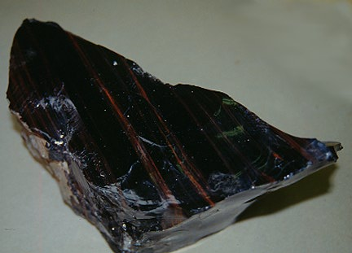


Minerals Decision Making

Slide 29

Questions?
USDA Forest Service Minerals and Geology Management Web Pages:
http://www.fs.fed.us/geology
http://fsweb.wo.fs.fed.us/mgm
Barb Beasley
North Zone Paleontologist
308-432-0351
When Calvin dreams…….

