Slide 1
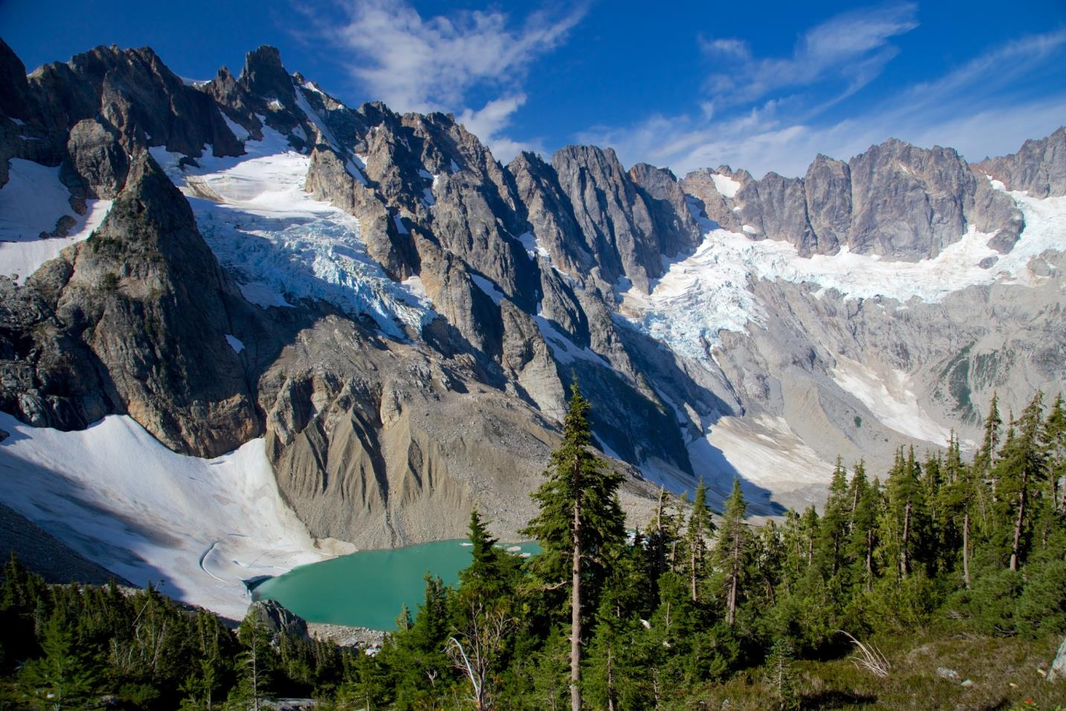

Evaluating Research Proposals in North Cascades National Park Service Complex
Photo by Victor Mesny
Regina M. Rochefort, Ph.D.

Slide 2
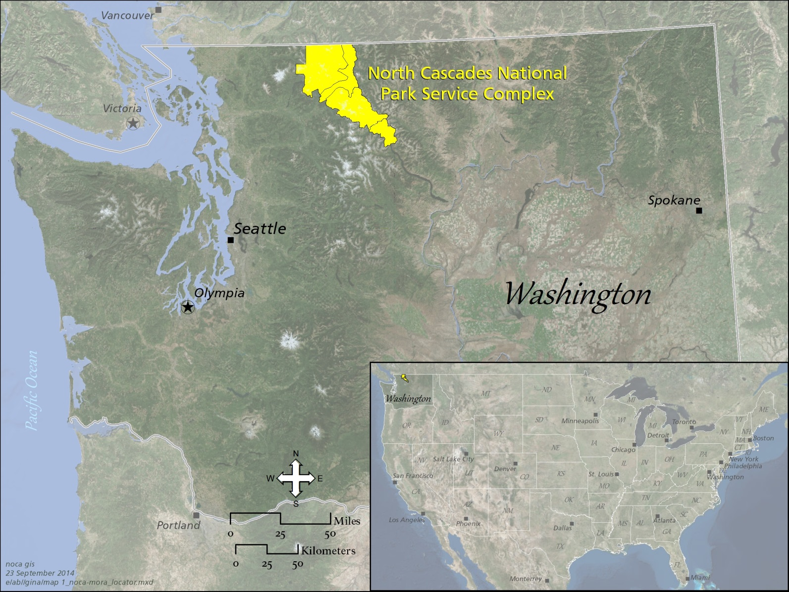
Where is North Cascades?
Notes:
First, I would like to give you a brief orientation to North Cascades National Park Service Complex. We are located in northwest Washington and our north boundary abuts the US/Canadian border.

Slide 3
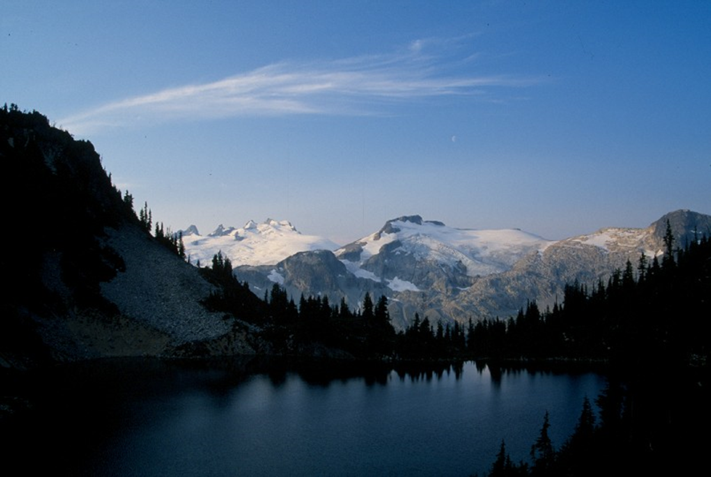
What is
North Cascades National Park Service
Complex?
3 Park Units:
North Cascades National Park
Ross Lake National Recreation Area
Lake Chelan National Recreation Area
Notes:
North Cascades is of course a little different than the other parks. Although we are going to try not to slip into our park slang, we thought we would start by giving a few of our acronyms – in case we slip. First – we are a Complex – 3 park units managed as one.

Slide 4
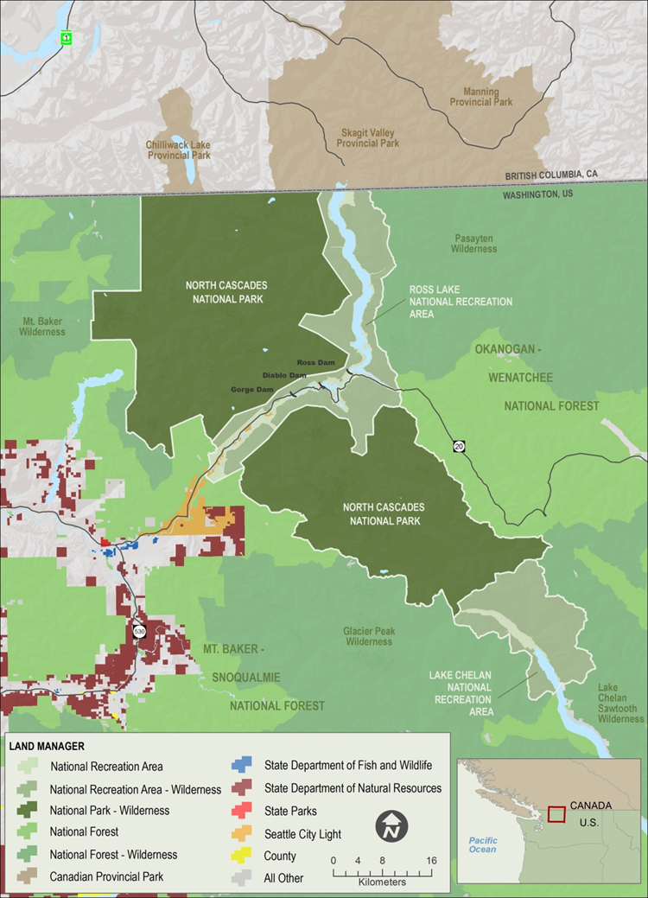
North Cascades
Facts
~ 684,000 acres
94 % of the Complex is in the Stephen Mather Wilderness
Elevation - 400’ to 9,206’
Precipitation – 30” to 140”
Glaciers - ~ 320

Slide 5
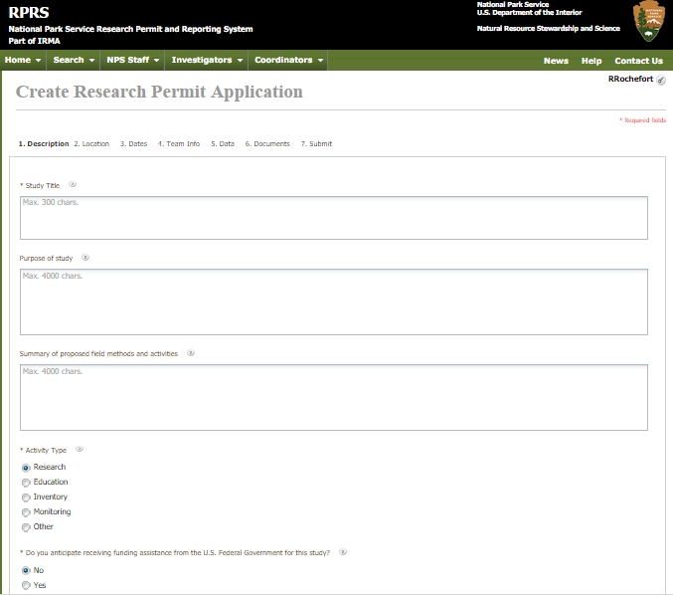
Research Permit Process
On-Line Application Procedure
Notes:
The National Park Service has an on-line Research and Collection Permit Process that all proposed research must by submitted through.

Slide 6

Research Permit Process
Initial Review
NPS Research Requirements
Research Coordinator & Curator
Scientific Review
NPS or Other Technical Expert
Categorical Exclusion?
Ground Disturbance?
Wilderness?
Endangered Species?
Other Permits? –Wildlife?
Compliance
IDT, PEPC, and Wilderness MRA
Superintendent
Notes:
Once the Research application has been completed, the park Research Coordinator & Curator are notified. They begin the review process in North Cascades by an initial review to determine if the application is complete and meets the basic conditions. Then the application is circulated to a subject matter expert. If they feel it is a valid proposal, then the Research Coordinator consults with the Environmental Compliance Specialist to determine if the project needs to be submitted to the interdisciplinary team (IDT) for review. This deliberation considers whether the project is in Wilderness, whether cultural resource concerns exist, whether there is potential to impact listed species, and in general, whether or not there could be environmental impacts from the proposed research and whether or not it is controversial. According to Director’s Order 12 (handbook), a research permit may fall under a CE which requires no documentation if it has “no potential for environmental impact” but requires documentation if it does have a potential to impact the environment. Regardless of whether or not the project requires documentation through the National Environmental Policy Act, if the project occurs in Wilderness and affects Wilderness character, then a minimum requirement analysis (MRA) (also known as minimum requirement decision guide (MRDG)) is completed and submitted to the wilderness coordinator for recommendation and to the superintendent for approval.

Slide 7
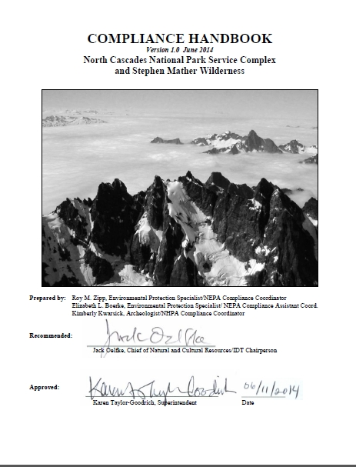
Research Permit Process
IDT: Interdisciplinary Team
PEPC: Planning, Environment, and public Comment
Notes:
For research that could have environmental impacts, the following categorical exclusion applies:
E(6) Nondestructive data collection, inventory (including field, aerial, and satellite surveying and mapping), study, research, and monitoring activities (this is also a Departmental CE).

Slide 8
Two Case Studies
Assessing the Effects of Nitrogen Deposition on High-Elevation Plant and Soil Communities
Wolverine Monitoring & Research
Notes:
Today I am going to briefly discuss two research projects which we reviewed through the Interdisciplinary (IDT) process and required a minimum requirement analysis (MRA).

Slide 9
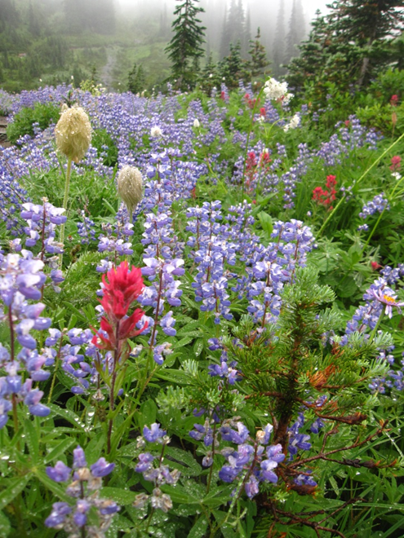
Experimental Nitrogen Deposition
Purpose: Identify Nitrogen Critical Loads to Protect High-elevation Plant & Soil Communities
Why? Increased N alters plant community function & species composition
Background: Identified as a high priority research need in a 2010 PNW Interagency Contaminants Workshop

Slide 10
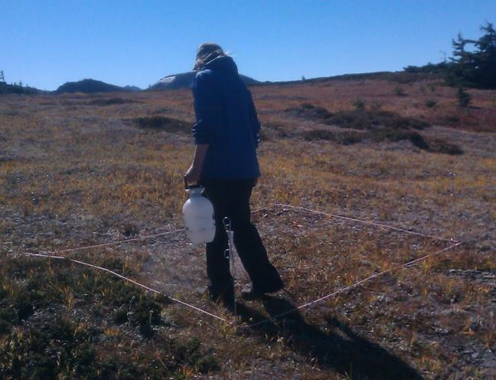
Experimental Nitrogen Deposition
Method: Fertilization of small test plots (20, 3x2m plots)
Location: North Cascades, Mount Rainier, & Olympic National Parks
Funding: NPS
NOCA Concerns: Why in our wilderness?
Notes:
The project was

Slide 11
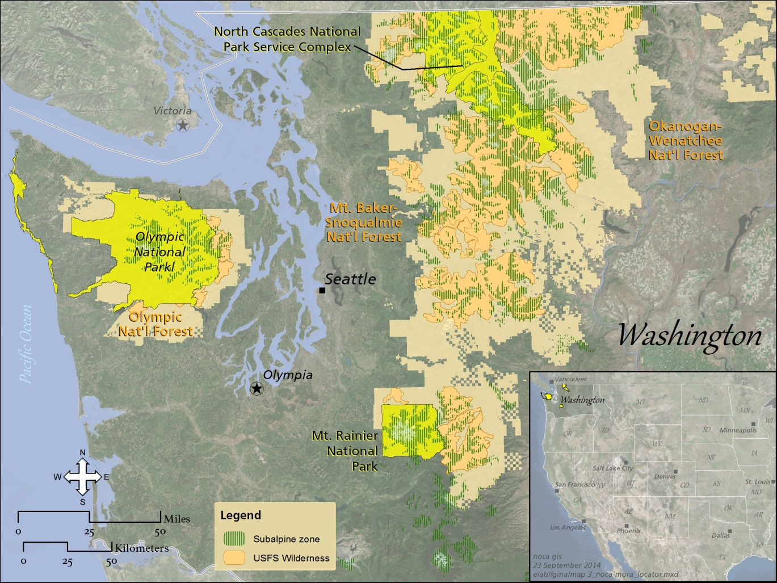
Experimental Nitrogen Deposition
Considerations:
Most alpine vegetation is in Wilderness
Class 1 airshed
Education is not adequate
Decision: Approved
Notes:
In considering this proposal, we first considered whether there were any subalpine areas within North Cascades National Park Service Complex, but outside of Wilderness and found there were no sites that met this condition. Next we looked outside of the park complex for suitable sites. In Washington 93% of all subalpine areas are managed by the federal; government and this map illustrates that most of this vegetation type is in designated wilderness. We also considered that protection of air quality is mandated in NPS areas the Olympic review also stated that education alone would not be sufficient to protect resources values in the Wilderness. Ultimately, the project was approved.

Slide 12
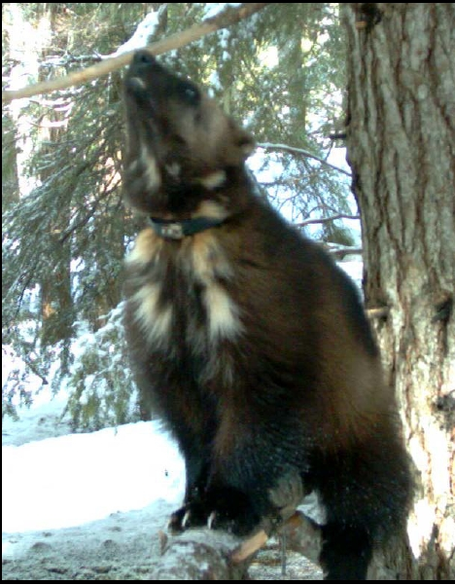
Wolverine Monitoring & Research
Purpose: Increase knowledge of wolverine distribution & ecology
Why? NPS protects resources unimpaired for future generations
Background: Candidate species, threatened by climate change
Notes:
My second example is that of a Wolverine Study that started in 2007 as a general research project to learn more about wolverine distribution and ecology. The study was an international collaboration between Dr. Keith Aubry of the USFS and researchers in British Columbia.

Slide 13
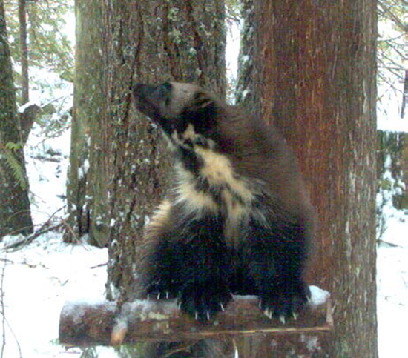
Wolverine Monitoring & Research
Location: Washington & British Columbia
Notes:
Early in the study, US Forest Service biologists had captured and radio collared wolverines and the map on the right gives you an idea of their movements across the landscape. Each colored line on the map represents a different individual. North Cascades NP is in the lower left of the photo. All individuals were captured east of North Cascades.

Slide 14
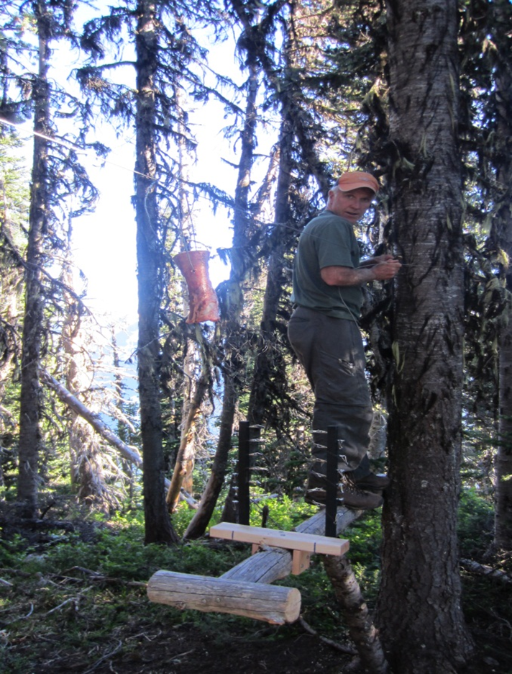
Wolverine Monitoring & Research
Four Stages:
2007 – Remote cameras
2008 – Radiotelemetry to monitor for winter reproductive denning sites
2008 winter helicopter landing if denning detected
2012 – winter & summer landing at site
Notes:
For North Cascades, the first application for a research permit was just to install some cameras – without bait stations. As more was learned about the activities of the wolverine, the research methodology evolved from satellite tracking of radio collars to the possibility of landing a helicopter in Wilderness if denning activity was indicated. Each year we re-examined the research permit and developed recommendations for wilderness activities.

Slide 15
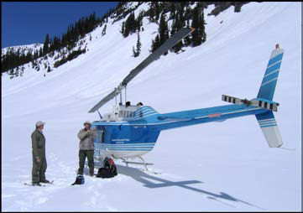
Wolverine Monitoring & Research
Wilderness Concern: Landing a helicopter in Wilderness
Safety Concern: Unsafe access both in winter and summer
Visitor Experience Concern: Related to helicopter use
Science Need: First known denning activity in PNW
Need to send in experience biologist to collect data

Slide 16
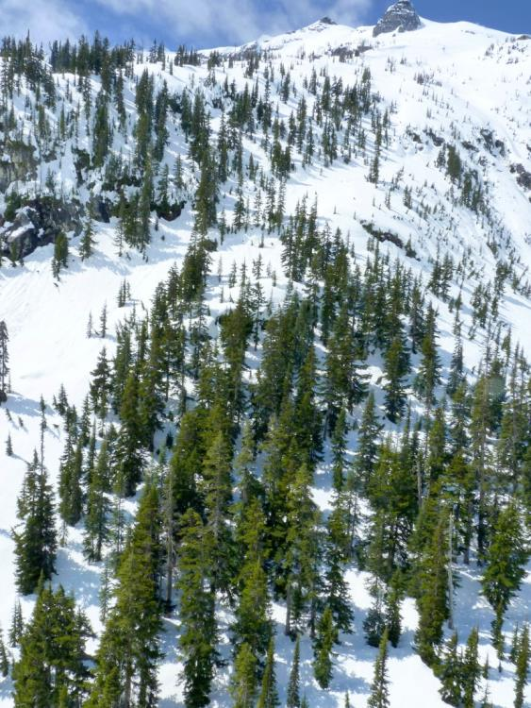
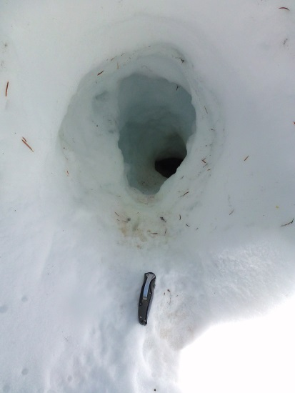
Wolverine Monitoring & Research
Wilderness Decision:
Permitted winter landing to confirm den
Permitted summer access to collect measurements, DNA

Slide 17
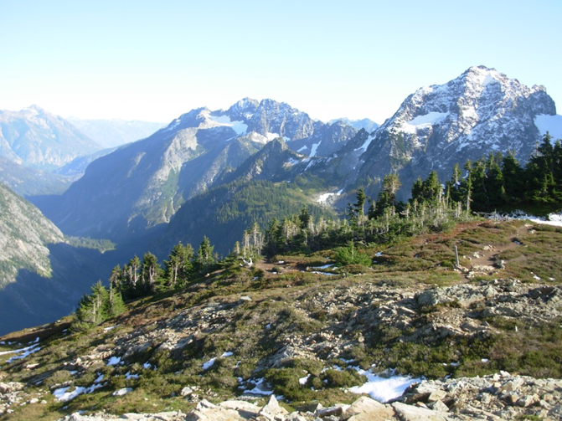
Photo

