Slide 1
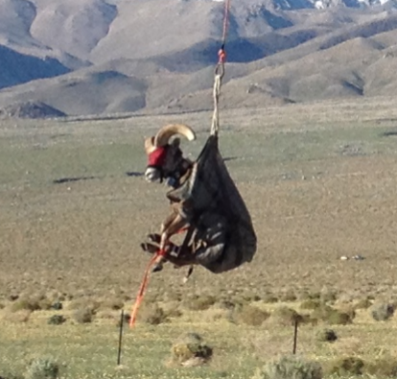
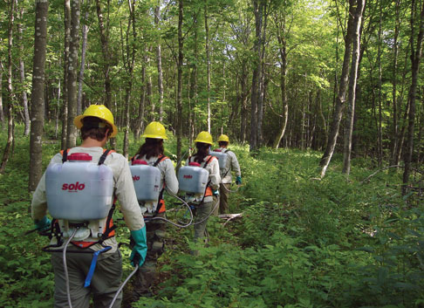
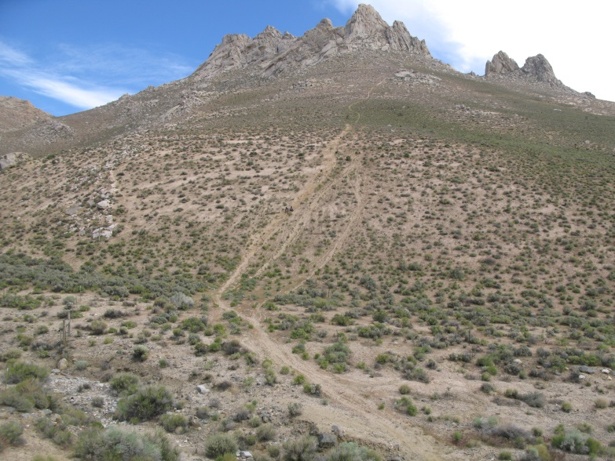
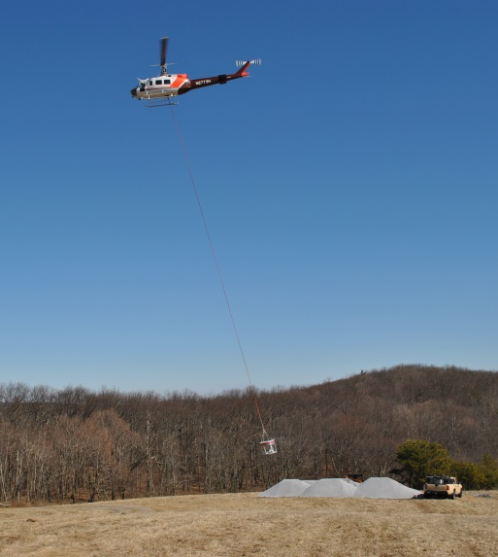
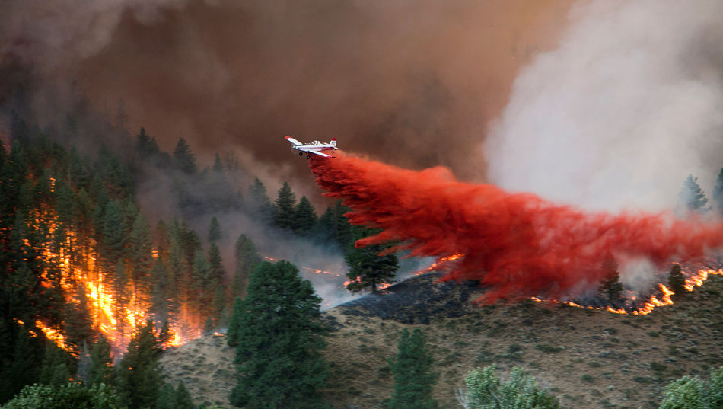
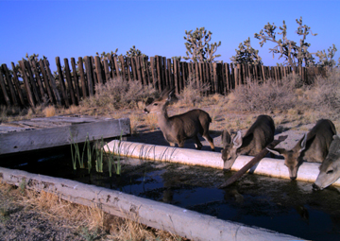
Ecological Restoration in Wilderness Complexity, Uncertainty, Conflict, Risk
Lucy Lieberman | lucy.lieberman@umontana.edu

Slide 2
Wilderness Act of 1964
The mandate of the Wilderness Act is to preserve the area’s “wilderness character”
Natural
Untrammeled
Solitude or Primitive and Unconfined Recreation
Undeveloped
Other Unique Qualities
Sequoia Kings Canyon Wilderness, CA

Slide 3
WILDERNESS ACT OF 1964 Sec. 2(c)
“A wilderness…is hereby recognized as an area where the earth and its community of life are untrammeled by humans” (Wildness)
freedom from intentional modern human control and manipulation
“An area of wilderness is further defined…retaining its primeval character and influence…which is protected and managed so as to preserve its natural conditions” (Naturalness)
species, patterns, and processes that evolved in the area
Notes:
Goal of wilderness stewardship is to preserve wilderness character. An example of a management action that improves the untrammeled quality of wilderness character would be letting a wildfire burn. For improving the natural quality of wilderness character a manager may decide to remove a non-native species. Both of these actions are consistent with the legal mandate to preserve wilderness character.
-trammels are both authorized and unauthorized (ex. Visitor stocking a lake or poaching)

Slide 4
Taking action vs not taking action
Taking restoration action compromises the untrammeled quality of wilderness
Not taking restoration action may compromise the natural quality of wilderness
Notes:
The wilderness management dilemma is characterized by the fact that….
Reasons to support ecological intervention: supports some social values about preserving certain species or iconic landscapes, combating impacts of climate change, ”feel good”/feels like we’re doing something about degradation, successful restoration projects
-Other hand: potential problems of intervention: “death to wilderness by a thousand cuts”, impacts the NWPS as a whole,
Benefits to hands-off approach:
Fosters scientific humility
Reduces risk of unintended consequences
Sustains non-focal species
Provides benchmarks of uncontrolled areas
Facilitates evolutionary change (slower)

Slide 5
Where do you fit?
Soule’s three archetypic ways of perceiving and saving the wild (Soule 2001)
Where do you fit?
Notes:
Regardless of our title, we are wilderness managers, and manage land in the public interest, yet personal values influence our goals and decisions. Resource managers may find themselves aligning with the Ecological/Process archetype, while the Visitor and Resource Protection folks may relate more to the Heroic/Experiential archetype. Yet the goal is to stay objective as possible and balance multiple policies, laws and objectives, all with the goal of preserving wilderness character. If you feel strongly about one archetype, I would encourage you to try wearing a different hat, and understand a different perspective for this presentation

Slide 6
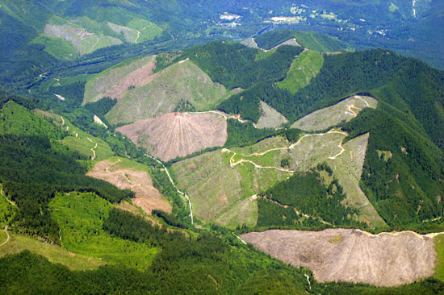
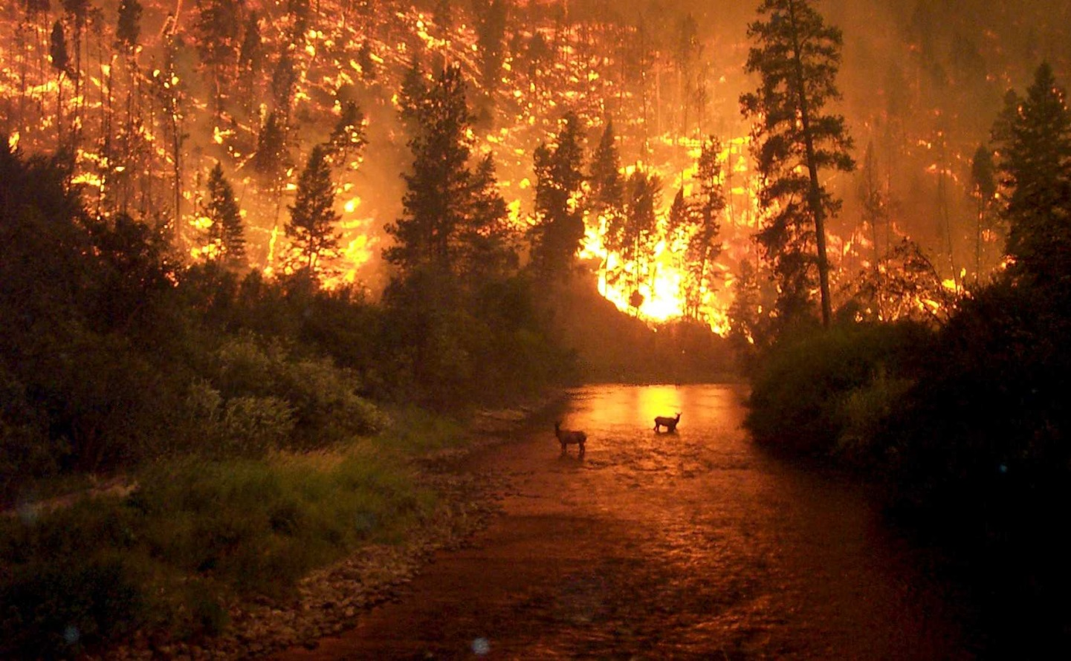
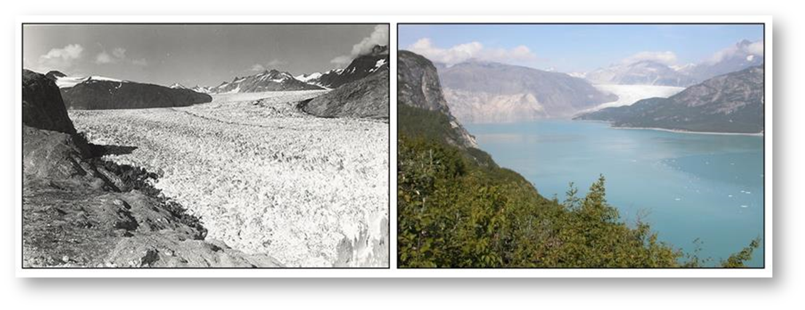
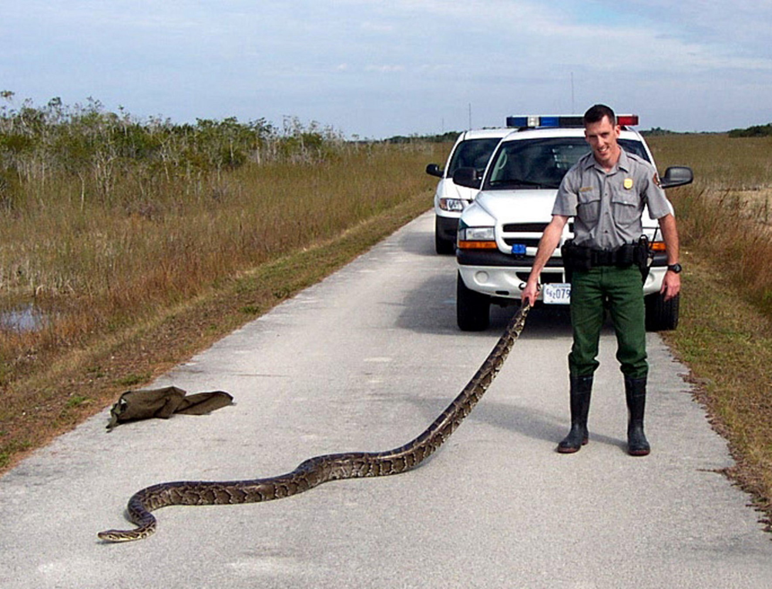
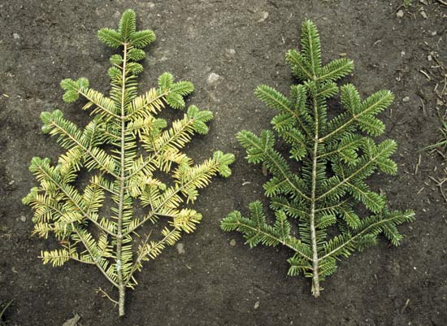
Threats to Wilderness Character
Notes:
Threats to wilderness – land use development, habitat fragmentation, altered disturbance regimes, pollution….and CLIMATE CHANGE

Slide 7
Reality – Wilderness Ecosystems Change …and Always Will
Does this change matter?
What is “natural”?
Has restraint been considered?
Should we take restoration actions?
If we act, what do we gain in the natural quality
and
what do we lose in the untrammeled quality?
If we act, what is the minimum necessary action to maximize the preservation of wilderness character?
Notes:
What is the ecological justification for restoring, and is it legitimate?

Slide 8
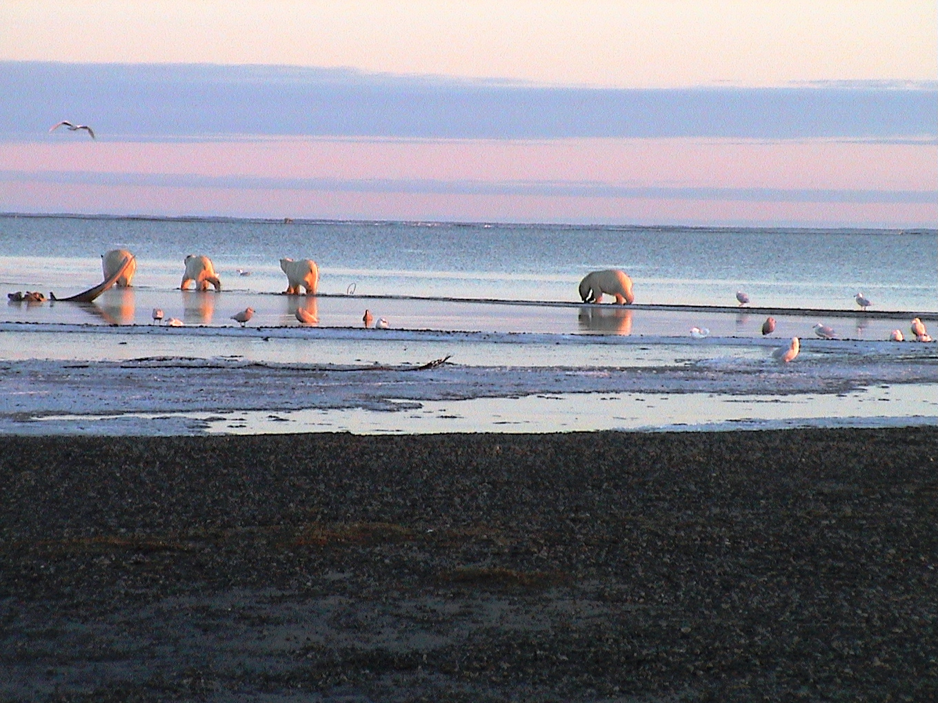
What’s the risk of doing nothing?
What’s the risk of doing something wrong?

Slide 9
What is “Natural” in Wilderness?
What does autonomous and historical fidelity mean when ecological systems in wilderness are changing?
Historic conditions may not be appropriate planning targets
Emergence of novel ecosystems
Uncertainties – ecological changes and restoration efficacy

Slide 10
Why does this matter?
Cumulative effects to wilderness character
Commercial, visitor, administrative, science
Death by a thousand cuts? Repeat actions, monitoring
Uncertainties, risks, unintended consequences
Pressure – partners, legislation, climate strategies
Divergent public values
Potential litigation

Slide 11
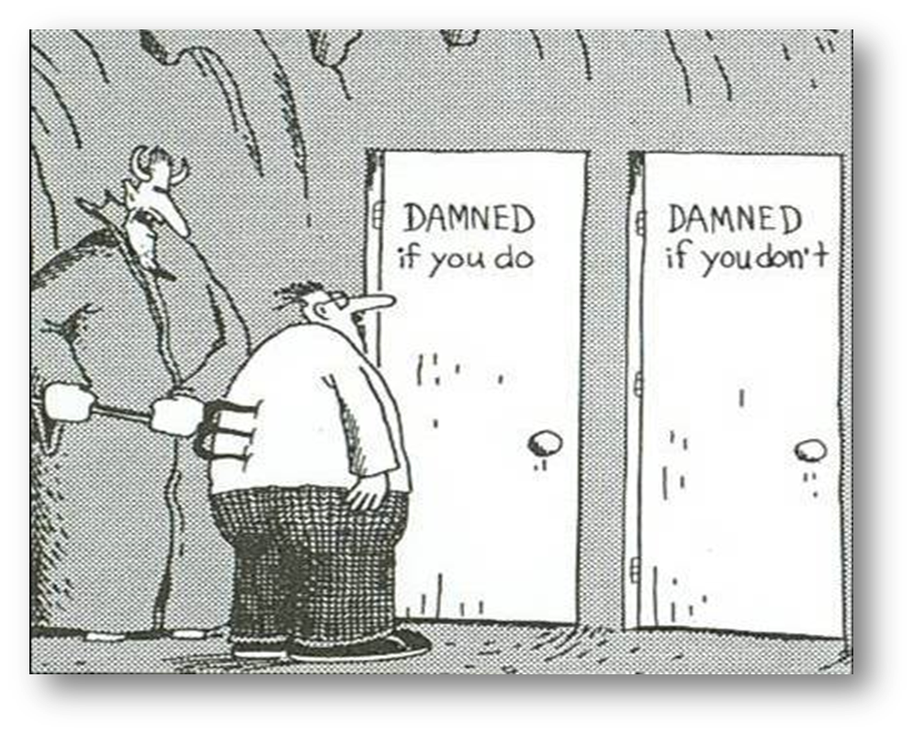
Wild Versus Natural
Wild And Natural
Notes:
Reality, we need to find a balance and preserve wilderness character in it’s entirety

Slide 12
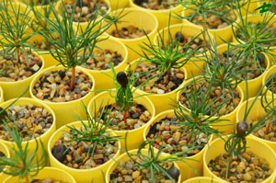
Interventions: Vegetation
Notes:
Invasive species removal using chemical herbicides, planting blister rust resistant seedlings

Slide 13
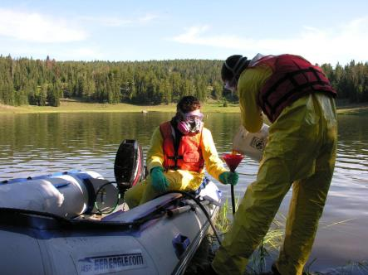
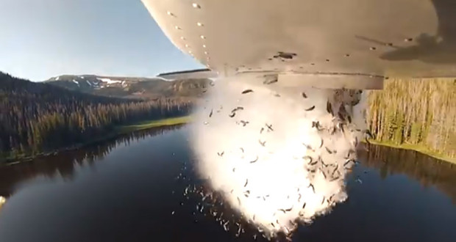
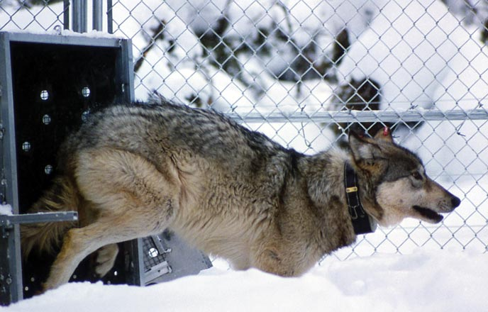
Fish, wildlife, and insects
Notes:
-Species reintroduction, assisted migration, removal of non-native fish or wildlife

Slide 14
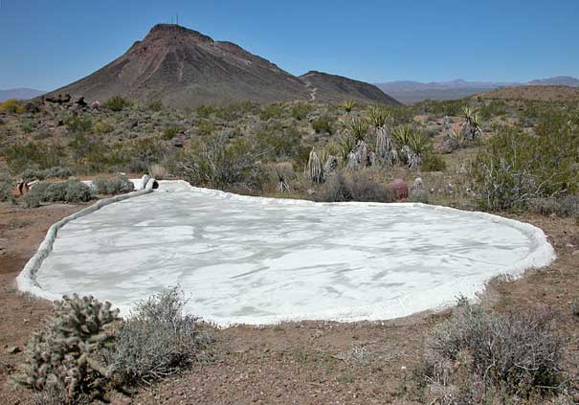
Soil and water
Notes:
Water chemistry, water diversion, water enhancement

Slide 15
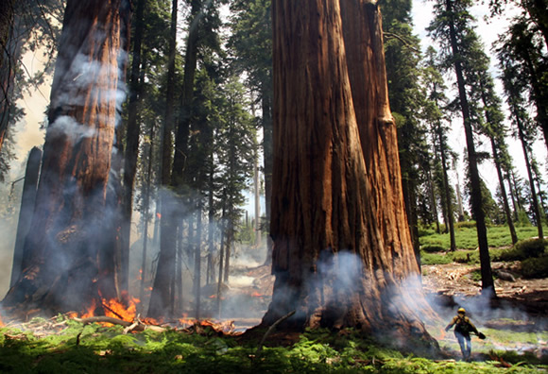
Fire
Notes:
Suppression, mechanical fuel reduction, prescribed fire

Slide 16
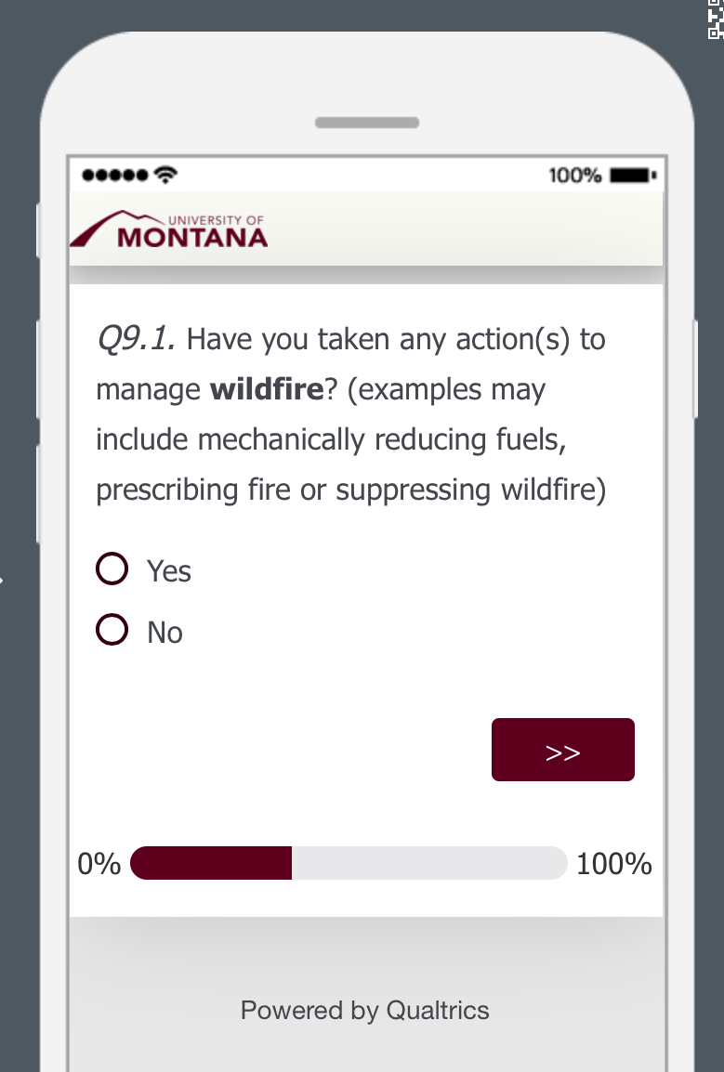
Methods
Quantitative Element
Online Survey to 523 wilderness units
Qualitative Element
Semi-structured interviews with 12 wilderness managers
Notes:
Quantitative: What types of interventions, how often, no personal perspectives
-all units were randomly selected
-survey was created in qualtrics, pilot-tested by 6 wilderness managers, educators and ecologists, and was available for one month
-data was then exported from Qualtrics to SPSS, a statistics program, for analysis
-In the next two slides I’ll review what types of questions the survey asked about
Qualitative: understand the why and the how of decision-making
-purposive sample of 12 retired and active wilderness managers, 3 from each of the 4 managing agencies
-average interview length of 54:43 minutes
-all interviews were recorded, transcribed and coded, linking responses to themes

Slide 17
Survey Response
Agency | Sent Surveys | Received Surveys
USFS | 291 | 93
BLM | 145 | 74
FWS | 46 | 26
NPS | 41 | 17
Total: | 523 | 210
40% Response Rate
Notes:
I used a formula to determine how many surveys should be sent to each agency for a 95% confidence interval and significant results

Slide 18
Survey Categories
Notes:
The quantitative survey was broken into four categories and using if/then logic for the questions, it would prompt the respondent first if they had vegetation interventions, then if they applied herbicide if yes, it asked how many projects to apply herbicide in each of the last five years, then for the most recent project it asked detailed questions about it: proposed it? NEPA level? Monitoring? Etc.

Slide 19
Results
37% of wilderness units intervened in wilderness over the last five years
Proportion of wilderness units who responded to the survey and took ecological interventions, by agency
Notes:
-USFS should have been higher, but my survey link was flagged as “suspicious” so I suspect many didn’t respond to it, I also had to resample the USFS to try and increase their response rate after the initial response
-Relative to the amount of survey responses, the NPS has the greatest proportion of wilderness units who intervened

Slide 20
Regional Distribution
Wilderness units that intervened by geographic region and agency (n=77 wilderness units)
Notes:
Summary of where the survey responses came from,

Slide 21
Percent of wilderness units with ecological intervention and "proposed but rejected intervention projects" status (n=209 wilderness units)
Potential action bias
Notes:
An initial question on the survey was, “have you had any proposals to intervene in wilderness that were rejected”-an indication of the hands-off approach, they’re saying no some times
Action bias: propensity to act even when risks are high and outcome is uncertain,

Slide 22
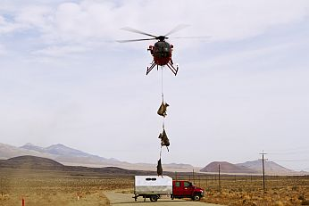
Types of Ecological Interventions
(n=111 intervention actions from 77 wilderness units)
Notes:
Why more vegetation: not as controversial, lots of funding for non-native species/weed removal
-wildlife could have been higher if it was a higher fire season, just depends on the year, this was for the last five years

Slide 23
Vegetation Results (n=56 vegetation intervention actions from 77 wilderness units)
Notes:
-“other” vegetation was the restoration of off-highway vehicle (OHV) incursions in wilderness units managed by the BLM; restoring sites with illegal marijuana operations were common sources of “other” vegetation interventions.
-pic: hand pulling buffelgrass in Saguaro Wilderness managed by the NPS

Slide 24
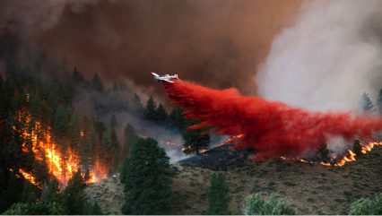
Wildfire Results (n=39 wildfire intervention actions from 77 wilderness units)
Notes:
-sample of some of the wildfire results
-Initial attack=full suppression, goal of putting out the fire
-post-fire restoration could be using mats or straw wattles to hold embankments, planting seeds, removing invasives, etc.

Slide 25
Wildlife Results (n=24 wildlife intervention actions from 77 wilderness units)
Remove: “Protect the habitat from damage from invasive feral hogs.”
Add: “The breeding of pronghorn is anticipated to raise the population to sustainable levels and reintroduce them to historically occupied lands.”
Remove: “Remove non-native fish from a naturally fish-less lake.”
Notes:
Add: supplement populations, reintroduce extirpated species
Remove: lethal-remove non-native species or ”problem animals”
-This is a sense of the reason why, this was an open ended question tied to each sub-category of intervention

Slide 26
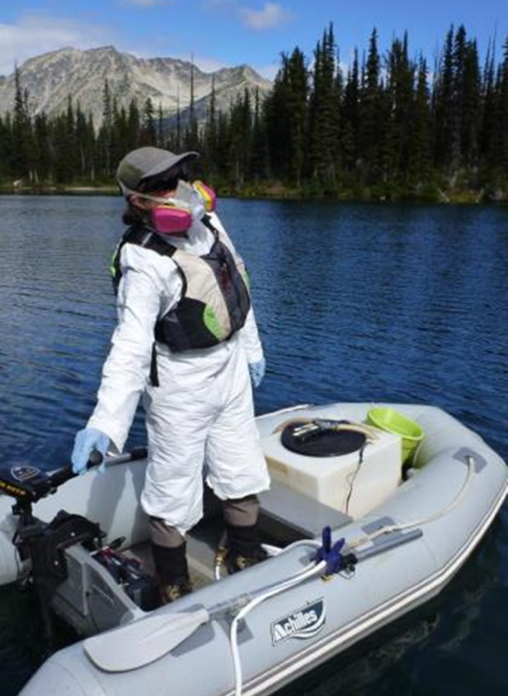
Wilderness Act 4c Prohibited Uses (n=90 wilderness unit responses; respondents could check multiple 4c uses per project)
Notes:
Require a minimum tool analysis to demonstrate that it’s the minimum tool necessary to manage the area as wilderness

Slide 27
NEPA Level of Analysis for Intervention Action
Notes:
-NEPA or National Environmental Policy Act, reviews are required by law when the action may cause significant environmental effects
-Multiple levels with CE being the lowest when they deem there aren’t significant environmental effects, followed by an EA and EIS
-High number of intervention actions did not do any NEPA analysis or did a CE, in which case the public did not need to be informed of the action

Slide 28
Post-action Monitoring (n=79 intervention actions from 77 wilderness units)
Notes:
-this is important not just to study the effectiveness of the action, but also because these projects are funded partially through public money and it’s part of being accountable of the actions that these agencies take
-monitoring also complicates the trammeling action by causing repeated incursions to monitor results, collars on animals potentially for their whole life, and structures in place to monitor results

Slide 29
Evaluation Framework for Proposed Ecological Intervention and Restoration in Wilderness
Preliminary Evaluation Framework
March 2014 workshop – Agency, University participants
Goal
Comprehensive and Systematic – structured approach to evaluate criteria involving law and policy, ecological understandings, and ethical considerations
Broadly Applicable – relevant across all NWPS agencies and units
Locally Flexible – reflects local values regarding wilderness and restoration
Notes:
Increasing need for technical assistance, context varies, but the way in which we approach decision making could be more consistent and this tool is meant to do that

Slide 30
Approach
Structured Decision-Making, an organized approach to identifying and evaluating options and making choices for complex decisions
Basic Premises
Be wary of action bias: first decide if action is necessary, then decide the minimum tool to accomplish the action
Be wary of oversimplification: decisions need to consider whether benefits outweigh impacts
Be wary of one size fits all: every situation is different (e.g., place, values at risk, threats, attitudes, knowledge)
Notes:
Design elements that shaped the development of this tool

Slide 31
Outcomes
Facilitate informed decision-making by wilderness managers
Increase transparency and defensibility of decisions
Improve stakeholder communication and awareness
Preserve wilderness character

Slide 32
Evaluation Framework for Proposed Ecological Intervention and Restoration in Wilderness
Relationship to the Minimum Requirements Analysis?
“... except as necessary to meet minimum requirements for the administration of the area for the purpose of this Act...”
Step 1: Is the action necessary?
Step 2: If so, determine minimum activity
The framework is intended to provide detailed support to early proposal planning and development (Step 1)
Relationship to NEPA?
Framework is designed for use during the pre-NEPA, pre-decisional stage of proposal development
But, analysis for framework can contribute to NEPA
And, framework can be used to strengthen proposals already in NEPA process
Importance of interdisciplinary engagement

Slide 33
Evaluation Framework for Proposed Ecological Intervention and Restoration in Wilderness
Evaluation Framework
Step 1: Describe the Situation
Step 2: Frame the Evaluation
Step 3: Complete Complex Evaluation
Step 4: Determine Minimum Activity MRA Step 2
Step 5: Complete NEPA, Identify Proposed Action
Step 6: Implement, Monitor and Adapt

Slide 34
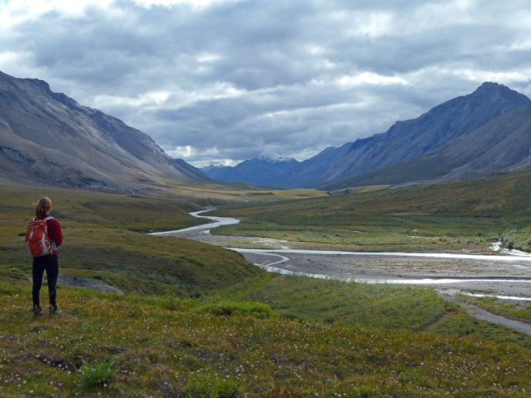
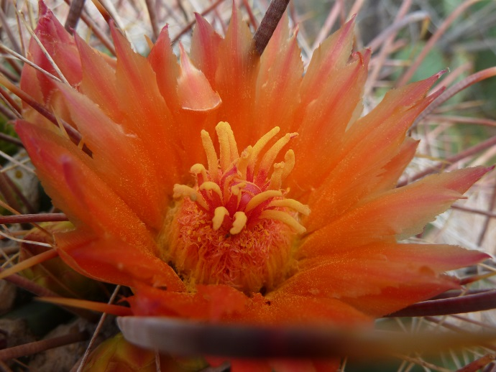
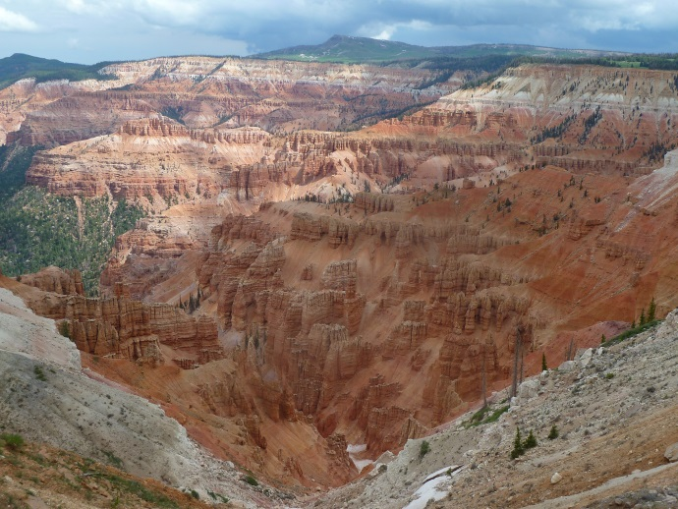
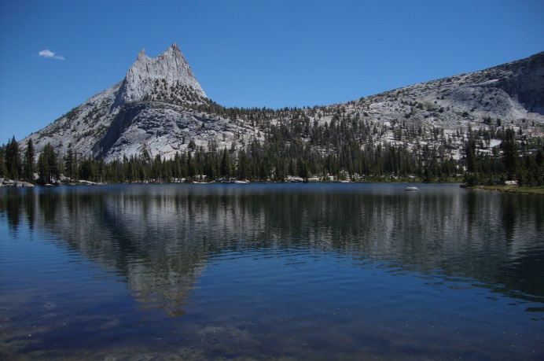
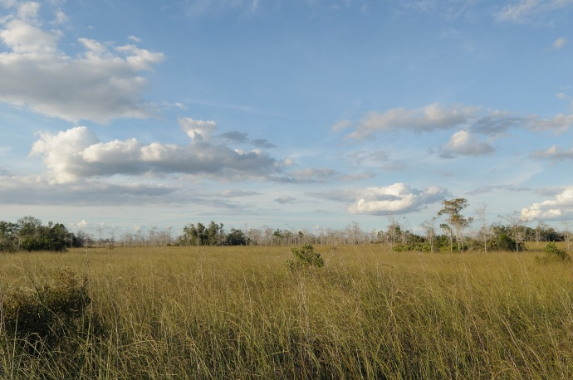
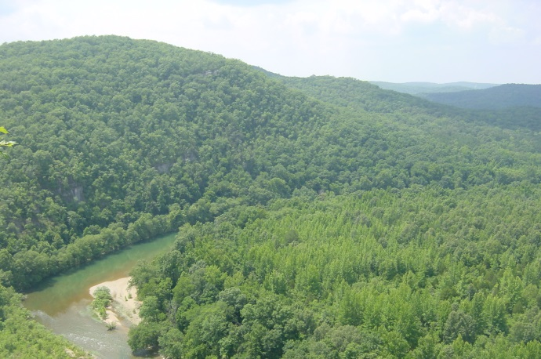
Thank you!
Lucy Lieberman| lucy.lieberman@umontana.edu

Slide 35
Questions
What ecological restoration projects have occurred in your wilderness? How did social values influence the process/decision to intervene?
How have wilderness concerns conflicted with agency policy?
Is a collared animal that is tracked for the duration of its life still wild?

Slide 36
Step 1: Describe the situation
What is the problem?
Is action necessary?
1.1 Is there a problem that may prompt ecological restoration action (i.e. trammeling)?
1.2 Is restoration needed here and now in this wilderness? (Why here, why now?)
1.3 Is Action Necessary? (MRA, Step 1) Does the proposed intervention have clear legal justification and/or clear benefit to wilderness character?
Notes:
Step 1 focuses on the need for ecological intervention and establishes a broad justification for the proposal. Successful passage through steps 1.1-1.3, indicates that an intervention proposal is sufficiently well justified and supported for reviewers to affirmatively answer the MRA Step 1 decision question: Is action necessary?

Slide 37
Step 2: Frame the Evaluation
2.1 Does the proposal include essential content for initial evaluation?
2.2 How much analysis is needed – complex or simple?
Notes:
Step 2 ensures that proposal content and detail relevant to subsequent evaluations has been identified (step 2.1) and then uses this information to address five potentially controversial issues (step 2.2) that either 1) trigger more in depth, complex analyses (Step 3), or 2) direct reviewers to initiate the NEPA process without additional proposal development efforts.

Slide 38
Step 3: Complete complex evaluation
3.1 Scientific criteria
3.2 Values and ethics criteria
3.3 Implementation criteria
3.4 Monitoring criteria
Notes:
For restoration proposals requiring complex evaluation, use the checklists of scientific, implementation, monitoring, and values and ethics content to proceed with evaluation and facilitate the development of action alternatives (steps 3.1-3.14). These checklists are intended to ensure that proposals include adequate and applicable information; YES responses help to build the case for ecological restoration in wilderness. The proposal should include a narrative description that addresses each of the following issues, including the strength of evidence and the degree of uncertainty.

Slide 39
Exit Evaluation Framework and complete next steps:
Step 4: Complete MRA Step 2, Determine minimum activity
Step 5: Complete NEPA and Identify Proposed Action
Step 6: Implement, Monitor and Adapt

Slide 40
Step 1: Describe the Situation
1.1 Is there a problem that may prompt ecological restoration action (i.e. trammeling)?
YES | NO
 |  | Proposal clearly describes the restoration issue (i.e. degradation)
 |  | Proposal articulates why action is more important than inaction to preserve wilderness character
 |  | Restoration needs, objectives, and outcomes are defined and linked to preservation of wilderness character
If YES to all rows, continue to evaluate the broad rationale. Ff NO to any rows, deny proposal and return for potential revision.
Notes:
Basic rationale for the trammeling of ecological restoration within wilderness

Slide 41
Step 1: Describe the Situation
1.2 Is restoration needed here and now in this wilderness? (Why here, why now?)
YES | NO
 |  | Proposal includes justification to implement proposal within wilderness (i.e. wilderness dependence)
 |  | Proposal considers the status and condition of surrounding lands to demonstrate rationale for proposed restoration within this particular wilderness unit at this time
If YES to all rows, continue to evaluate proposal. If NO to any rows, deny proposal and return for potential revision.
Notes:
Need for restoration within wilderness
Broader spatial context for restoration within a particular wilderness unit

Slide 42
Step 1: Describe the Situation
1.3 Is restoration action necessary? (MRA, Step 1)
Does the proposed intervention have clear legal justification and/or clear benefit to wilderness character?
YES | NO
 |  | Proposal includes restoration action(s) to satisfy valid existing rights or a special provision in wilderness legislation (the Wilderness Act of 1964 or subsequent wilderness laws) that requires action
 |  | Proposal includes restoration action(s) to meet the requirements of other federal laws (e.g., Endangered Species Act, Dam Safety Act, Clean Air Act)
 |  | Proposal includes restoration action(s) to preserve one or more of the qualities of wilderness character: Untrammeled, Undeveloped, Natural, Outstanding Opportunities for Solitude or Primitive and Unconfined Recreation, or Other Features of Value that reflect the character of this wilderness area
If YES to any rows, continue to evaluate proposal to determine the extent of needed analysis. If NO to all rows, deny proposal and return for potential revision.
Notes:
Legal criteria of necessity
- specific to wilderness legislation or valid existing rights
- other legislation
- direct link to qualities of wilderness character

Slide 43
Step 2: Frame the Evaluation
2.1 Is the proposal sufficient for an initial evaluation?
YES | NO
 |  | Administrative jurisdiction and decisionmaker(s) identified.
 |  | Potential stakeholders identified.
 |  | Spatial scale(s) of action and restoration outcome(s) identified.
 |  | Temporal scale(s) of action (including frequency) and restoration outcomes(s) identified.
 |  | Proposal is clearly designed to accomplish stated restoration outcome(s).
 |  | Potential conflicts in law and policy identified.
 |  | Potential conflicts in values and ethics are identified.
 |  | Potential effects on wilderness character described, including strength of evidence.
 |  | Potential cumulative effects are identified, including strength of evidence.
 |  | Uncertainties are identified: law and policy; science; implementation; monitoring; values and ethics; restoration outcomes; and, other types of uncertainty.
 |  | Monitoring is included that assesses effectiveness of restoration and impacts/benefits on wilderness character.
If YES to all rows, continue to evaluate proposal to determine is any restoration action is necessary If NO to any rows, deny proposal and return for potential revision.
Notes:
2.1Determine if proposal is sufficient for basic evaluation: the proposal includes specific management objectives, desired restoration outcomes, potential effects and uncertainties, and an initial monitoring strategy. In Step 2.1, the proposer should have a succinct narrative description that accompanies Table 2; for all rows, approximately 2-5 sentences should be sufficient at this stage of the proposal development. (Essential proposal content for subsequent analysis and decision-making.)

Slide 44
Step 2: Frame the Evaluation
2.2 How much evaluation is needed – complex or simple?
YES | NO
 |  | Proposed intervention will have significant negative impact to wilderness character.
 |  | Proposed intervention will use activities prohibited by the Wilderness Act section 4(c).
 |  | Proposed intervention has high potential for legal and/or policy conflict.
 |  | Proposed intervenion has high potential for conflict of values and/or ethics.
 |  | Proposed intervention will set a precedent for actions taken in wilderness.
A YES in any category triggers a complex evaluation in this Framework, which is completed in Step 3. Only if all categories are NO should the proposal proceed with relevant staff consultations and project planning through the required NEPA process. Lack of consensus in any of the rows suggests that a complex evaluation is needed.

Slide 45
Step 3: Complete complex evaluation
3.1 Is there sufficient consideration of science?
YES | NO or INADEQUATE | NOT APPLICABLE | Science
 |  |  | There is sufficient historic and current information about the problem (including distribution and rate of spread), its source, and the threats and risks posed by the problem
 |  |  | Problem is caused by modern human actions, and not a result of natural variation in species occurrences, rates of ecological processes, or disturbances
 |  |  | Threats or circumstances causing the problem have been stopped, or adverse effects caused by problem can be mitigated even though problem persists
 |  |  | There is sufficient information about the direct effects of climate change and the interaction between climate change and the problem to support restoration action
 |  |  | Problem is currently causing or likely to cause secondary or cascading problems
 |  |  | There is sufficient understanding about the short- and long-term effects of the proposed restoration actions
 |  |  | Traditional and Local Ecological Knowledge are available and appropriate for use in this restoration proposal
Notes:
for restoration proposals requiring complex evaluation, use the checklists of scientific, implementation, monitoring, and values and ethics content to proceed with evaluation and facilitate the development of action alternatives

Slide 46
Step 3: Complete complex evaluation
3.2 Is there sufficient consideration of values and ethics?
YES | NO or INADEQUATE | NOT APPLICABLE | Values and Ethics
 |  |  | Tradeoffs in managing to preserve wilderness character have been identified
 |  |  | Tradeoffs in laws and policies have been identified
 |  |  | Site-specific values and tradeoffs have been identified
 |  |  | Stakeholder values and tradeoffs have been identified
 |  |  | Restoration action will be inclusive, participatory, and transparent, commensurate with scale and complexity of restoration action(s) and level of uncertainty
Notes:
for restoration proposals requiring complex evaluation, use the checklists of scientific, implementation, monitoring, and values and ethics content to proceed with evaluation and facilitate the development of action alternatives

Slide 47
Step 3: Complete complex evaluation
3.3 Is there sufficient consideration of implementation?
YES | NO or INADEQUATE | NOT APPLICABLE | Implementation
 |  |  | There is sufficient understanding to identify the necessary short- and long-term actions needed to achieve restoration outcome(s)
 |  |  | There is sufficient knowledge and experience to demonstrate that implementation of the restoration action is effective and practical to achieve restoration outcome(s)
 |  |  | Internal agency resources are adequate to successfully implement the restoration actions and monitor effects
 |  |  | External resources (e.g., volunteer groups) are available to facilitate the implementation and monitoring of restoration actions
Notes:
for restoration proposals requiring complex evaluation, use the checklists of scientific, implementation, monitoring, and values and ethics content to proceed with evaluation and facilitate the development of action alternatives

Slide 48
Step 3: Complete complex evaluation
3.4 Is there sufficient consideration of monitoring?
YES | NO or INADEQUATE | NOT APPLICABLE | Monitoring
 |  |  | Monitoring strategy includes pre-implementation baseline monitoring
 |  |  | Monitoring strategy considers the potential effects of monitoring on wilderness character, including cumulative effects and the use of minimum activity
 |  |  | Proposal includes implementation monitoring to ensure that restoration action was implemented as designed
 |  |  | Proposal includes effectiveness monitoring to test whether restoration actions will achieve the defined objectives and desired outcomes
 |  |  | Proposal includes effects monitoring to evaluate ecological tradeoffs and detect non-target or unintended effects of the restoration actions
 |  |  | Monitoring strategy includes an evaluation process to determine whether to continue or stop restoration actions, and may include thresholds and triggers
 |  |  | Extent of monitoring is commensurate with scale and complexity of restoration action(s) and level of uncertainty
 |  |  | Monitoring plan includes data analysis methods and plan for completing analysis
 |  |  | Monitoring plan describes the appropriate audience and responsible entities for analysis, reporting, and archiving
Notes:
for restoration proposals requiring complex evaluation, use the checklists of scientific, implementation, monitoring, and values and ethics content to proceed with evaluation and facilitate the development of action alternatives

Slide 49
NPS Units Table
NPS Unit - Wilderness | State | Proposal
Pictured Rocks National Lakeshore – Beaver Basin Wilderness | MI | Beech bark disease restoration
Crater Lake National Park – Recommended wilderness | OR | Whitebark pine restoration
Glacier National Park – Proposed wilderness | MT | Vegetation management – non-native invasives
Channel Islands National Park – Eligible wilderness | CA | Invasives
Point Reyes National Seashore – Phillip Burton Wilderness | CA | Marine restoration

Slide 50
FWS and BLM Units Tables
FWS Unit - Wilderness | State | Proposal
Kenai NWR – Kenai Wilderness | AK | Forest-to-grassland conversion from spruce beetle outbreaks, fire and climate change
Moosehorn NWR – Moosehorn Wilderness | ME | Red pine preservation using prescribed fire
Farallon NWR – Farallon Wilderness | CA | Removing non-native mice to improve avian nesting success
Kofa NWR – Kofa Wilderness | AZ | Wildlife water installations
BLM Unit - Wilderness | State | Proposal
Burns District – Steens Mountain Wilderness | OR | Juniper removal
Multiple California desert wilderness areas | CA | Variety of restoration proposals

Slide 51
FS Units Table
FS Unit - Wilderness | State | Proposal
Hoosier NF – Charles C. Deam Wilderness | IN | Prescribed fire and herbicide application to treat invasive Ailanthus altissima tree
Mark Twain NF – Bell Mountain Wilderness | MO | Mead’s milkweed restoration via thinning and burning
Okanogan-Wenatchee NF – Pasayten Wilderness | WA | Whitebark pine restoration
Rio Grande NF – Weminuche Wilderness | CO | Fisheries restoration
Kaibab NF – Kendrick Mountain Wilderness | AZ | Post-fire restoration

Slide 52
SHOULD RESTORATION ACTIONS BE TAKEN? Conflicting Ethical Views
GOAL: Untrammeled / Let It Be
GOAL: Natural / Restore
Manipulation is not justified for any reason (2 wrongs don’t make a right)
Manipulation is justified to restore naturalness (it is our responsibility)
Current problems are deemed acceptable (although not desired)
Current problems are deemed unacceptable (we must do something)
Potential results of action may be worse than the results of inaction (do no harm is the first rule)
Potential results of inaction may be worse than the results of action (doing something is better than nothing)
There is no “target” and we watch, and learn, from what happens
There is a “target” that we are obligated to preserve and restore

