Slide 1
Wildfire Interventions in Wilderness: What’s happening on the ground?
Lucy Lieberman & Beth Hahn
Aldo Leopold Wilderness Research Institute

Slide 2
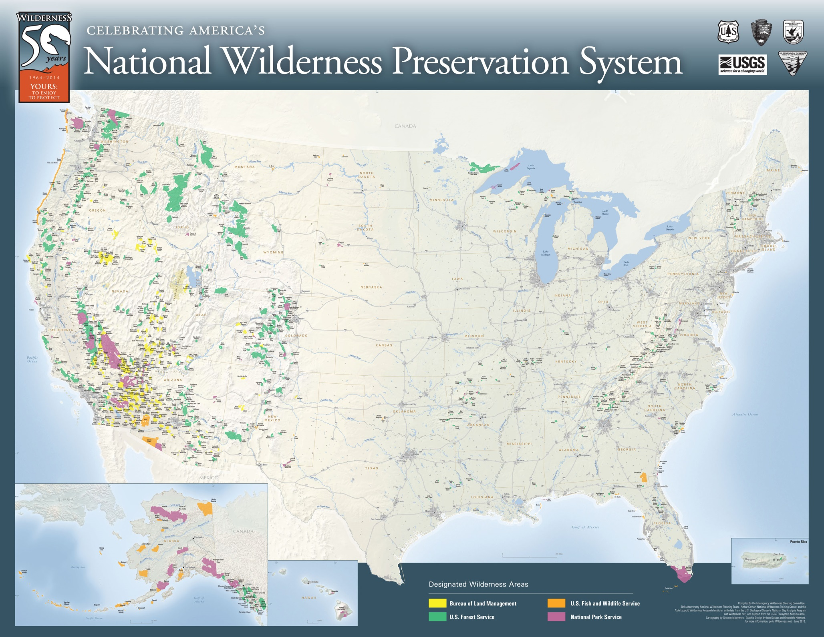
Celebrating America’s NWPS
765 areas
110 million acres
BLM, USFWS, USFS, NPS
Notes:
Context:
-1964 Wilderness Act established the NWPS
-4 fed agencies under 2 departments; each has their own mission and policies; NPS manages most acreage, USFS manages the most units
-No current method for documenting ecological interventions for the entire NWPS

Slide 3
Wilderness Act of 1964
The mandate of the Wilderness Act is to preserve the area’s “wilderness character”
Natural
Untrammeled
Solitude or Primitive and Unconfined Recreation
Undeveloped
Other Unique Qualities
Sequoia Kings Canyon Wilderness, CA

Slide 4
WILDERNESS ACT OF 1964 Sec. 2(c)
“A wilderness…is hereby recognized as an area where the earth and its community of life are untrammeled” (Wildness)
freedom from intentional modern human control and manipulation
“An area of wilderness is further defined…retaining its primeval character and influence…which is protected and managed so as to preserve its natural conditions” (Naturalness)
species, patterns, and processes that evolved in the area
Notes:
-Goal of wilderness stewardship is to preserve wilderness character.
-untrammeled, must be an opportunity to show restraint
-trammels are both authorized and unauthorized (ex. Visitor stocking a lake or poaching)
-An example of a management action that improves the untrammeled quality of wilderness character would be letting a wildfire burn (must be an opportunity for restraint).
-For improving the natural quality of wilderness character a manager may decide to remove a non-native species. Both of these actions are consistent with the legal mandate to preserve wilderness character.
-tension for managers to preserve both qualities

Slide 5
Taking restoration action compromises the untrammeled quality of wilderness
Not taking restoration action may compromise the natural quality of wilderness
Notes:
The wilderness management dilemma is characterized by the fact that….
Reasons to support ecological intervention: supports some social values about preserving certain species or iconic landscapes, combating impacts of climate change, ”feel good”/feels like we’re doing something about degradation
-Other hand: potential problems of intervention: “death to wilderness by a thousand cuts”, impacts the NWPS as a whole,
Hands-off approach:
Fosters scientific humility
Reduces risk of unintended consequences
Sustains non-focal species
Provides benchmarks of uncontrolled areas
Facilitates evolutionary change (slower)

Slide 6
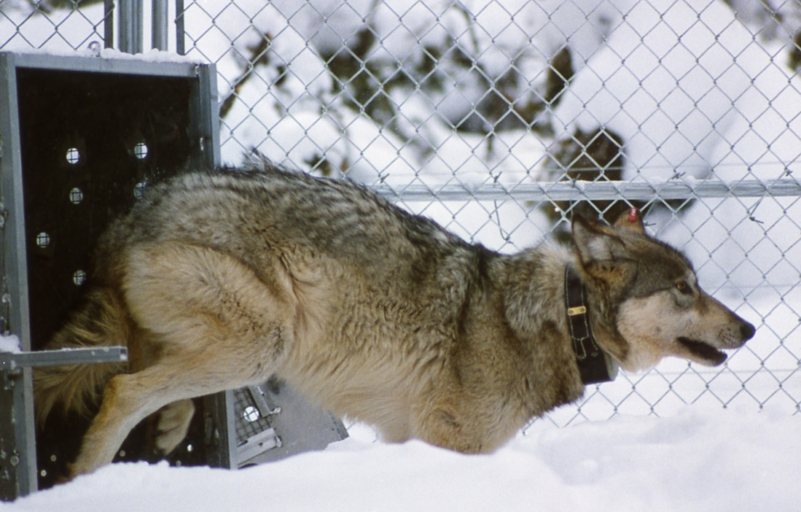
What is an ecological intervention?
An intentional management manipulation
Trammeling action
What is NOT an ecological intervention?
Actions that fall below a minimum threshold of scale and scope such as hand pulling a few weeds or restoring a camp site
Ecological change that managers do not have the ability to control
Notes:
What is an eco intervention? An action that purposefully alters, hinders, restricts, controls, or manipulates ‘the earth and its community of life’.”
Not an intervention: water acidification from a coal plant outside the wilderness
-defer to Keeping it Wild 2

Slide 7
Purpose
Gap in research
No baseline data currently exists
Understand decision-making
Viability of the hands-off approach (preserve untrammeled)
Notes:
-Attempt to find out what kinds and how many eco interventions are occurring in the NWPS
-Why decision support is needed, how are managers on the ground making these decisions?

Slide 8
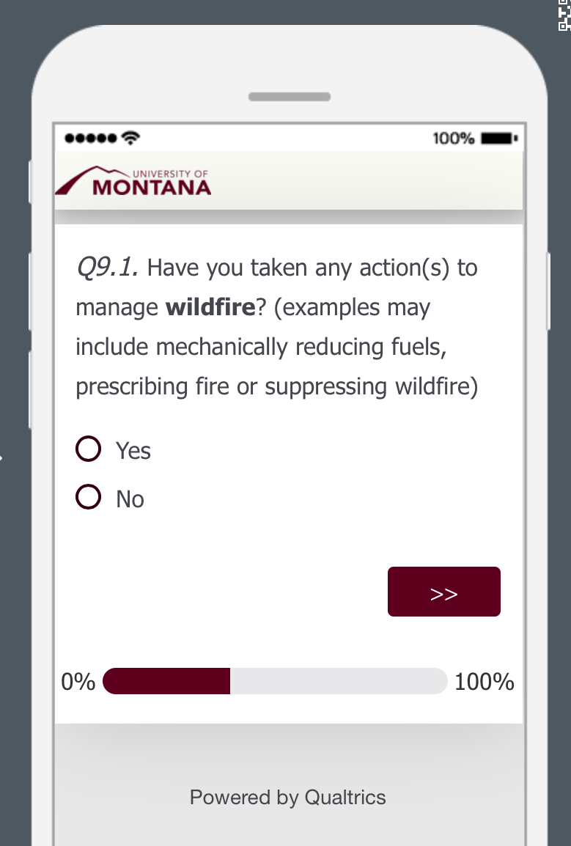
Methods
Online survey to 523 wilderness units
Notes:
Quantitative: -all units were randomly selected
-survey was created in qualtrics, pilot-tested by 6 wilderness managers, educators and ecologists, and was available for one month
-data was then exported from Qualtrics to SPSS, a statistics program, for analysis
-In the next two slides I’ll review what types of questions the survey asked about

Slide 9
Survey Categories
Notes:
-Categories were created with assistance from subject matter experts, for example Carol Miller, a fire ecologist at ALWRI assisted me with the wildfire questions
The quantitative survey was broken into four categories and using if/then logic for the questions, it would prompt the respondent first if they had vegetation interventions, then if they applied herbicide if yes, it asked how many projects to apply herbicide in each of the last five years, then for the most recent project it asked detailed questions about it: proposed it? NEPA level? Monitoring? Etc.

Slide 10
Survey Response
Agency | Sent Surveys | Received Surveys
USFS | 291 | 93
BLM | 145 | 74
FWS | 46 | 26
NPS | 41 | 17
Total: | 523 | 210
40% Response Rate
Notes:
I used a formula to determine how many surveys should be sent to each agency for a 95% confidence interval and significant results, proportional to the units managed per agency

Slide 11
Survey Response per Agency

Slide 12
Results
37% of wilderness units intervened (n=210)
Notes:
-USFS should have been higher, but my survey link was flagged as “suspicious” so I suspect many didn’t respond to it, I also had to resample the USFS to try and increase their response rate after the initial response
-Relative to the amount of survey responses, the NPS has the greatest proportion of wilderness units who intervened

Slide 13
Regional Distribution of Interventions
Wilderness units that intervened by geographic region and agency (n=77 wilderness units)
Notes:
Summary of where the survey responses came from,

Slide 14
Size Distribution Among Survey Respondents
Notes:
-Simple analysis, other ways to cut this
-Wildernesses were labeled “small” if they were between 1 and 26,467 acres (the median) and were considered “large” if they were between 26,468 acres or above.
-Most of the wilderness units sampled who intervened were large wildernesses, but the literature suggested that small wildernesses would be more prone to intervention because of the “edge effect” where more encroachment from outside the wilderness would increase pressure to intervene

Slide 15
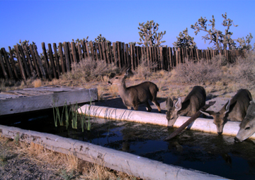
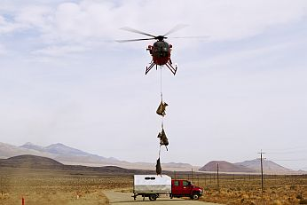
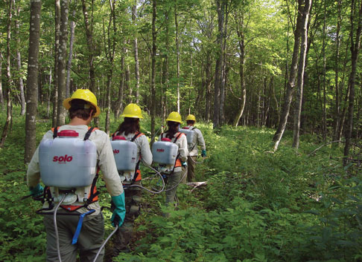
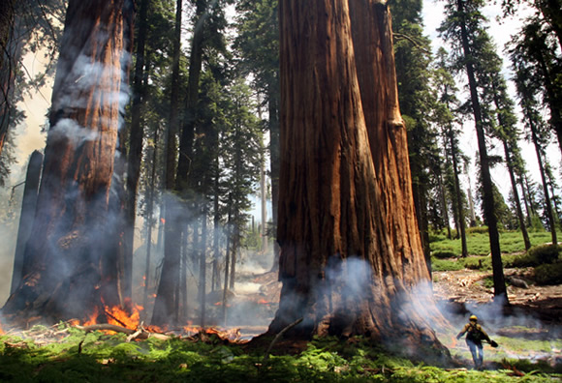
Types of ecological interventions
(n=111 intervention actions from 77 wilderness units)
Notes:
Why more vegetation: not as controversial, lots of funding for non-native species/weed removal
-wildlife could have been higher if it was a higher fire season, just depends on the year, this was for the last five years
-The question was have you taken wildfire interventions in the last five years, 39 wilderness units said yes.

Slide 16
Wildfire Interventions
Notes:
-Worked with Carol Miller, fire ecologist at the ALWRI

Slide 17
Types of Wildfire Interventions
Notes:
Fuels management, initial attack, control lines, post-fire restoration

Slide 18
Wildfire interventions per agency
Notes:
Relative to total response rate per agency, the NPS took the most wildfire interventions with 50%
-cover with shape,

Slide 19
5 Year Trends for Wildfire Interventions

Slide 20
Fuels Management 5 year trends
Notes:
5 Year Trends by Agency

Slide 21
Frequency of Initial Attack

Slide 22
Initial Attack 5 year trends

Slide 23
Frequency of Control Lines

Slide 24
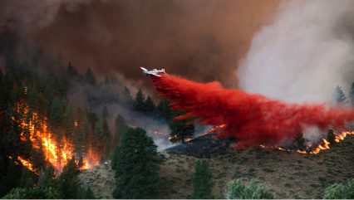
Wildfire Intervention Sub-Categories
“Yes” to control lines, then “was fire retardant dropped?”

Slide 25
Control Lines 5 year trends

Slide 26
Frequency of Fire Retardant Application
Note: the BLM manages 8% of the NWPS; FWS 18%; USFS 33%; NPS 40%

Slide 27
Fire Retardant and Water Drop 5 year trends

Slide 28
Frequency of Post-Fire Restoration

Slide 29
Wildfire Intervention Sub-Categories
“Yes” to post-fire restoration, then:
Planting seeds?
Stabilizing hill slopes?
Applying soil/mulch?
Inserting contour logs or straw wattles?
Other post-fire restoration?

Slide 30
Frequency of Post-Fire Restoration Projects

Slide 31
Why did wilderness managers intervene?
Notes:
2 questions attempted to answer this: what factors influenced the decision (could check multiple), and an open ended question, why did you intervene?

Slide 32
Factors Influencing Decision to Intervene

Slide 33
Reasons for intervening: (n=14 wildfire responses)
Ecological (NNIS-removal, habitat improvement)
“Fuel reduction and habitat improvement”
“longleaf pine habitat restoration”
“Replanting after a fire to prevent invasive species”
Anthropogenic-focused (safety/recreation)
“Fuels reduction to provide protection for structures outside of park”
“Reduce fuels in park housing”
“Stabilization of slopes and Pacific Crest Trail, and removal of hazard trees”
Remedial?
“The State plowed into the wilderness boundary impacting less than 20 acres during Initial Attack before the US Forest Service arrived. The rehabilitation project restored the vegetation, access point, and removed the visual impact.”
“Rehab of fire lines”

Slide 34
Wilderness Act 4(c) Prohibited Uses

Slide 35
Frequency of Prohibited Uses
Notes:
These uses are prohibited in wilderness unless they are deemed the minimum necessary to manage the area as wilderness, in which case they need to justify it through a minimum requirements analysis

Slide 36
Intervention Effectiveness, Post-Action Monitoring, NEPA Level
All four intervention types compared
Vegetation, wildfire, wildlife, water

Slide 37
Effectiveness of Intervention Action (n=61 intervention actions from 77 wilderness units)
Notes:
-I asked this because there has been examples of failed restoration projects and it’s important to gauge whether we should be intervening, but if the interventions are actually successful

Slide 38
Post-action Monitoring (n=79 intervention actions from 77 wilderness units)
Notes:
-this is important not just to study the effectiveness of the action, but also because these projects are funded by public money and it’s part of being accountable of the actions that these agencies take
-monitoring also complicates the trammeling action by causing repeated incursions to monitor results, collars on animals potentially for their whole life, and structures in place to monitor results

Slide 39
NEPA Level of Analysis for Intervention Action
Notes:
-NEPA or National Environmental Policy Act, reviews are required by law when the action may cause significant environmental effects
-Multiple levels with CE being the lowest when they deem there aren’t significant environmental effects, followed by an EA and EIS
-High number of intervention actions did not do any NEPA analysis or did a CE, in which case the public did not need to be informed of the action
-37% EA or EIS, 19% unsure, 44% CE or no NEPA for all types of interventions
-unsure? High staff turnover
-no public involvement, edging towards half not having public engagement, something to think about in terms of litigation

Slide 40
Summary
Ecological interventions are occurring at a rate of 37% (n=210 wilderness units)
Wildfire interventions were the second most common type of intervention
Agency wildfire interventions proportions:
NPS 69% (n=13 wilderness units)
USFS 50% (n=34 USFS wilderness units)
FWS with 50% (n=4 FWS wilderness units)
BLM with 42% (n=26 BLM wilderness units)
Notes:
Grey area with open ended responses, differences in interpretation

Slide 41
Why are wildfire interventions occurring?
Survey results:
Desire to improve the natural quality of wilderness character (heart of stewardship dilemma)
State agency influencing decision to intervene
Other influences:
Record dry years and accumulated fuel, potential for more fires (more resources)
Managers didn’t cite funding as a factor, but fire budgets are increasing across agencies
Safety/WUI protection
Potential action bias
Hands-off approach is difficult
Social and political pressures to extinguish wildfires
Competing interests (from other policy and law)
Other reasons?

Slide 42
Implications
Lack of consistency in vetting proposals
No interagency baseline of criteria (justifications vary)
Project level evaluation tool (ALWRI framework)
Difficult to assess cumulative impacts to NWPS
Lack of transparency
Few opportunities for public comment (if CE or no NEPA analysis)
44% of all interventions had no NEPA or a CE
The legal mandate is to preserve wilderness character, so how do we know?
Most wildernesses don’t have a baseline of wilderness character
Notes:
Ambiguity in law and agency policy, room for individual discretion at the unit level; two perspectives, rationale not always clear

Slide 43
Opportunities for Improvement
Case studies highlighting best practices for ecological interventions (reviewed by WPC or Carhart)
Internal reporting on ecological interventions to be reviewed by agency
Analyze trends every 5 years as part of wilderness character monitoring
Community of practice for restoration practitioners and decision-makers
Navigate challenging questions, provide resources
Wilderness.net/wilderness connect
Notes:
10:30 at Forestry sciences building

Slide 44
Thanks!
Lucy Lieberman
lucy.lieberman@umontana.edu
Beth Hahn
bhahn@fs.fed.us

