Slide 1
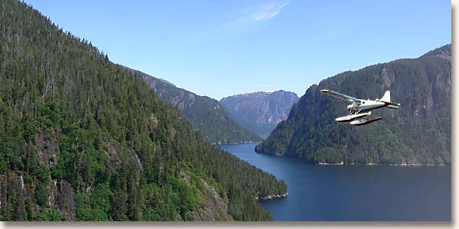
Misty Fiords National Monument Wilderness Sound Monitoring 2008
Project Leader:
Jacob Hofman, Wilderness Inventory/Monitoring Crew Leader
Notes:
This document is part of the Soundscapes Toolbox on http://www.wilderness.net/toolboxes/
Jacob Hofman – 2-days natural sounds workshop at NPS regional office in Anchorage in March, 2008.
Two Forest Service staff attended from Glacier Ranger District
Disclaimer – technical information; have copies of his report and can contact him in January for more info

Slide 2
Overview
Opportunities for solitude in Misty Fiords National Monument
National Park Service’s Natural Sound Program
Our Project / Equipment
Results / Data Analysis
What Worked/What Didn’t?
Recommendations
Notes:
MFNMW – location and access, management issues associated with motorized access

Slide 3
Misty Fjords National Monument Wilderness
Located 22 miles east of Ketchikan
Accessed by boat or floatplane
Portions of the area (e.g. Rudyerd Bay) popular for flightseeing
~ 2,000 commercial floatplane landings per summer
Wilderness Act, 10 YWSC, and KMRD Recreation Planning Process – Inventory/Monitoring of conditions related to solitude
Notes:
We authorize landings on freshwater lakes in MFNMW
Authorized 13,672 visitor service days in 2008, app. Or 2,000 landings
Use concentrated (weather, short ice-free season, cruise ship schedule)
Actual Use Data and past monitoring efforts indicate conditions exceed ROS encounter standards in popular areas
Commercial Uses EIS – worked with Ken Post to identify information needs at the beginning of the field season

Slide 4
National Park Service Natural Sounds Program / Soundscape Inventory
Provided audio processing scripts and software
Acoustic inventory of all natural and man-made sounds in the National Parks
Sound level standards (decibels, % time audible for non-natural sounds, # and duration noise-free intervals, time above speech interference threshold )
NPS staff provided troubleshooting assistance
Notes:
Methods and equipment are BEING DEVELOPED by the NPS – audio processing scripts and software provided free of charge
Monitoring conditions related to sound level standards in decibels requires the use of more expensive equipment ($5,000 per unit) and requires use of solar panels and large batteries

Slide 5
2008 Sound Monitoring
Monitoring sounds associated with motorized use
Sampling design/methods : accessibility, level of use, areas with other work planned
77 days continuous audio data collected at 5 freshwater lakes
44 days of data successfully analyzed
Data supported by staff sound monitoring efforts (Attended Listening Sessions)
Notes:
Sampling Design in 2008 – TEST RUN
Accessibility to provide frequent access to the equipment and address problems
Areas with higher levels of mechanized use – a lot of events in the data facilitated interpretation; because such a busy area, it was easy to identify aircraft, but more difficult to identify landings, because there were so many flights in these areas. Could get better info in regards to landings in the areas that receive less motorized use.
Areas where we already had work planned – lower costs associated with the monitoring
Attended Listening – Emerick/Sitka RD

Slide 6
Attended Listening Form
Notes:
3 intensity rankings – found intensity 1 was not consistently picked up by recorder – focused on events with intensity rating of 2 or 3
Used to interpret recorded sound events and assign intensity ratings to recorded sound events

Slide 7
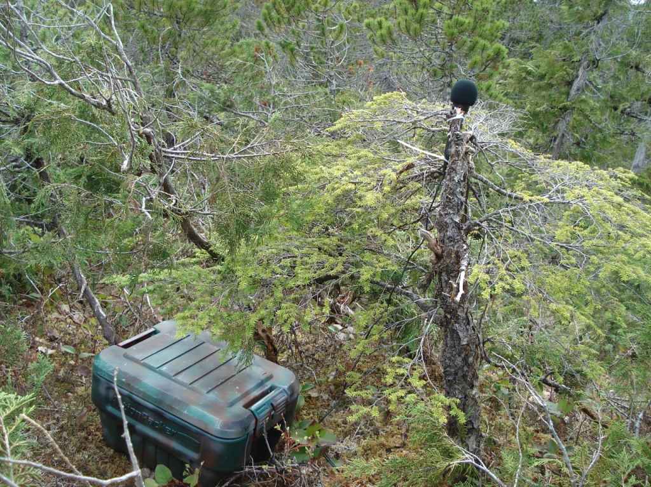
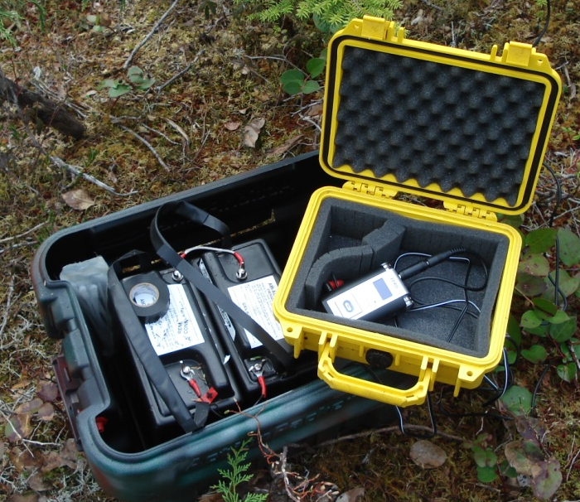
Equipment
Audio Recorder 500.00
Onmi - directional Microphone 25.00
8 GB Memory Cards (2) 220.00
Plastic Tote 20.00
Pelican Case 25.00
Radio Repeater Batteries (2) Free
Adapter Cable 17.00
Memory Card Reader 13.00
Microphone Windscreen 3.00
Microphone Plug Converter 3.00
_______________________________________
TOTAL $828.00
Notes:
Batteries free because expired (last a very long time for these purposes)
Equipment relatively light (batteries app. 25 pounds ea.) and compact, easy to install and remove

Slide 8
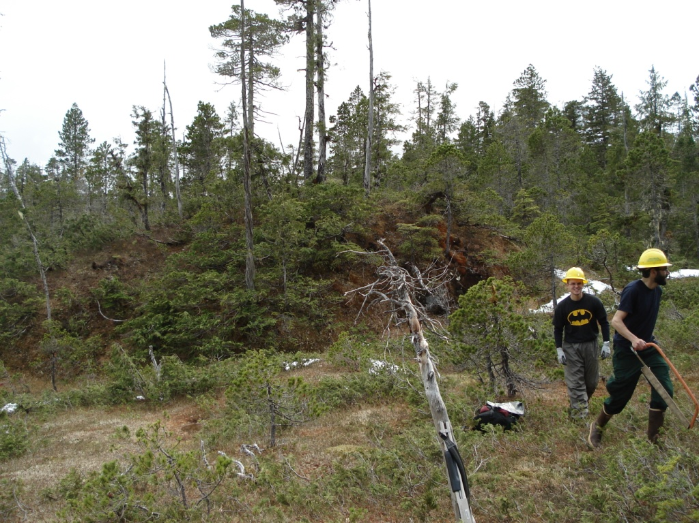
Monitoring Equipment Location
Notes:
Punchbowl Lake sound recorder placement

Slide 9
Data Analysis
SPLat – graphically represents audio information
Spectrograph indicates sound frequency and intensity over time
Sound events displayed in a lighter color (greater intensity) along a frequency spectrum
Notes:
SPLat software used to analyze the data provided by the NPS
Ability to play the original audio file allows user to confirm the sound source
Sound events assigned an intensity ranking based on attended listening forms
Major human-made sound events are visible on the spectrograph and form a recognizable pattern. Other sounds are distinguishable based on their frequency, duration, and intensity. Sound events classified as intensity of 1 in attended listening sessions, were often not reliably picked up due to natural, background sound levels. Sound events with intensity rating 2 or 3, however, were easily recognized.

Slide 10
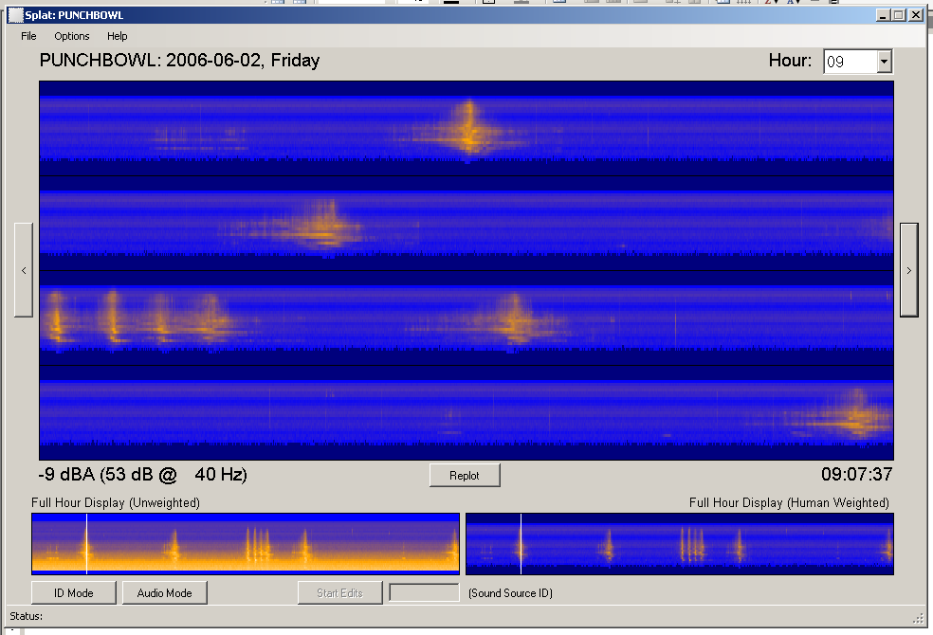
Punchbowl Lake Overflights
Aircraft Overflight
Distant Aircraft
Notes:
Display is “weighted” – only shows the range of human hearing (only displays what can be heard)
Bottom left an example of unweighted – a lot of low frequency (background noise)

Slide 11
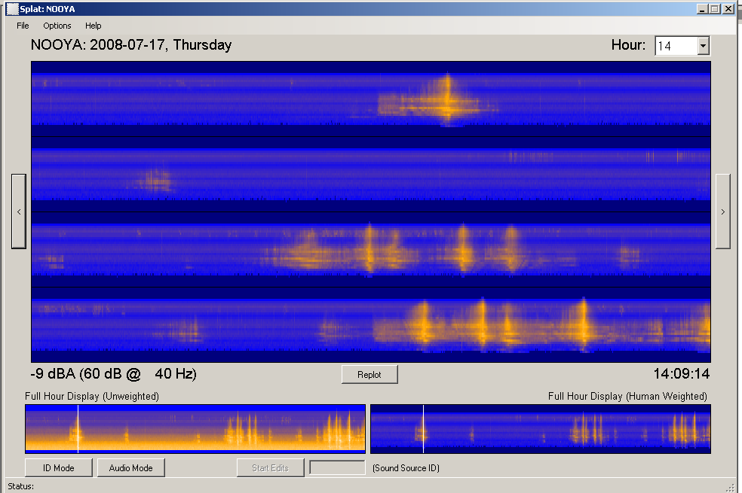
Nooya Lake Take-Offs and Landings
Aircraft Takeoff (low level)
Notes:
Low level – shorter buildup, more intense sounds associated with aircraft take-offs

Slide 12
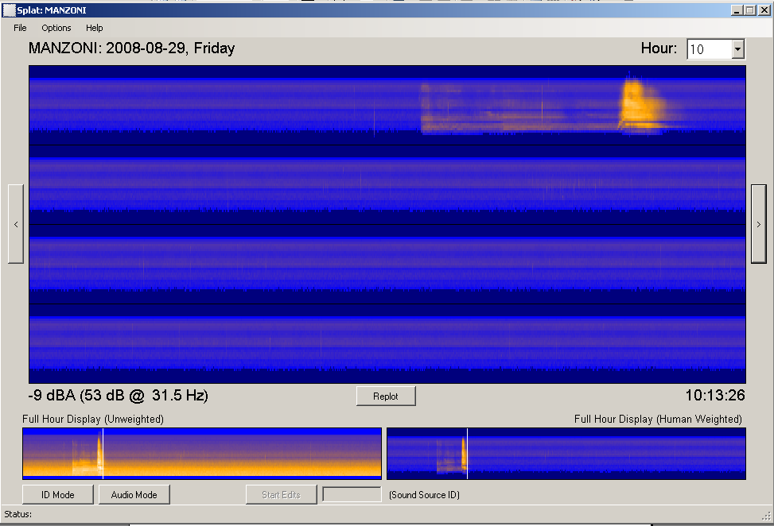
Manzoni Floatplane Take-Off
Aircraft Startup
Aircraft Takeoff
Notes:
Quiet background/natural environment
Aircraft less than 100 yards from the microphone

Slide 13
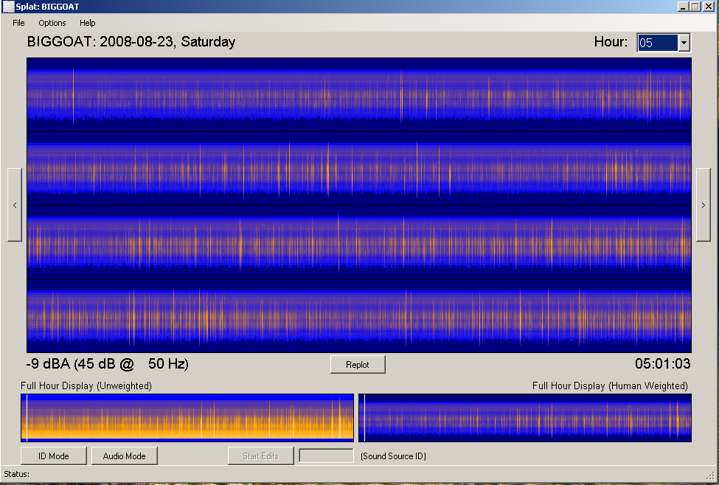
Big Goat Lake Rain Event
Raindrop on Microphone

Slide 14
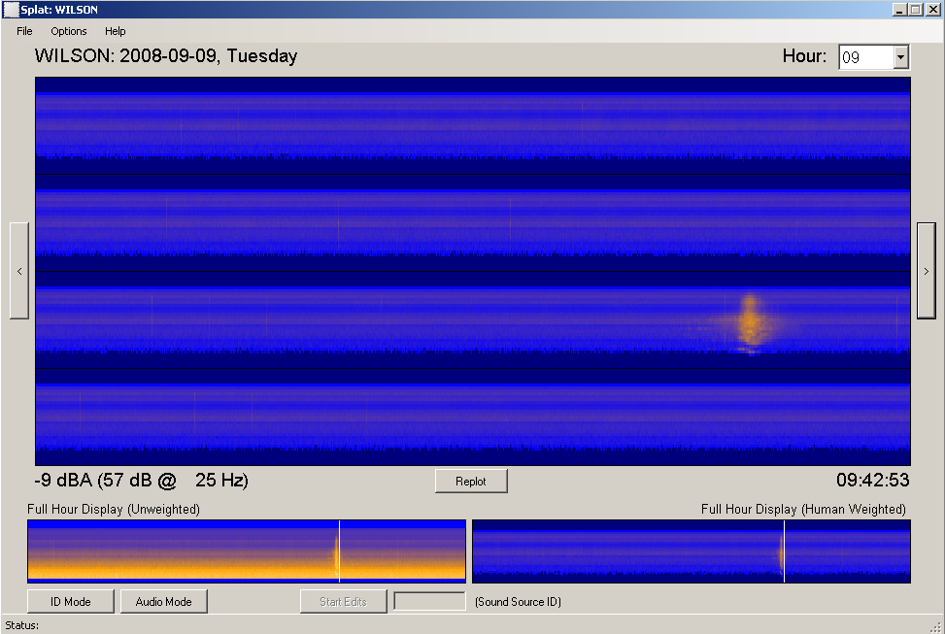
Wilson Lake Helicopter Overflight
Helicopter Overflight
Low Frequency Signature
Characteristic of Helicopters
Notes:
Sound signature of the helicopter.

Slide 15
Average Number, Duration, and Time Audible for Mechanized Transport Sound Events Per Day1
Location | # of Sound Events | # of Sound Events | Total Duration | Duration per Event | % Time Audible²
 | (average per day) | (average per hour) | (minutes per day) | (average minutes) | (average per day)
Big Goat Lake (9 days)
Sound Intensity 2 | 7.7 | .5 | 9.6 | 1.1 | 1.1
Sound Intensity 3 | 2.0 | .1 | 1.0 | .4 | .1
Total | 9.7 | .6 | 10.6 | 1.0 | 1.2
Manzoni Lake (5 days)
Sound Intensity 2 | 7.3 | .5 | 9.2 | 1.3 | 1.1
Sound Intensity 3 | 1.9 | .1 | 1.1 | .6 | .1
Total | 9.1 | .6 | 10.2 | 1.2 | 1.3
Nooya Lake (10 days)
Sound Intensity 2 | 56 | 3.7 | 65.2 | 1.2 | 7.2
Sound Intensity 3 | 16.5 | 1.1 | 5.0 | .3 | .6
Total | 72.5 | 4.8 | 70.2 | 1.0 | 7.8
Punchbowl Lake (17 days)
Sound Intensity 2 | 33.4 | 2.2 | 78.9 | 2.4 | 8.8
Sound Intensity 3 | 3.4 | .2 | .9 | .2 | .1
Total | 36.8 | 2.4 | 79.8 | 2.2 | 8.9
Wilson Lake (3 days)
Sound Intensity 2 | 8.7 | .6 | 7.0 | .8 | 1.2
Sound Intensity 3 | 1.0 | .1 | .4 | .3 | .1
Total | 9.7 | .7 | 7.3 | .8 | 1.2
¹ Data analyzed for 15-hour day, from 0600 to 2100 daily. ² Audible at sound intensity rating 2 or 3.
Notes:
Note: Able to determine the average number of sound events, average duration total of sound events, and percent time audible at intensity rating 2 or 3
Units may be more useful in per day.
Also determined average time of first and last sound event and the maximum duration of sound events.
Problem with averages is that the sound events are not evenly distributed.

Slide 16
Example
Nooya Lake. At 0830 an aircraft over flight creates sound so loud that conversational speech is impossible for 6 seconds. The aircraft sound is then clearly audible for over a minute. This is repeated 16 more times throughout the day. Because most aircraft fly during the morning and early afternoon, these interruptions will happen about three times an hour until 1400. During this 15-hour day, aircraft sound will be clearly audible for one hour and ten minutes (about 8% of the day).
Notes:
Can use information to understand opportunities for solitude in the Monument.
Most of the very loud (intensity level 3) sound events are associated with aircraft landings and takeoffs at this lake
Landings are permitted by the Forest Service
Data indicates an average of 8 landings per day (16/2=8). If these lake landings constitute social encounters, then this area consistently exceeds the limit of 6 social encounters per day established by the Semi-Primitive Motorized Recreational Opportunity Spectrum (ROS) Class.

Slide 17
What Worked
Recording system gathers large amounts of information with minimal investments of money and field personnel time.
Captures the number, time, duration, and relative intensity of sound events
Captures soundscape variation throughout the day, week, and season
Document aircraft takeoffs and landings in some situations
Provides information on total use at lakes (including unguided)
Check assumptions regarding low use areas
Notes:
Data can be collected unattended for 14 days
Understand general patterns in ways that we were unable to with just field personnel.
Small lakes with minimal background sound/flyovers
Small/le

Slide 18
What Didn’t Work
Inconsistent record of take offs and landings
SPLat software is still being developed
Data processing is very time consuming
Lack of accuracy (can not get accurate total decibel readings with this system)
Notes:
Difficult to collect consistent info about takeoffs and landings because of the large size of some lakes and the natural, ambient sounds (e.g. rainfall, waterfalls). Had more success at identifying all landings at the smaller lakes and when aircraft landed relatively close (within 0.5-mile) of the recording equipment and there was a low level of ambient sounds. Also easier to identify landings in areas where there is less flyover traffic.
Would make establishing standards or use for LE reasons difficult
Difficulties processing some of the data. Only 44 of the 77 days of information recorded were processed.
Takes 8 hours to process 24 hours worth of data

Slide 19
Recommendations
Revise attended listening forms
Personal data recorders and timers on recording equipment
Continue to work with NPS staff as software is developed/improved
What can we do with this information? Developing standards and indicators related to solitude.
Develop a sampling methodology – stratified/random
Notes:
Continue staff monitoring with an emphasis on accurate data collection near recording equipment
Sampling methodology – stratified by levels of use, accessibility, and/or distance from town. So that we are covering more areas and inferences can be extended to less-commonly visited areas.
Purchase electronic data recorders for field staff
Data used from this sound monitoring program may be used to help quantify and evaluate conditions related to opportunities for solitude and establish related standards.
This equipment should also prove useful in assessing aircraft landing levels at our more remote wilderness lakes.
The information gathered could guide future management decisions regarding the allocation of special use permits for freshwater lake landings.

Slide 20
More Information
MFNMW Sound Monitoring Report 2008
Jacob Hofman (907.228.4140) – technical aspects
http://www.nature.nps.gov/naturalsounds/
Notes:
Park Service Natural Sound Monitoring Program
Problem – keeping it simple. Very technical.

