Slide 1
Warm Springs Rigging Project
Bitterroot National Forest
Level 1 Maintenance Crew
Aug. 10-17, 2004
By Renae Pooley

Slide 2
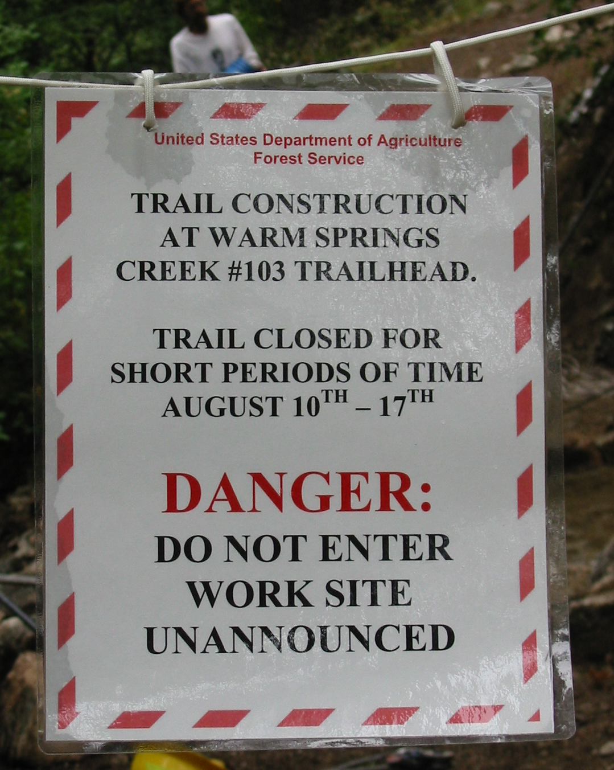
Trail construction sign

Slide 3
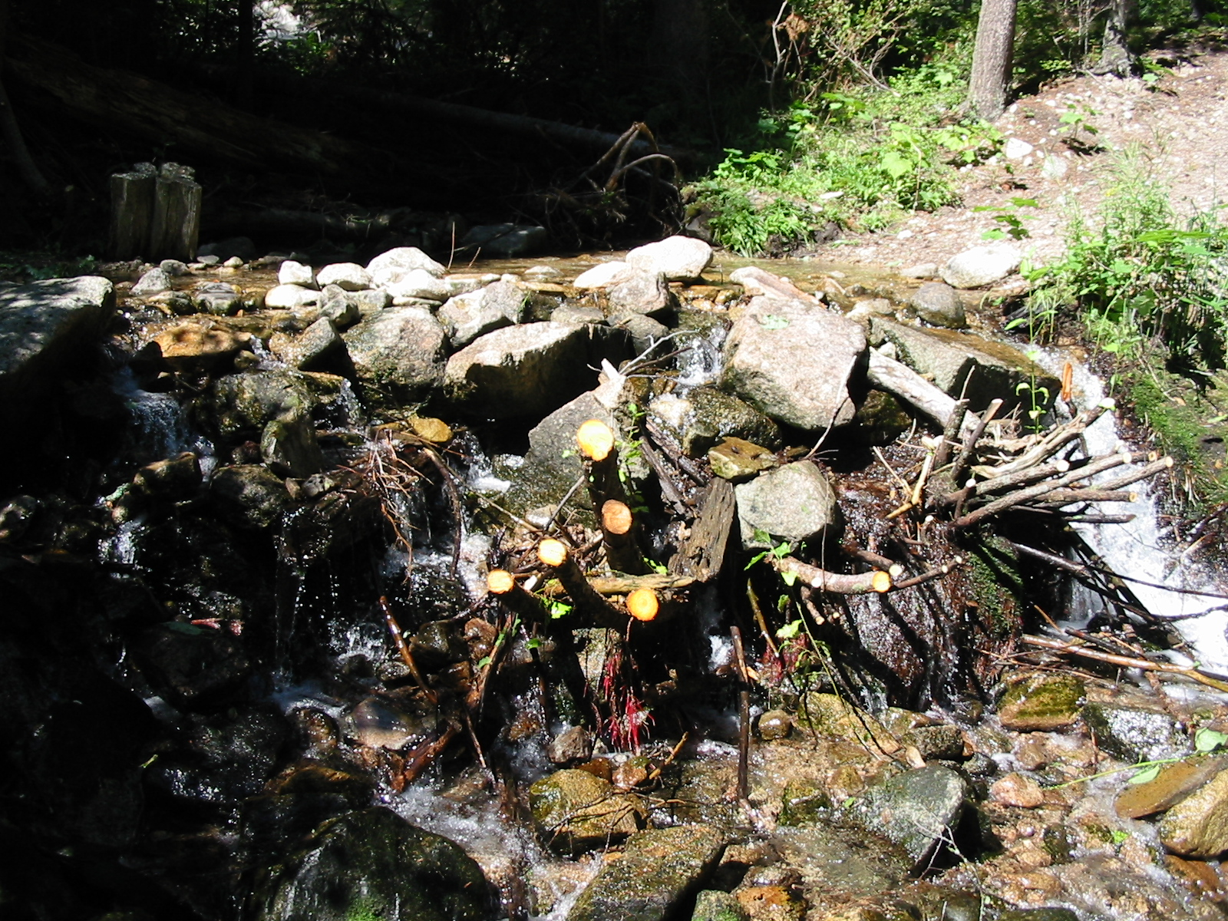
Close up of Crazy Creek Prior to deconstruction

Slide 4
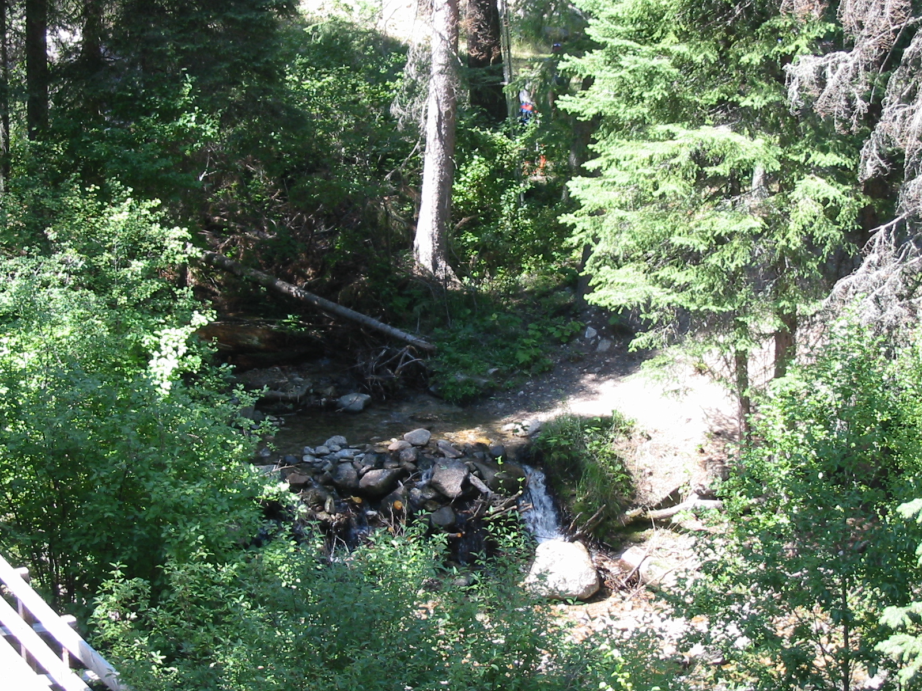
View from Talus Slope

Slide 5
Rigging setup on talus slope
Anchor Rock
Grip Hoist

Slide 6
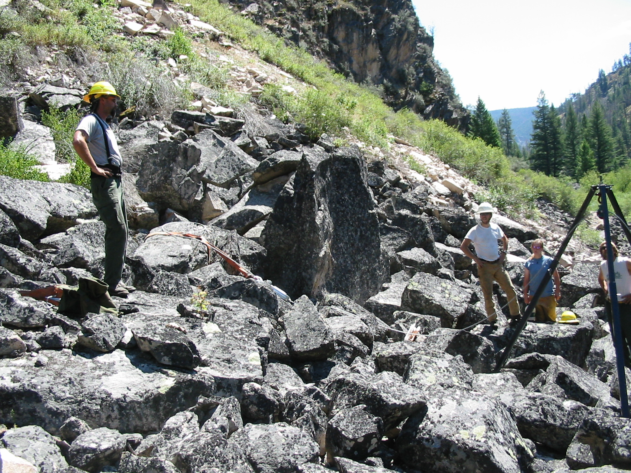
Rigging set up
Anchor
Grip hoist
Cable
Tripod

Slide 7
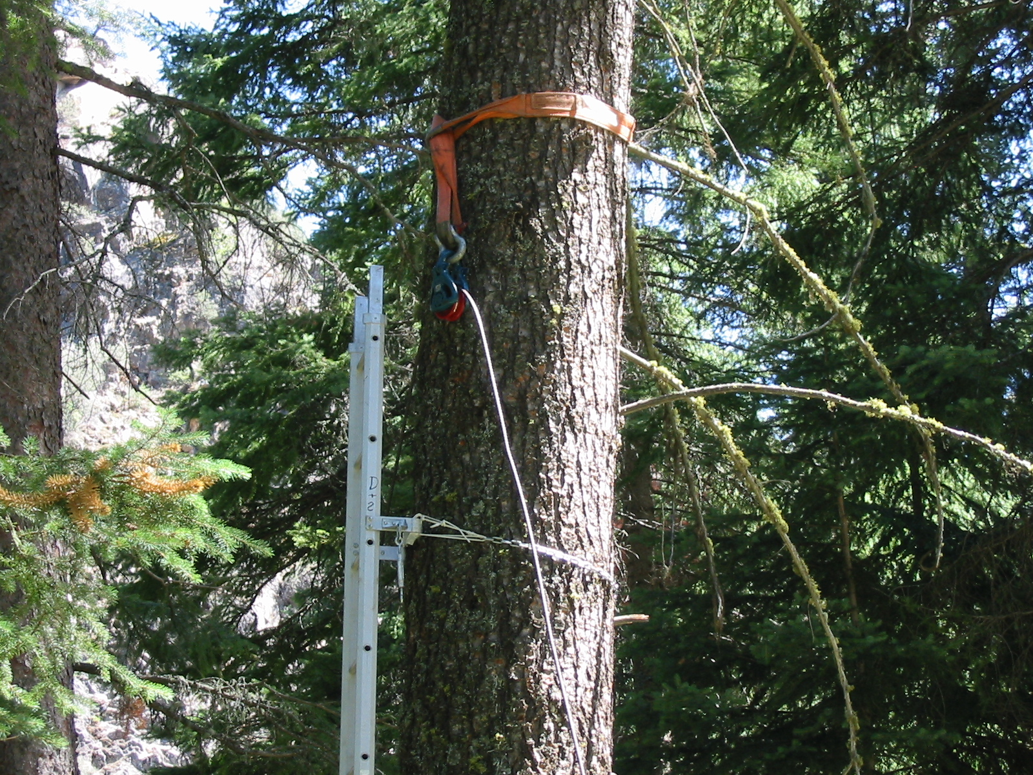
Block set up in tree adjacent to Crazy Creek
Block

Slide 8
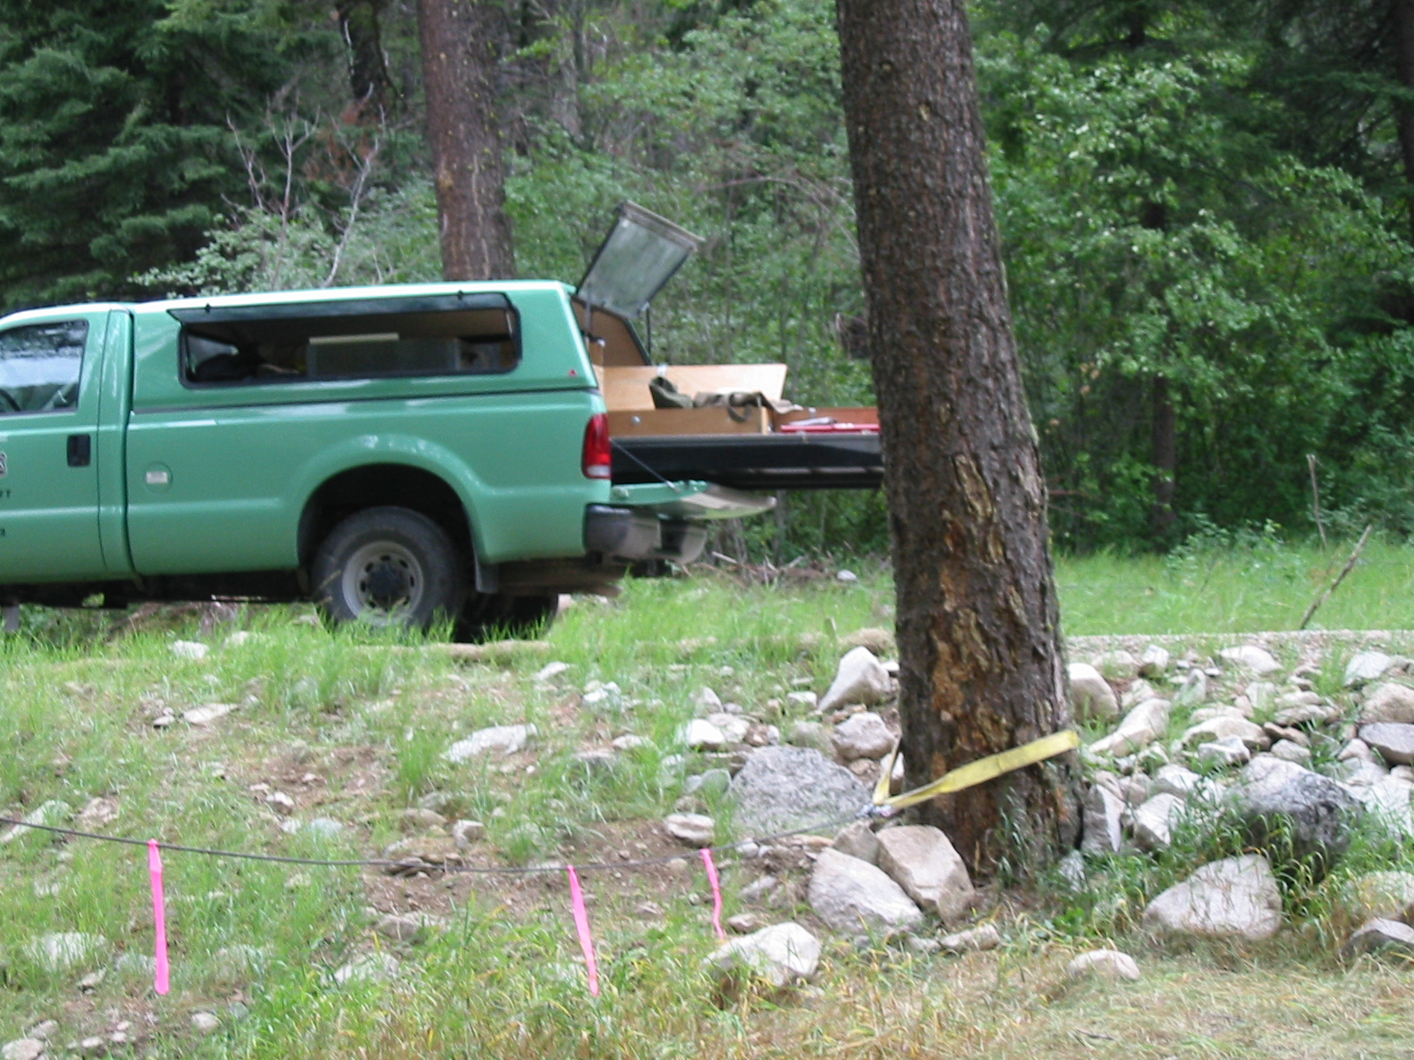
Anchor Tree

Slide 9
Grip hoist and tripod in action

Slide 10
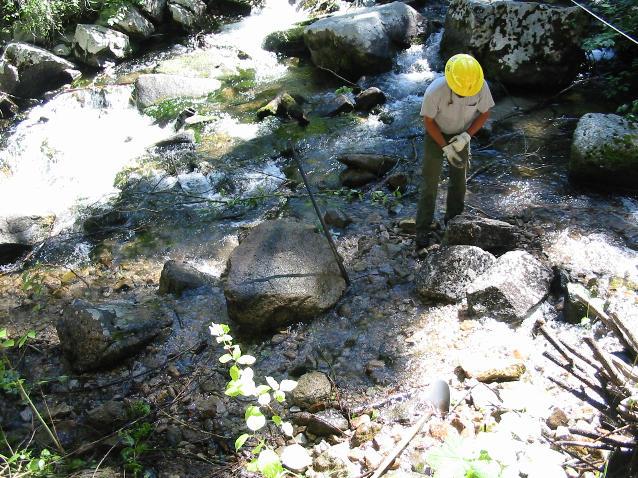
View from trail 1st anchor rock placed

Slide 11
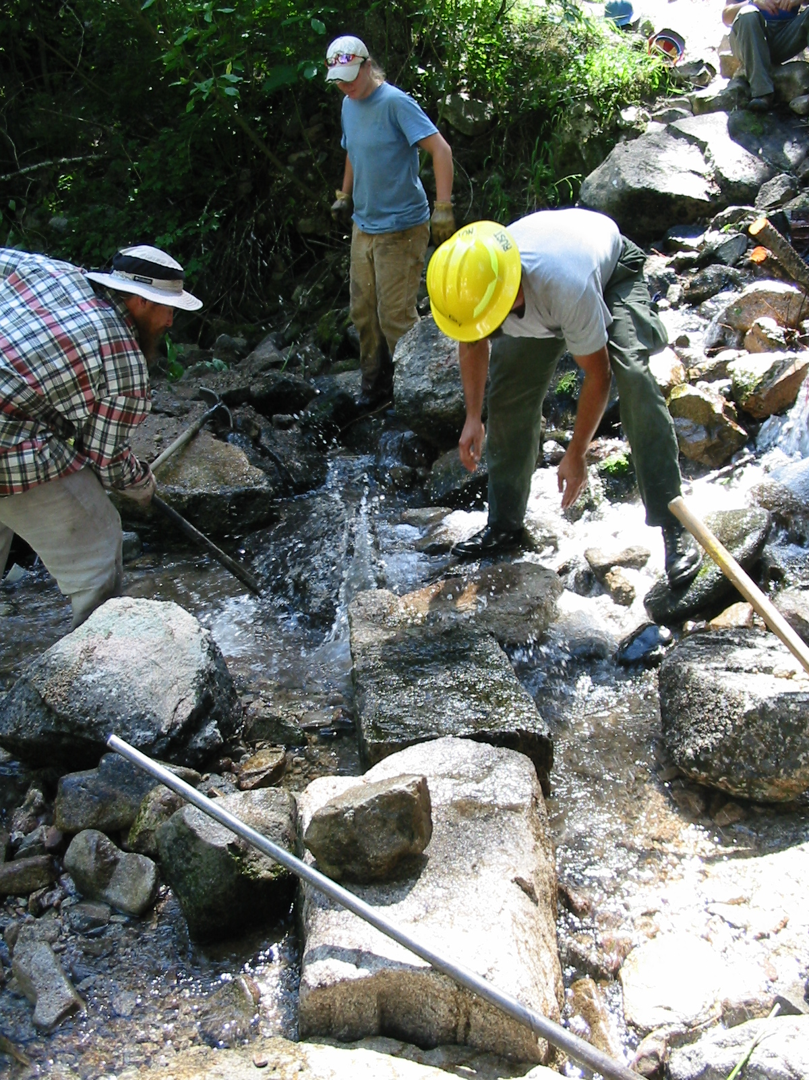
1st few rocks of structure
Crazy Creek

Slide 12
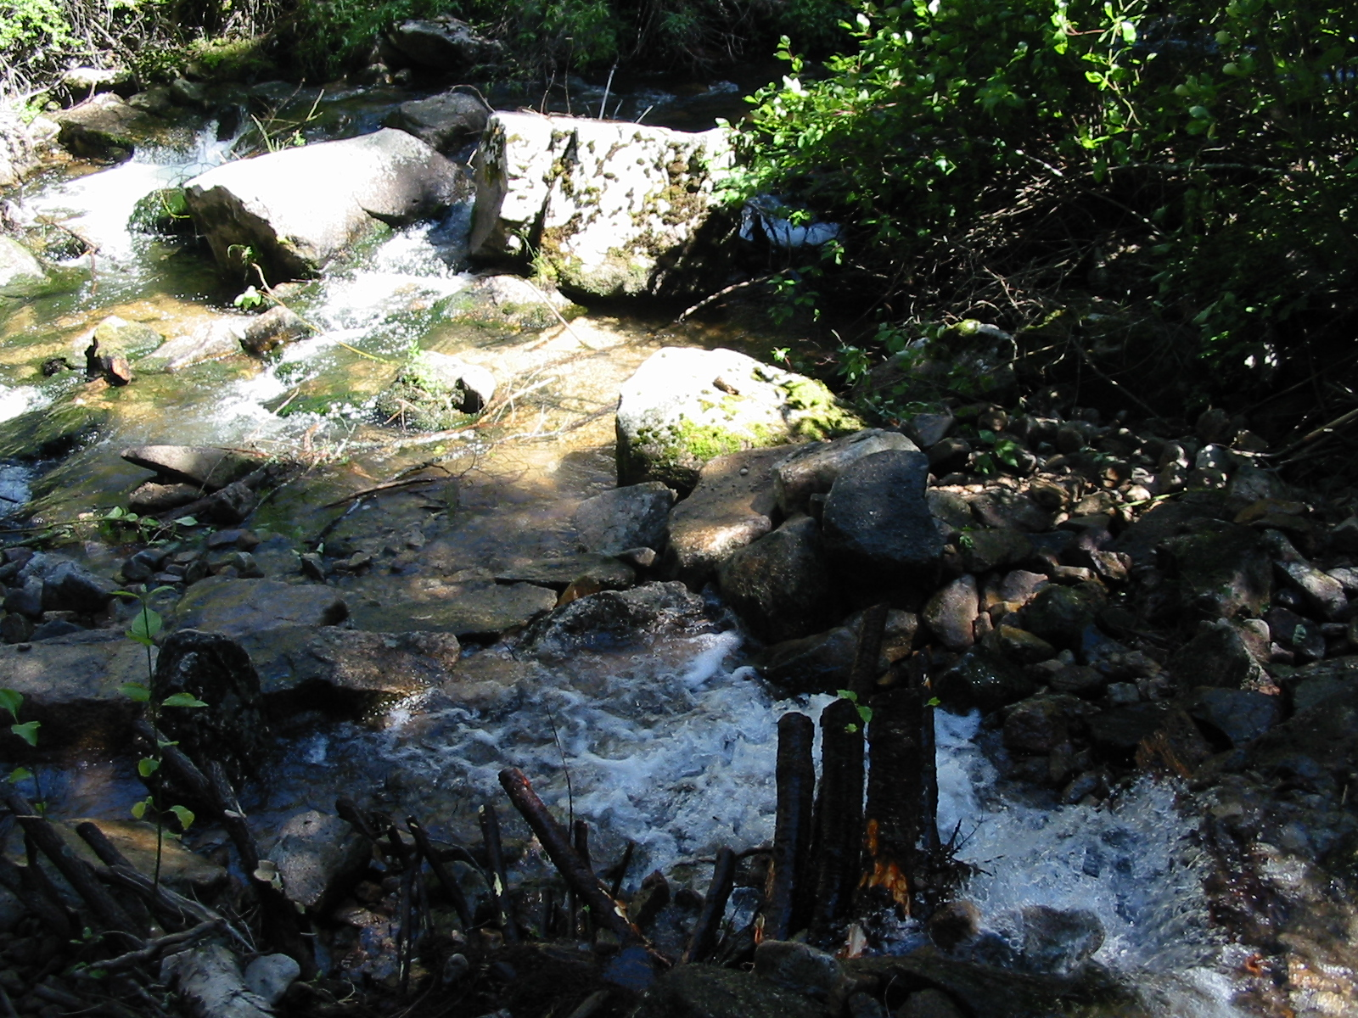
View from trail-1st tier
Warm Springs
Tier
Crazy Creek

Slide 13
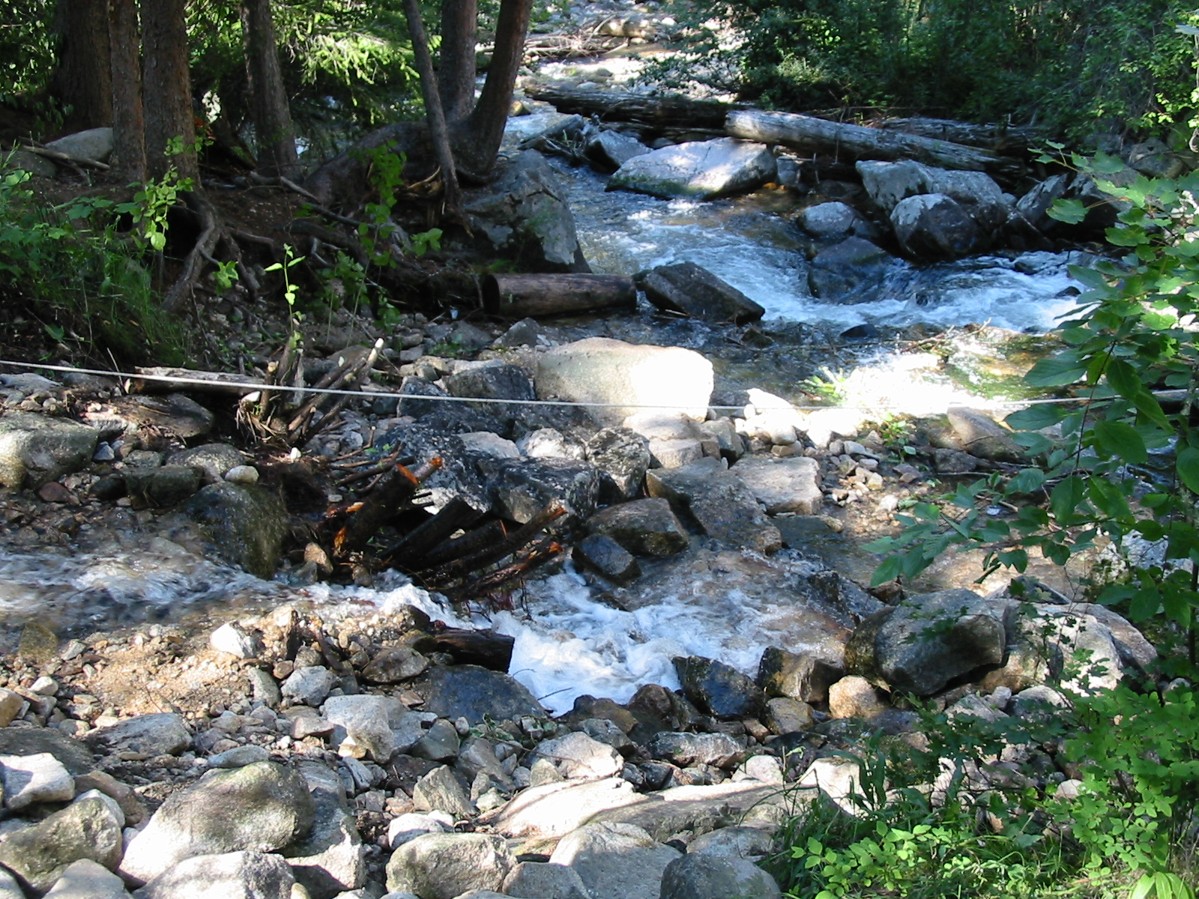
Side view of structure
Warm Springs
Crazy Creek

Slide 14
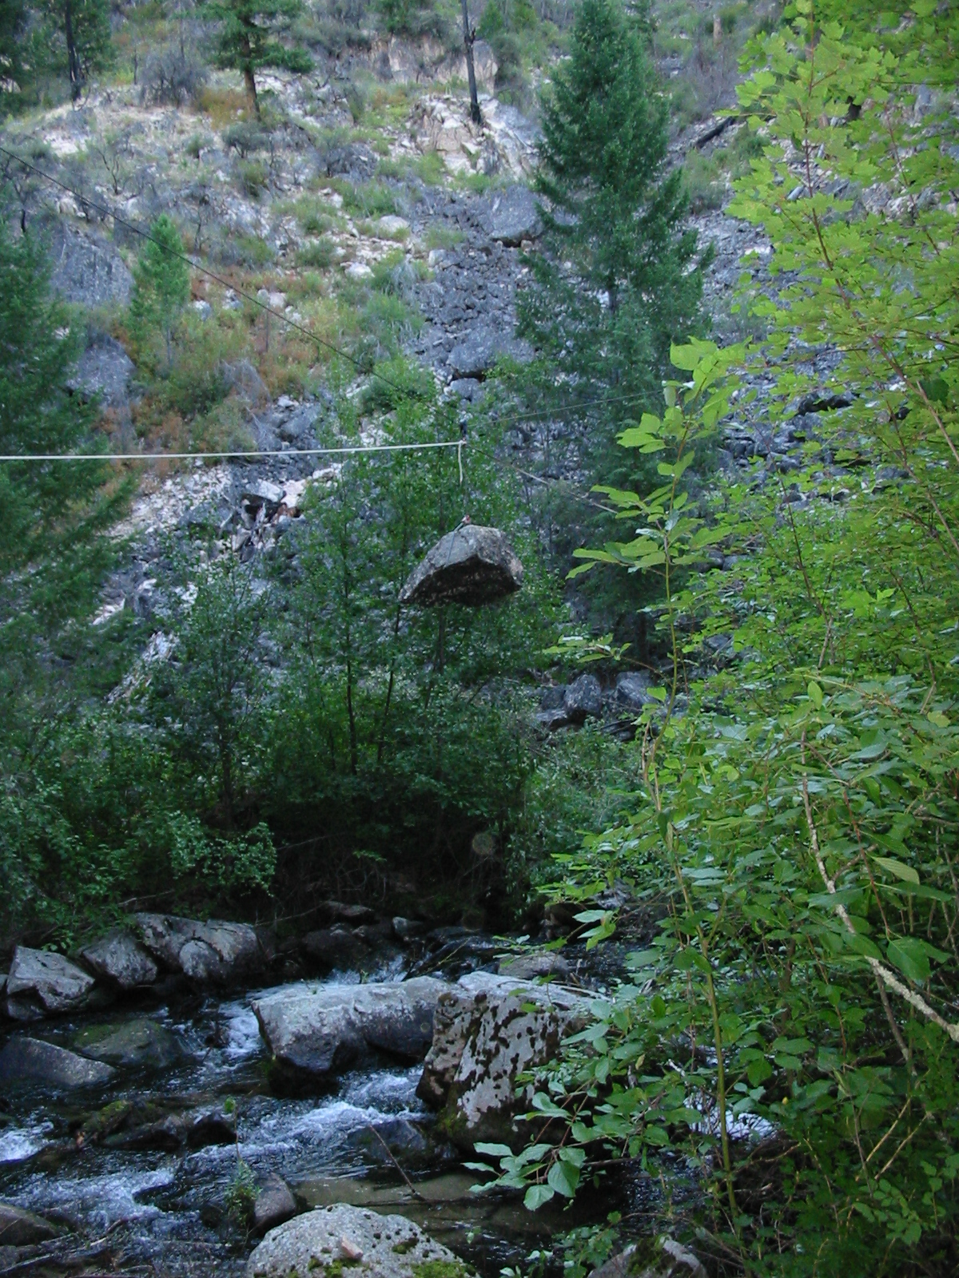
Transportation of rock across Warms Springs to Crazy Creek

Slide 15
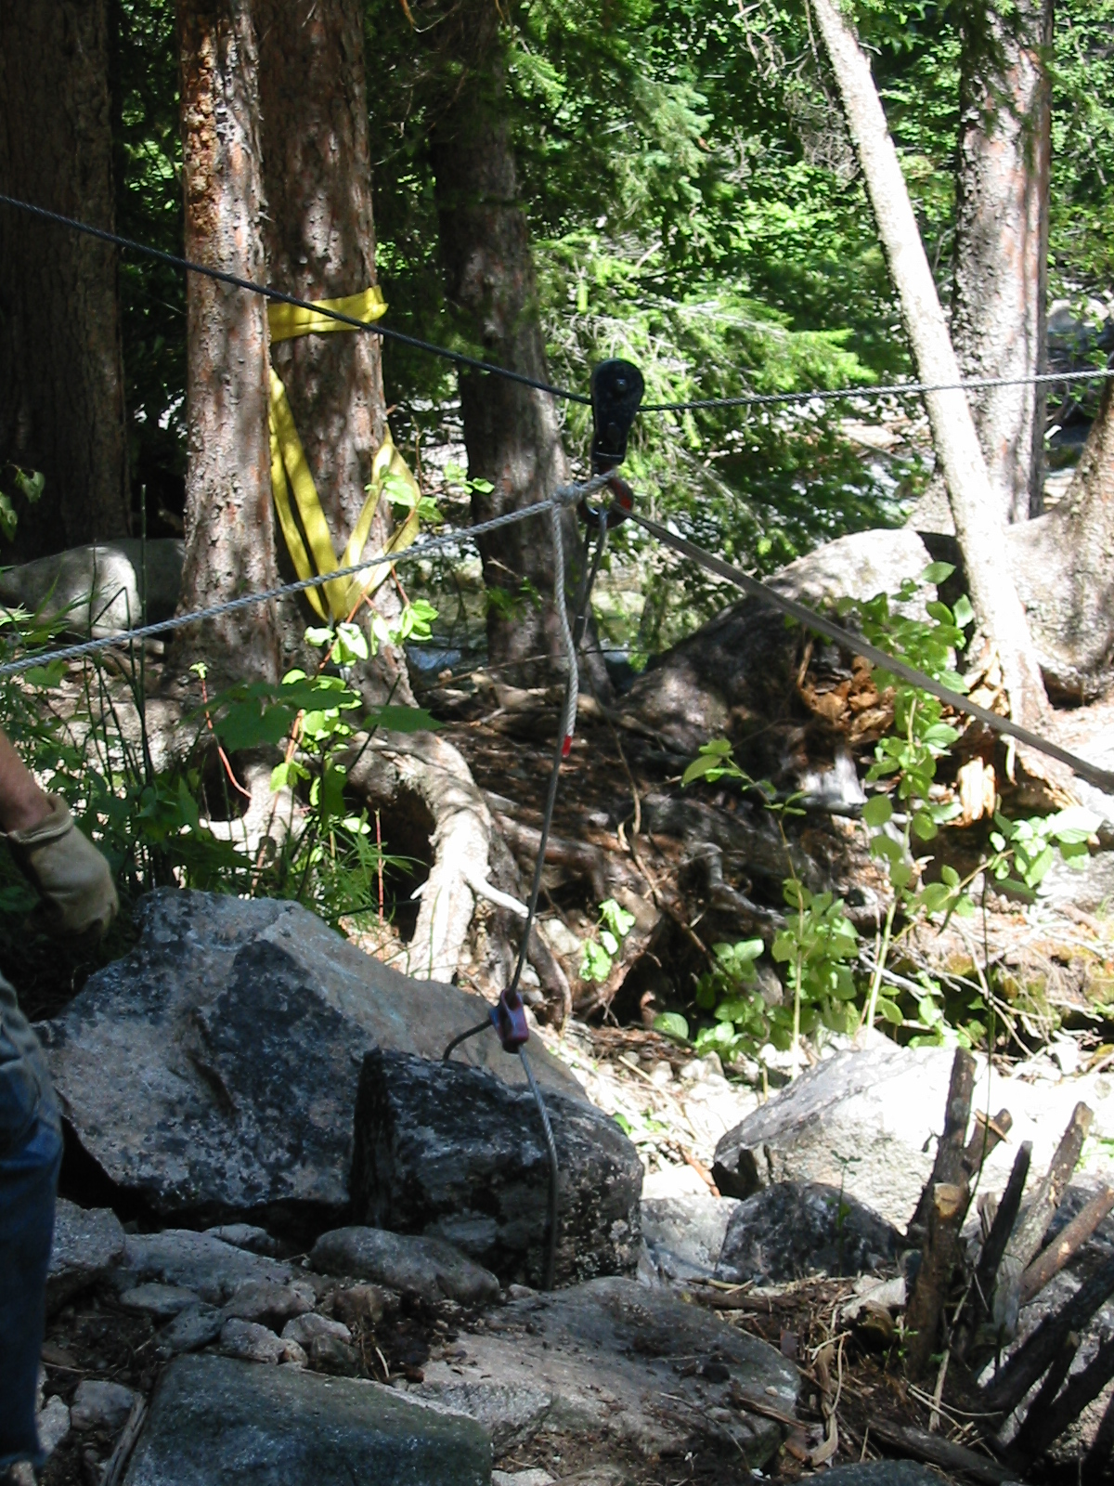
Placement of rock
Cable
Block
Choker
Rock

Slide 16
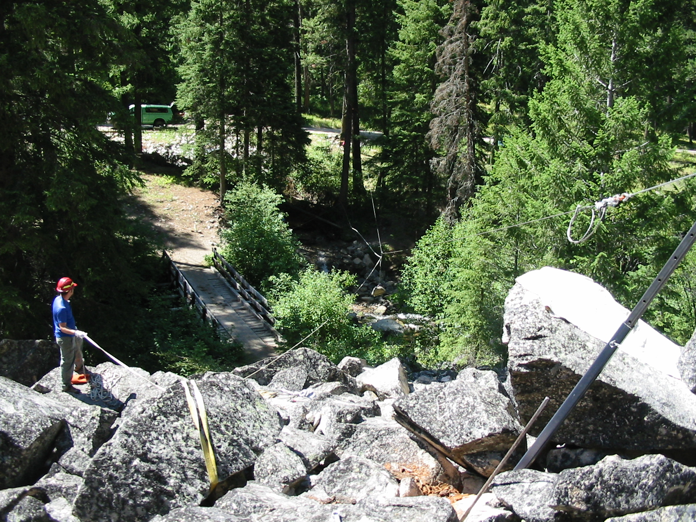
View of Rigging
Block in tree
Break man
Rock
Tripod

Slide 17
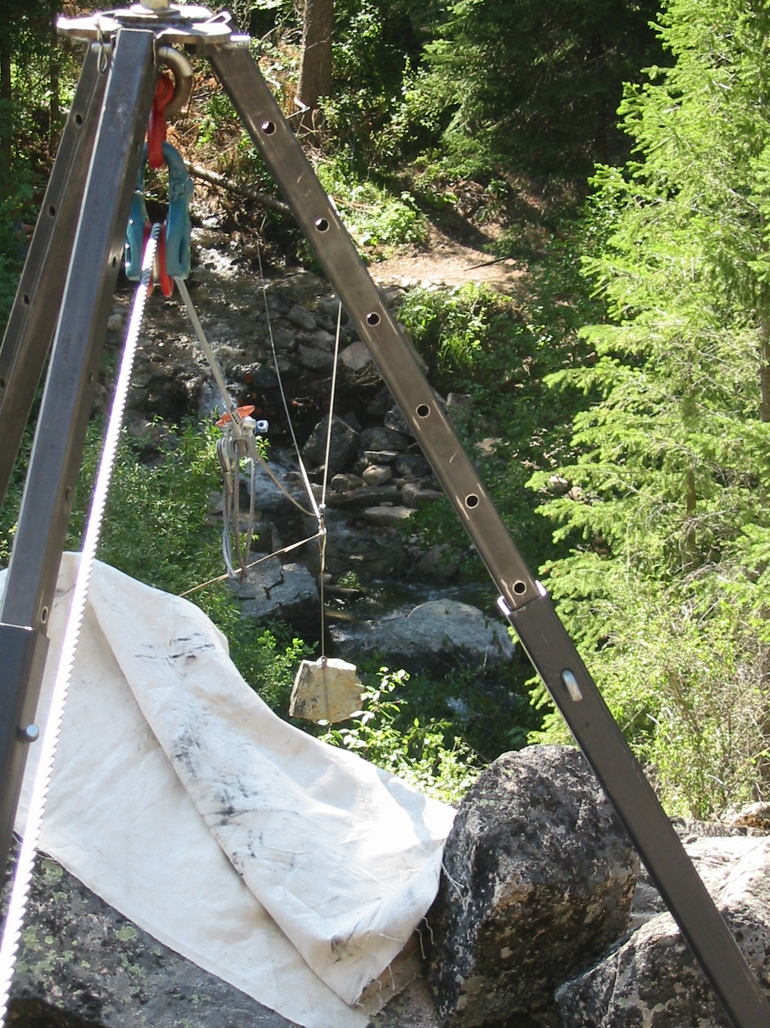
Rigging in action

Slide 18
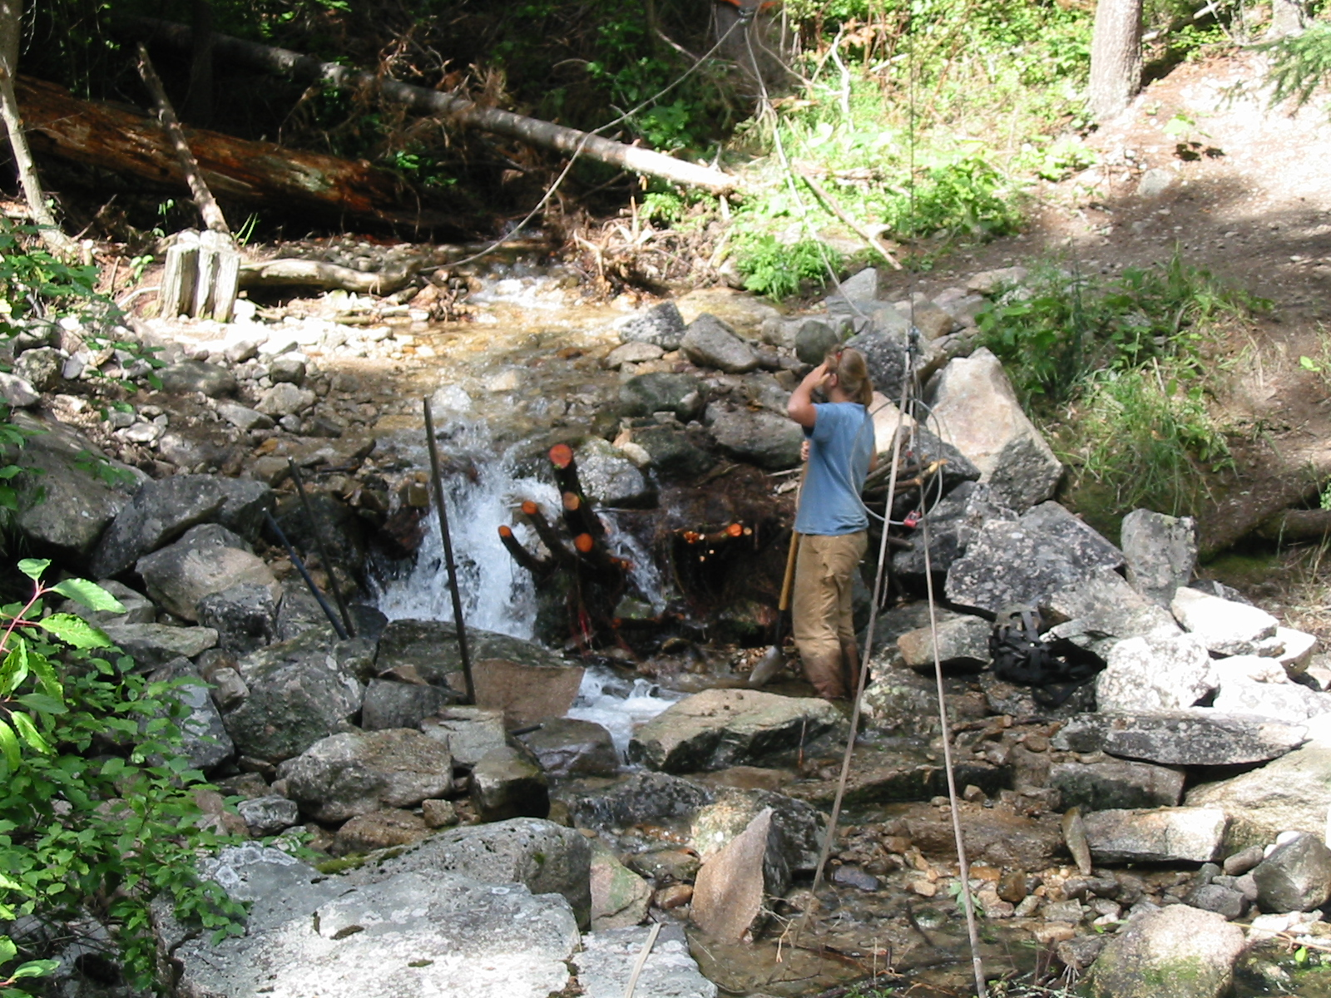
Working in Crazy Creek

Slide 19
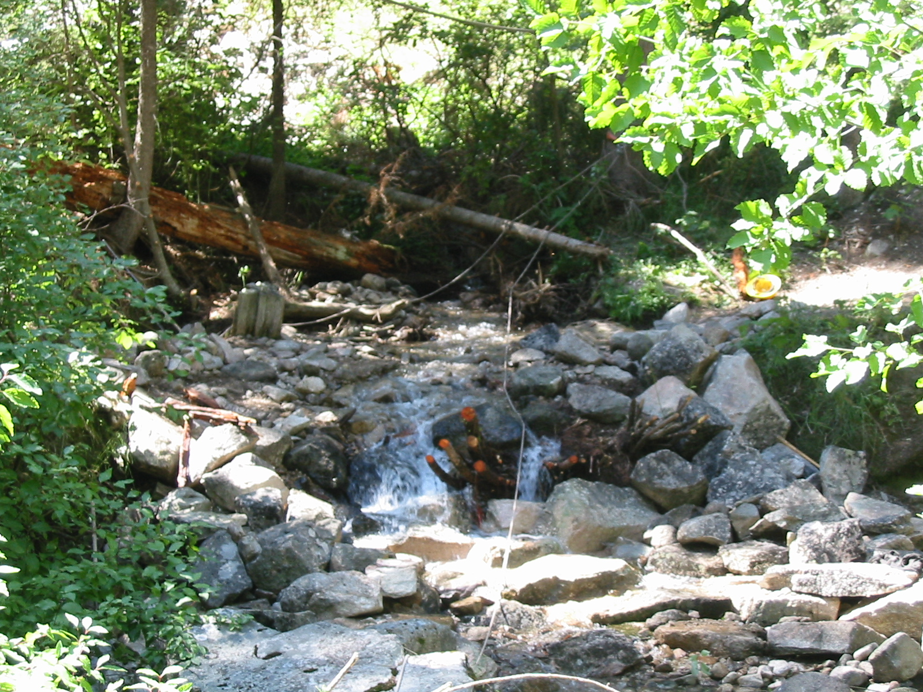
More Tiers

Slide 20
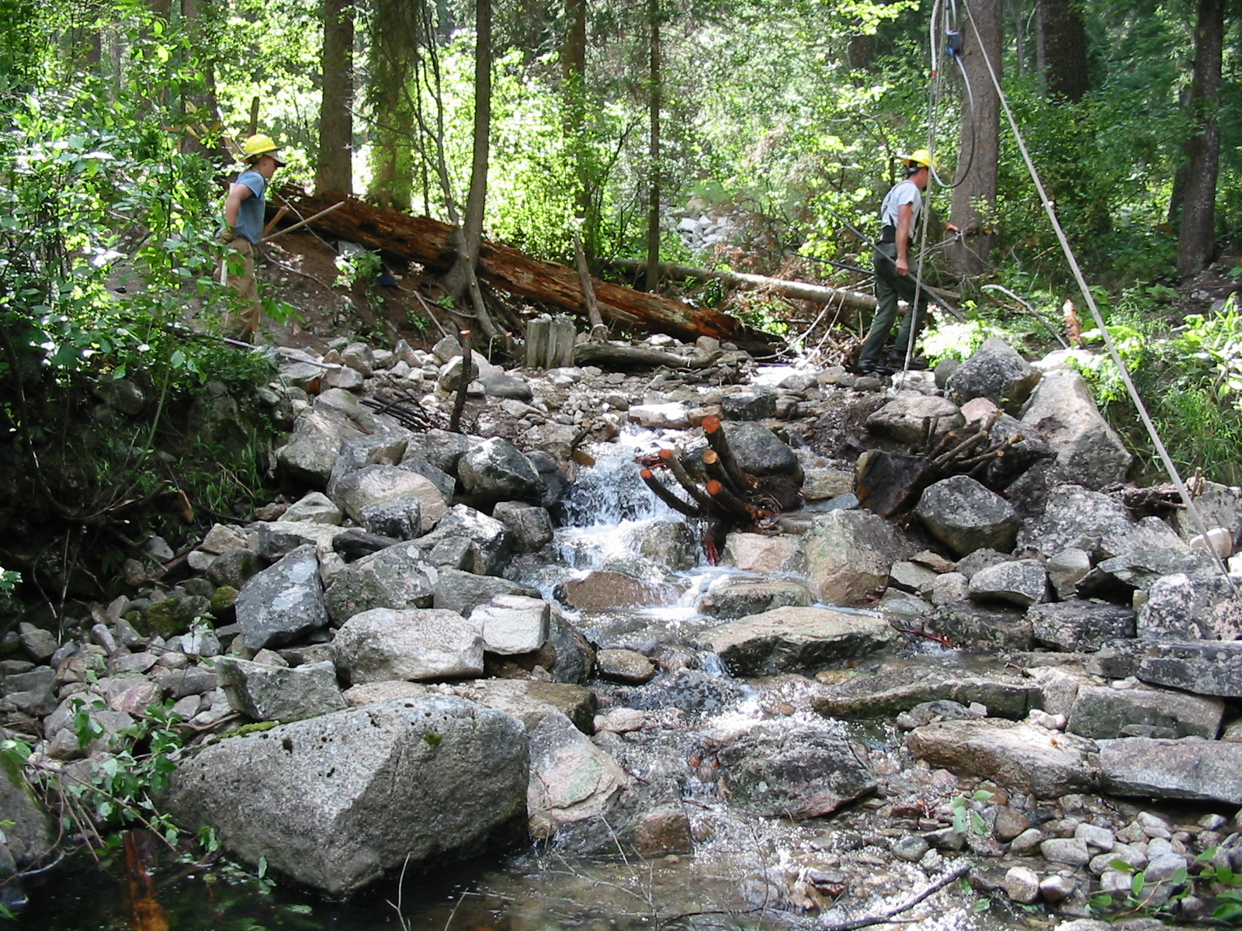
Progress

Slide 21
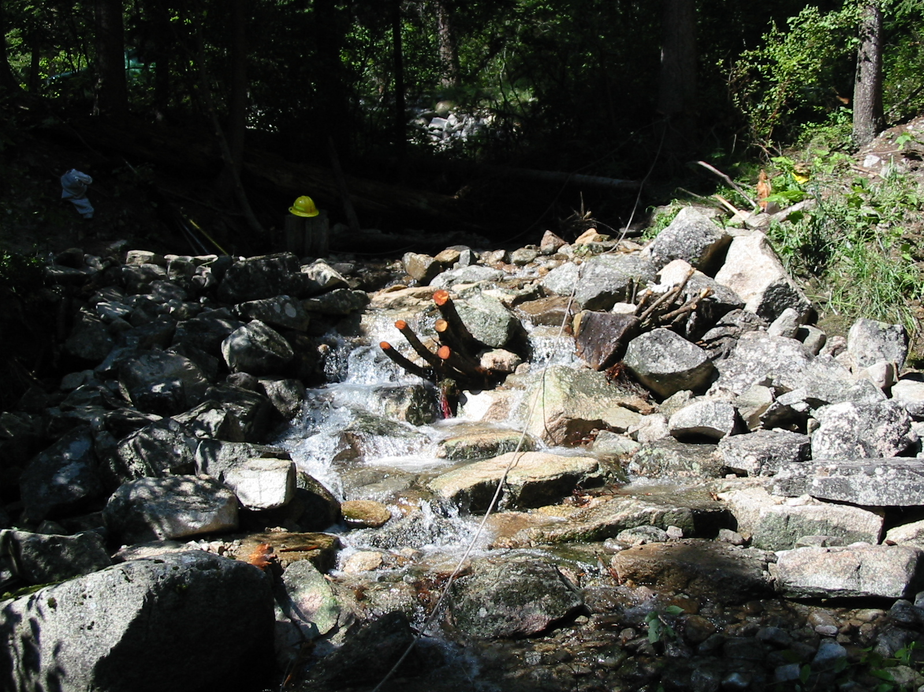
Creek

Slide 22
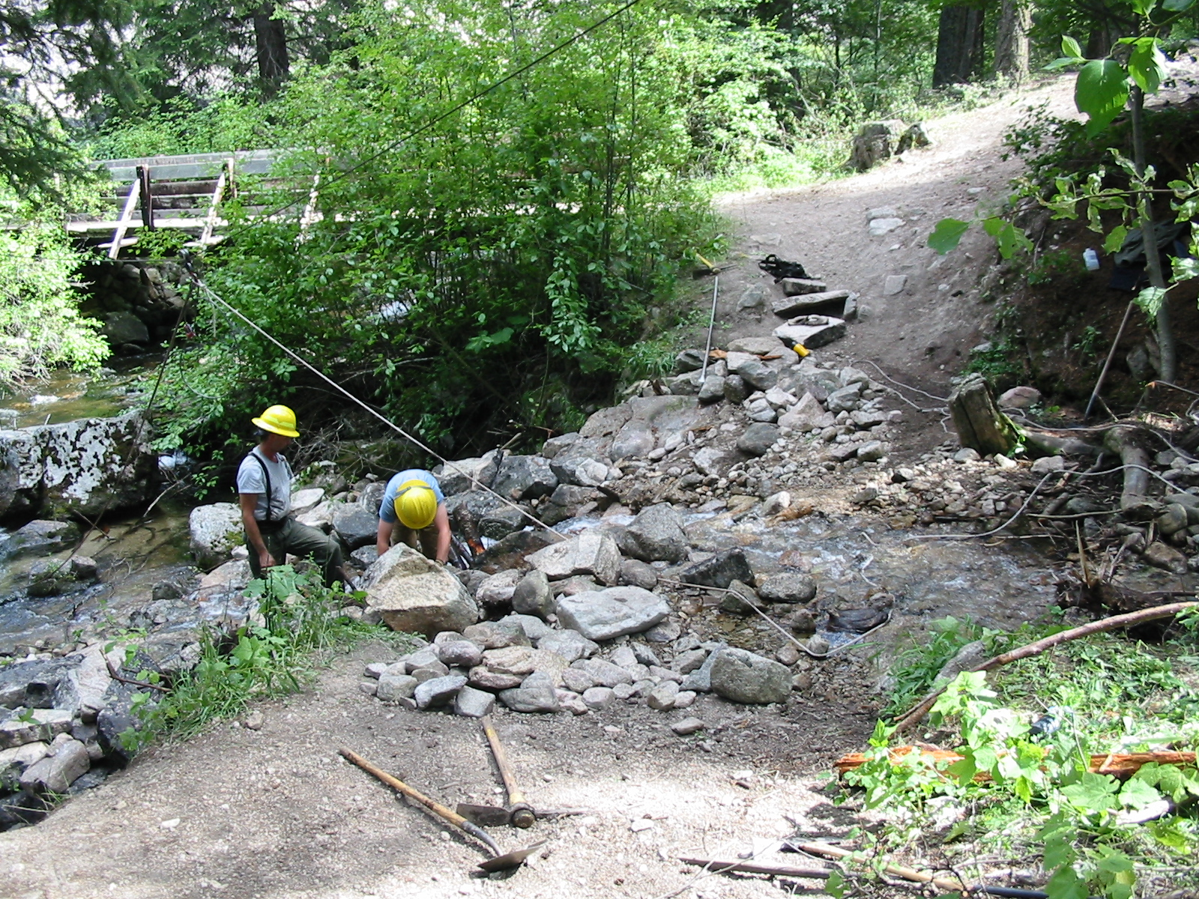
Stream Ford before construction

Slide 23
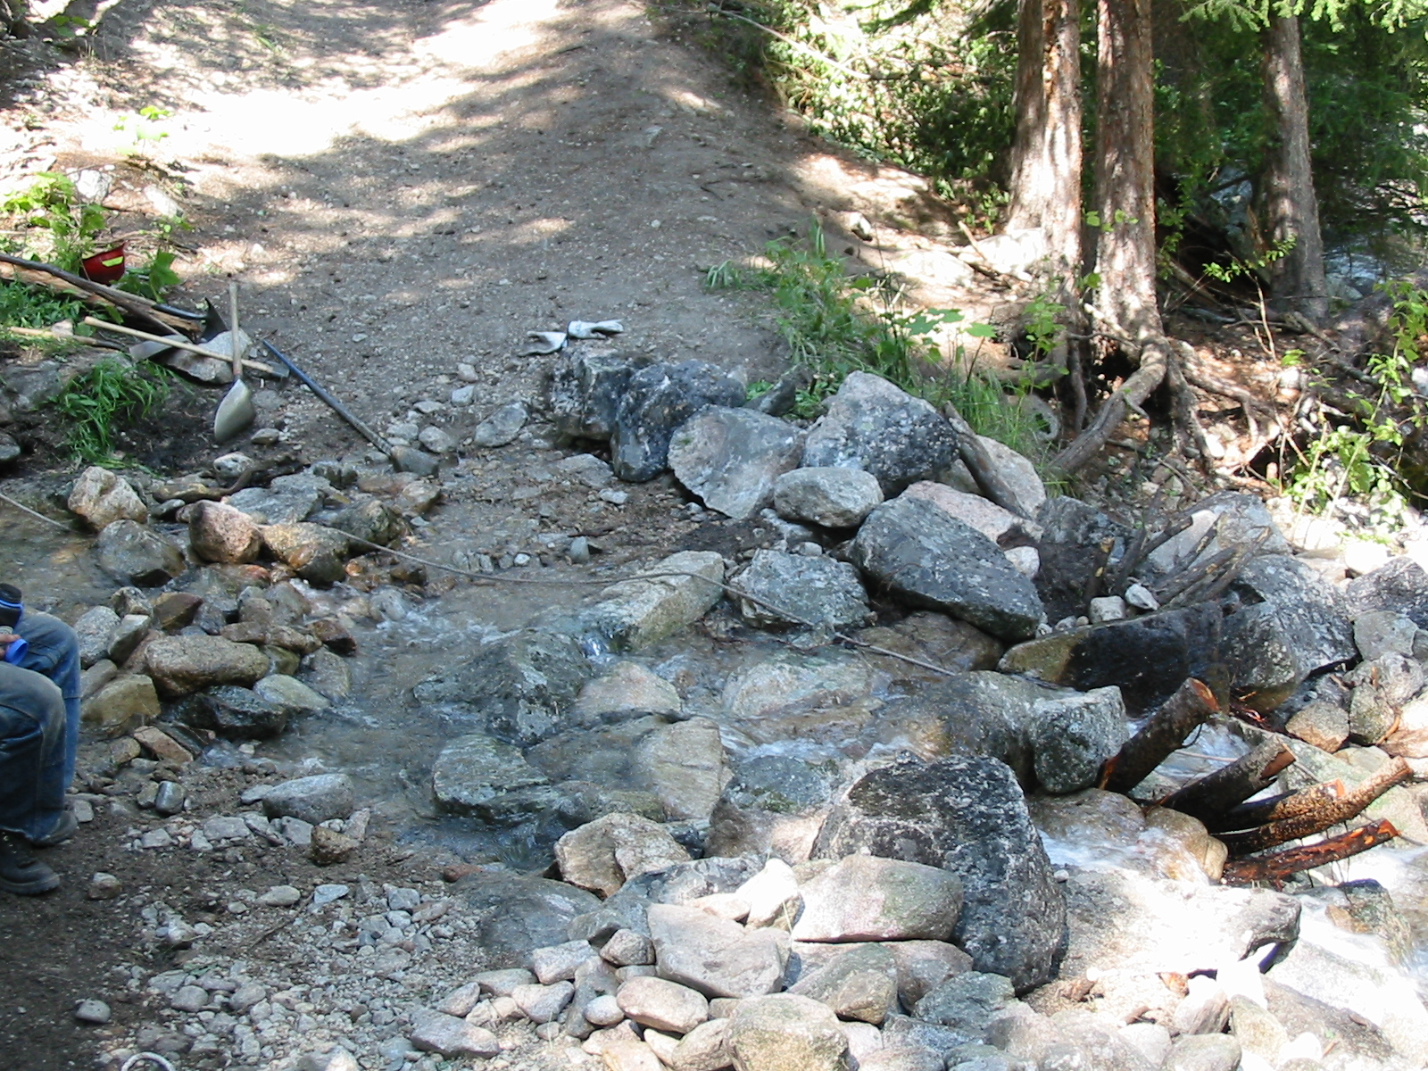
Close up view (stream ford)
Top tier

Slide 24
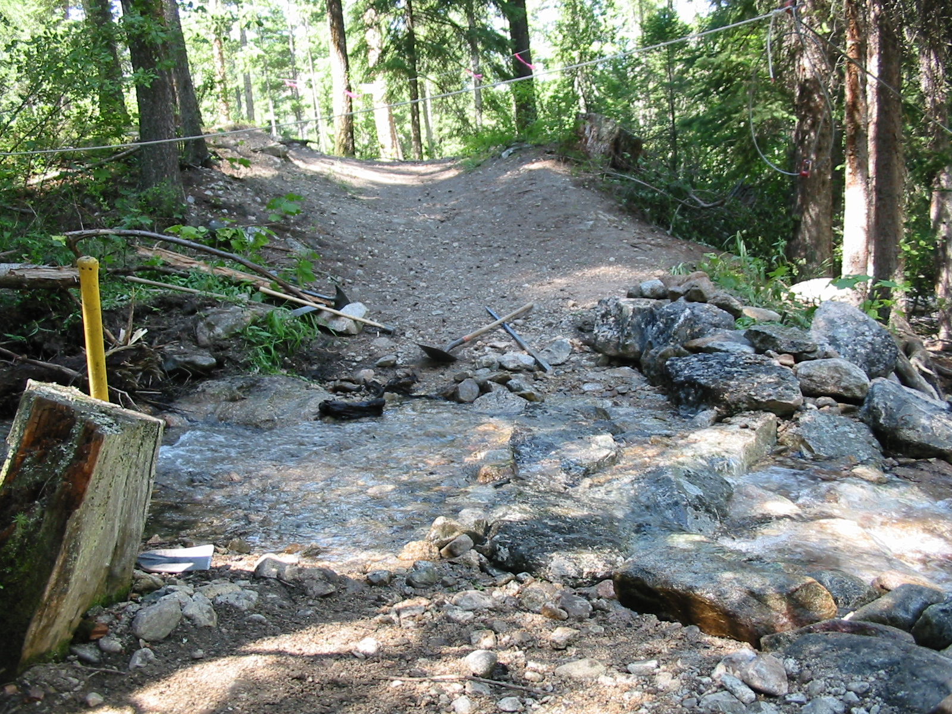
Progress of stream ford

Slide 25
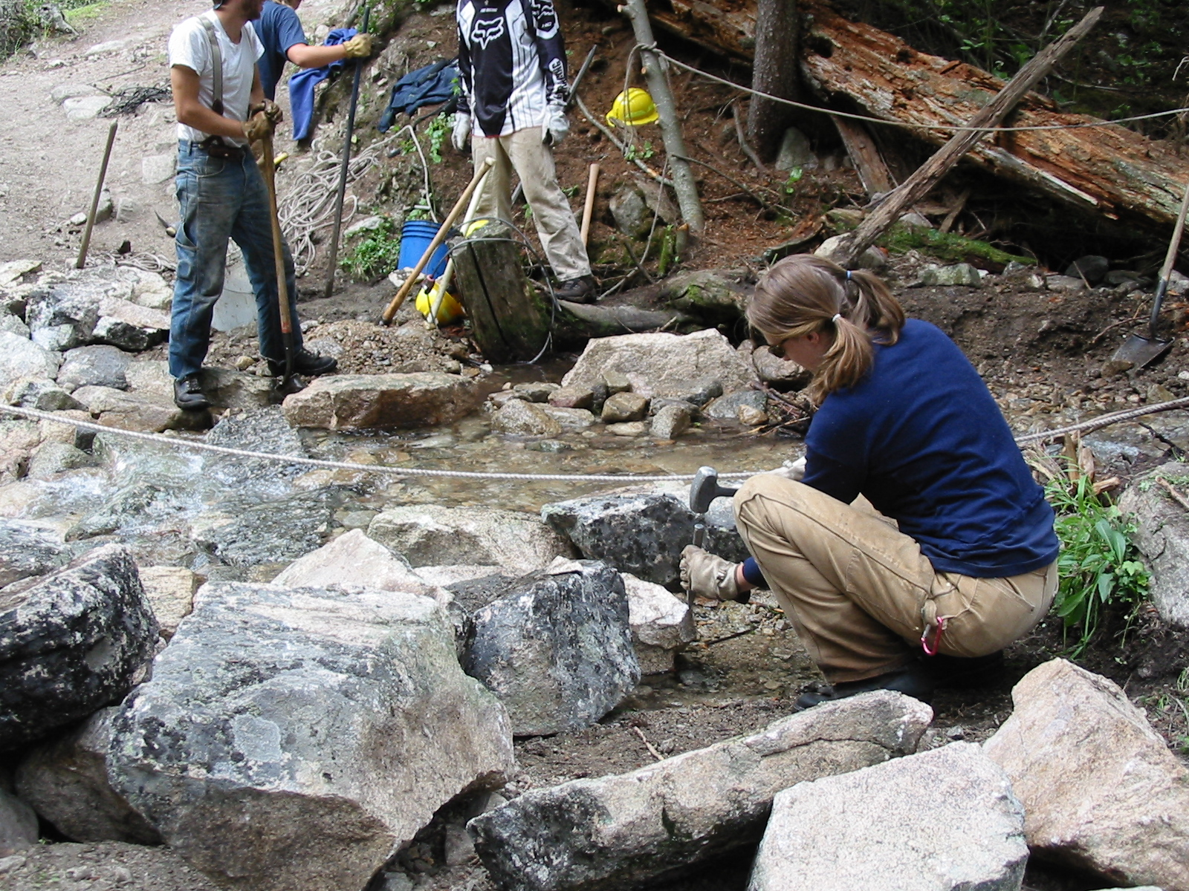
New structure for stream ford
Crazy Creek

Slide 26
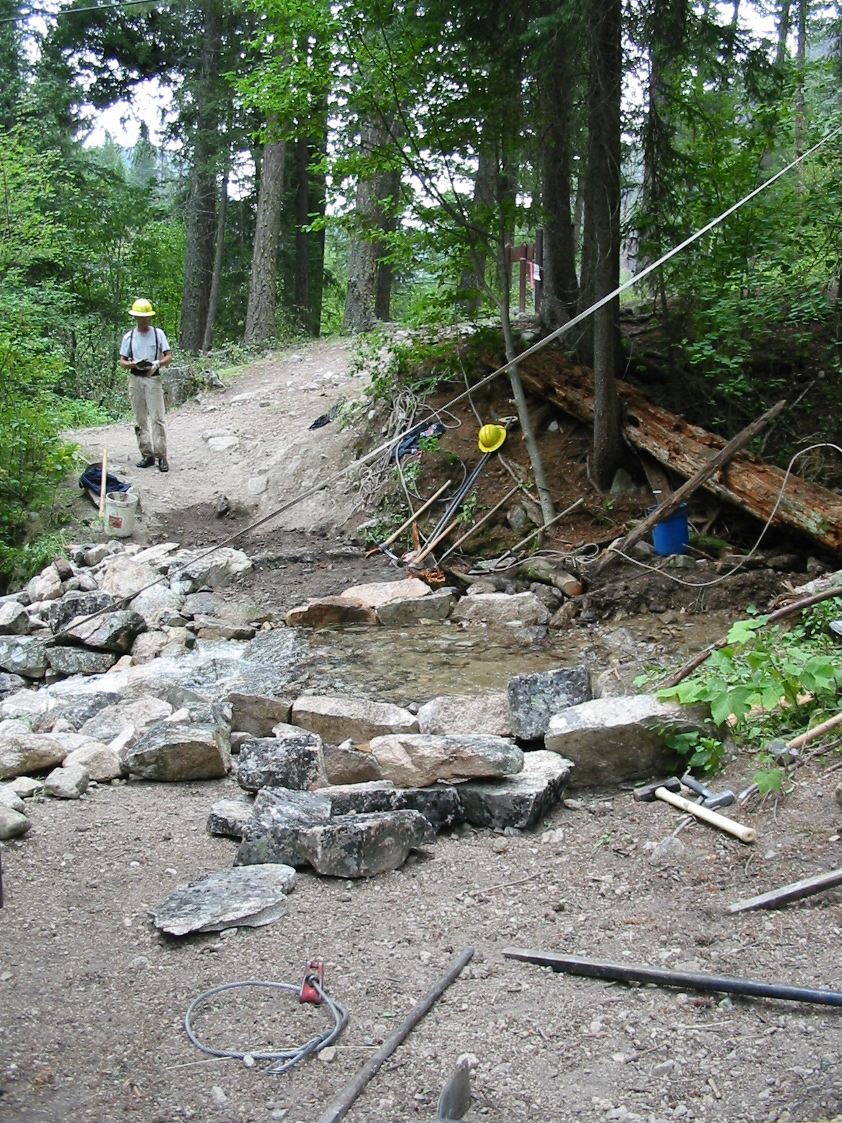
Beginning to see formation of stream ford

Slide 27
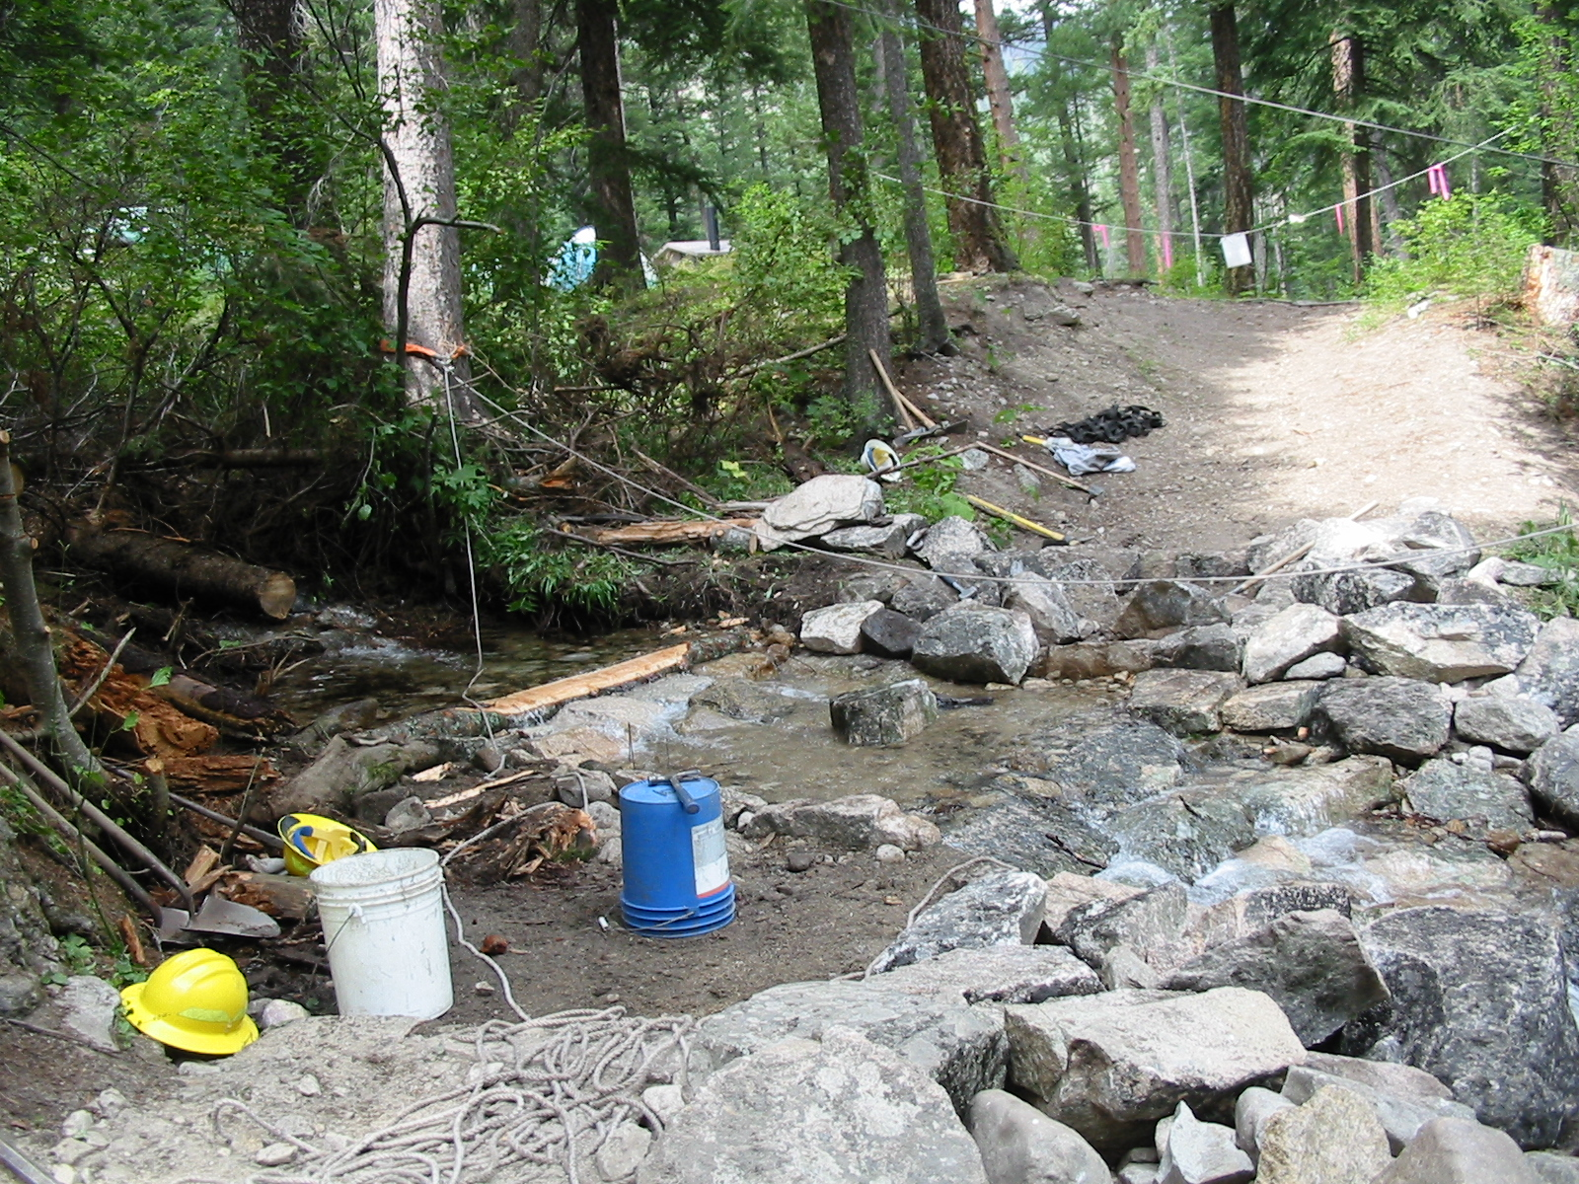
Added log to slow water
Log

Slide 28
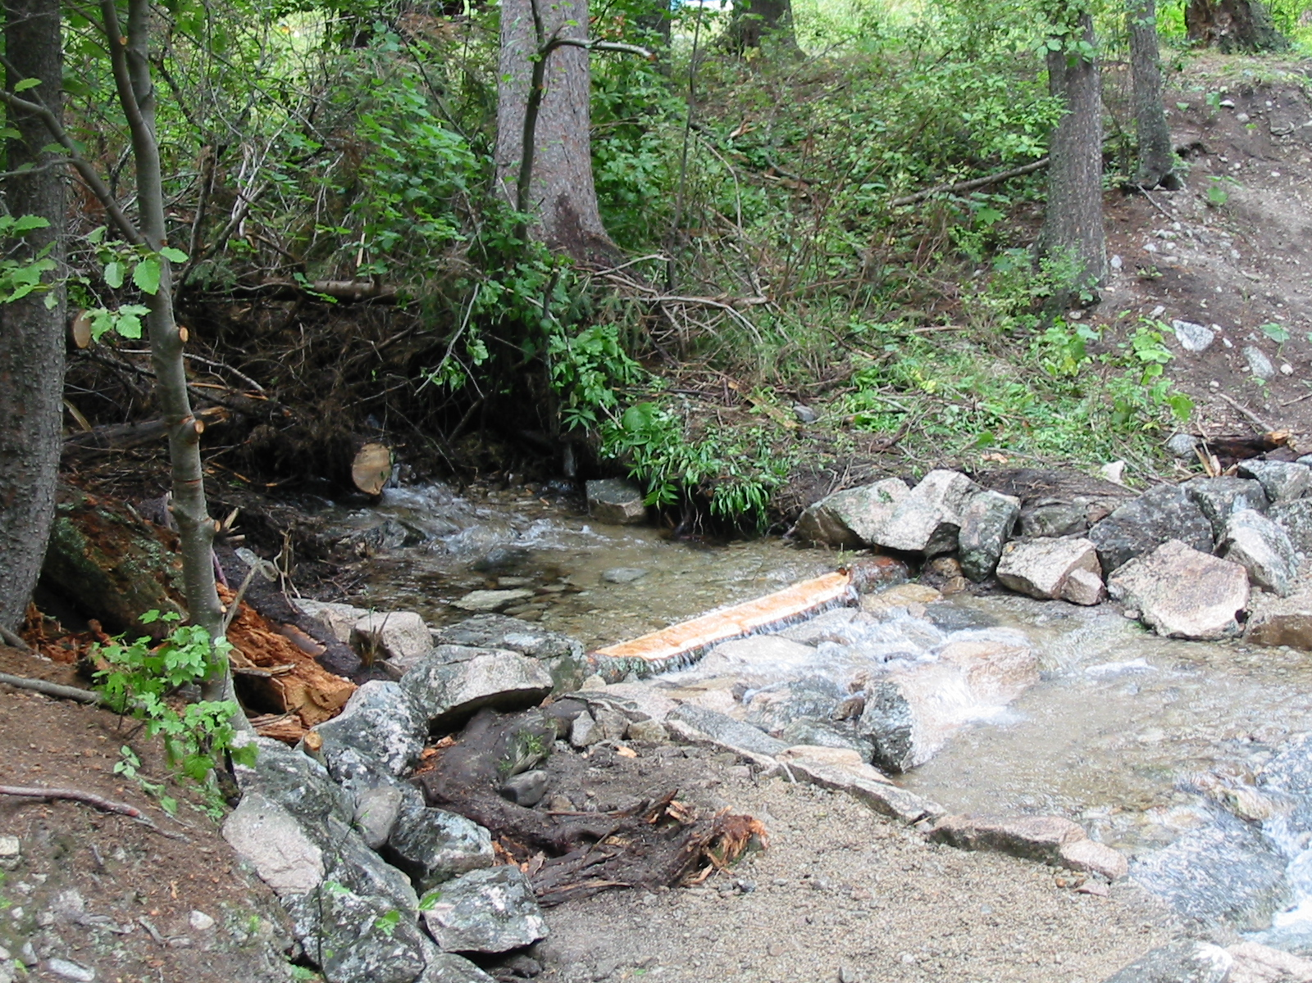
Bank stability

Slide 29
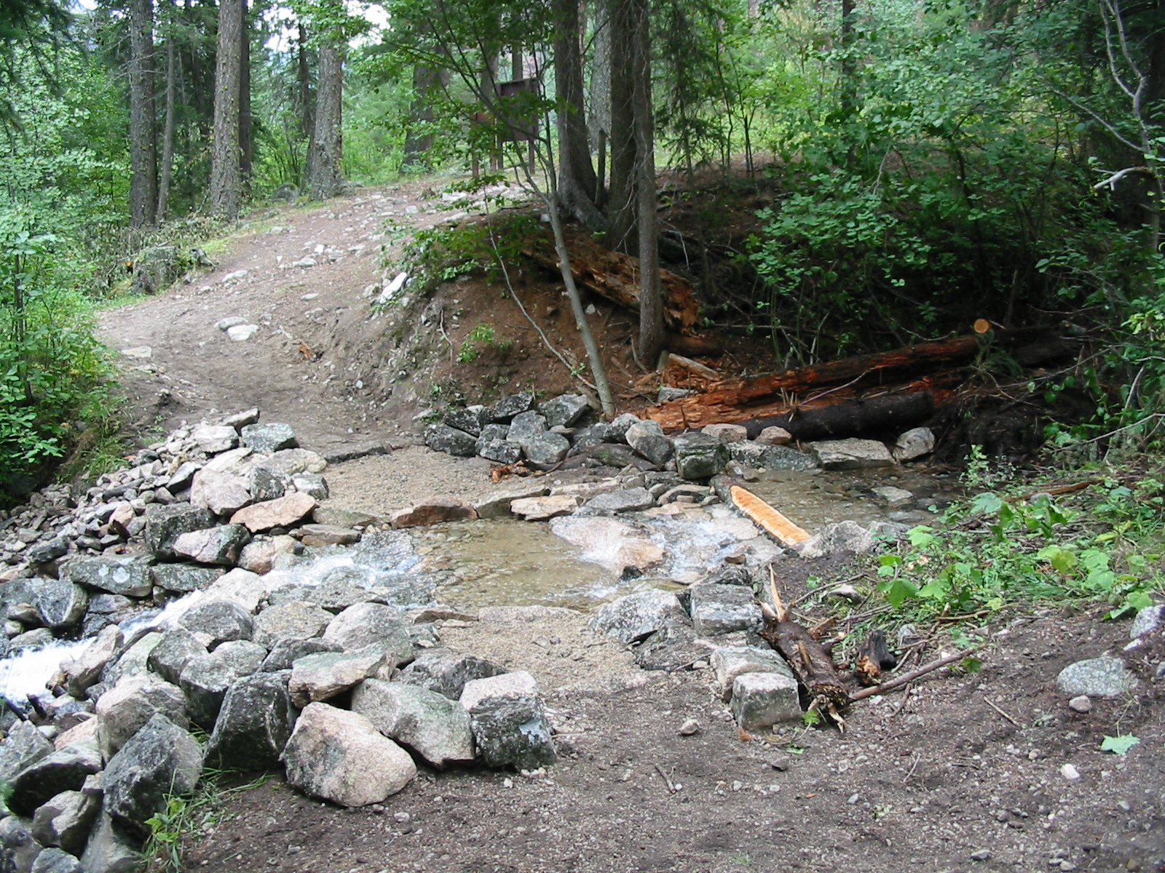
Final stream ford

Slide 30
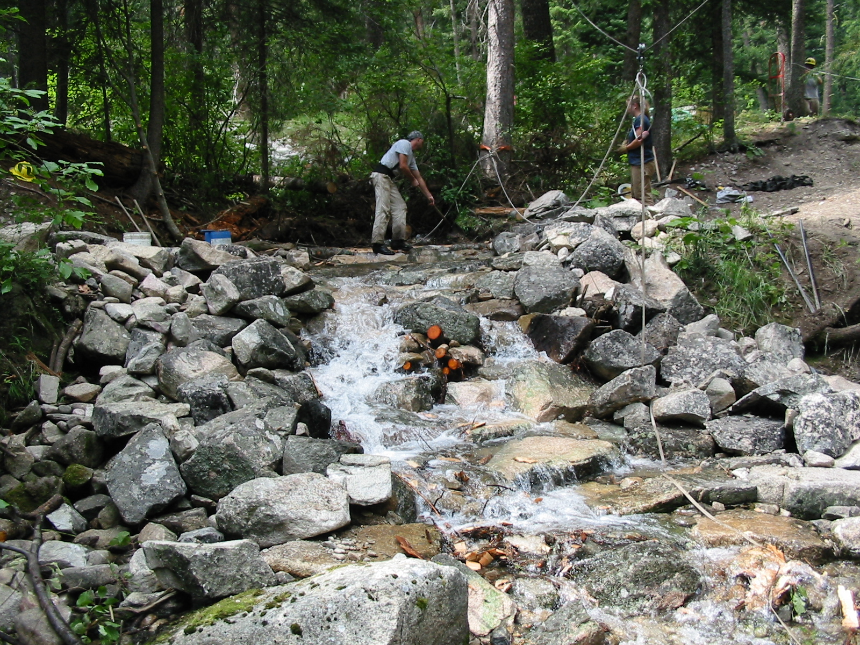
Structure taking form!
2 distinct channels

Slide 31
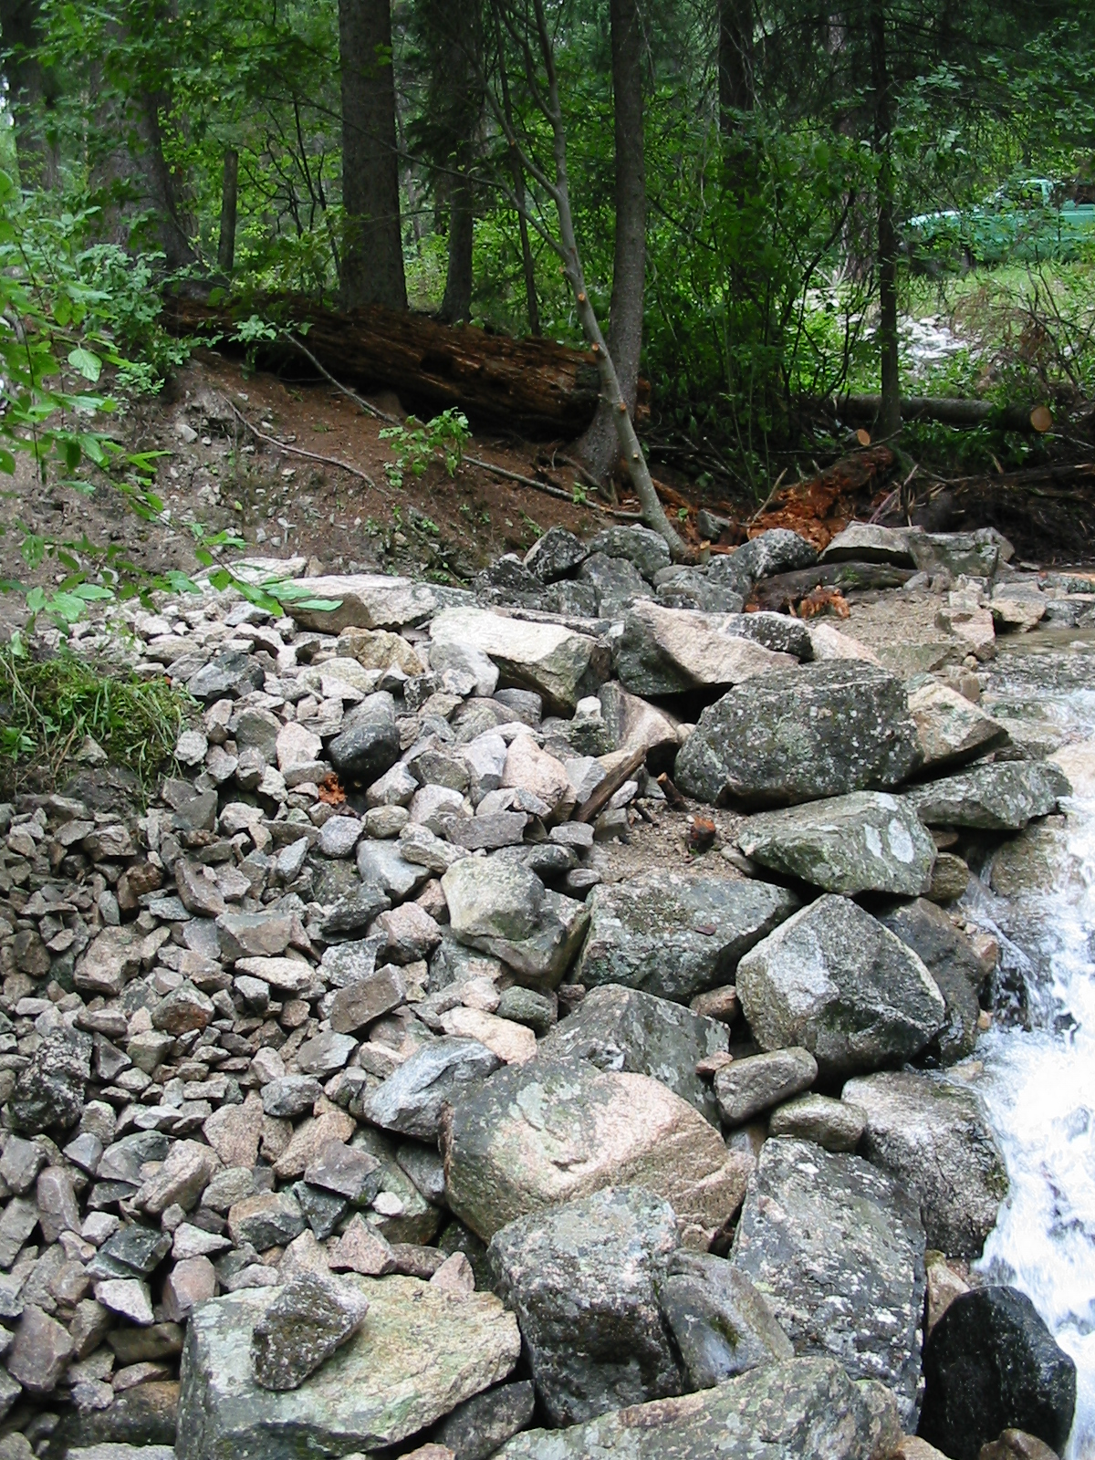
View from bottom of structure (left wing)

Slide 32
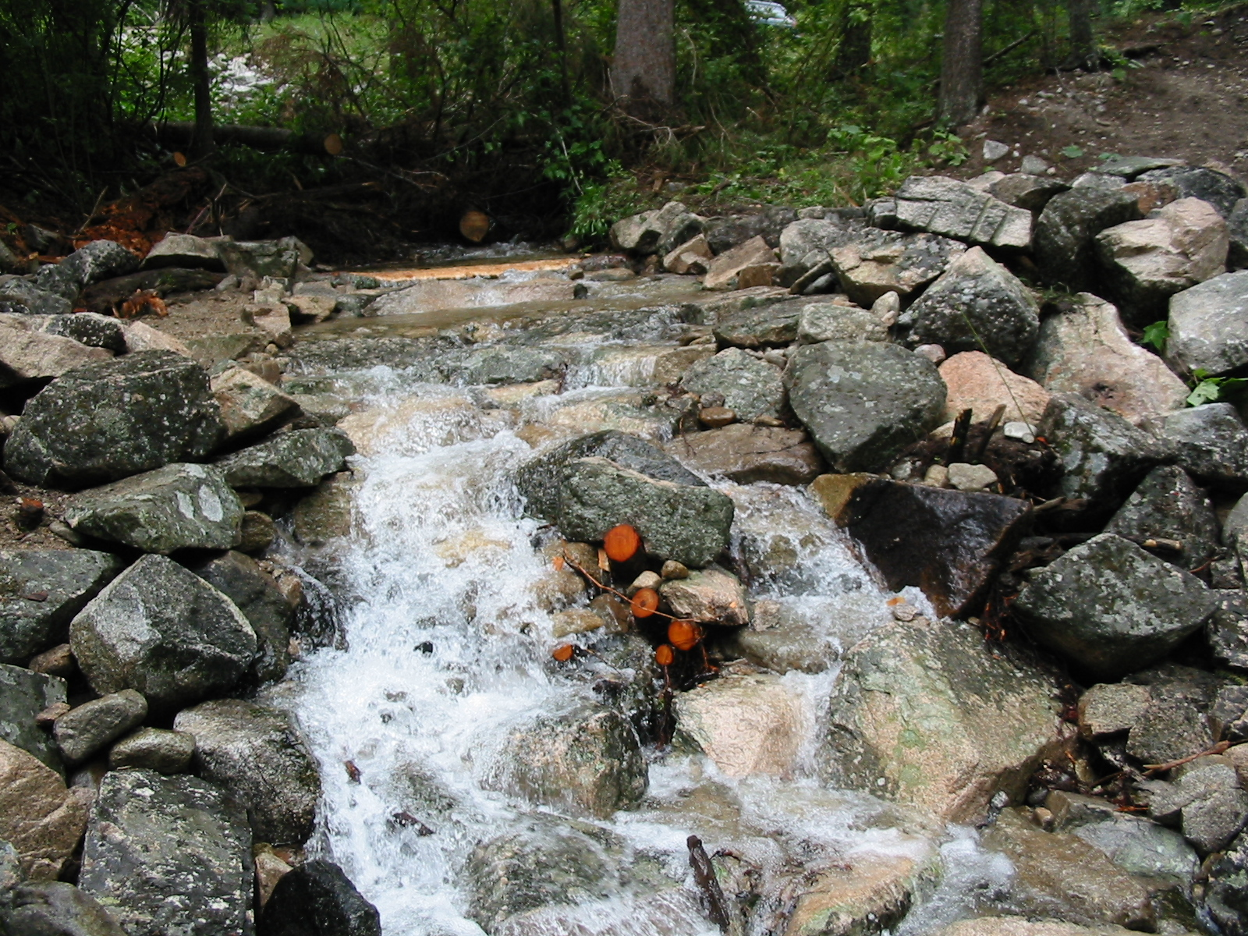
View from bottom of structure (crazy creek)

Slide 33
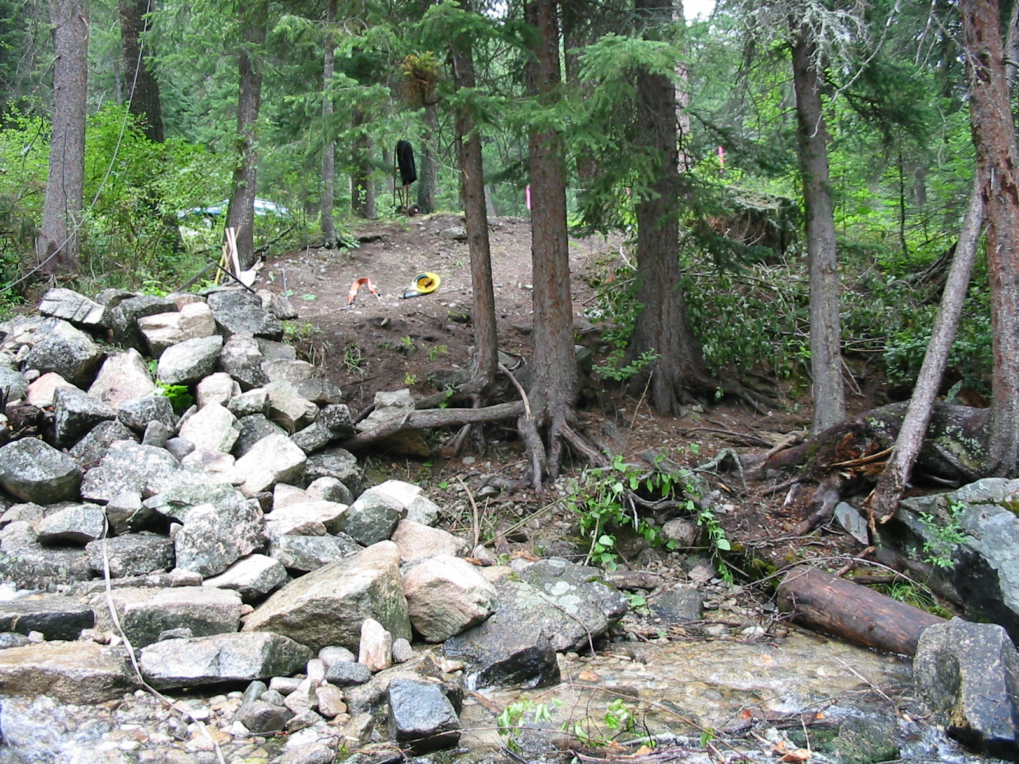
View from bottom of structure (right wing)

Slide 34
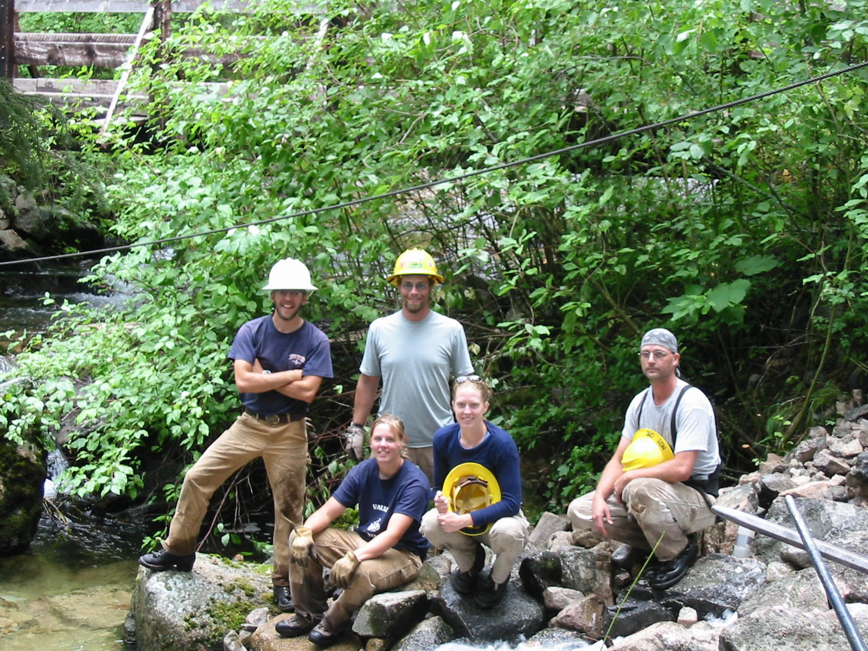
Construction crew

Slide 35
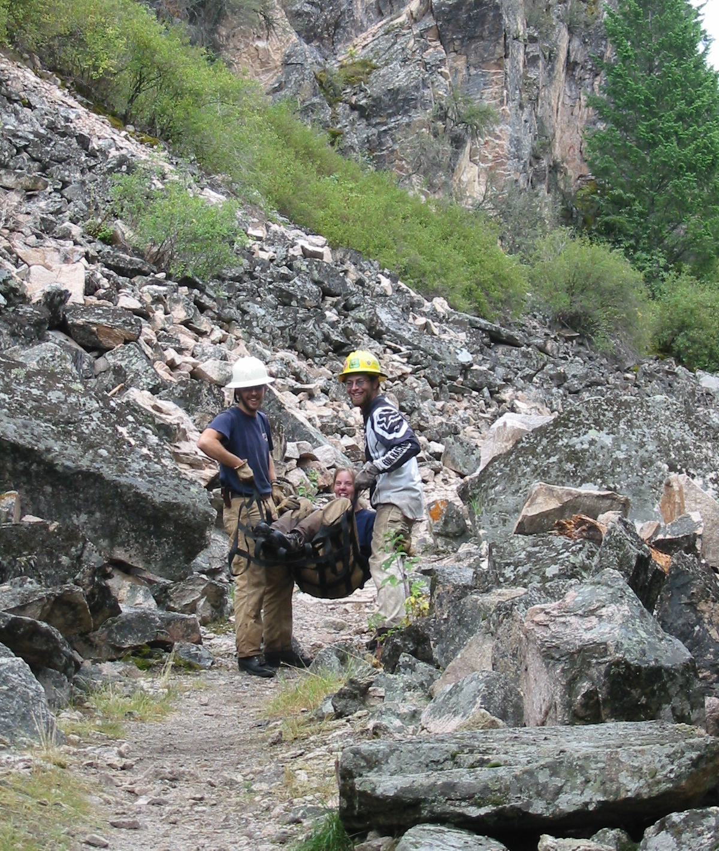
Gotta have some fun!

Slide 36
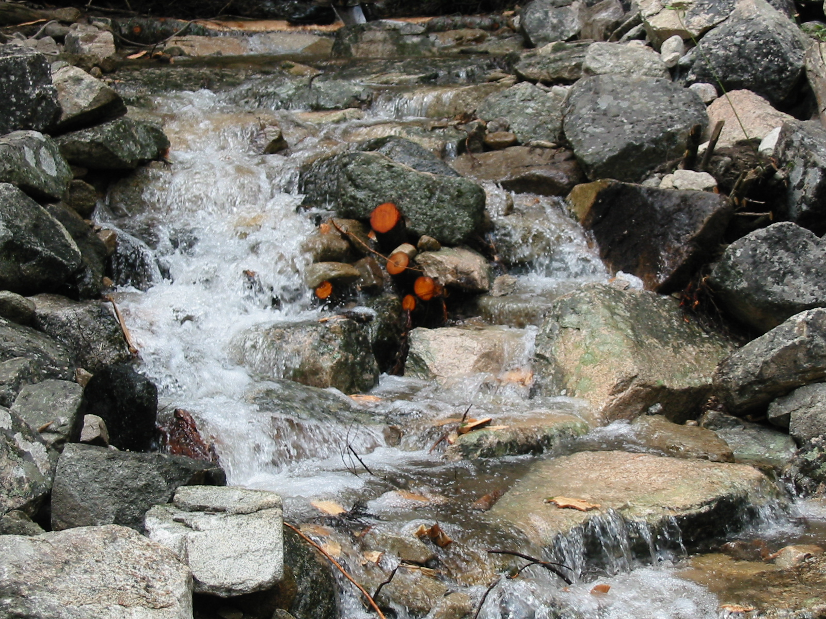
Creek close-up

Slide 37
Thank you to everyone who assisted in the planning, design, construction, and logistics of this project

