Slide 1
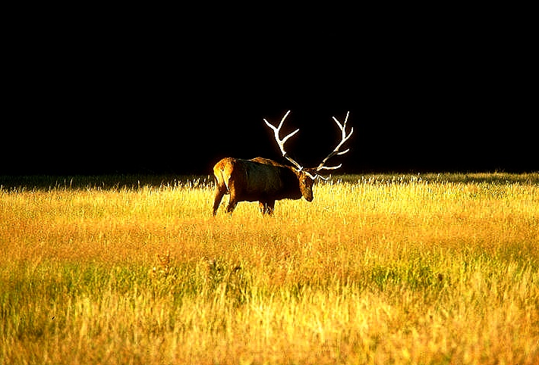
Wilderness is . . .
. . . a damp dreary place where all
manner of wild beasts dash about uncooked.
Anonymous, 19th Century

Slide 2
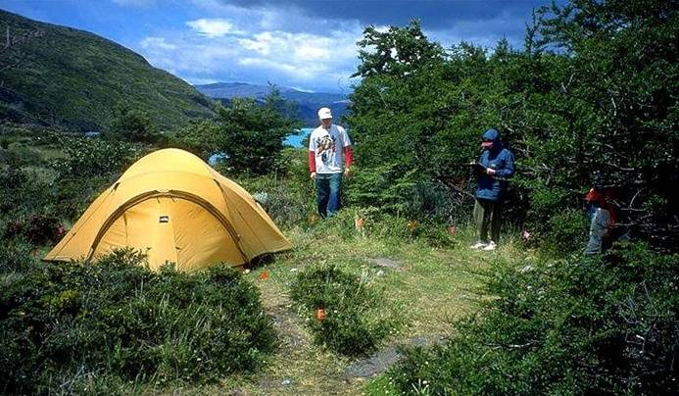
Development Process for Impact Monitoring Programs: Campsites
Jeff Marion, Unit Leader/Scientist
Virginia Tech Field Unit, USGS, Patuxent WRC
jmarion@vt.edu, 540-231-6603

Slide 3
Presentation Objectives
1. Review steps for developing a visitor impact monitoring program, illustrated with campsite monitoring indicators.
2. Highlight the need and process for evaluating alternative monitoring approaches.

Slide 4
Inventory and Monitoring Definitions
Natural Resource Inventory - The process of acquiring, managing, and analyzing information on protected area resources, including but not limited to the presence, distribution, and condition of plants, animals, soils, water, air, natural features, biotic communities, and natural processes.
Natural Resource Monitoring - The systematic collection and analysis of resource data at regular intervals, in perpetuity, to predict or detect natural and human-induced changes, and to provide the basis for appropriate management response.

Slide 5
Monitoring Program Development Steps
Step 1. Evaluate Need for Monitoring Program
Step 2. Initiate Monitoring Program
Step 3. Review Existing Monitoring Approaches
Step 4. Develop Monitoring Procedures
Step 5. Document Monitoring Protocols
Step 6. Conduct Monitoring Fieldwork
Step 7. Develop Analysis and Reporting Procedures

Slide 6
Monitoring Program Development Steps
Step 1 Evaluate Need for Monitoring Program
Step 2 Initiate Monitoring Program
Step 3 Review Existing Monitoring Approaches
Step 4 Develop Monitoring Procedures
Step 5 Document Monitoring Protocols
Step 6 Conduct Monitoring Fieldwork
Step 7 Develop Analysis and Reporting Procedures

Slide 7
Evaluate Need for Monitoring Program
Legislative mandates, management policies and guidelines, and specific protected area objectives should be reviewed to establish the need for a monitoring program.
Review and documentation of these needs are often critical in enlisting and sustaining organizational support for monitoring programs.

Slide 8
Resource Protection & Recreation Provision: Dual Mandates
The National Park Service shall:
... promote and regulate the use of the ... National Parks ... to conserve the scenery and the natural and historic objects and the wildlife therein and to provide for the enjoyment of the same in such manner and by such means as will leave them unimpaired for the enjoyment of future generations.
National Park Service Organic Act of 1916
Wilderness shall:
... be administered for the use and enjoyment of the American people in such manner as will leave them unimpaired for future use and enjoyment as wilderness ...
The Wilderness Act, 1964

Slide 9
Agency Management Policies
“Backcountry use will be managed to avoid unacceptable impacts on park resources or adverse effects on visitor enjoyment of appropriate recreational experiences.”
“To fulfill the mission of conserving parks, it is essential that park managers know the nature and condition of the resources in their stewardship, have the means to detect and document changes in those resources, and understand the forces driving the changes.”
NPS Management Policies

Slide 10
Monitoring Program Capabilities
Identify and quantify site-specific resource impacts
Summarize impacts by environmental or use-related factors to detect and evaluate relationships
Aid in setting and monitoring management standards for resource conditions
Evaluate deterioration in resource conditions to suggest potential causes and effective management actions
Evaluate the effectiveness of resource protection measures
Identify and assign priorities to maintenance needs

Slide 11
LAC & VERP Planning
And Management
Decision Making
Frameworks
Establish Prescriptive Management Objectives
Choose Biophysical and Social Indicators of Change
Formulate Standards
Monitor Conditions
Compare Conditions to Standards
Standards Exceeded
Standards
Not Exceeded
Evaluate and Identify Causal Factors
Select Appropriate Management Action
Implement Management Action

Slide 12
Monitoring Program Development Steps
Step 1 Evaluate Need for Monitoring Program
Step 2 Initiate Monitoring Program
Step 3 Review Existing Monitoring Approaches
Step 4 Develop Monitoring Procedures
Step 5 Document Monitoring Protocols
Step 6 Conduct Monitoring Fieldwork
Step 7 Develop Analysis and Reporting Procedures

Slide 13
Initiate Monitoring Program
This step highlights the need to secure organizational support for the monitoring effort.
Resource Management Plan - describes the nature and severity of visitor impact problems and the need for a monitoring program.
Visitor impact monitoring proposal - clearly identify the monitoring needs, objectives, and program. Circulate within the organization to develop a clear understanding of how the monitoring program will support management decision making.
Identify monitoring questions and apply criteria to select indicators.

Slide 14
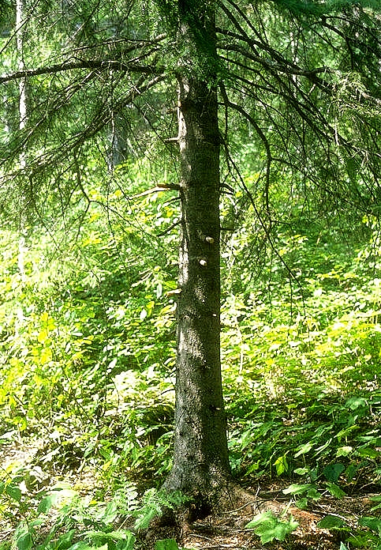
Common Campsite Indicators
Campsite Density (#, #/unit area)
Legal & illegal campsites
Informal Trails (#)
From firewood gathering, exploring, travel to other sites or water source.

Slide 15
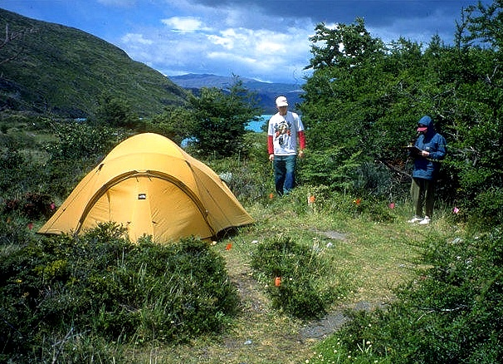
Common Campsite Indicators
Site Size (sq ft)
Vegetation Loss (%, sq ft) - compared to control
Vegetation Composition Change (# non-native species)
Soil Exposure (%, sq ft)
Fire Sites (#)
Trees w/Exposed Roots (#)

Slide 16
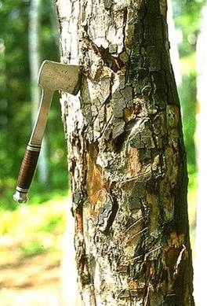
Common Campsite Indicators
Tree Stumps (#)
Damaged Trees (#)
Human Waste Sites (#)
Litter / Trash (volume)
Shoreline Disturbance (lineal length, ft²)
Composite or Index Values
e.g., weighted sum of ratings or standardized measures.

Slide 17
Inventory Indicators
Site Number/Name Tree Canopy Cover
Inventory Personnel Distance from Trail
Assessment Date Distance to Water
Vegetation Type UTM Coordinates
Management Zone Tentsite Capacity
Elevation Firewood Availability
Water Source Site Facilities Present
Intersite Visibility Facility Condition
Amount of Site Use User-Built Facilities
Note: Often collected at the same time to address management information needs or for analyses of monitoring data.

Slide 18
Monitoring Program Development Steps
Step 1 Evaluate Need for Monitoring Program
Step 2 Initiate Monitoring Program
Step 3 Review Existing Monitoring Approaches
Step 4 Develop Monitoring Procedures
Step 5 Document Monitoring Protocols
Step 6 Conduct Monitoring Fieldwork
Step 7 Develop Analysis and Reporting Procedures

Slide 19
Monitoring Approaches
Photographic Systems - Aerial photography, photographs from permanent photopoints, stereo photographs.
Condition Class Systems - Descriptive statements that characterize a range of site degradation from low to high.
Rating Systems - Separate assessments of multiple indicators with categorical ratings.
Measurement Systems - Separate assessments of multiple indicators with measurements

Slide 20
Evaluation and Selection Criteria
What types of information are needed? Will a summary assessment be sufficient or are data on specific types of impacts required?
How many sites are there and what percentage should be monitored? Census or sample; consider geographic, biophysical, use-related, or managerial stratifications.
Who will conduct the monitoring and how often? Evaluate staffing and funding constraints and select a system that can be sustained.

Slide 21
Evaluation and Selection Criteria
Measurement Scale - Ordinal or ratio measures?
Accuracy vs. Precision - Accuracy refers to how close measures are to the true value. Precision refers to how close repeated measures of an attribute are to each other and to the sensitivity of the measurement method. Measurement error can arise from the poor application of methods or from coarse assessment methods.
Sensitivity - How large must a change be for it to be identified confidently as a real change in resource conditions?

Slide 22
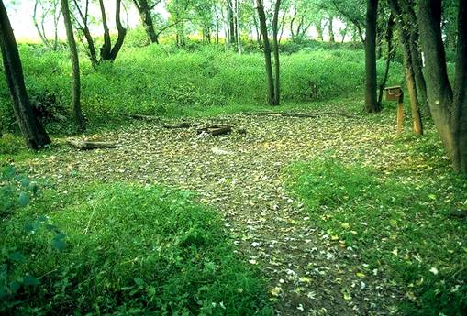
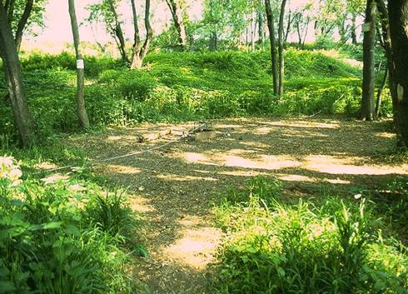
Photographic Systems
Aerial photography, photographs from permanent photopoints, stereo photographs.
1985
1988

Slide 23
Photographic Systems
Advantages - Rapid, provides photographs for direct visual comparisons.
Disadvantages - Variable photographic quality, can’t cover all areas of a site, difficult to obtain accurate quantitative data, aerial photos useful only when tree cover is absent.

Slide 24
Ratings: Condition Class
Class 1: Campsite barely distinguishable; slight loss of vegetation cover and/or minimal disturbance of organic litter.
Class 2: Campsite obvious; vegetation cover lost and/or organic litter pulverized in primary use areas.
Class 3: Vegetation cover lost and/or organic litter pulverized on much of the site; some soil exposed in primary use areas.
Class 4: Nearly complete or total loss of vegetation cover and organic litter; bare soil widespread.
Class 5: Soil erosion obvious, as indicated by exposed tree roots and rocks and/or gullying.

Slide 25
Condition Class System
Advantages - Rapid and easy to apply, provides a useful summary of general site conditions.
Disadvantages - Ordinal data limits summary and analysis capabilities, no information on the condition of individual indicators, low accuracy.
Assessment Time - About 2 minutes for one staff.

Slide 26
Rating Systems
Process - Separate assessments of multiple indicators with categorical ratings.
Example - Site size is roughly measured or estimated to select an appropriate category:
1) < 500 ft² 2) 501 - 1000 ft² 3) > 1000 ft²

Slide 27
Rating Systems
Advantages - Fairly rapid and easily applied, provides information on a variety of indicators.
Disadvantages - Yields ordinal data, low accuracy due to rapid assessments and use of categories.
Assessment Time - About 10 minutes for one staff.

Slide 28
Measurement Systems
Process - Separate assessments of multiple indicators with measurements or counts.
Example - Site size is measured using one of the following methods: Geometric Figure Method, Fixed Radial Transect Method, or Variable Radial Transect Method.

Slide 29
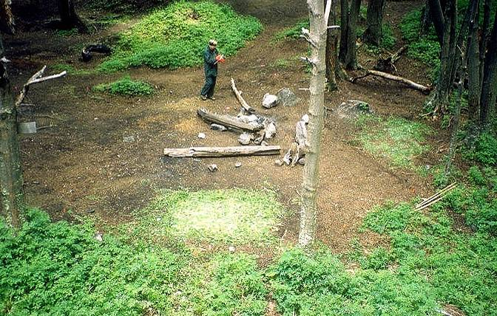
Site Boundaries

Slide 30
Site Size Measurement Methods
Geometric Figure Method
Fixed Radial Transect Method
(12 transects)

Slide 31
Variable Radial Transect Method
75, 5.0
143, 7.3
31, 7.0
53, 4.2
153, 9.3
141, 1.9
168, 9.9
10, 7.8
178, 5.7
345, 7.8
193, 11.2
326, 4.2
333, 4.2
248, 4.2
207, 8.7
204, 10.8
291, 4.4

Slide 32
Comparison of Measurement Methods
Measurement Time (minutes)
25
V24
20
F24
15
F16
V16
F12
10
V12
F8
V8
5
G
0
0
2
4
6
8
10
12
14
16
18
20
22
24
Percent Error in Site Size (accuracy)

Slide 33
Comparison of Measurement Methods
Geometric Method
Transect Methods
Lower precision due to
different shapes used and
indistinct site boundaries.
Higher precision due to use of transects and a permanent reference point.

Slide 34
Site Size Remeasurement Methods
Indistinct boundary
Distinct
boundary
Current Boundary
Original Boundary
Keep the previous transect length unless there is a compelling reason to alter it. Add new transects as needed to characterize new boundary.

Slide 35
Measurement Systems
Advantages - Provides more accurate ratio level information on a variety of indicators, minimizes measurement error.
Disadvantages - More time-consuming, particularly during reassessments.
Assessment Time - About 15 - 25 minutes for two staff.

Slide 36
Monitoring Program Development Steps
Step 1 Evaluate Need for Monitoring Program
Step 2 Initiate Monitoring Program
Step 3 Review Existing Monitoring Approaches
Step 4 Develop Monitoring Procedures
Step 5 Document Monitoring Protocols
Step 6 Conduct Monitoring Fieldwork
Step 7 Develop Analysis and Reporting Procedures

Slide 37
Develop Monitoring Procedures
The purpose of this step is to modify or develop specific assessment procedures for each indicator.
Review and select monitoring procedures - Use existing standardized procedures that have been peer-reviewed (don’t reinvent the wheel).
Field test and refine procedures - adapt procedures only to the extent needed to address unique local conditions or needs.

Slide 38
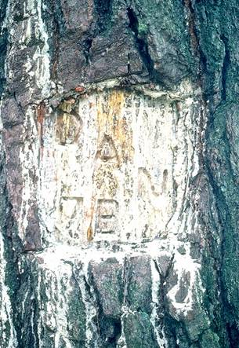
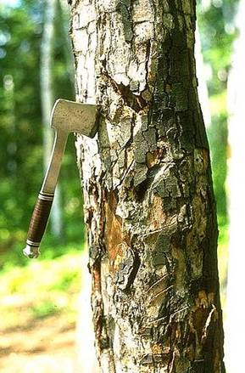
Tree Damage
None/Slight: No or slight damage such as broken or cut smaller branches, 1 nail, or a few superficial trunk scars.
Moderate: Numerous small trunk scars and nails or 1 moderate sized scar.
Severe: Trunk scars numerous and many that are large and have penetrated to the inner wood; any complete girdling of tree.

Slide 39
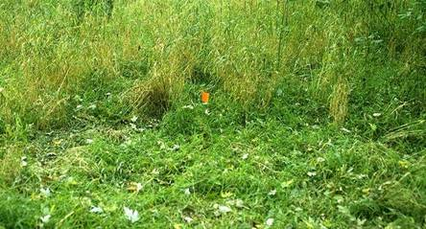
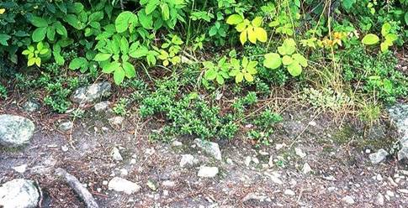
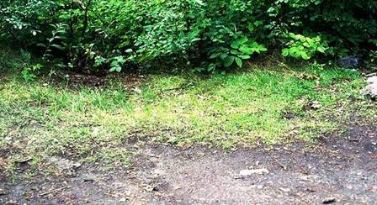
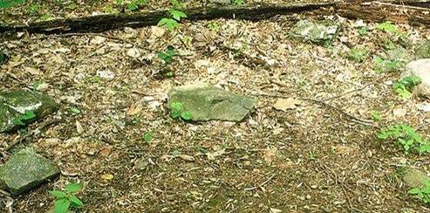
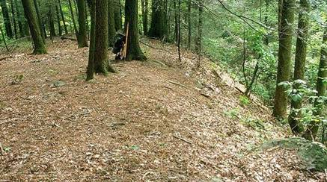
Site Boundaries
Identified by pronounced changes in vegetation, organic litter, or topography

Slide 40
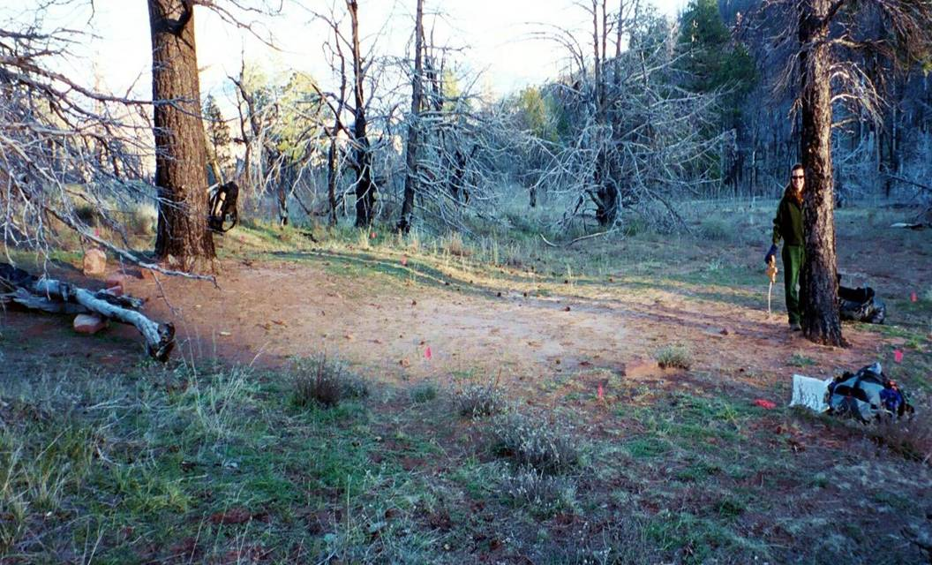
Campsite Size Variable Radial Transect Method

Slide 41
Monitoring Program Development Steps
Step 1 Evaluate Need for Monitoring Program
Step 2 Initiate Monitoring Program
Step 3 Review Existing Monitoring Approaches
Step 4 Develop Monitoring Procedures
Step 5 Document Monitoring Protocols
Step 6 Conduct Monitoring Fieldwork
Step 7 Develop Analysis and Reporting Procedures

Slide 42
Document Monitoring Protocols
Monitoring Manual - Develop a comprehensive manual with well-documented assessment procedures that employ written descriptions, diagrams, and photos.
Updates - Manuals are dynamic, they should be revised as needed to address field assessment problems and improved methods. Evaluate and carefully consider how changes will affect comparability.
Version - Each version should be numbered, dated, and archived.

Slide 43
Document Monitoring Protocols
Field Data Forms - Forms should facilitate the accurate recording of field data and computer data entry. Organize blanks in columns, use meaningful codes, measurement units, and indicator numbering that corresponds to the manual. Consider data recorders.
Develop computer databases - Input data to computer database , spreadsheet, or statistical packages. Use these to calculate new variables, summarize data and graphically present findings to decision makers.

Slide 44
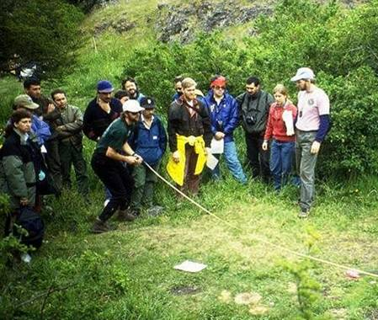
Document Monitoring Protocols
Staff Training - A comprehensive training program is essential to communicate and illustrate field procedures, develop and refine staff experience and judgment
in a variety of field settings, and build a commitment to quality assurance.

Slide 45
Monitoring Program Development Steps
Step 1 Evaluate Need for Monitoring Program
Step 2 Initiate Monitoring Program
Step 3 Review Existing Monitoring Approaches
Step 4 Develop Monitoring Procedures
Step 5 Document Monitoring Protocols
Step 6 Conduct Monitoring Fieldwork
Step 7 Develop Analysis and Reporting Procedures

Slide 46
Conduct Monitoring Fieldwork
Staffing - Higher quality assurance with small number of full-time staff vs. large number of part-time staff. Full-time staff could be assisted by part-time staff. Teams of two are generally the most effective and efficient.
Staff Management - Stress importance of quality assurance - need to assess “real changes in conditions” while minimizing measurement error. Hold periodic discussions on problems and solutions and rotate staff to promote consistent judgment. Consider “calibration exercises.”

Slide 47
Conduct Monitoring Fieldwork
Data Entry - Have staff input the data they collected on rainy days (teaches the need for legibility, importance of quality assurance, problems with missing data, etc.).
Timing - Conduct fieldwork during mid-to late season. Coordinate timing of work for each geographic area to roughly match phenological timing of prior surveys.

Slide 48
Monitoring Program Development Steps
Step 1 Evaluate Need for Monitoring Program
Step 2 Initiate Monitoring Program
Step 3 Review Existing Monitoring Approaches
Step 4 Develop Monitoring Procedures
Step 5 Document Monitoring Protocols
Step 6 Conduct Monitoring Fieldwork
Step 7 Develop Analysis and Reporting Procedures

Slide 49
Develop Analysis & Reporting Procedures
Consider Different Types of Analyses
Number/distribution of campsites
Listings of raw data
Descriptive statistics
Impact indicator relational analyses
Trend analyses
GIS analyses/presentations

Slide 50
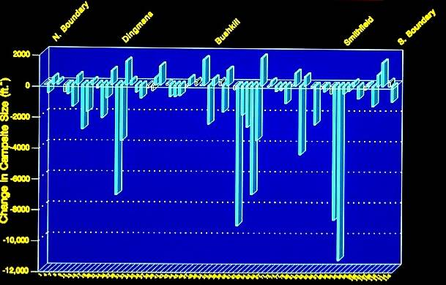
Campsite Size Comparisons: 1986 - 1991
Delaware Water Gap NRA Campsite Monitoring
Change in Campsite Size (ft²)
Campsite Number

Slide 51
Monitoring Results

Slide 52
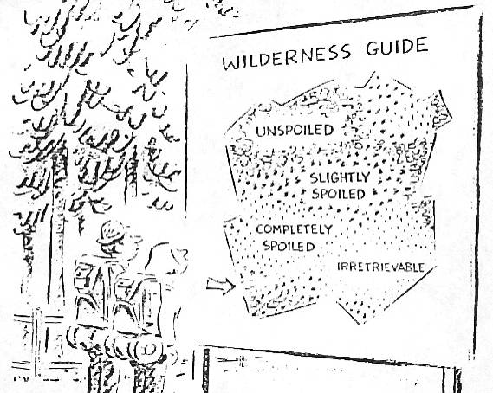
Communicating I&M results to the public…

