Slide 1
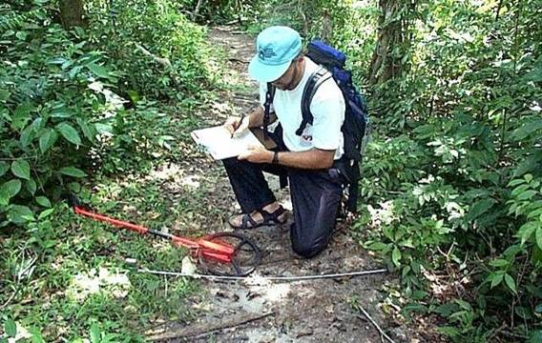
Identifying Indicators & Standards
Jeff Marion, Unit Leader/Scientist
Virginia Tech Field Unit, USGS, Patuxent WRC
jmarion@vt.edu, 540-231-6603

Slide 2
Selecting Indicators & Standards
Presentation Objectives:
1. Define indicators and describe their role, review criteria for their selection, and illustrate with trail impact examples.
2. Define indicator standards and describe their role, describe alternative types of standards, and illustrate with trail and campsite examples.

Slide 3
LAC & VERP Planning
And Management
Decision Making
Frameworks
Establish Prescriptive Management Objectives
Choose Biophysical and Social Indicators of Change
Formulate Standards
Monitor Conditions
Compare Conditions to Standards
Standards Exceeded
Standards
Not Exceeded
Evaluate and Identify Causal Factors
Select Appropriate Management Action
Implement Management Action

Slide 4
What Are Indicators?
What are indicators and why do we use them?
Indicators are measurable physical, ecological, or social variables used to track trends in conditions caused by human activity so that progress toward goals / desired conditions can be assessed.
Indicators provide a means for restricting information collection and analysis to the most essential elements needed to answer management questions.

Slide 5
Indicator Selection: A Process
Begin by defining monitoring questions:
“Are visitors experiencing an environment where the evidence of human activity is substantially unnoticeable?”
“Are trails in good usable condition?” or, “Are the number and length of visitor-created trails increasing?”

Slide 6
Indicator Selection: Sources of Indicators
Employ one or more of the following sources:
Consult Scientific Literature: There is a large and growing body of applicable literature.
Conduct Scientific Research: Conduct site-specific research or inventories where necessary to address information gaps.
Consult the Public: Involve stakeholders.
Apply Management Judgment: Consult with experienced managers, both local and distant.

Slide 7
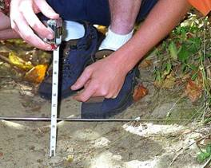
Indicator Selection: Screening Questions
Does the indicator tell you what you want to know? Is it ecologically or experientially meaningful?
Is the indicator independent of environmental variation?
Can the indicator be measured reliably?
Is the indicator responsive to manage - ment action within a reasonable time frame?

Slide 8
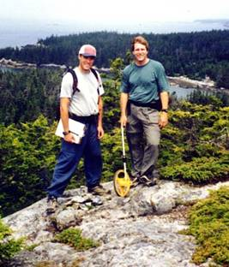
Indicator Selection: Screening Questions
Does the indicator act as an early warning, alerting you to deteriorating conditions before unacceptable change occurs?
Can the indicator be measured with minimal impact to the resource or the visitor’s experience?
Can the indicator provide information worth the time and cost required?

Slide 9
Indicator Selection: Screening Criteria
Primary Criteria | Secondary Criteria
Specific | Easy to train for monitoring
Objective | Cost-effective
Reliable and repeatable | Minimal variability
Related to visitor use | Responds over a range of conditions
Sensitive | Large sampling window
Resilient | Availability of baseline data
Low-impact
Significant | (Source: VERP Handbook, 1997)

Slide 10
Trail Indicators
Selected from a review of the scientific and management literature.
LAC/VERP frameworks typically include a small number of indicators, far fewer than those shown in the following lists.
Indicator assessment/monitoring methods need to be considered during the indicator selection process.

Slide 11
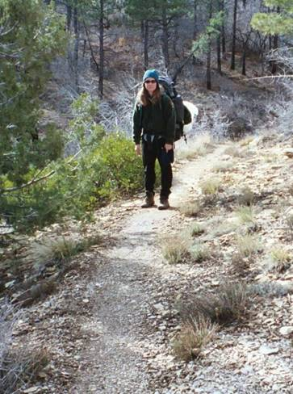
Forms of Trail Impacts
Informal trails (number, length, condition)
Trail widening
Soil erosion
Trail muddiness

Slide 12
Trail Indicators
Monitoring approaches must be considered in selecting indicators and setting standards. Two common types:
Problem Assessment: Assess location and lineal extent of all occurrences of pre-defined tread impacts (e.g., eroded or muddy sections).
Point Sampling: Assess tread conditions through individual measures of indicators at sampling points.

Slide 13
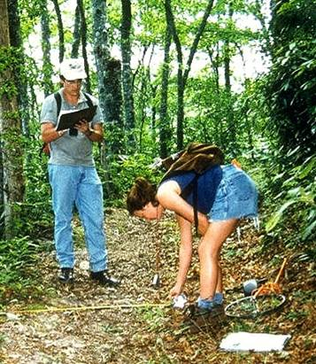
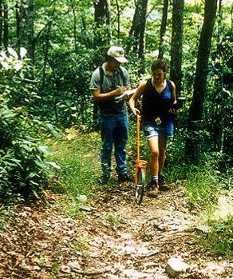
Trail Assessment Survey Types
Point Sampling
Problem Assessment

Slide 14
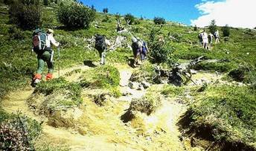
Common Trail Indicators
Soil Erosion
Cross Sectional Area (sq ft) ^{PS}
Maximum Incision (in) ^{PS}
Excessive Erosion (# ft/mi, lineal ft, % of trail length) ^{PA}
I₁
I₂
I₃
I₄
I₅
I₆
T₁
T₄
T₆
T₂
T₃
T₅

Slide 15
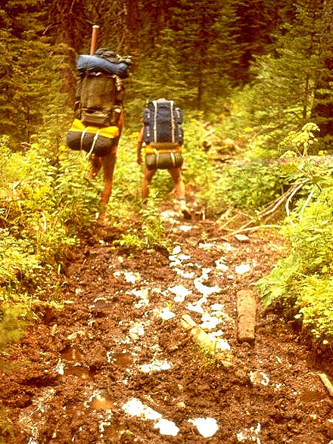
Common Trail Indicators
Tread Muddiness
Muddiness (% of tread width) ^{PS}
Excessive Muddiness (# ft/mi, lineal ft, % of trail length) ^{PA}
Tread Width
Tread Width (ft) ^{PS}
Excessive Width (# ft/mi, lineal ft, % of trail length) ^{PA}

Slide 16
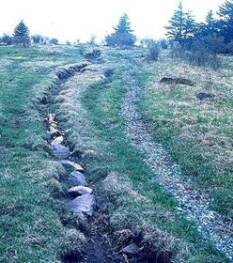
Common Trail Indicators
Multiple Treads
Multiple Treads (# at sample points) ^{PS}
Multiple Treads (# ft/mi, lineal ft, %) ^{PA}
Visitor-Created Trails
Informal Trails (#, #/mi, lineal extent, % of formal trail miles)
Other concerns related to informal trails: density, proximity to sensitive resources, and condition

Slide 17
What Are Indicator Standards?
What are indicator standards and why do we use them?
Indicator Standards - Measurable statements that define minimally acceptable conditions.
Standards narrow the focus of management from broad, qualitative statements of management intent to specific statements of desired conditions that provide a basis for decision making.

Slide 18
What Are Indicator Standards?
Standards reflect desired conditions. Standards:
Are specific and achievable.
Describe ends (desired resource and social conditions) rather than means (management actions).
Standards are established for setting attributes that reflect degree of naturalness or that influence experience quality.
Setting attributes must be subject to management control. For example, a standard could be written for encounter rates but not for solitude or satisfaction, which are direct attributes of the experience.

Slide 19
What Are Indicator Standards?
Standards quantitatively specify a limit on the amount of change that will be tolerated.
Standards define the compromise between resource/visitor experience protection and access to recreational opportunities, i.e., they represent an explicit trade-off between two conflicting goals.
Standards are statements of minimally acceptable conditions (thresholds of acceptability). They define the point past which conditions become unacceptable, they do not define desired or unacceptable conditions.

Slide 20
Characteristics of Good Standards
Quantitative: Measurable.
Time or Space-Bounded: Expressed as “x”/day or “y”/unit area.
Expressed as a probability: Allows flexibility when needed for random or peak-use events.
Impact-Oriented: Focus on impacts, not on management actions (e.g., conditions, not # of visitors)
Realistic: Focus on attainable conditions.

Slide 21
Interpreting Standards
Standards are absolute limits, not just warnings.
Violation of standards should not be tolerated.
Tolerances can be written into standards in the form of probabilities. e.g., <10 encounters/day on 90% of the summer use season days. Such standards allow for more crowded conditions during a few peak use weekends.
When a standard is exceeded managers should implement actions to avoid compromising resource or experience conditions further.

Slide 22
Interpreting Standards
Standards are value-based management decisions.
Setting standards ultimately involves inherently subjective and value-based management decisions.
It is desirable that standards be developed through a collaborative process with input from stakeholders.
Public involvement and/or participation is preferred but managers have been delegated the authority and responsibility for making final decisions.

Slide 23
Setting Standards: Role of Science
Science can characterize the range of indicator conditions to allow evaluation of draft standards. Indicator data may also be examined to look for “thresholds”:
e.g., level of vegetation disturbance beyond which annual recovery cannot occur.
Standards can be informed by science but cannot be derived from science.
Standards are evaluative, they must consider resource impacts in the context of the recreational “costs” of not exceeding them.

Slide 24
Types of Standards
Maximum Condition - Specifies maximum acceptable indicator value at a single site.
e.g., trail width < 10 in
Aggregate Condition - Specifies maximum acceptable aggregate indicator value for a group of sites.
e.g., Sum of informal trail lengths in travel zone x < 3.5 mi
Rate of Change - Specifies maximum acceptable rate of change between monitoring cycles. e.g., increase in trail incision < 0.25 in/yr

Slide 25
Examples of Standards: Trails
Potential Indicators Examples of Standards
Informal trails/unit area <2500 ft/5 acres
Increase in informal trail lengths < 100%
Trail width <4 ft
Trail width >3 ft <500 ft/mi
Soil erosion <2 ft
Soil erosion > 2 ft <300 ft/mi
Trail muddiness <5% of trail length
Note: Standards are generally set and vary by zones.

Slide 26
Examples of Standards: Campsites
Potential Indicators Examples of Standards
Campsites/unit area <12 sites/5 acres
Campsite size/site <1800 ft²
Campsite size/unit area <8000 ft²/5 acres
Increase in campsite size < 100%
Soil exposure/site <1200 ft²/campsite
Soil exposure/unit area <6000 ft²/5 acres
Tree damage <10 damaged trees/site
Fire sites <3/site
Note: Standards are generally set and vary by zones.

Slide 27
Conclusions
Scientific literature and research can help identify alternative resource indicators and provide objective measurement methods
Scientific surveys can describe the distribution of values for each indicator – illustrating outcomes of alternative standards.
Science cannot be used to identify indicator standards. Standards are evaluative, they represent tradeoffs between competing management objectives.

