Slide 1
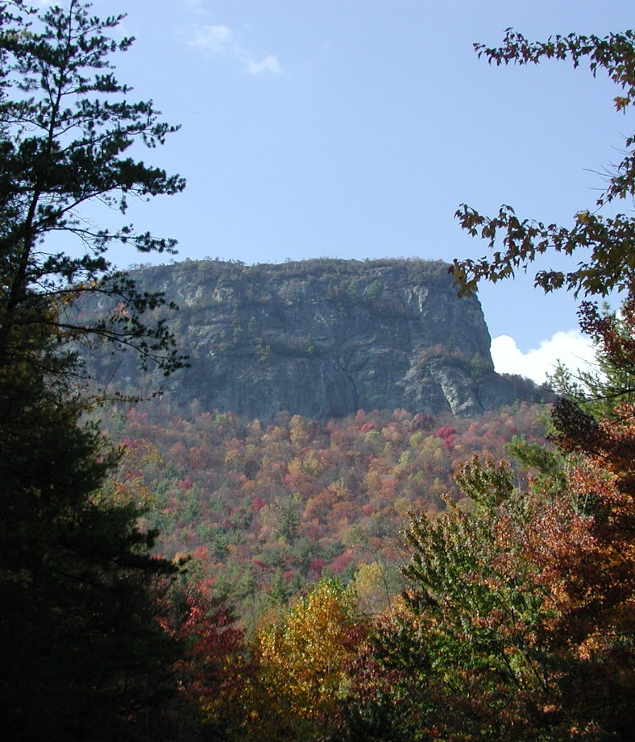

Managing Visitor Use in Wilderness
Arthur Carhart National Wilderness Training Center
Greg Philipp
Pisgah National Forest
Grandfather Ranger District
109 East Lawing Drive
Nebo, NC, 28761
828-652-2144
Welcome to the
Linville Gorge Wilderness

Slide 2
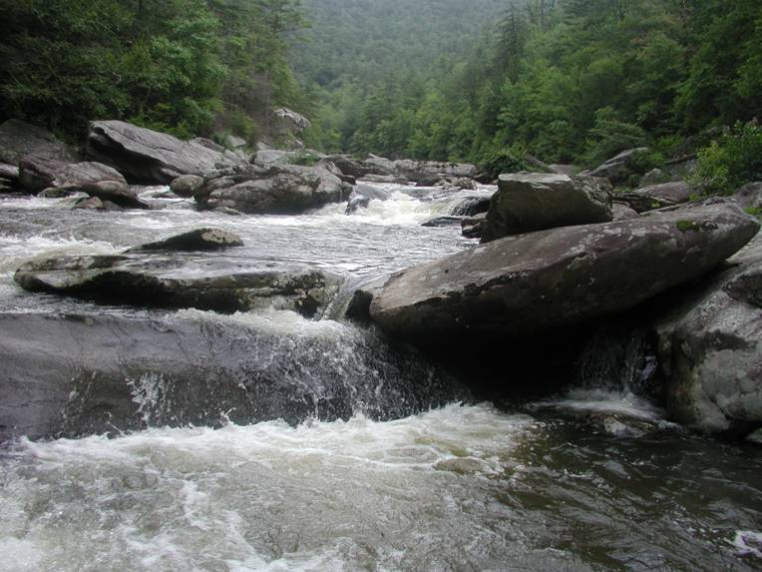
Linville River

Slide 3
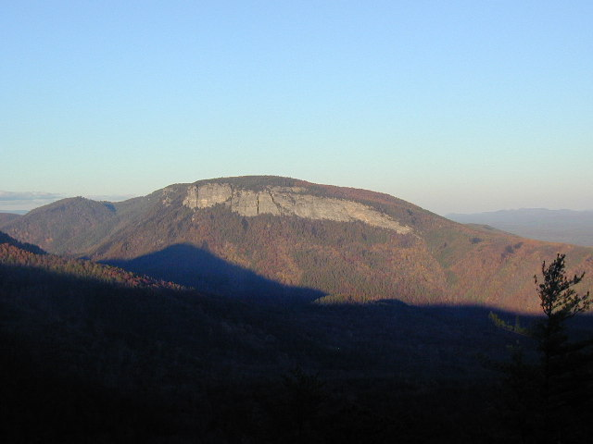
Shortoff Mountain

Slide 4
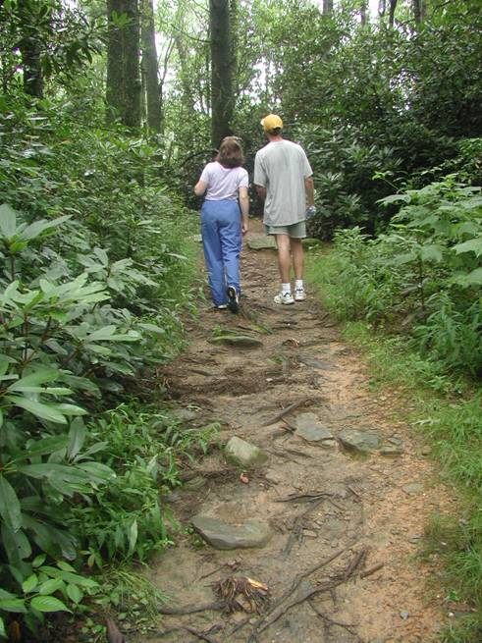
Day Hikers

Slide 5
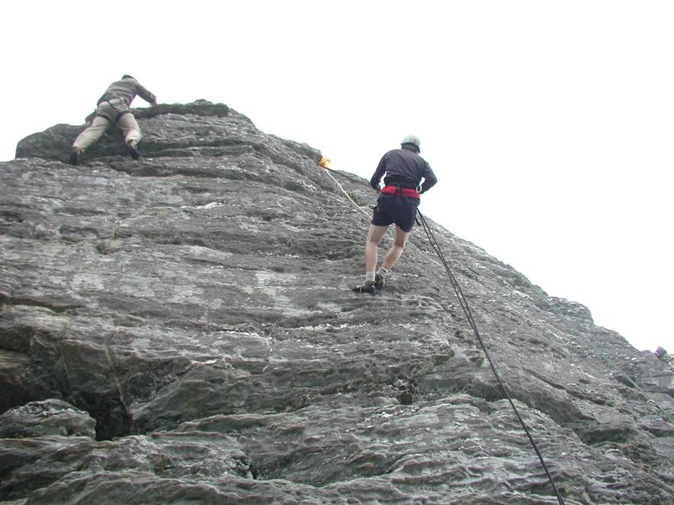
Climbers

Slide 6
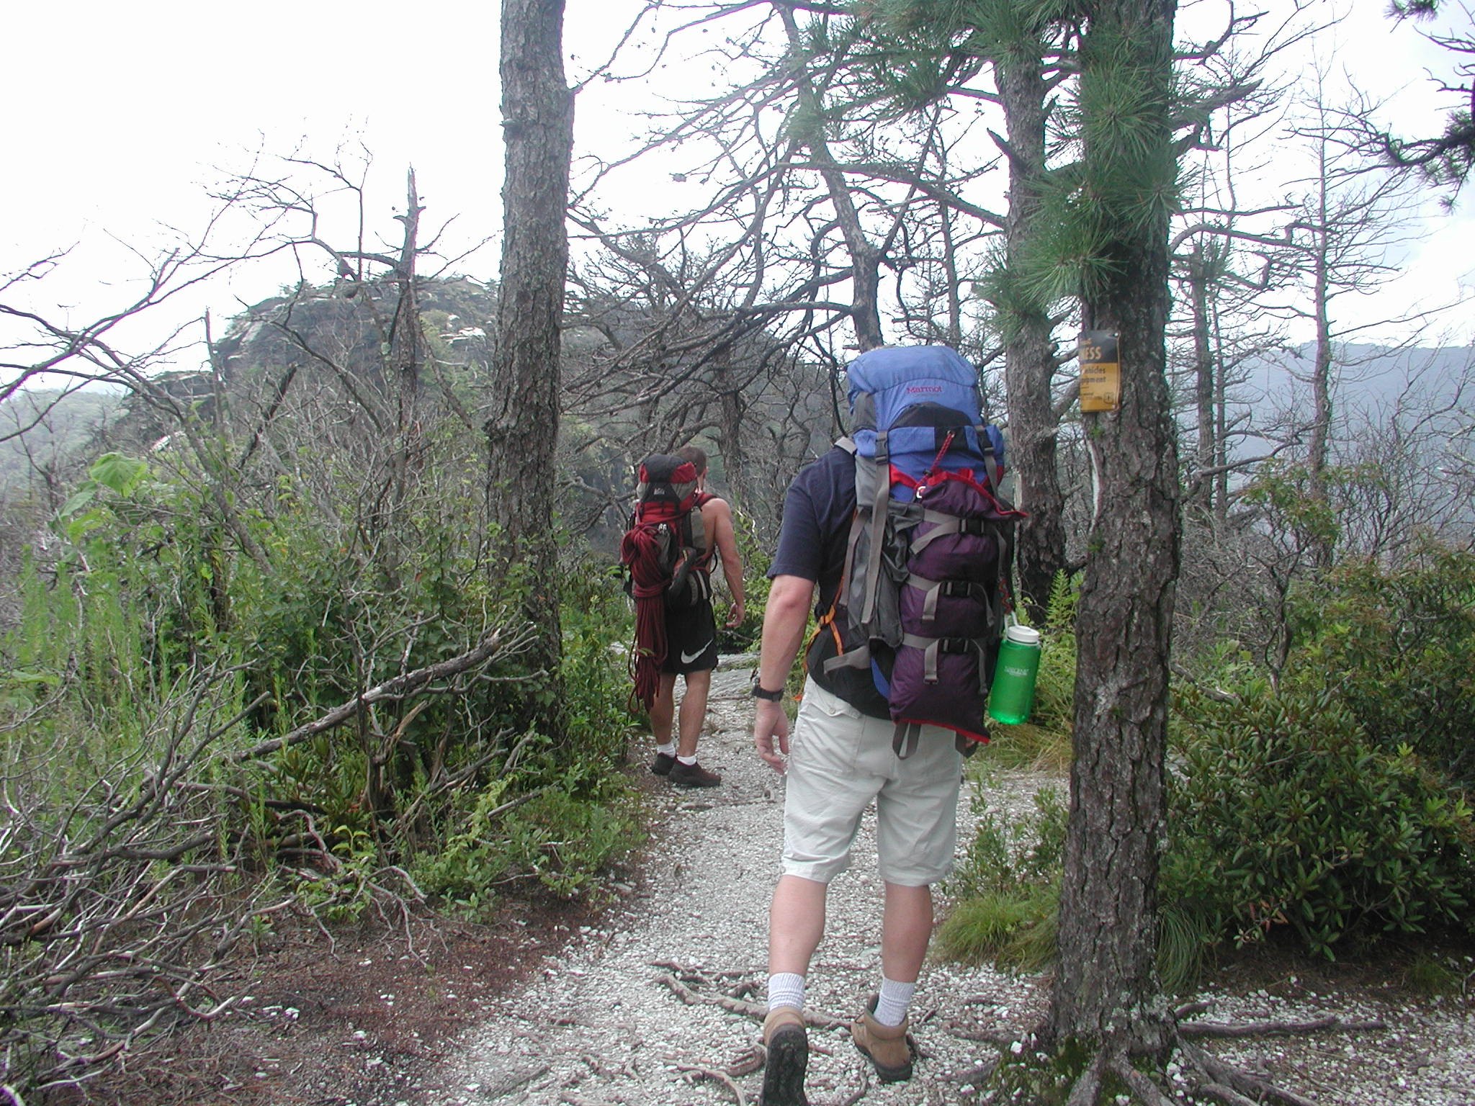
Backpackers

Slide 7
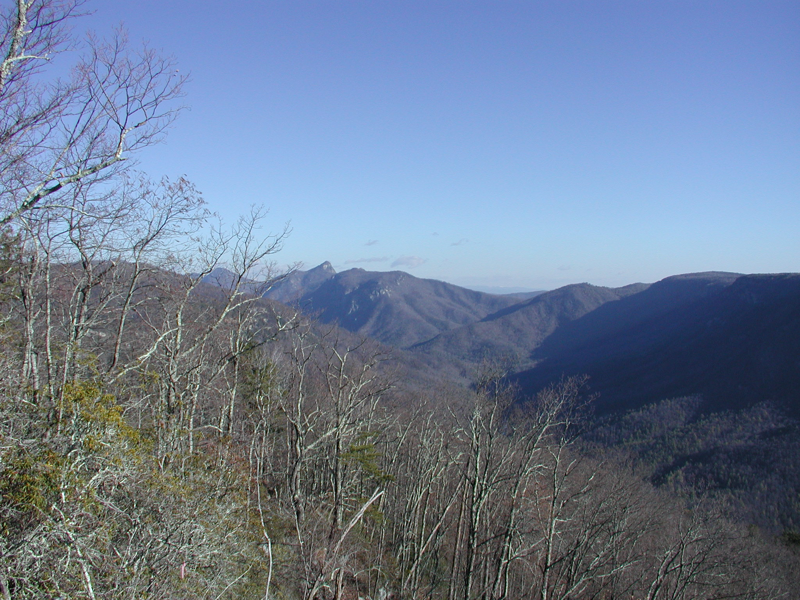

Slide 8
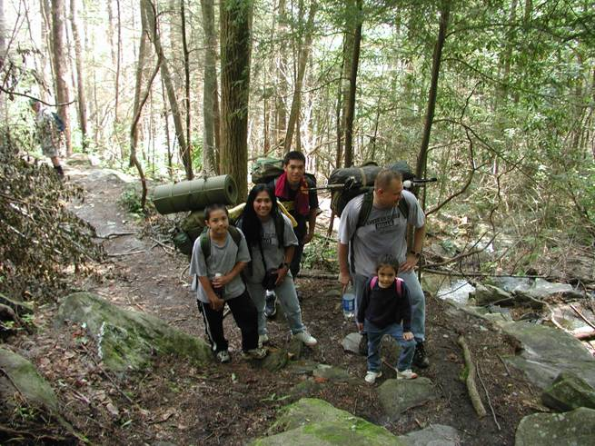

Slide 9
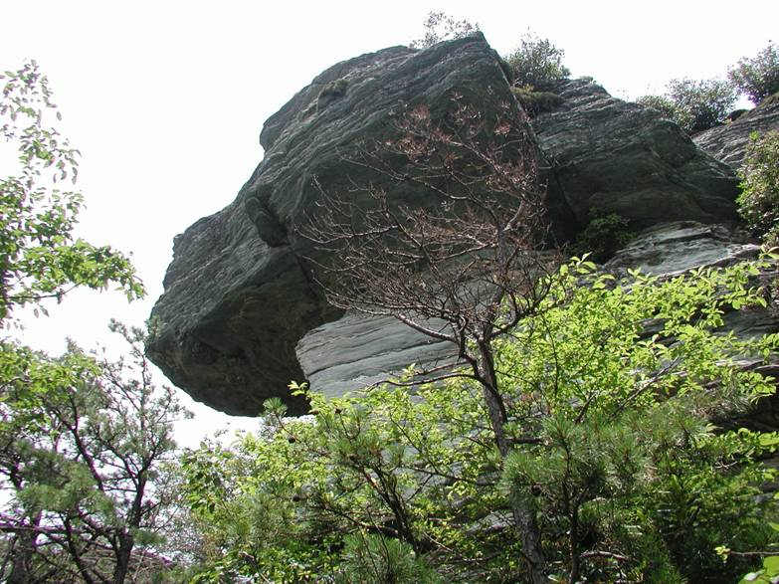

Slide 10
Brief History of Linville Gorge
Linville Gorge Wild Area established in 1950 comprising 7,600 acres established under the authority of Regulation U-2 of the Secretary of Agriculture.
7,575 acres established as Linville Gorge Wilderness in 1964 under original Wilderness Act.

Slide 11
History continued
4,427 acres added under North Carolina Wilderness Act for present total of 12,002 acres.
First Wilderness Permit plan approved in 1974.
Permit plan revised in 1984 to current system.

Slide 12
Home to Proposed, Threatened, Endangered and Sensitive Species
Peregrine Falcon
Black Vulture
Olive-sided Flycatcher
Allegheny Woodrat
Redeye Bass
Eastern Creekshell
Brook Floater

Slide 13
Proposed, Threatened, Endangered and Sensitive Species continued
Plants: Amelachier sanguinea, Campanula aparanoides, Cephaloziella obtusilobula, Dicentra eximia, Drepanolejeunea appalachiana, Fothergilla major, Hudsonia Montana, Liatris Asper, Liatris Helleri, Monotropsis odorata, Minuarita, greonlandica, Plagiochila sullivantii var. spinigera, Scripus ceaspitosus, Sphagunum pylaesii

Slide 14
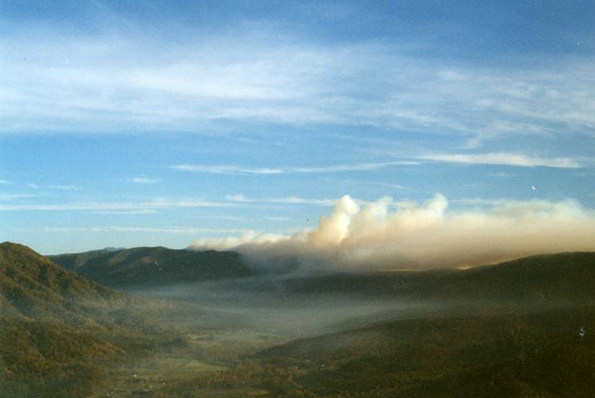
Fire in Linville Gorge

Slide 15
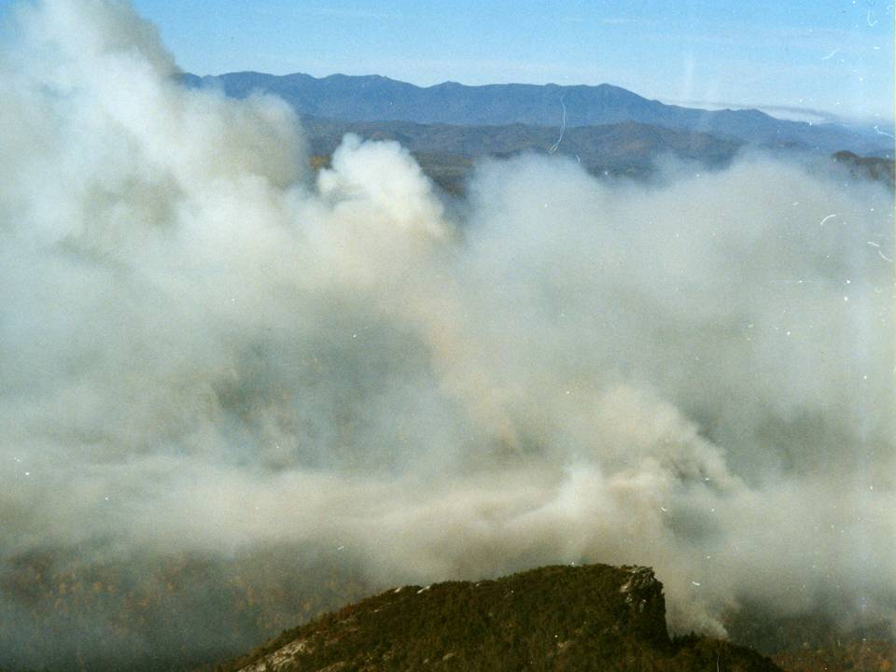
1865 Catastrophic Crown Fire
1915 Crown Fire
1950s Widespread ground fire
Combination Ground Fire
with short crown runs

Slide 16
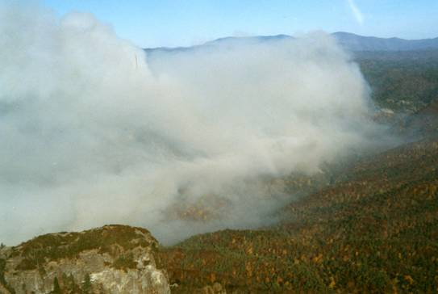
10,120 acres burned from unattended campfire in Fall 2000

Slide 17
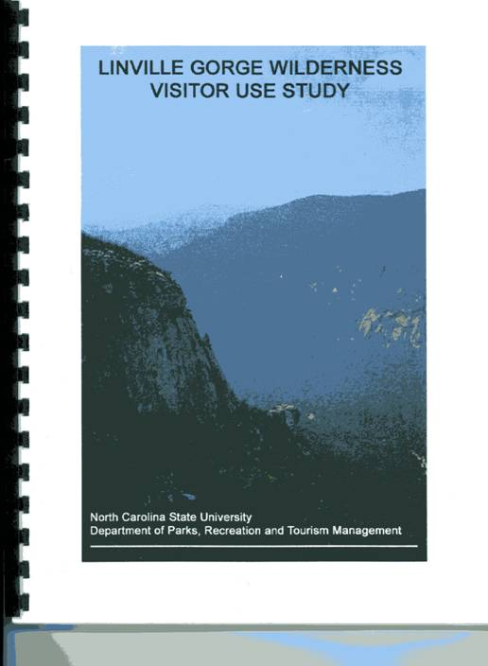
Research…
5-10 requests annually
- Bird Communities
- Snails
- Exotic Invasives

Slide 18
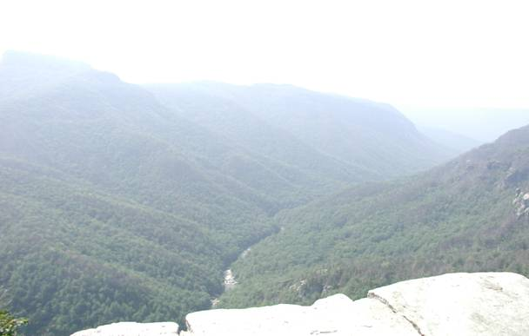
The Linville Gorge’s protected status since 1950 makes it an ideal setting for research due to its unmanaged condition.

Slide 19

Visitor Use Study
Overall, happy with visit
Resource damage and negative visitor contacts biggest detractor
Users responded as willing to pay a fee for permit if used for management of Gorge

Slide 20
Evaluating the Effectiveness of Monitoring Biophysical Conditions in Wilderness
A National Committee is looking at Monitoring Protocols in Wilderness Areas
Linville Gorge in study from October 2004 through Spring 2005
Emphasis placed on campsites and trails

Slide 21
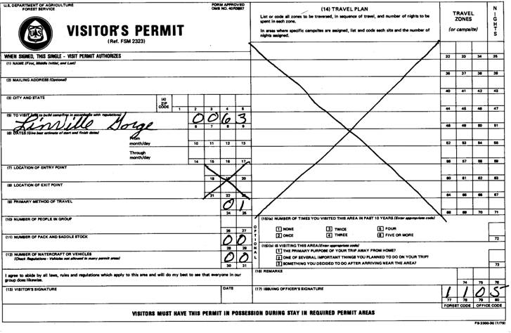
Linville Gorge Wilderness Permit System
Only Wilderness Area in NC with Permit System

Slide 22
Permit System
In 1974 the original purpose of the wilderness entrance permit plan was to specify how certain coordinating requirements will be implemented in order to preserve, maintain, or enhance the wilderness resource of Linville Gorge Wilderness.

Slide 23
1974 Permit Plan
Issued on a daily basis with 130 people allowed in the wilderness at one time.
80 on West side of Linville River
50 on East side
No more than 30 permits for camping

Slide 24
1974 Permit Plan continued
Permits obtained at the Ranger Station by phone, mail, or in person
Obtain permit up to 6 months in advance
Stay limited to 3 consecutive days and 2 nights
Permits controlled by the District Office
Permits enforced by District Office

Slide 25
1984 Wilderness Permit System
Change was designed to make it easier for the public to visit the wilderness area
Requires permits for camping only on weekends and holidays during the period of May 1 through October 31
Not an Entrance Permit
Permits not required November 1 through April 30 when use is normally light

Slide 26
1984 Permit System continued
Reservations accepted on first come – first served basis
Permits may be obtained up to one month in advance
Group size is limited to 10
Maximum length of stay is 3 consecutive days and 2 nights

Slide 27
1984 Permit System continued
Permits can be obtained at the Ranger Station or at the Linville Gorge Information Cabin
50 maximum permits are allowed for any period of time.
35 permits from the office, 15 from the cabin
Available for outfitter/guides: rock climbing Monday – Thursday only
Same system still in use today

Slide 28
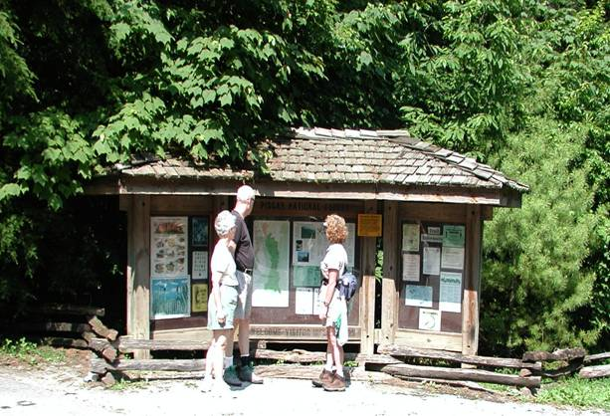
Visitor Use – Linville Gorge Information Cabin

Slide 29
Number of visitors through Cabin
FY2000: 29,000 (7 days a week)
FY2001: 29,700 (7 days a week)
FY2002: 29,800 (7 days a week)
FY2003: 21,500 (7 days a week)
FY2004: 18,000 (5 days a week)

Slide 30
Total Number of Permittees
April 1 – October 31 2000: 1250 people
April 1 – October 31 2001: 2025 people
April 1 – October 31 2002: 1465 people
April 1 – October 31 2003: 1360 people
April 1 – October 31 2004: 1505 people

Slide 31
The District depletes all permits on peak weekends and most holidays. Also seasonal variations such as leaves changing color and rhododendron blooms deplete permits. Forecasted nice weather has the same effect.

Slide 32
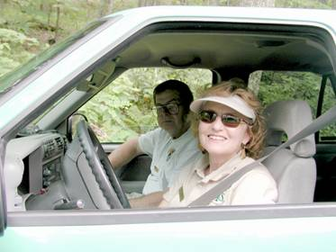
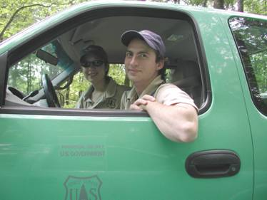
Enforcement of Permit System

Slide 33
Enforcement of Permit System
Volunteers as Wilderness Rangers
Seasonal Wilderness Rangers
College Interns
YCC crews with District Personnel
Research Students
Permanent Full-Time Employees with duties as Wilderness Rangers

Slide 34
Recreation in Linville Gorge
As with most Wilderness Areas, the Linville Gorge is “loved to death.”
Day hikers, Backpackers, Fisherman, Hunters, Climbers, Leaf Lookers all compete for the same resource.

Slide 35
Problems encountered in the Linville Gorge
Rough terrain and unprepared visitors provide a very challenging experience.
Search and Rescues occur often in peak months
Access is limited
Highly impacted campsites and litter
Relatively small area close to urban centers

Slide 36
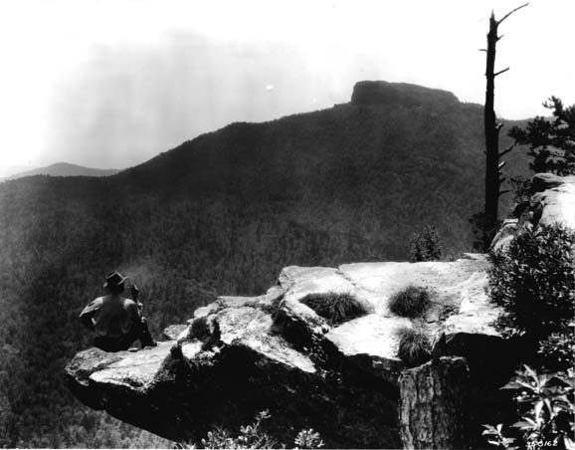

Slide 37


Slide 38
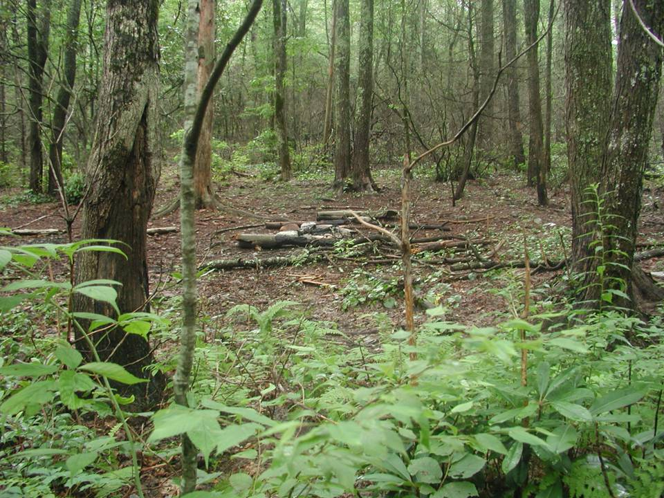

Slide 39
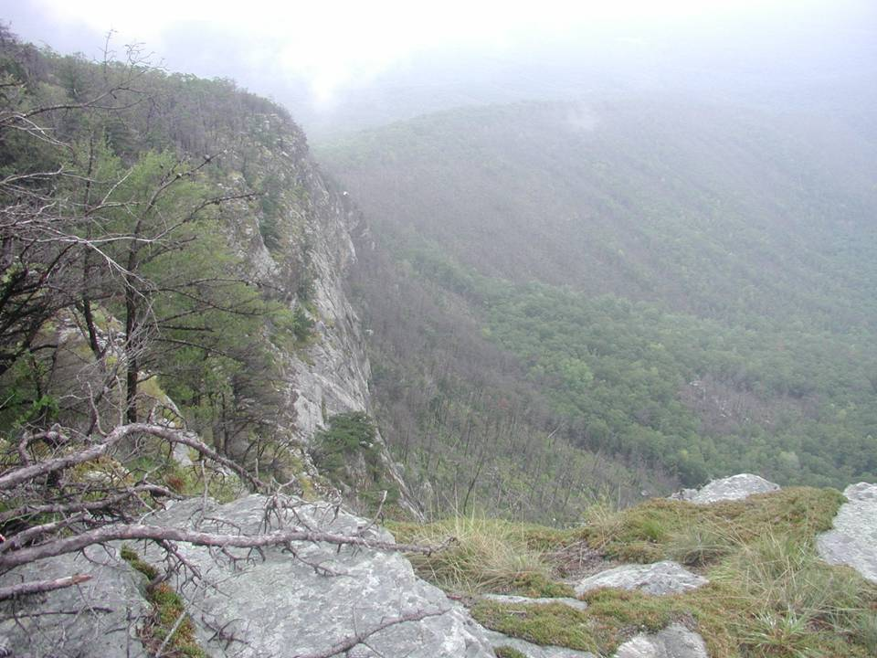

Slide 40
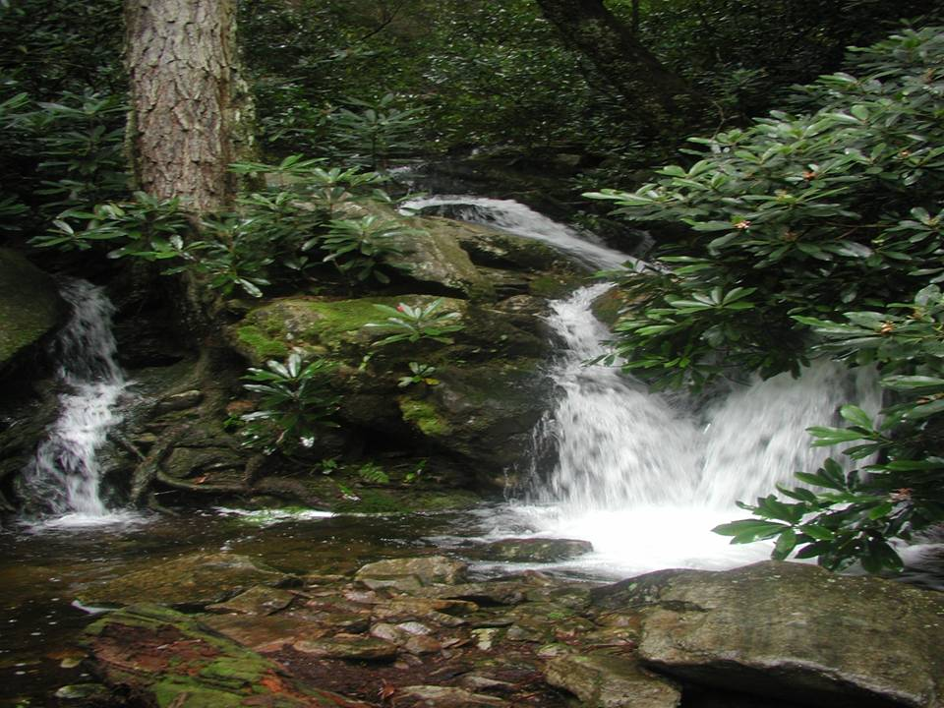

Slide 41
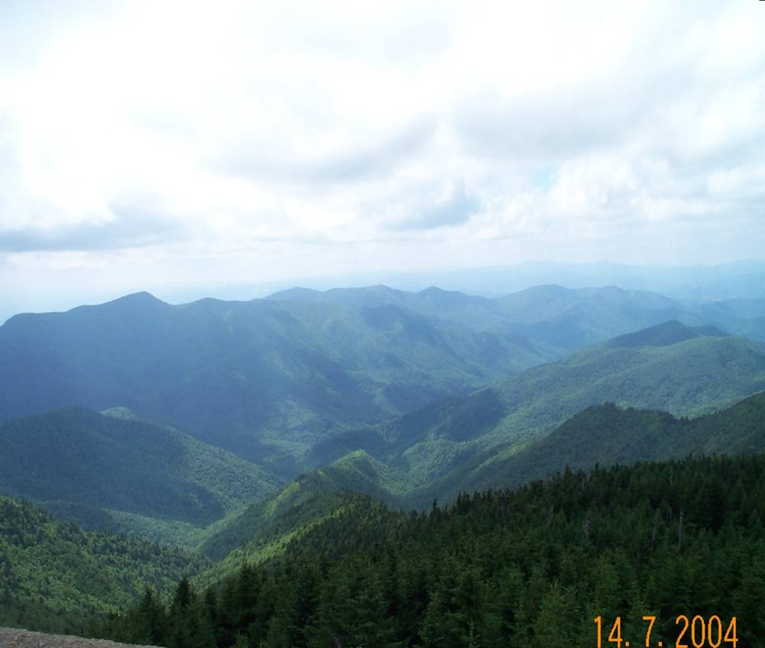
Thank You

Slide 42
Questions?
gphilipp@fs.fed.us
828-652-2144

