Slide 1
Inventory & Monitoring of Visitor Use and Experiences
Troy Hall
Visitor Use Management
Missoula, MT
April 2005

Slide 2
What is inventory?
What is monitoring?
Why do we do them?
Notes:
Inventory – develop EA; identify supply & demand; prioritize workforce; develop information base; be proactive;
Monitory – evaluate effects of actions; trigger actions

Slide 3
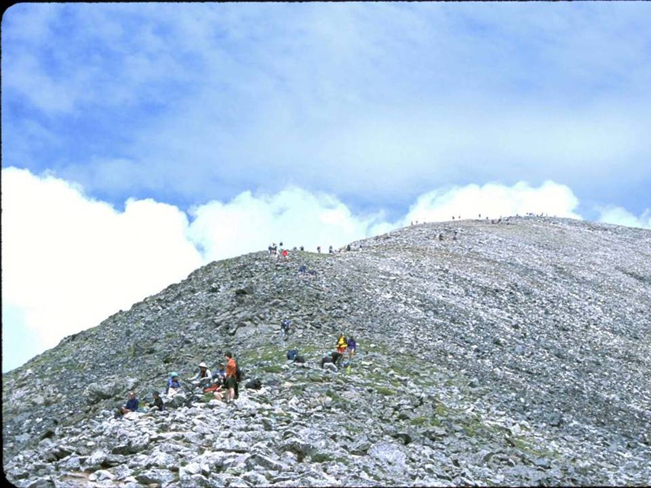
Social Impacts
Conflict Crowding
Solitude
“Experience Quality”

Slide 4
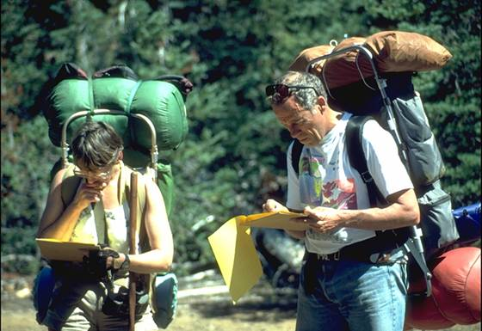
How do you decide if you are providing high quality experiences?

Slide 5
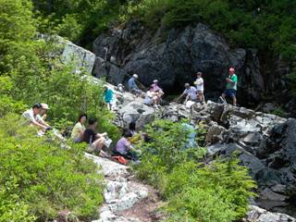
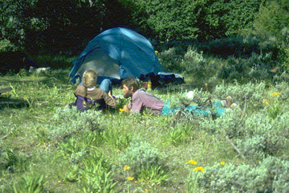
Wilderness Experience:
“Solitude or a primitive and unconfined type of recreation”

Slide 6
What conditions do you monitor?
What conditions could you monitor to tell you about status and trends?

Slide 7
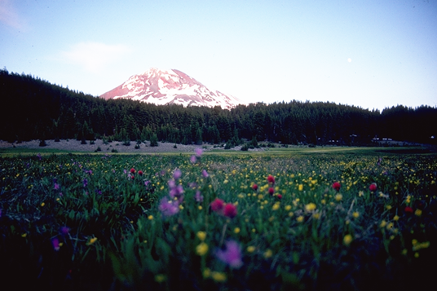
Do we monitor an indicator or the experience itself?

Slide 8
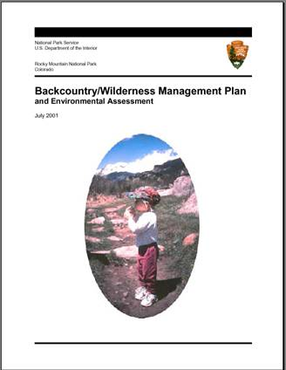
RMNP Backcountry/Wilderness Plan
“Visitors…should have the opportunity for a variety of personal outdoor experiences, ranging from solitary to social”
“The visitor experience should relate intimately to the splendor of the wilderness resource of RMNP”
Solitude and challenge are specifically emphasized; freedom discussed a little

Slide 9
White River NF Plan
PRISTINE
“Opportunities for solitude and self-reliance are excellent”
“No more than two other parties encountered during cross-country travel per day on 80% of the days during each use season”
“No other party within sight or sound of campsites should be encountered on 80% of the days in the summer and fall”
PRIMITIVE
“Moderate to high occasions of solitude while traveling and camping outside the trail corridors”
“Moderate-to-high level of risk and challenge”
“No more than 12 parties encountered per day on trail 80% of the time”
“No more than 6 campsites in sight/sound 80% of the days”

Slide 10
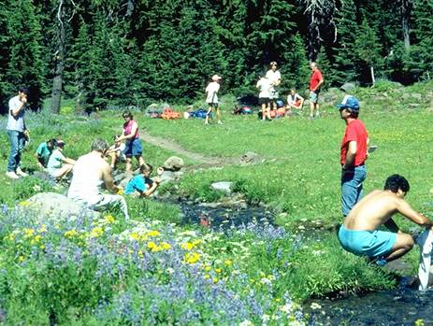
White River NF Plan
SEMI-PRIMITIVE
“Encounters with other users may be frequent”
“low-to-moderate opportunities for solitude”
No more than 20 other parties encountered on trail 80% of the time”
No standard for camps in sight/sound

Slide 11
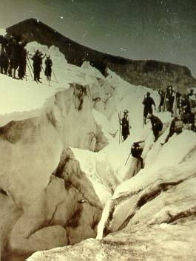
Mt. Hood Forest Plan Social Standards
“Encounters with other groups shall be limited to no more than ten groups per day in semi-primitive areas, and no more than six groups per day in primitive areas, during 80 percent of the primary recreational use season.”

Slide 12
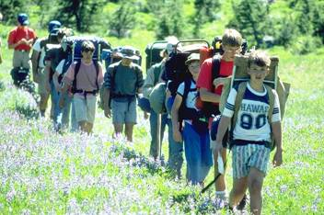
Selecting indicators – what to monitor
Not all indicators are equally useful
Valid (significant), Relevant
Measurable/Reliable
Responsive

Slide 13
Selecting social indicators
3 main choices:
Document use trends
Observe visitors
Talk to visitors

Slide 14
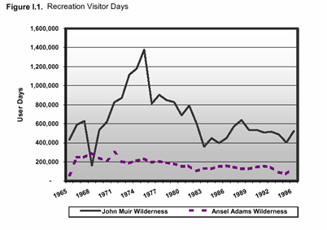
1. Documentation of Use Levels
Often done for overnight, but not day
may require compliance checking
Info can be quite valuable
Can be costly
John Muir/Ansel Adams and Dinkey Lakes FEIS

Slide 15
1. Documentation of Use Levels
Many handbooks and examples are available
Pros and cons of use measurement systems

Slide 16
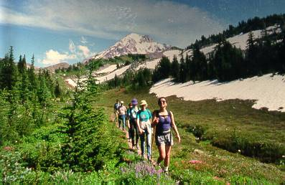
2. Observing Visitors
Documentation of encounters
Other observations?

Slide 17
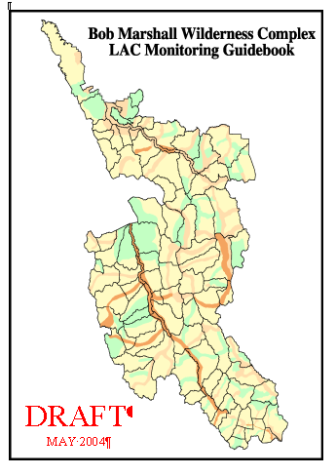

Slide 18
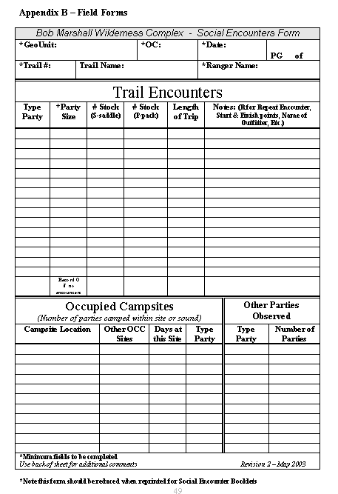

Slide 19
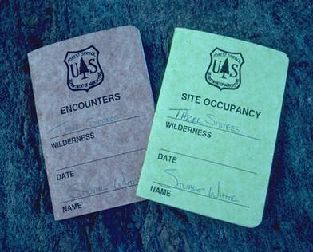
Monitoring Encounters - Considerations
Source of data?
Sampling
Timing
Duration
Locations
Training/standardization
Definitions
Additional data
Concurrent data on use levels
Notes:
Definitions:
Groups or people
Seen more than once?
How close to count?

Slide 20
Monitoring Encounters – Using the Data
Organization by location
Standardizing time frame
Analysis by day of week

Slide 21
Shenandoah – Ranger Data on Encounters

Slide 22
Shenandoah – Ranger Data on Encounters

Slide 23
Shenandoah – Ranger Data on Encounters

Slide 24
Shenandoah – Ranger Data on Encounters

Slide 25
Encounter Rates, Mt. Hood

Slide 26
3. Talk to Visitors
Less common as a form of monitoring
Often used to help in setting standards

Slide 27
Shenandoah- Visitor Responses
 | Encounters Per 8 Hours
Cedar Run | 27.5
Jones Run | 9.2
Upper Hazel | 28.6
Notes:
Note that visitor recalled encounters are much lower than for rangers

Slide 28
Shenandoah- Visitor Responses
 | Encounters Per 8 Hours | % Felt Solitude | % Time In Solitude
Cedar Run | 27.5 | 87 | 84.5
Jones Run | 9.2 | 100 | 90.4
Upper Hazel | 28.6 | 100 | 93.4

Slide 29
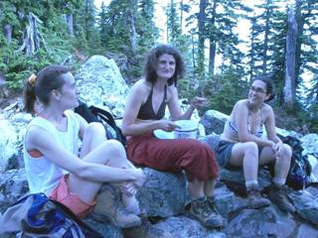
Talking to Visitors - Issues
Obtaining visitor input
OMB clearance
What conditions to ask about
How to ask specific questions
Which people to survey
Identifying proper indicators
For many visitors, there’s a weak correlation between encounters and solitude
How to use the data
Notes:
Calwild.org

Slide 30
Coping with lack of resources
Volunteers?
Staggered observations?
Internships?

Slide 31
Update: Wilderness Monitoring Committee
Statutory qualities
Natural
Untrammeled
Undeveloped
Outstanding opportunities

Slide 32
Conclusions
Understand why you are monitoring and how you will use the data before you start
Consider the spatial and temporal scope of needed data
How important is the issue? How accurate do you need to be?
How much information do you need before you act?
Notes:
Analysis should be commensurate with potential consequences.

Slide 34
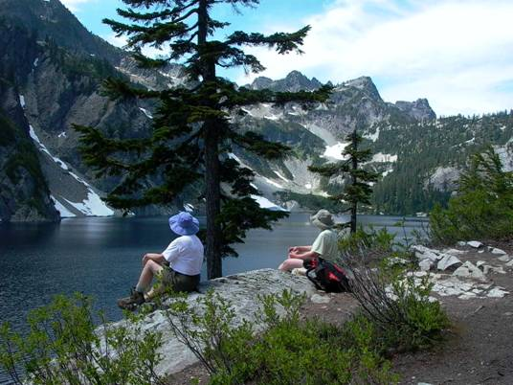
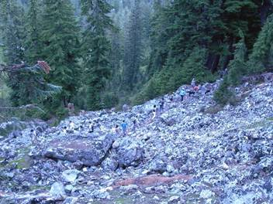
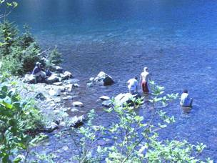
Snow Lake study

