Slide 1
Wilderness and Recreation: Why management is critical!
Wayne Freimund
Professor, Wildland Recreation Management
Chair, Department of Society and Conservation
Wayne.freimund@umontana.edu

Slide 2
Objectives
Express the growing scarcity of wilderness dependent opporttunities
Look at some societal trends in recreation that will affect wilderness
Appeal for the need to think regionally, build solid recreation management plans and protect wild experiences

Slide 3
Outline
Recreation management Imperatives
  Remembering the value of wilderness experiences
  Legal mandate for solitude or unconfined experiences
  Escalating demand
  Consider management responses
  Need for a constituency
  Situating wilderness in a regional recreational context

Slide 4
Remembering the Recreational Values of Wilderness

Slide 5
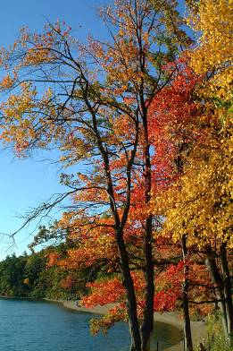
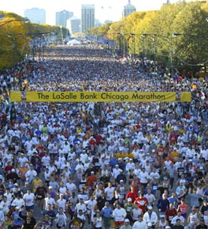
The masses of men live lives of quiet desperation Henry David Thoreau
Photographer: Ian Britton
Freephoto.com

Slide 6
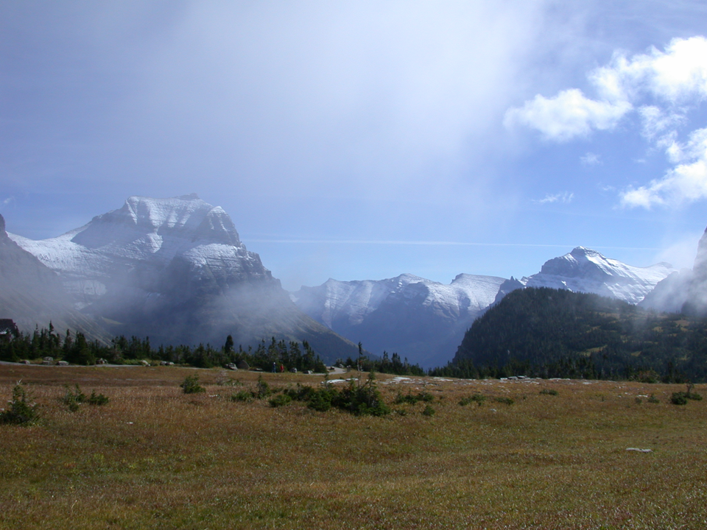
Thousands of tired, nerve-shaken, over-civilized people are beginning to find out that going to the mountains is going home: that wildness is a necessity; that mountain parks and reservations are useful not only as fountains of timber and irrigating rivers, but as fountains of life.
John Muir

Slide 7
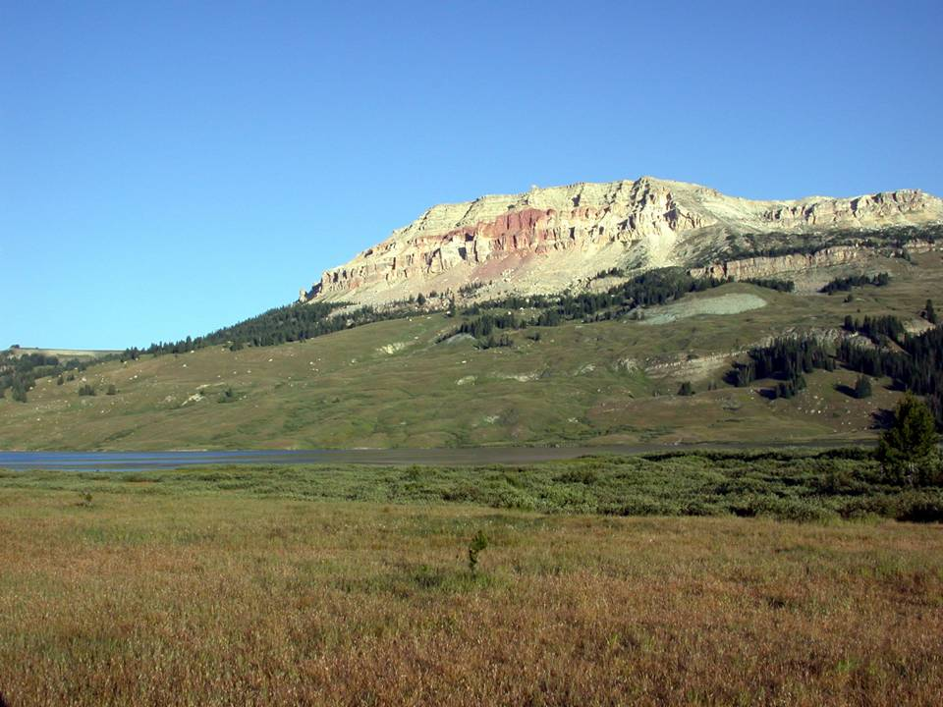
For me, and for thousands with similar inclinations, the most important passion of life is the overpowering desire to escape periodically from the clutches of a mechanistic civilization. To us the enjoyment of solitude, complete independence, and the beauty of undefiled panoramas is absolutely essential to happiness.
Bob Marshall

Slide 8
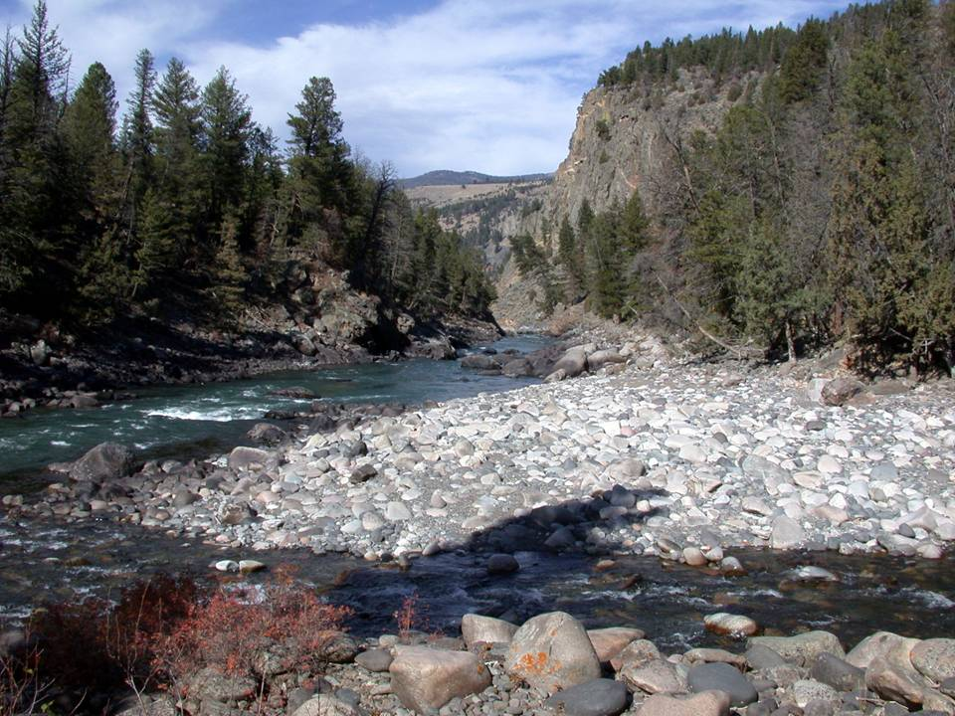
The mist was all gone from the river now and the rapids sparkled and sang. They were still young as the land was young. We were there to enjoy it, and the great machines seemed far away.
Sigurd F. Olson

Slide 9
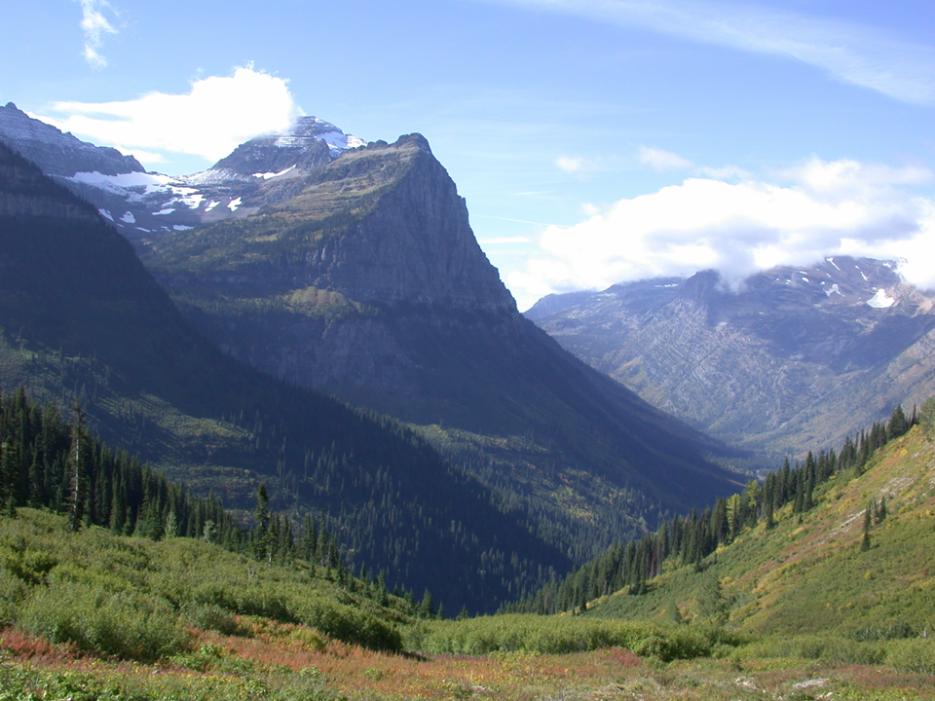
I hope the United States of America is not so rich that she can afford to let these wildernesses pass by, or so poor she cannot afford to keep them.
Margaret (Mardy) Murie

Slide 10
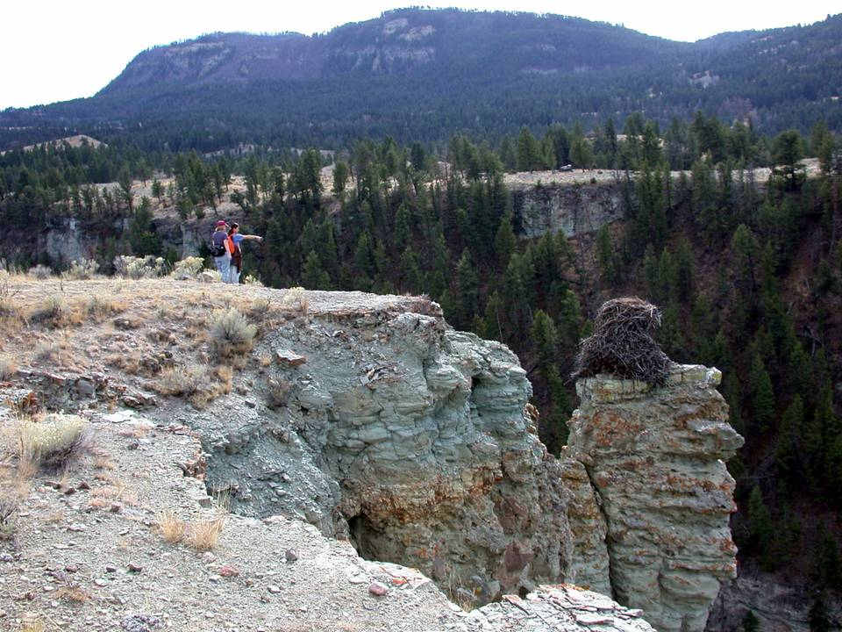
Harmony with the land is like harmony with a friend. You cannot cherish his right hand and chop off his left. Aldo Leopold

Slide 11
…. "reserved and withdrawn from settlement, occupancy, or sale under the laws of the United States, and dedicated and set apart as a public park or pleasuring-ground..." YNP act 1872
“Like ions shot from the sun, the week-enders radiate from every town, generating heat and friction as they go” Leopold 1949
“Recreation management is not a job of building roads into lovely country, but of building receptivity into the still unlovely human mind” Leopold 1949

Slide 12
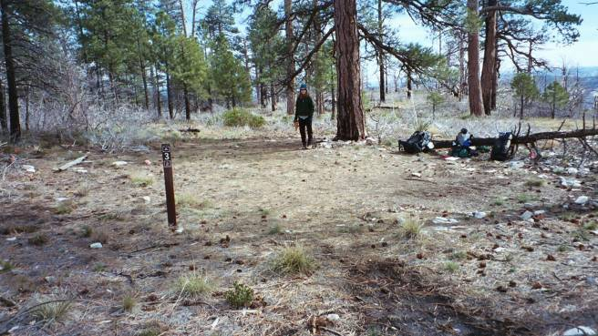
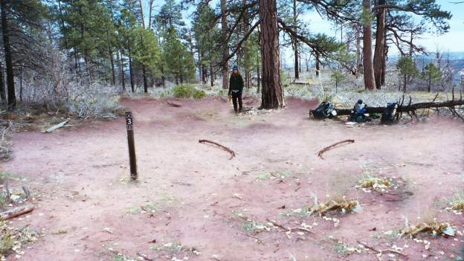

Slide 13
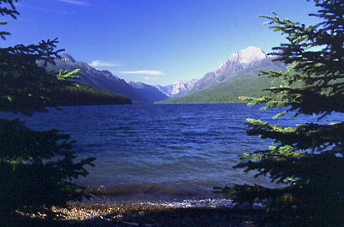
Where does Wilderness fit into the continuum of Natural Experience?
Escape
Self Sufficiency
Humility
Awe
Oneness
Quiet Contemplation

Slide 14
Remembering the legal niche of Wilderness Recreation
(1) generally appears to have been affected primarily by the forces of nature, with the imprint of man's work substantially unnoticeable;
(2) has outstanding opportunities for solitude or a primitive and unconfined type of recreation;
(3) has at least five thousand acres of land or is of sufficient size as to make practicable its preservation and use in an unimpaired condition; and
(4) may also contain ecological, geological, or other features of scientific, educational, scenic, or historical value.

Slide 15
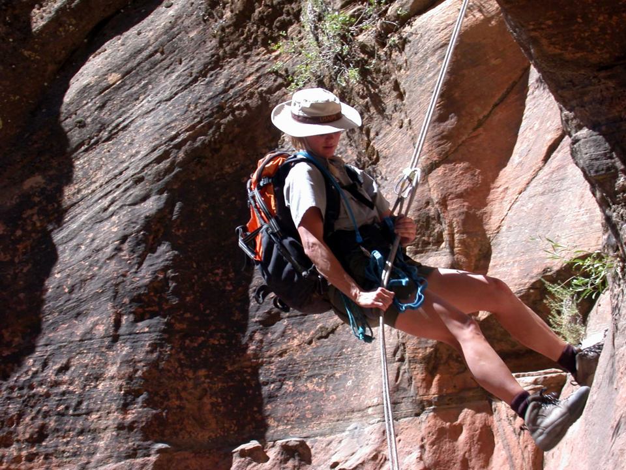
I'd rather wake up in the middle of nowhere than in any city on earth.
Steve McQueen

Slide 16
Steve McQueen is not alone: Escalating demand

Slide 17
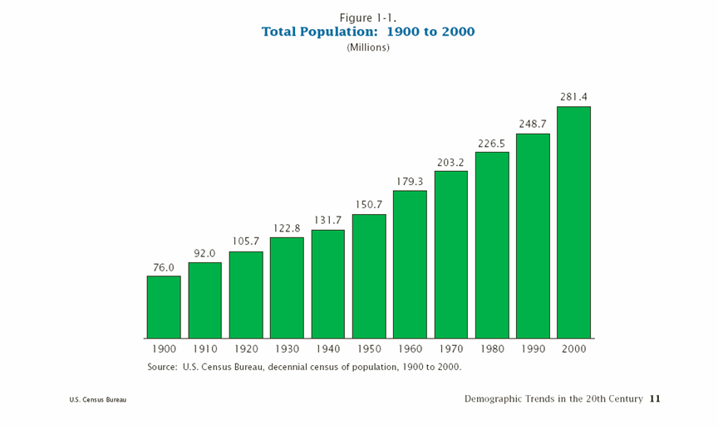
Numbers matter
Todays planning efforts
Wilderness Act debated and signed
National Park Act

Slide 18
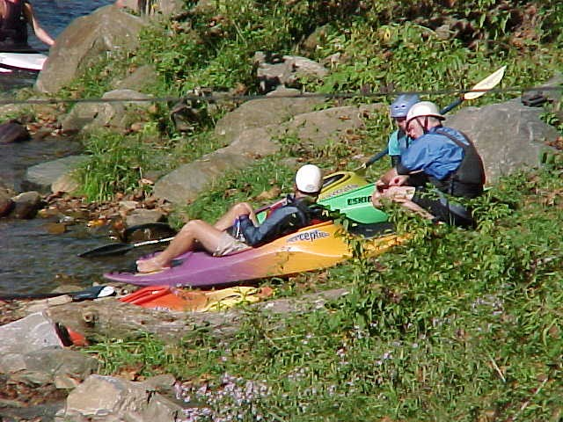
Fastest Growing One-Half, Cordell, 2000
Recent Trends
(Millions of Participants, 16 and Older)
Percent
Number Number Number Change
Activity in 1983 in 1995 in 2000 (83-2000)
Backpacking 8.8 15.2 27.9 +217.1
Hiking 24.7 47.8 69.8 +182.6
Snowmobiling 5.3 7.1 10.7 +101.8
Walking 93.6 133.7 172.3 + 84.1
Downhill Skiing 10.6 16.8 19.3 + 82.1
Off-Road Driving 19.4 27.9 35.0 + 80.4
Bird Watching 21.2 54.1 38.2 + 80.2
Swimming/river, lake,
or ocean 56.5 78.1 94.8 + 67.8
Cross-country Skiing 5.3 6.5 8.8 + 66.0
Boating (overall) 49.5 58.1 76.7 + 54.9
Bicycling 56.5 57.4 86.2 + 52.6

Slide 19
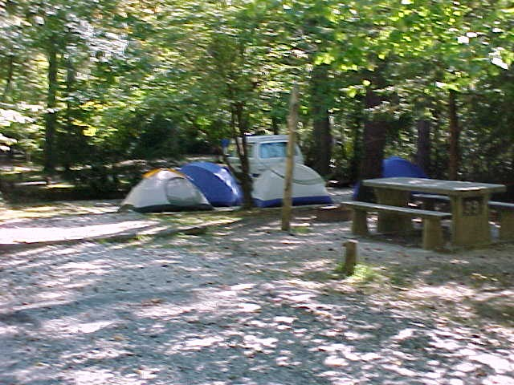
The Rest of the Story
Recent Trends
(Millions of Participants, 16 and Older, Cordell, 2000)
Percent
Number Number Number Change
Activity in 1983 in 1995 in 2000 (83-2000)
Camping – Primitive Area 17.7 28.0 25.8 +45.8
Horseback Riding 15.9 14.3 23.1 +45.3
Motorboating 33.6 47.0 48.2 +43.5
Picnicking 84.8 98.3 118.3 +39.5
Camping - Developed Area 30.0 41.5 41.3 +37.7
Sightseeing 81.3 113.4 108.6 +33.6
Fishing 60.1 57.8 67.9 +12.9
Sailing 10.6 9.6 10.9 + 2.8
Water Skiing 15.9 17.9 15.7 - 1.3
Hunting 21.2 18.6 20.9 - 1.4

Slide 20
Counties with Wilderness Acreage,
Cordell, 2000

Slide 22
So what is going on with Demand?
More people
Who are more active
Living closer to Wilderness
Does this just mean more of the same?

Slide 23
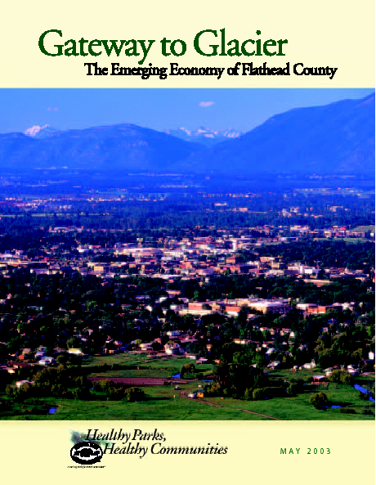
Flathead country grows 26% in 90’s
Jobs by 50%
1000 new business’
Per capita income up 13%
Environment is chief asset and Glacier the top draw
Indicative of western trend

Slide 24
How are things Changing in Visits and Visitors?
Whitmore, Borrie and Watson (2004) (compared 70, 82 04)
Visitors in 04 were more likely to be :
  Older
  Slightly more hikers from out of state
  Repeat visitors to the Bob and other Wilderness areas
  Make more visits and spend more days
  Take shorter trips, encounter more people but feel about the same about conditions

Slide 25
Industry is Organized: Proposed Recreation Policy
Proposed National Recreation Policy Act
Calls for a national recreation strategy
Moves recreation up the priority list in federal land management to a primary objective
Increased partnerships (public-private)
Increase supply of frontcountry recreational trails and facilities
Allow more private capitol to be infused into facility development
This represents pressure and leadership coming from outside of the agencies
If we move toward another Mission 66 it will not be run as it was last time.

Slide 26
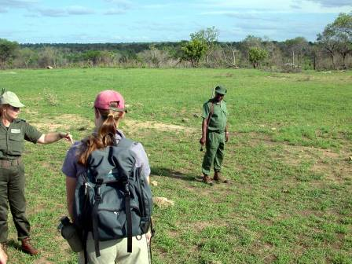
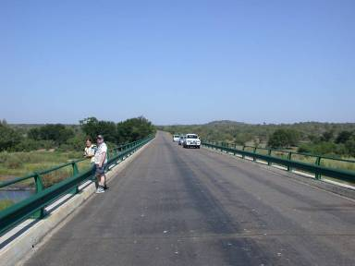
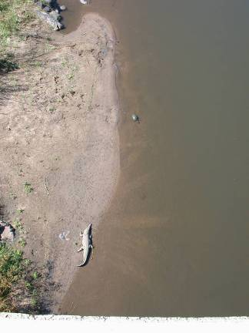
How do we Tend to React?

Slide 27
What does this mean for Wilderness Recreation Planning?
Recreationists have been and are needed as a constituency for wilderness dependent experiences
We need to think in terms of geographic and social systems
Be involved in the planning outside of the wilderness whenever possible

Slide 28
What does this mean for Wilderness Recreation Planning continued?
You may end up planning for more day users who may have subtle differences in their support for management actions Seek opportunities for buffer type allocations and hold fast to them
Use the tools you have
  ROS, LAC, VERP
Monitor both social anf biological conditions, it is difficult to take out a road or reduce the standards below status quo

Slide 29
Questions to keep in mind this week
Are my decisions recognizing the importance increased scarcity and value of wilderness recreation?
Do I have a good sense of who my visitors are and what they are seeking?
Have I strived to provide the greatest level of wildness in experiences possbile in my planning?
  – if you must limit use, try to do so in wild friendly ways
Since I can’t possibly plan for the same level of wildness and naturalness in every place, do I understand the context your site fits within – Think regionally
Have I done whats possible to build constitucies from within our wilderness recreationsis?
Are the social values of wilderness going to endure as a result of your work, enven thought he challengs you face are more complex than ever before?

Slide 30
Conclusion
Invest in Recreation Planners! Try not to feed into the defensiveness between social and biological systems that we see occurring around the world.
Society generally cares about biodiversity, but those who are directly invested are your strongest voices.
Take full advantage of training like this one.
Initiate discussion and possible action soon.

Slide 31
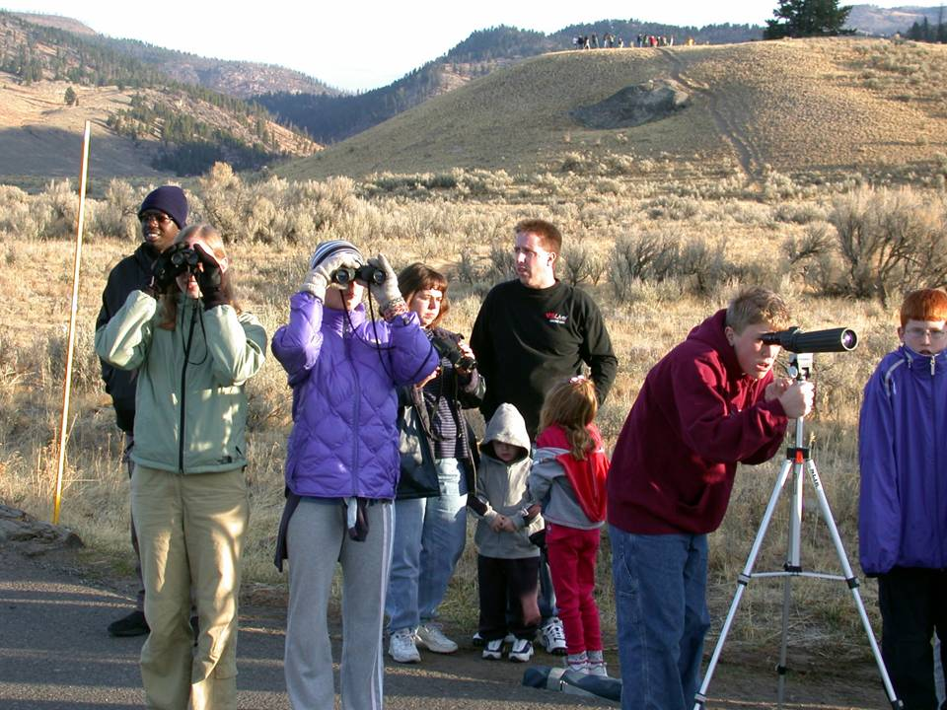
We simply need that wild country available to us, even if we never do more than drive to its edge and look in. For it can be a means of reassuring ourselves of our sanity as creatures, a part of the geography of hope.
Wallace Stegner

